Slide 1
Be Sure to sign in
Meeting #4
December 12th, 2023

Slide 2
Club Information
Sign up for remind: Text @NHSFHS23 to 81010
Check school issued email: Download the Outlook app
Check School Website frequently!
STUDENTS MUST BE RESPONSIBLE FOR STAYING UP TO DATE ON ALL CLUB MEETINGS/ACTIVITIES.

Slide 3
NATIONAL HONOR SOCIETY
Meeting #4
December 12th, 2023

Slide 4
Agenda 12/12/2023
Treasurer Opening
Taco Bell/Food Fair Results
Account Balance
Points Sheet- (Sign-off)

Slide 5

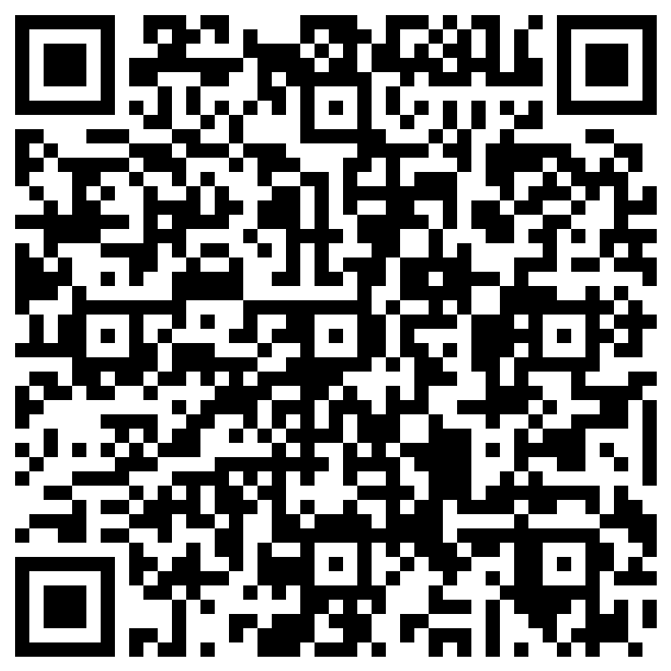
Treasurer Application for the remainder of 2023-2024 School Year
The treasurer(s) shall keep the record of business expenses, dues, and all other financial transactions of the chapter.
Treasurer Position will be open after the semester (Alvin has completed his high school coursework). For those interested scan here, and apply. Per NHS bylaws, the student executive board will nominate a Treasurer and the Faculty Council must approve the nomination. A student must apply by the deadline to be eligible for consideration. Up to two, may be considered
QUALIFICATONS:
Current NHS Member in good standing (Jr. or Sr.)
Food Fair and additional counting and signature req.

Slide 6


Taco Bell
Q2 Food Sales Results 11/16/2023
$188 profit
($263 sales-$75 costs)
Thank you to all that helped out, working or purchasing… another successful event

Slide 7

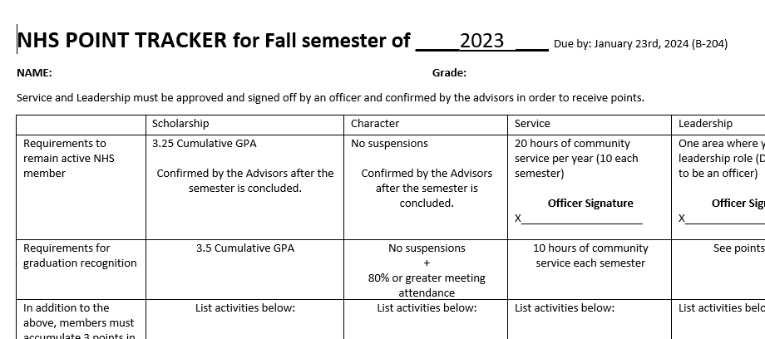

Point Sheet
Sign-offs available starting today after the meeting.
Fall Semester Sheets Due
January 23rd, 2023
Executive Committee Members can sign off and collect point trackers starting today. Next and final opportunity is on January 23rd 2024, our next meeting.

Slide 8
Point Sheet The Process (step by step)
Self check that ALL your
Service and Leadership requirements have been met
At least 10 hours of Community Service (with completed timecard)
Documentation of an area of Leadership
3 Points in each of the four categories Scholarship, Character, Service, Leadership
You should take a picture of your Point Tracker and Community Service Log before submitting it, (for your receipt)
Present your Point Tracker etc. to any of the students on the exec. board for review and their signature (Service and Leadership)
Sign the turn-in log once you have turned your point tracker in. This must be done to confirm you have turned in your point tracker
Next and final opportunity is on January 23rd 2024, our next meeting

Slide 9

Account Balance as of 12/11/2023
$2,677.01
Please note the suggested donation is $20 annually. This money goes to buy the stoles and provide scholarships.
To donate please being cash or check to the Student Store and let Ms. Watson know this is for NHS. Or log in online.

