Slide 1

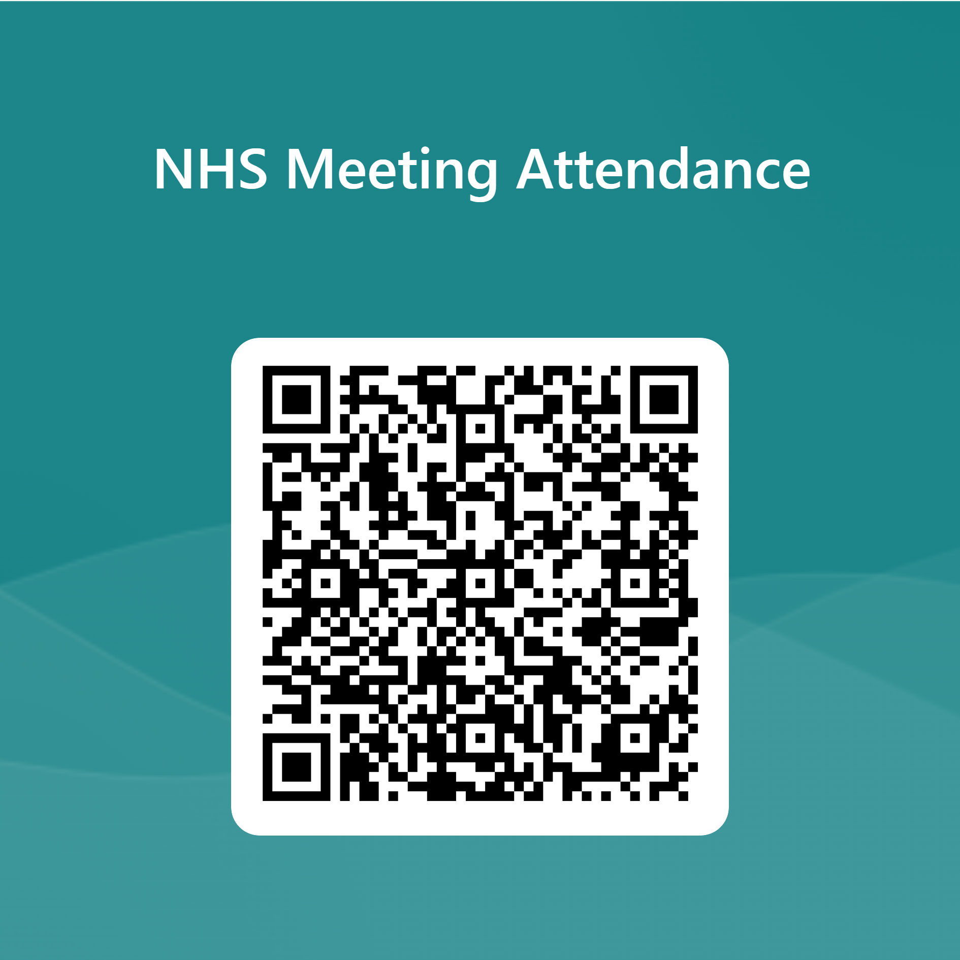

NATIONAL HONOR SOCIETY
Please be sure to sign in with the QR code below.
Meeting #6
February 20th, 2024

Slide 2
Agenda 2/20/2024
Active Member List
Spring Festival
Food Fair
Future Cabinet Candidates/Position Overview
Treasurers Report
Upcoming Dates of Interest

Slide 3


Active Member List
List posted on the club website under NHS Members 2023-2024, students must submit a point tracker each semester to be considered as active:
https://ca01001129.schoolwires.net/Page/20278
* Only active members for all 4 semesters are eligible for graduation recognition.

Slide 4
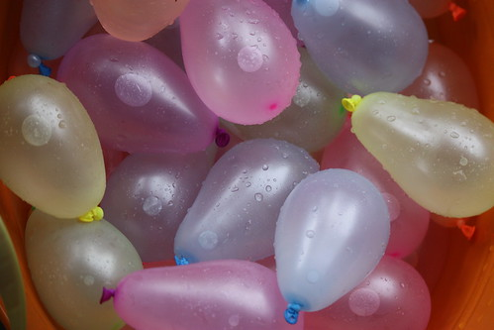


Spring Festival Tuesday April 9th 2024
Open for other clubs to join and participate. Fundraising opportunity for all clubs. Games and activities.

Slide 5
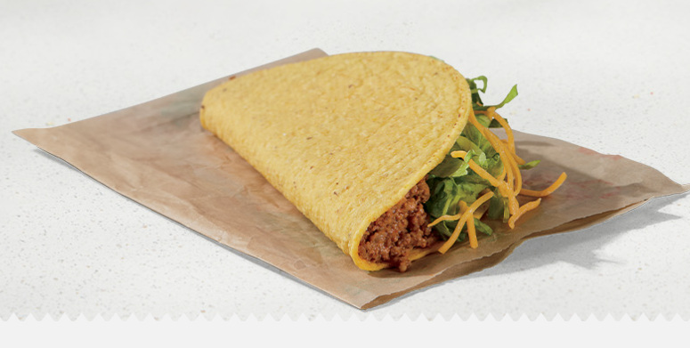


Food Fair Thursday February 22nd
NHS will be selling Taco Bell Tacos on Thursday. Food Fair is a club Fundraiser. Food Fair is designed to raise money for all clubs. Please bring CASH and support our club.
1 Taco and a bottled water $5
or
3 Tacos for $10 (no water)

Slide 6
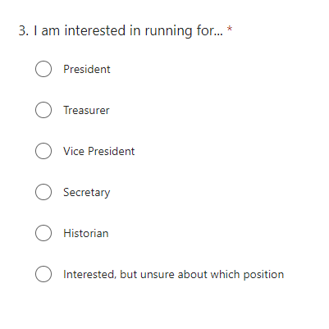

2024-2025 Officer positions
Current Juniors…Interested in holding a cabinet position? The selection process is starting today.

Slide 7
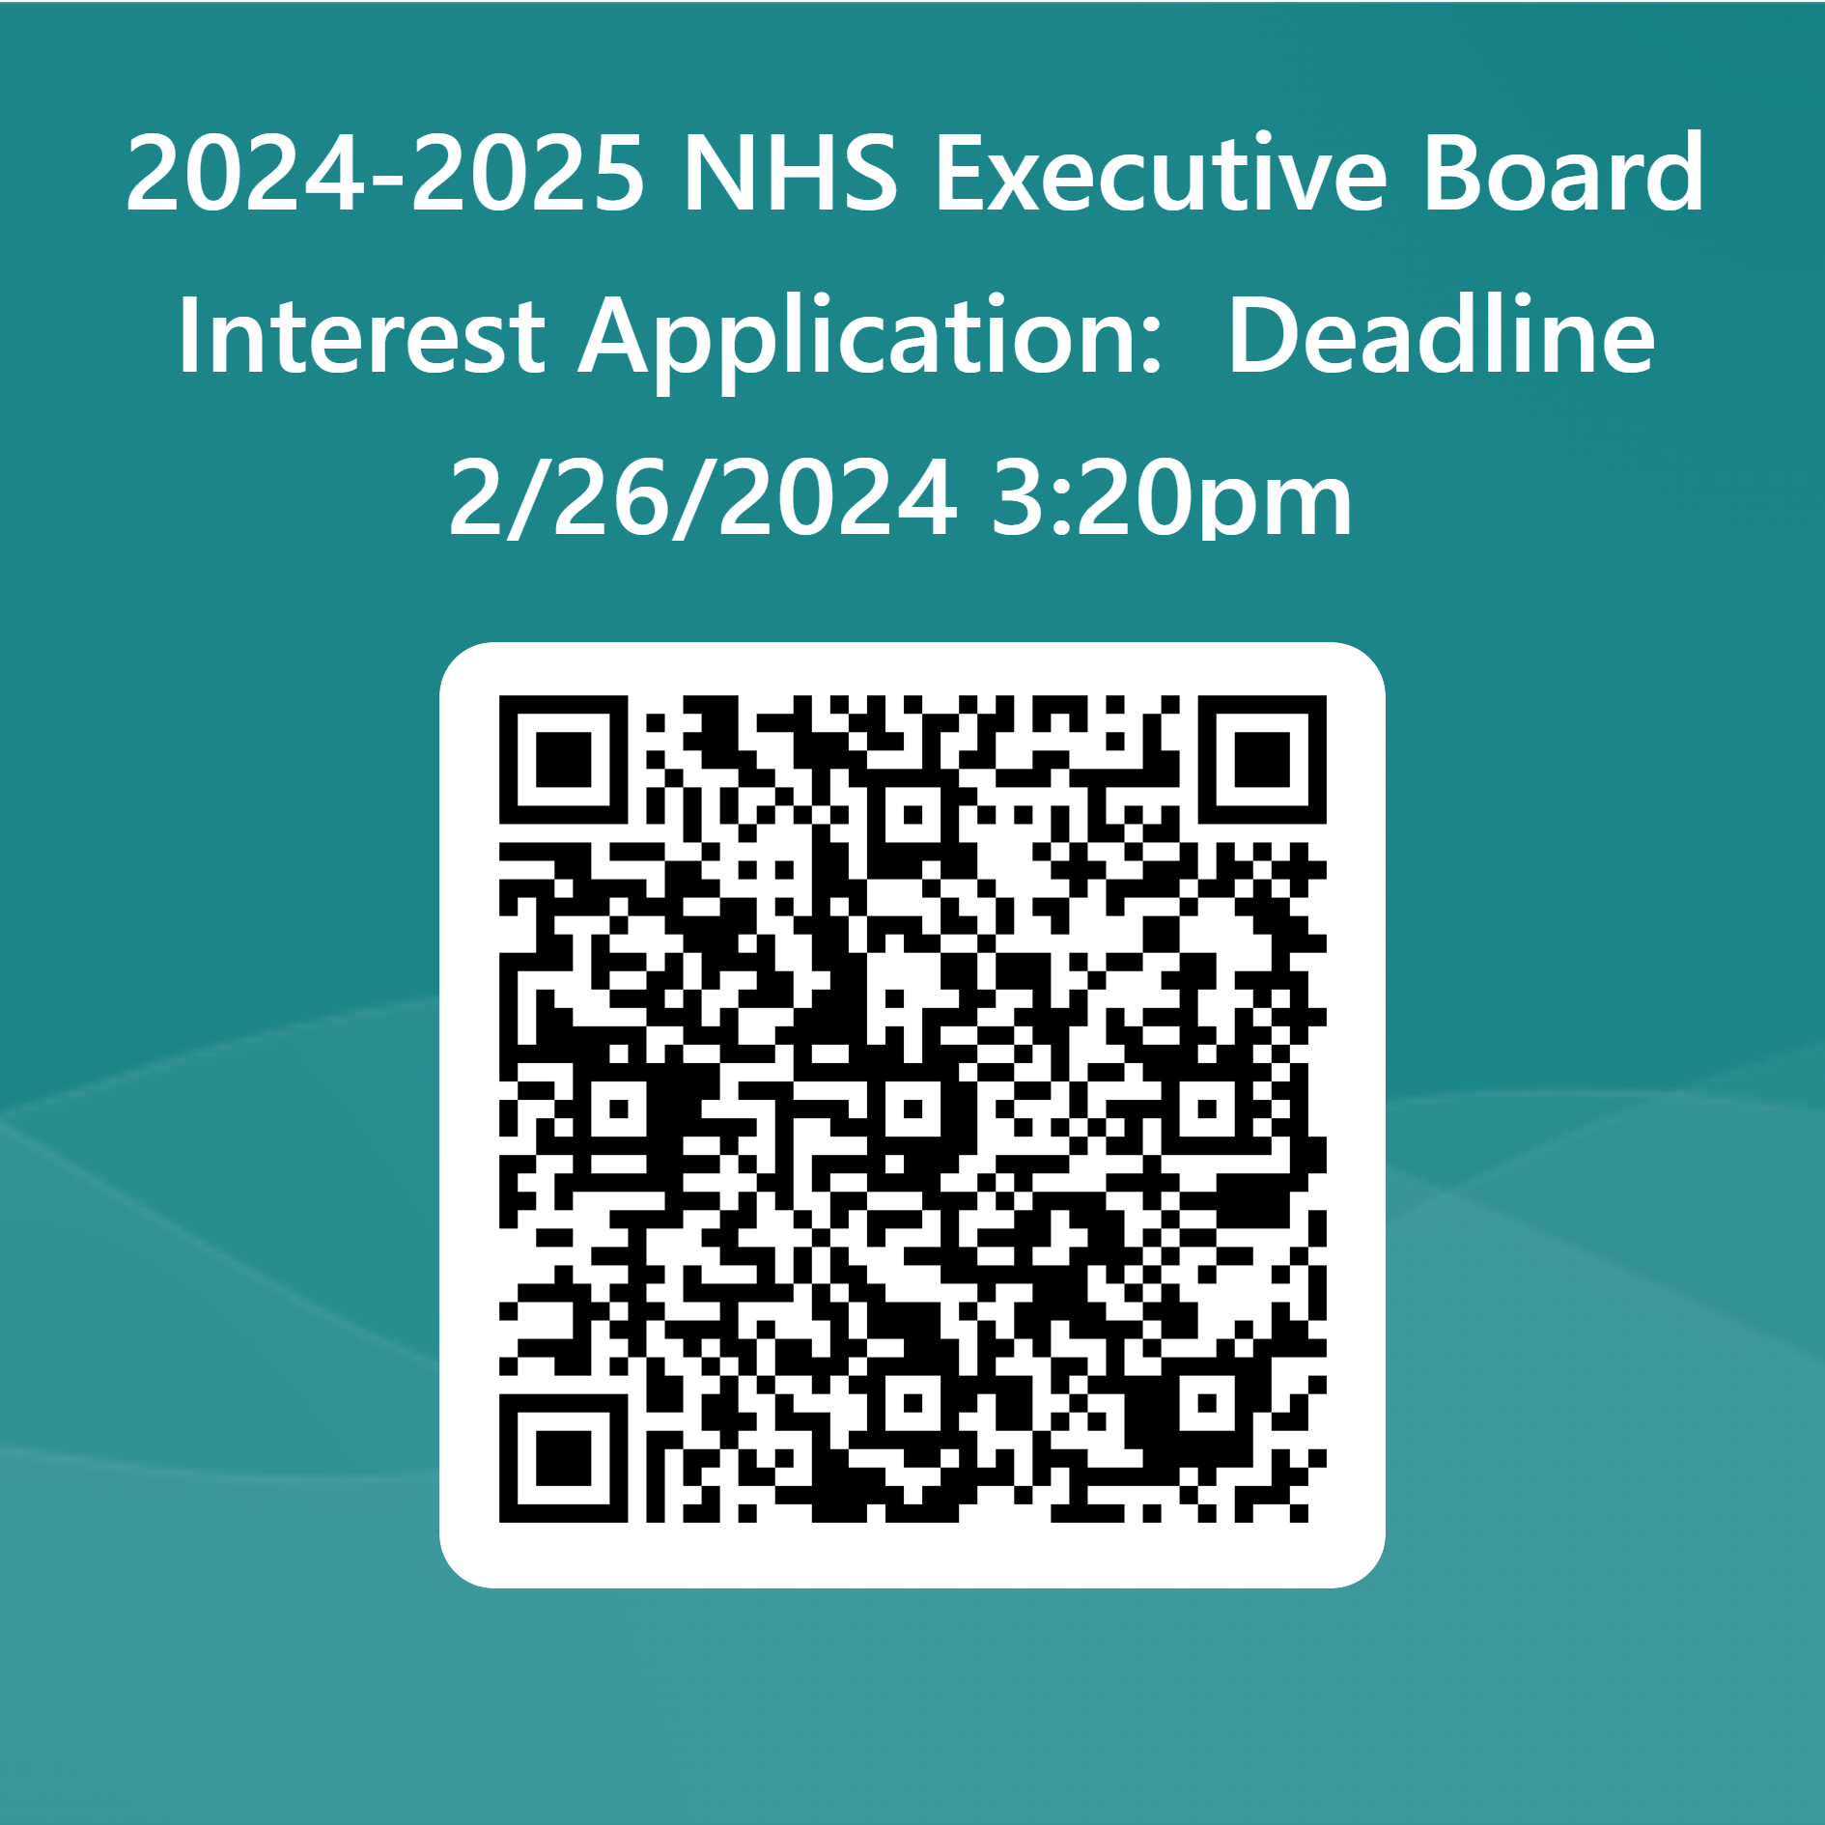
2024-2025 Officer positions Brief Explanation of expectations
President- Lead presenter for Induction, meetings, and honors night. Runs meetings and organizes cabinet events. Big picture ideas and ability to delegate and follow through. Facilitate the organization of club events.
Vice President(s)- Organize and lead committees and events like the Spring Festival and group volunteer projects. Present at induction and lead meetings in the President’s absence. Several public speaking opportunities.

Slide 8
2024-2025 Officer positions Brief Explanation of expectations
Secretary- Take meeting notes and manage attendance. Verify and present to the advisor and Principal designee the students eligible for graduation honors. Have a voice in the direction of the club. Some public speaking opportunities.
Treasurer- Create and manage the club budget. Sign off on all purchases and make deposits. Count cash from events like food fair and other sales opportunities. Some public speaking opportunities.
Historian- Attend all or most club events and take pictures to document. A seat at the table for executive meetings. Some public speaking opportunities.

Slide 9


Treasurers Report
Current Balance $2,677.01
as of 2/14/2024
Reminder NHS is still accepting yearly donations, see point tracker for details.
Suggested/voluntary donations are $20/year

Slide 10
Upcoming Dates
Upcoming meeting dates:
April 4th
May 9th
Spring Festival
Tuesday, April 9th
Community Service and Point Tracker due
April 26th
Senior Honors Night (NHS/CSF)
May 14th

