Slide 1
National Honor Society
Meeting #3
October 29, 2024

Slide 2
Agenda 10/29/24
01
02
03
04
05
06
Guest Speaker Superintendent Rugani
Group photo: Complete
Safe Halloween Recap
Upcoming Food Fair
Point sheets: Updates and information
Donations

Slide 3
Guest Speaker- Denise Rugani
Superintendent of Liberty Union School District

Slide 4
Group photos
Our turnout for our yearbook photo was great! Make sure to check out our photo when yearbook comes out!
If you missed it, make sure to keep checking Remind and your school email where we send important dates and information.
Reminds:
Nhs2425jrs
OR
nhs2425snr

Slide 5
Food Fair
Food Fair is November 7th!
We will be selling Taco Bell tacos again and are looking for bottled water donations.
For Food Fair we are also looking for 3 seniors and 3 juniors to volunteer during lunch. For more information, please message Angelica on Remind.

Slide 6
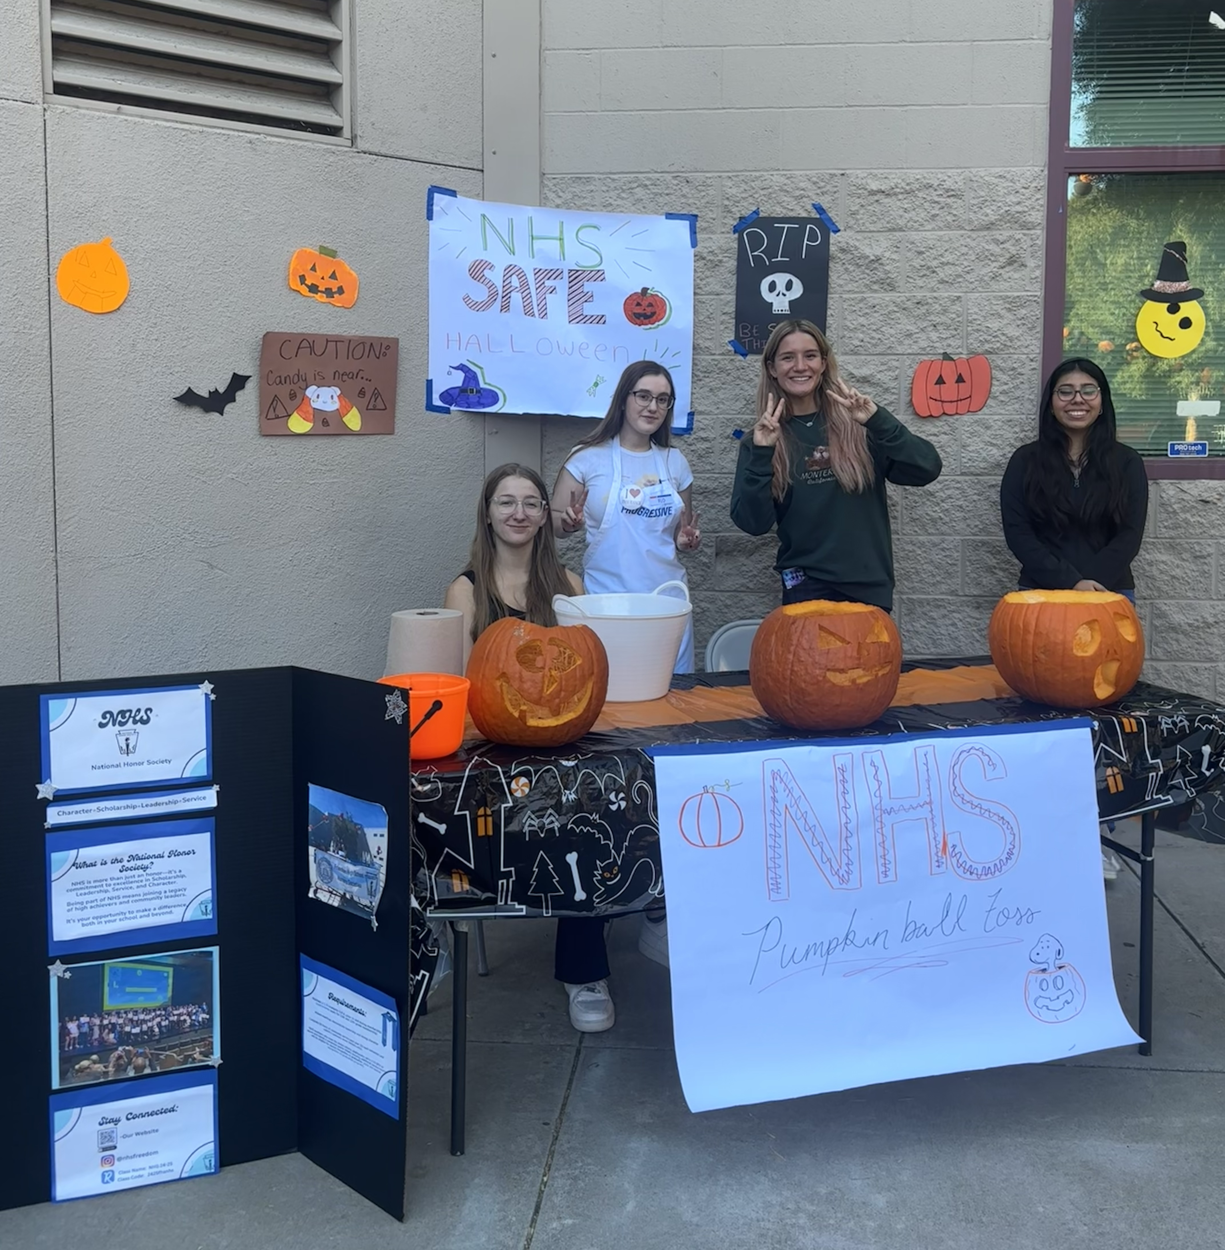
Safe Halloween Recap

Slide 7
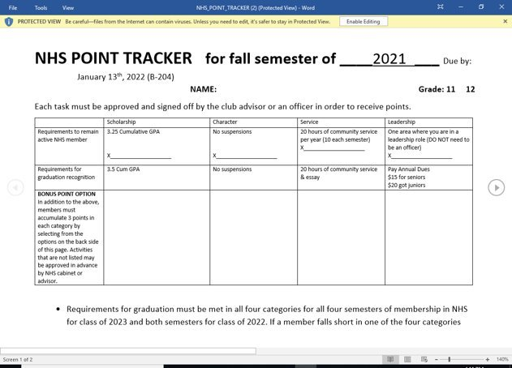
Point sheet/ Attendance/ Graduation Recognition
- Updates
-Requirements
-Due Date for FALL 2024 Community Service and Points:
January 14th, 2025

Slide 8
Club Information
Check school issued email: Download the Outlook app and check your school email frequently​
Check club NHS Website frequently!​
STUDENTS MUST BE RESPONSIBLE FOR STAYING UP TO DATE ON ALL CLUB MEETINGS/ACTIVITIES​
Follow us on Remind for important information...​
Senior class code: nhs2425snr​
Junior class code: nhs2425jrs
Next meeting: @Lunch December 3, 2024

Slide 9
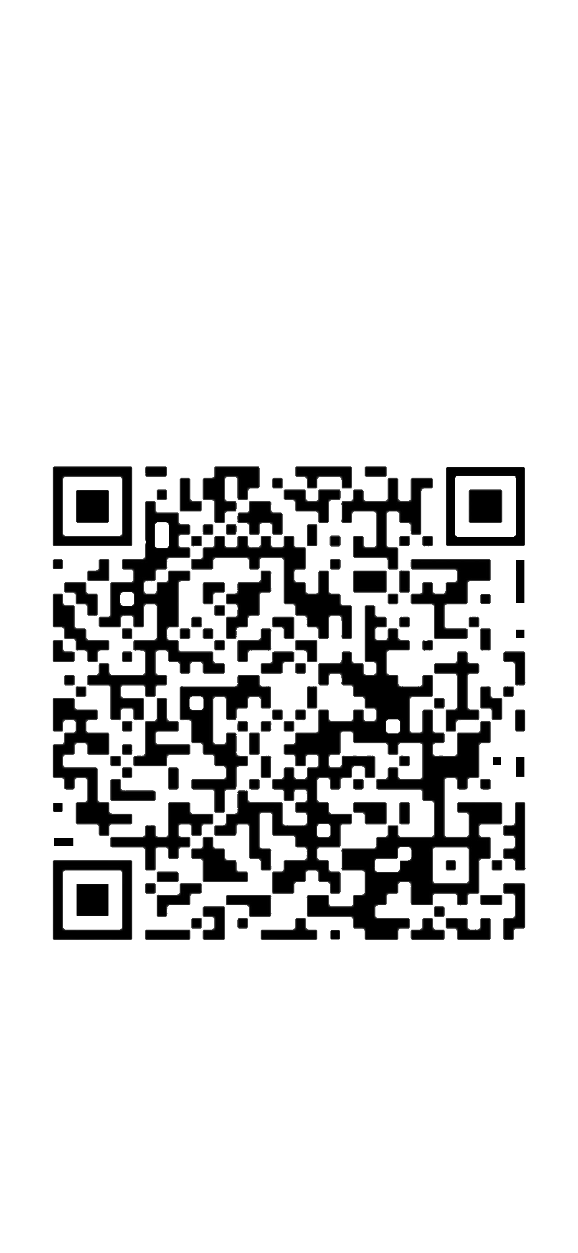
Sign-in

