Slide 1
S-club Meeting!
2020-2021 School Year
Glad to see you here!

Slide 2
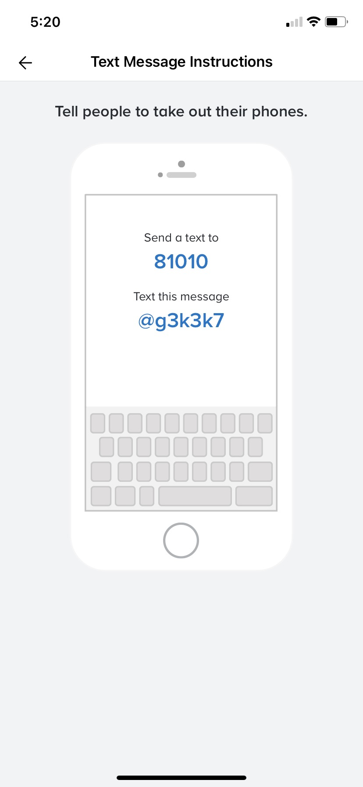
Welcome back!!
Thank you for joining us today!!
Here are a couple quick reminders!!
Join our Remind for all current info: Text 81010 with the message @g3k3k7
Follow us on Instagram: @sclub_heritage

Slide 3
What are we even going to do??
Toiletry Drive!
Where: Community Violence Solutions Resource Center
When: We will begin collecting donations after October break. The last day to drop off your stuff is November 20th.
What: They need toiletries. Ex. razors, deodorant, toothpaste, toothbrushes, shampoo, conditioner, body wash/soap, tampons, pads, etc.
How: Email us at heritagehighsclub@gmail.com using your school email to get the address for donation drop offs

Slide 4
Violet Richardson’s Service Award/Scholarship
“Good morning ladies!
Attached is the Violet Richardson Award application and media consent form. I need your help getting this out to girls 14-18 years of age who are active in community service in our local area.
Since the schools are distance learning, the counseling centers are not able to really promote this award. I have sent it to the 4 high schools and haven't heard back from the counselors as to how they can inform the girls of its existence.
If you know of any girls, please forward the application to them.
Thank you and I'll see you all tonight at our zoom meeting.”
Jan Schults
SI of the Delta
Creating Opportunities for Empowerment

Slide 5
Community Chest Toy Sorting
What: We will be sorting toys for the annual Brentwood Community Chest.
When: November 15th & 16th from 5:30-7:00 pm
Where: Behind the police station in a warehouse
**Covid requirements will be released soon and we will be the only group at this time slot**

Slide 6
Thank you for coming!

