Slide 1

Antigone Packet Guide
Let’s Work Smarter not Harder!

Slide 2
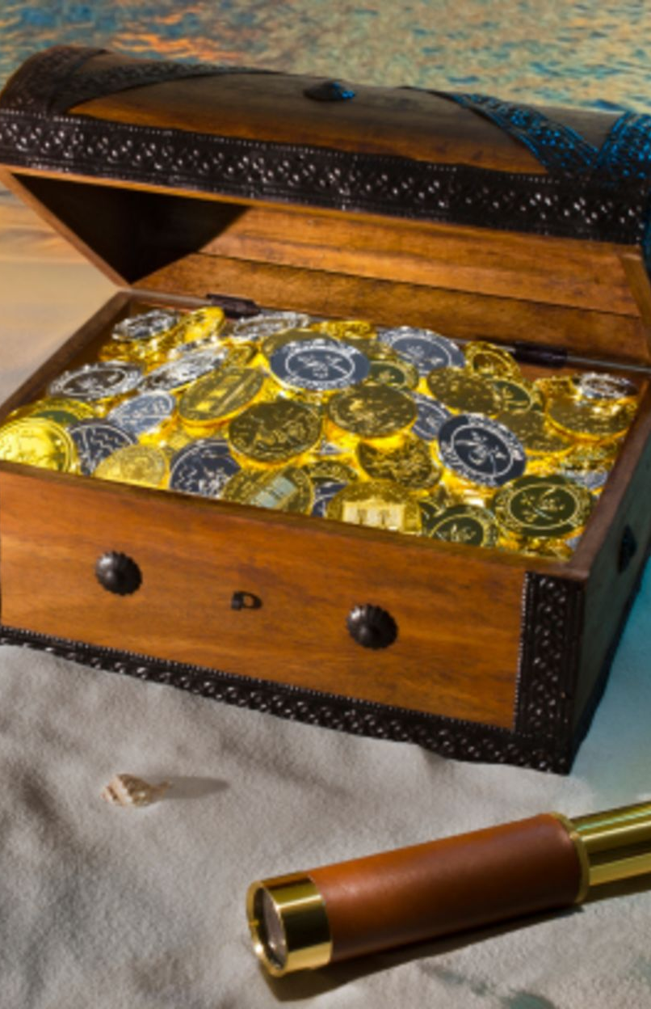

Overview
The world is a massive treasure hunt full of wonderous things! It is always my goal for all my classes that I help you unlock some of this treasure for yourselves by helping you to understand the value and wisdom locked up in the what you read. If you aren’t careful, you will miss, things of great beauty standing right before your eyes!
In order to participate in this kind of treasure hunt, though, it requires reading and careful consideration. Unlocking the mysteries of the world is surely not an easy task, but it can be done by all of us with practice!
That being said, I do not want to be overbearing, and I am saddened to hear that my class has been stressful for some of you. It is my intention that this class lifts you up to things you had not seen before and never drags you down with the weight of needless work.
I have tried to tune my class so that everyone is able to complete the work in no more than 1.5 hours. Having heard that it is taking some of you much longer than that to complete the work, I have made this guide to clarify my expectations and help you complete the work in a more reasonable amount of time.

Slide 3

Summaries Overview
In order to be able to find the treasure locked up in a text, you need to make sure you understand it all. So often, it seems like we (myself included) are willing to skim over things and miss important information.
The summaries are the building blocks for the rest of the packet. They are intended to help you focus on what is happening in each scene so that you don’t get lost or confused in the complexity of the plot.
I have also broken up each scene into major sections so that you can better see when major events shift. This is supposed to help you see how the scene has been structured.

Slide 4
Summaries Expectations
When I grade the summaries, I am looking to see evidence that you have read the scene and have a basic understanding of what happens.
So, when you write the summary, you only need to describe the main events from the section.

Slide 5
Summaries Expectations
Continued
You can use bullet points in this section as long as they are descriptive and cover all of the major events.
Please DO NOT attempt to find every detail in each section. While this level of thoroughness is sometimes beneficial, it is more than I expect and will cause you to do a great amount of work that does not improve your grade.
In general, if you have read carefully, completing the summaries should not take more than a few minutes!

Slide 6
Summaries Tips
Complete while reading:
  Often, we forget the specifics of what we read as soon as we are finished reading! Completing each section of the summary as you read should prevent you from needing to read the same thing over and over again.
Report efficiently:
  Remember, I am only looking for the main events from each section. If you find yourself getting bogged down in small details, take a step back and think about the one main thing that happens in the section.
Write concisely:
  I am only looking for a general overview. Writing long paragraphs here, while probably more thorough, will not add anything to your final grade.

Slide 7

Character Analysis Overview
The focus of this unit is how foils can be used over the course of a story to reveal the development of a complex character.
In order to do this, I have identified a major foil to Creon in each scene of the play so that you can see that many different foils can be used to flesh out a single character.
Character analysis is difficult and requires patience and practice to master. Each time you come to this page of the packet, it should get easier and easier to complete!

Slide 8
Character Analysis Expectations
The character analysis page is broken into two sections. At the top, you will list major traits for each character. At the bottom, you will analyze how the contrast between the listed characters has an effect on the scene.
Top of the page:
  I am only looking for 2-3 general personality traits that you see in the scene.
  As with the summaries, you can be brief here and use bullet points as long as they are descriptive and not vague.
Bottom of the page:
  You need to make sure that the traits you provide are opposites. Merciful and cruel are opposing traits. Merciful and hungry are not.

Slide 9
Foil Analysis Expectations
In the last box on the Character Analysis page, you are asked to explain how the foil affects the scene. Many of my students have lost points on this section, so I want to make sure to explain how to get full credit.
When you talk about the foil, it is important to explain what the differences between the characters reveal in the scene.
Please DO NOT simply describe how the two characters are different.
You also need to make sure to be SPECIFIC about the effect on the scene. Simply saying that the difference causes conflict is not enough.

Slide 10
Foil Analysis Example
  Good: The fact that Antigone insists on burying Polynices while Ismene begs her to be more cautious causes Antigone to appear bold and stubborn.
  Bad: Antigone and Ismene’s difference in opinion on what to do about Polynices causes them to argue.

Slide 11
Character Analysis Tips
Complete while reading
  As with the summaries, it is a good idea to work on the character analysis page as you read the play.
Go with your gut
  For the most part, you should be able to provide your own interpretation for each character. While you do need to back up your thoughts with a page number, there are no specifically correct answers for this section.

Slide 12

Questions for Analysis Overview
Once you have read the text, it is important to make sure that you have understood its implications.
The questions for analysis are intended to help you process the text so that you can better understand how and why the major characters and events work together in the plot.
Because of the amount of critical thinking required to answer the questions, this should be the most time-consuming part of the packet.

Slide 13
Questions for Analysis Expectations
While I do not expect a large amount of writing, I do expect a brief paragraph for each question.
Your answer should be thoughtful, thorough, and reveal a deep understanding of the text.
You should also make specific references to the text in each answer. This means that you need to include at least one quote in each answer!

Slide 14
Questions for Analysis Tips
My mentor Mrs. Pedrotti likes to say, “Writing is easy. Thinking is hard!”
  What this means is that if you know what you want to write about and have planned what you want to say, writing it down is very easy.
  So, my advice is to consider everything you want to say in your paragraph before you begin writing. This should make the process easier and prevent you from getting stuck.
Along with this, please use the following format:
  Claim->Evidence->Reasoning->Conclusion

Slide 15

Final Thought
While I want my class to be challenging enough to push my students to new heights of thought and awareness, I also care very much about your well-being.
If you feel my class is becoming burdensome, or if you are not able to complete the work in 1.5 hours, please contact me! We can work together to find a solution so that you feel comfortable learning in my class.

