Slide 1
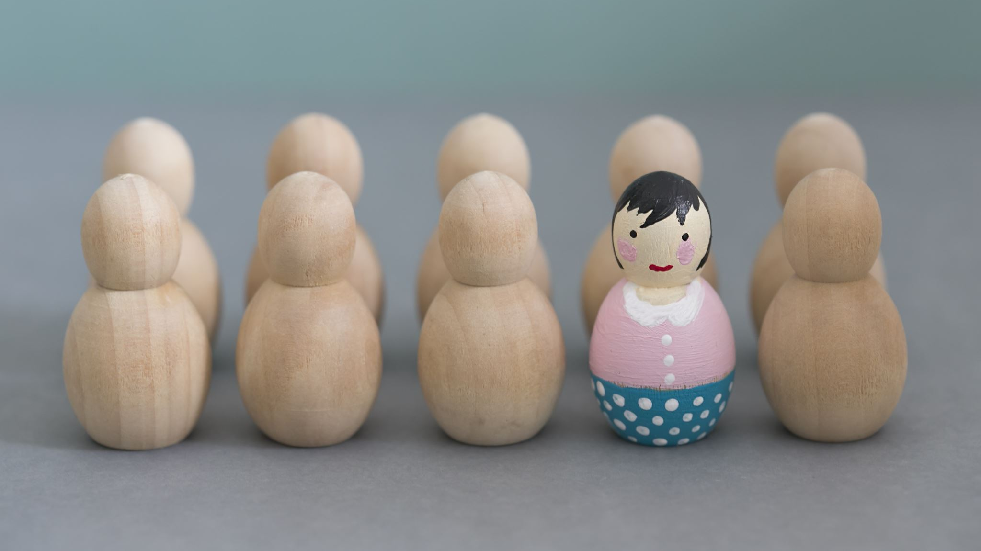

Character Sketch Example
Possibly the most detailed analysis of Klipspringer that has ever existed.

Slide 2

Klipspringer
Klipspringer is a man who invites himself to live at Gatsby’s house and does not seem to do anything to benefit society.
This picture of a lazy kid captures Klipspringer’s immaturity and unproductivity.

Slide 3
Klipspringer’s Thoughts
Klipspringer thinks of himself as entitled to Gatsby’s house and possessions.
“We went upstairs, through period bedrooms …intruding into one chamber where a disheveled man in pajamas was doing liver exercises on the floor. It was Mr. Klipspringer, the ‘boarder’” (98).
Klipspringer has decided without invitation to live at Gatsby’s house. In this scene, Klipspringer is in the middle of a morning exercise routine when he is interrupted by Gatsby, Nick, and Daisy. It is almost as if they walk in on Klipspringer as he is getting ready for the day in the privacy of his own home!

Slide 4
Klipspringers Desires
Klipspringer wants to take advantage of people like Gatsby in order to live a carefree life.
“‘I was asleep,’ cried Mr. Klipspringer, in a spasm of embarrassment. ‘That is, I’d BEEN asleep. Then I got up…’” (101).
From the look of it, Klipspringer has not done anything of value all day! After Nick sees him combing the beach and doing “liver exercises,” we now learn that he went back to bed and was just woken up from a nap!

Slide 5
Klipspringer’s Actions
Klipspringer complains constantly while playing the piano at Gatsby’s request.
“When Klipspringer had played ‘The Love Nest’ he turned around on the bench and searched unhappily for Gatsby in the gloom. ‘I’m all out of practice, you see. I told you I couldn’t play. I’m all out of prac——‘” (102).
While playing the piano for a small group of acquaintances can hardly be considered a strenuous activity, Klipspringer complains several times about being asked to do it. This makes him seem lazy and childish.

Slide 6
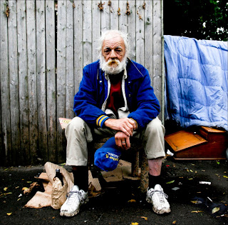
Klipspringer’s Obstacles
Klipspringer’s goals will probably be put on hold after Gatsby stops having his weekly parties.
“So the whole caravansary had fallen in like a card house at the disapproval in her eyes” (121).
When Nick says this, he implies that Gatsby is no longer hosting any massive parties. While Klipspringer is not specifically mentioned here, we can assume that he has become temporarily homeless until he can find someone else on whom to mooch.

