Slide 1
Creon and Ismene
A brief guide to foils

Slide 2
Ismene as a foil to Creon
Last week, you looked at several characters from Antigone to see how they were foils to Creon.
Eventually, you will use this information to write a paragraph in which you select one of Creon’s foils and explain how they have an effect upon Creon’s character.
This presentation will provide an example of last week’s assignment so that you can know if you are on the right track when it comes to the characters in Antigone and how some of them are foils to Creon.

Slide 3
Traits
Foils are all about a contrast that helps to reveal important character traits.
So, the first thing you should have done is think about how your chosen foil reveals something in Creon.
Note: Each foil is complex and reveals multiple traits in Creon’s character. So, there are many ways to correctly answer this question.
This Photo by Unknown Author is licensed under CC BY-NC-ND

Slide 4
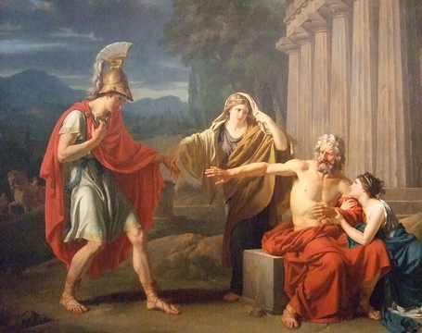
Trait Examples: Ismene as a Foil to Creon
Antigone
Creon
Trait 1: Ismene’s insecurity makes Creon seem more self- assured in his decisions.
Trait 2: Ismene’s kindness and attempt to comfort her sister at the cost of her life makes Creon seem cruel.
Ismene

Slide 5
Support
Once you have identified traits that have been revealed through your chosen foil, you need to back up your claims using evidence from the text.
This evidence needs to be carefully selected to reveal the trait in question.
Long quotes may be shortened in order to focus on the specific trait.
Make sure to provide correct citations after each quote that include the line numbers from the play.

Slide 6
Support Examples: Ismene as a Foil to Creon
Trait 1: Self-Assurance
Support: “Yes--- for you and me the matter’s closed. No more delay… From this point on they must act like women and have no liberty to wander off” (660-663).
Trait 2: Cruelty
Support:
“Ismene: You’re going to kill your own son’s bride?
Creon: Why not? There are other fields for him to plow” (650-651).

Slide 7
Reasoning
Having good evidence is important, but it is not enough to make a strong argument.
Now you need to describe the context surrounding your evidence and explain how it supports your claim.
While you do not need to be long-winded, you do need to be thorough. Don’t assume that the reader is able to follow your logic!

Slide 8
Reasoning Example 1: Ismene as a Foil to Creon
Trait 1: Self-Assurance
Support: “Yes--- for you and me the matter’s closed. No more delay… From this point on they must act like women and have no liberty to wander off” (660-663).
Reasoning: Ismene’s decision to support Antigone in this scene represents that she is willing to change sides depending on how she feels. Creon, however, takes a strong stance throughout the entire play. Here, he definitively decides that “the matter is closed,” and that Antigone and Ismene have their right stripped away immediately.

Slide 9
Reasoning Example 2: Ismene as a Foil to Creon
Trait 2: Cruelty
Support:
“Ismene: You’re going to kill your own son’s bride?
Creon: Why not? There are other fields for him to plow” (650-651).
Reasoning: In this scene, Ismene attempts to comfort and defend Antigone by claiming to have helped bury Polynices. Here, she also appeals to Creon’s sensibilities as a father by reminding him that Antigone is Haemon’s fiancée. Creon’s cold response highlights the fact that he is cruelly willing to disregard his son’s feelings in his decision to kill Antigone.

