Slide 1
Character Foils
Let’s have fun with equal and opposite forces!

Slide 2
What is a foil?
Foils are all about striking differences.
They occur when a sharp contrast exists between things in a story.
While the term can be used to describe anything with contrasting traits, it normally refers to characters.

Slide 3
General Examples of foils
A child who spends time between his divorced parents. His father is a conservative traditionalist and his mother is a new-age hippy.
An impeccably well-groomed character who hates to be seen with her frumpy and overly casual roommate.
A brooding, teenager wearing a black lace mourning gown stands in a room decorated with pink wallpaper and unicorn pillows.

Slide 4
How to use the word “Foil”
This term is always a noun and can never be used as a verb or adjective.
Something is always “a foil to” something else.
Example: In the movie Inside Out, Sadness, because of her low energy and crippling pessimism, is a foil to Joy’s energetic optimism.

Slide 5
What does a foil do?
Writers use foils for a variety of reasons. Here are a few:
  They help to highlight subtle details in a character’s personality that would otherwise be overlooked. ​
  Because of this, writers use foils to quickly establish important traits in a character.
  They can also be a source of conflict to make a scene or character more interesting.

Slide 6
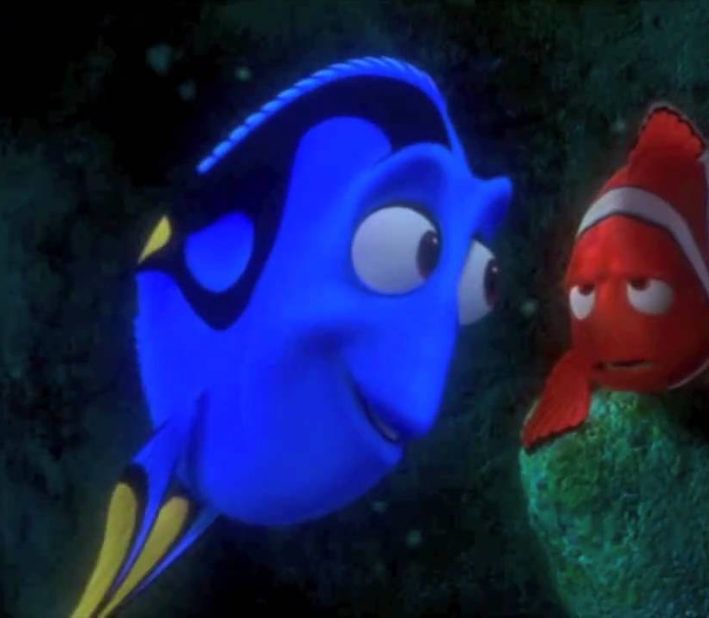
In Finding Nemo, Marlin is a foil to Dory
Contrasting Traits:
Marlin is obsessively organized and feels the need to be in control of his surroundings.
Because of her short-term memory loss, Dory is incapable of organizing her life, and happily improvises everything she does.
Effect:
Dory’s contented disorganization highlights the fear that drives Marlin’s unhealthy need to control the world around him and shows the audience how Marlin must change in order to be happy when he finds his son.

Slide 7
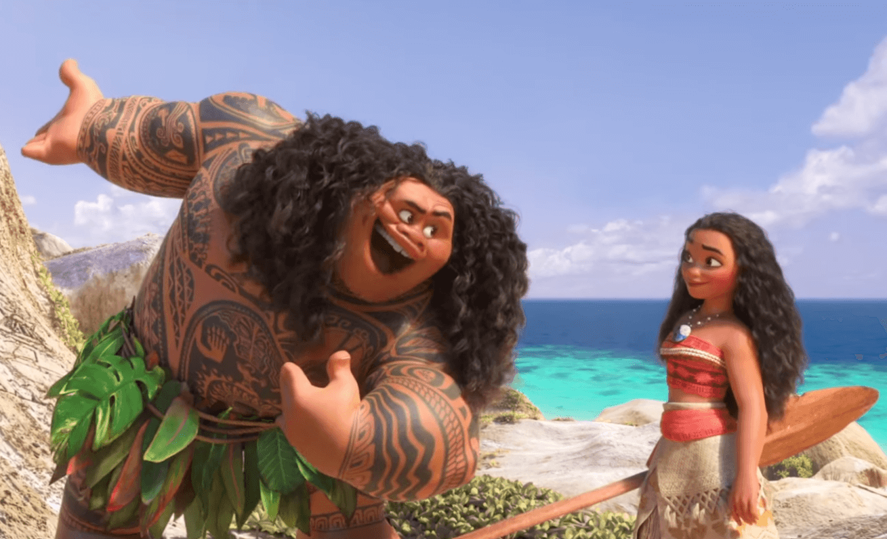
In Moana, Maui is a foil to Moana
Contrasting Traits:
Moana, while brave in her own way, is an inexperienced and generally humble young girl.
Maui has had many adventures in his life and is exceedingly full of himself.
Effect:
Maui’s cockiness and knowledge of the world highlight’s Moana’s vulnerability and lack of experience at the beginning of the story. This helps the audience to see how Moana grows in maturity and confidence over the course of the plot.

Slide 8
Foils and Complex Characters
Complex characters have a variety of traits and attributes, but not every trait is important all the time.
Many times, writers use foils to show the audience which attribute is important in a specific scene.

Slide 9
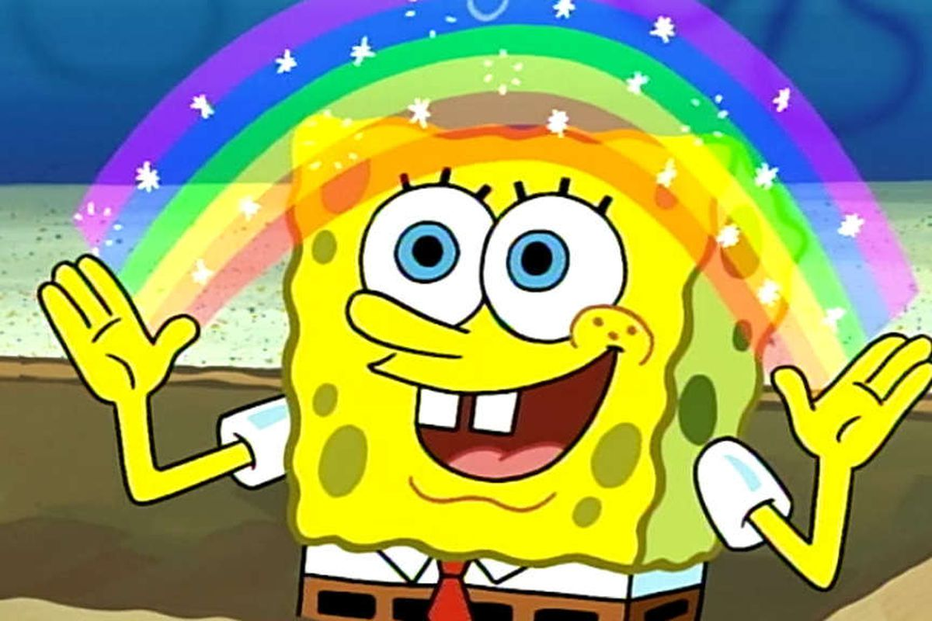
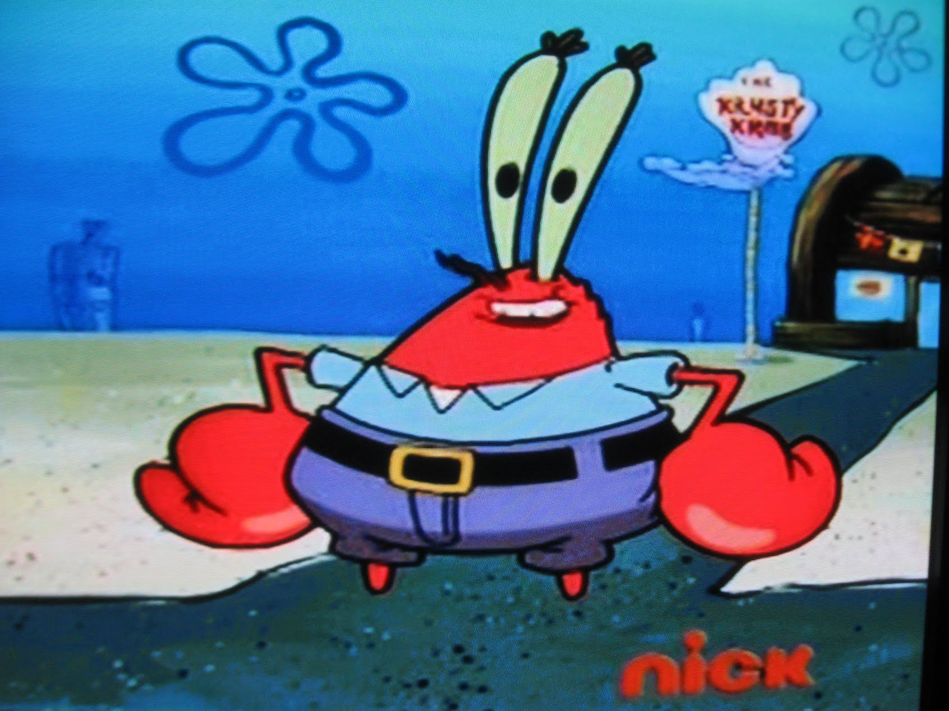
When SpongeBob is a foil to Mr. Krabs, Mr. Krabs appears greedy.

Slide 10
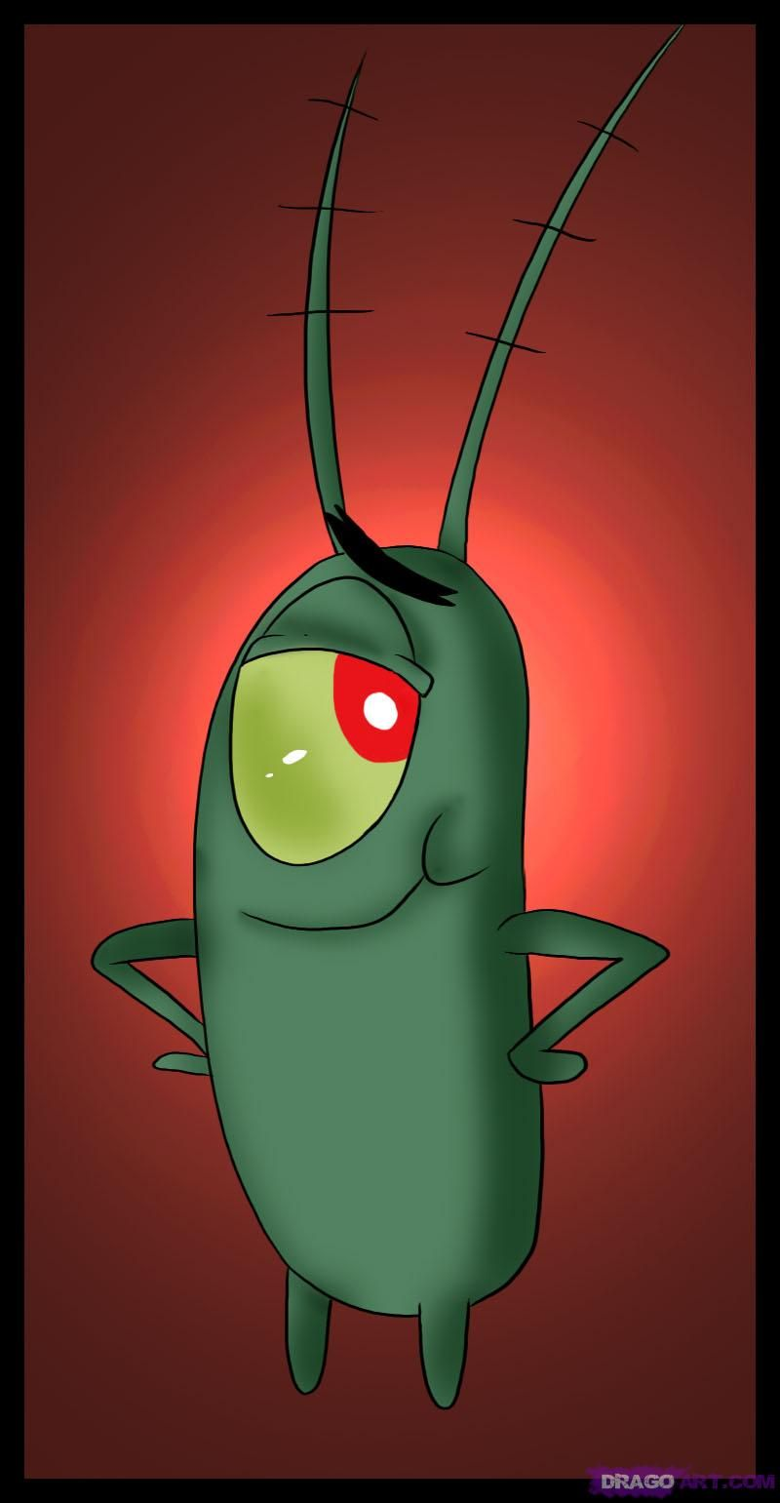
When Plankton is a foil to Mr. Krabs, Mr. Krabs becomes a victim

Slide 11
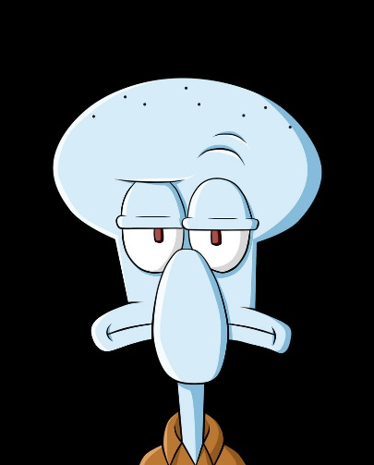
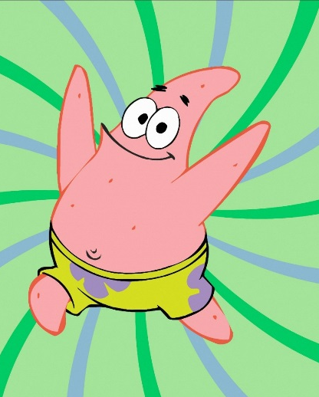
Sometimes, a character can have contradictory traits depending on the foil with which they are paired.
When compared to Squidward, SpongeBob often appears childish and immature.
When compared to Patrick, SpongeBob often appears responsible and mature.

Slide 12
Recap
A foil occurs when things in a story (especially characters) have striking differences.
Foils help to highlight important traits in a character.
Foils help to show which traits are important in a complex character.

