Slide 1


The Great Gatsby
A brief introduction

Slide 2
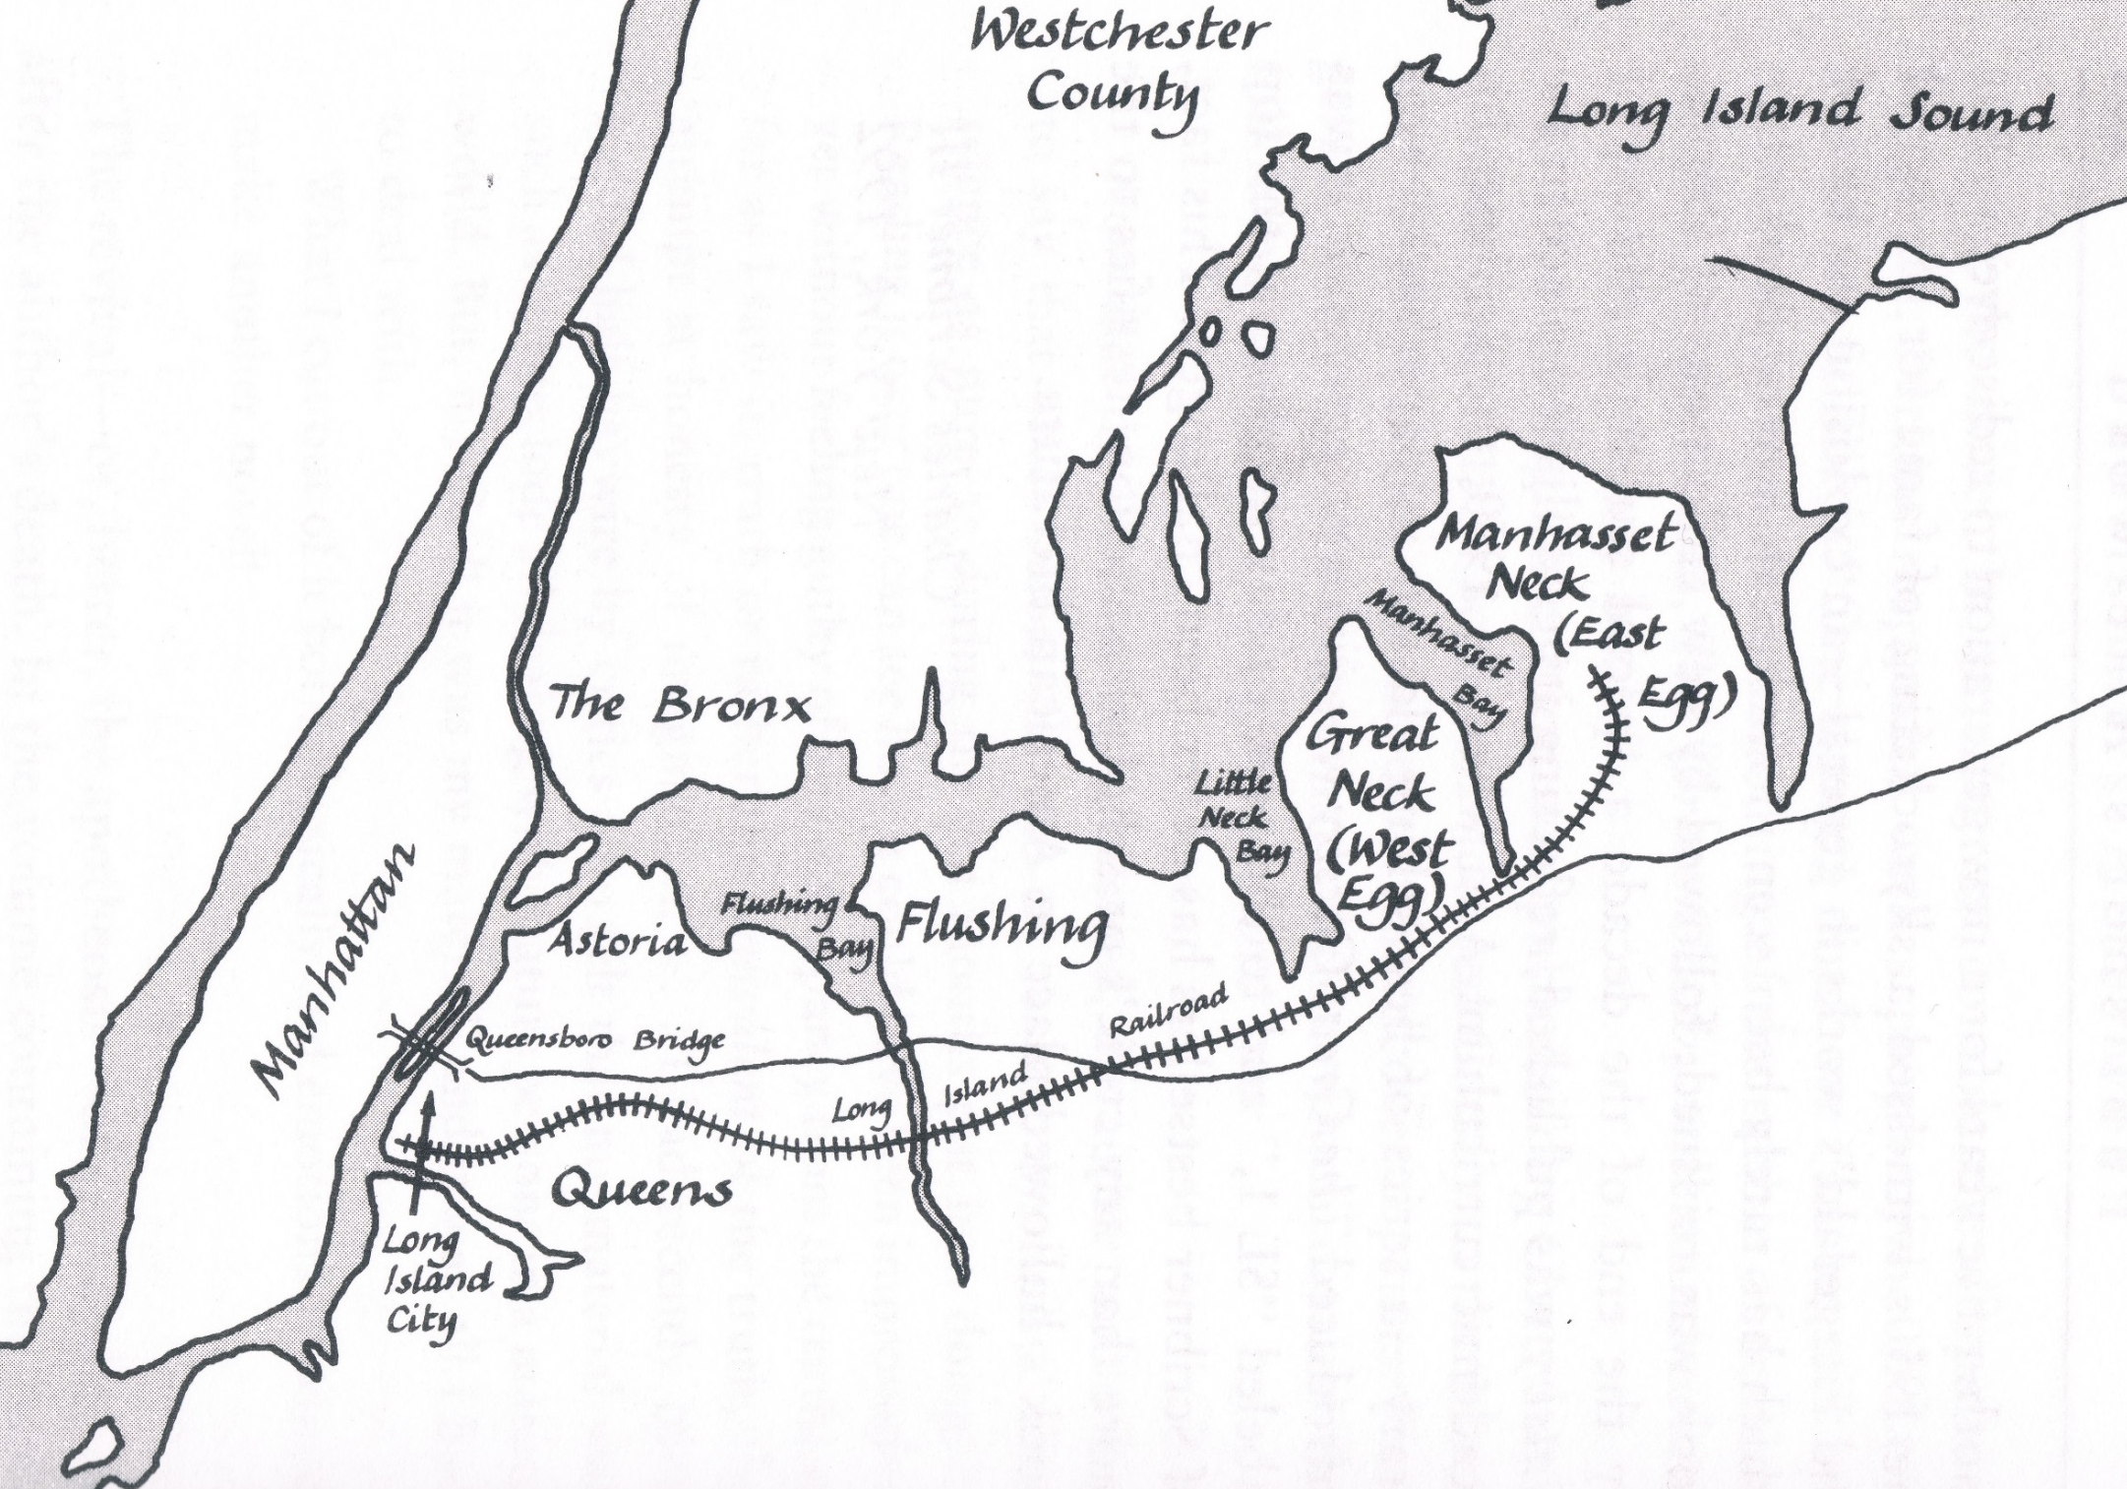
Tom and Daisy’s House
Wolfsheim’s Clubhouse
Gatsby’s House
George’s Garage
Valley of Ashes

Slide 3

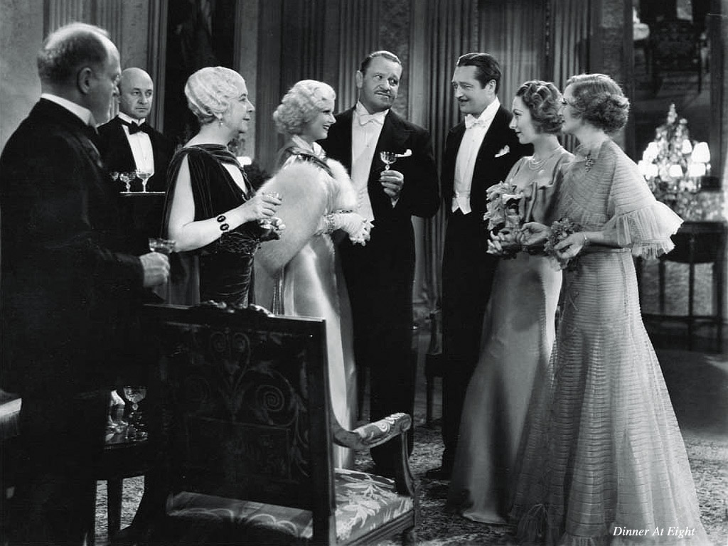
East Egg (Chapter 1)
Old Money
Traditional
Elegant
Exclusive
Aristocratic

Slide 4

East Egg: Associated Characters
Tom Buchanan
Strong and athletic
Rich solely from inherited money
Believes in “traditional values”
  White Supremacy
  Class Privilege
  Male Dominance

Slide 5
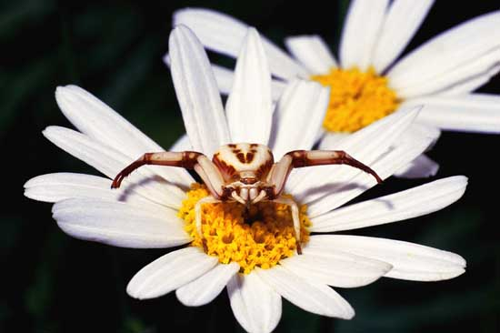
East Egg: Associated Characters
Daisy Buchanan
Beautiful
Rich solely from inherited money
Cynical
Bored with life

Slide 6
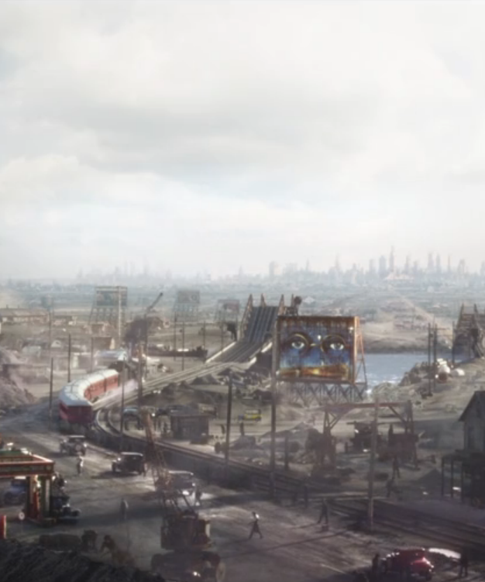
Valley of Ashes/ Manhattan (Chapter 2)
No Money
No Rules
Dirty
Forgotten

Slide 7
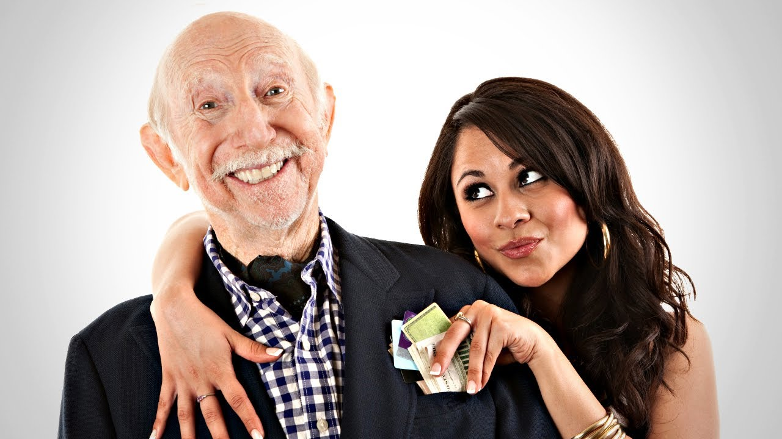
VoA: Associated Characters
Myrtle Wilson
Reasonably attractive
Hates her husband
Wants to get out of poverty
GOLD DIGGER

Slide 8
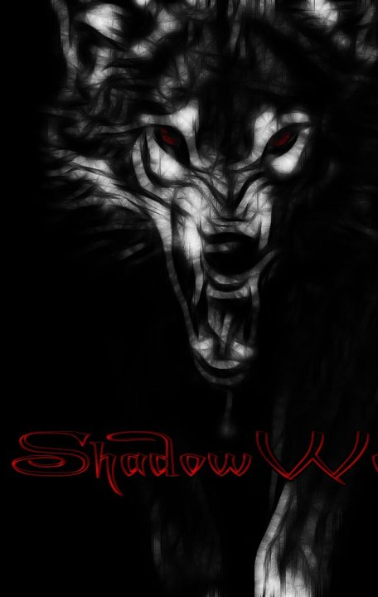
Manhattan: Associated Characters
Meyer Wolfsheim
Dangerous
Mysterious
Powerful connections
Straight Gangster

Slide 9
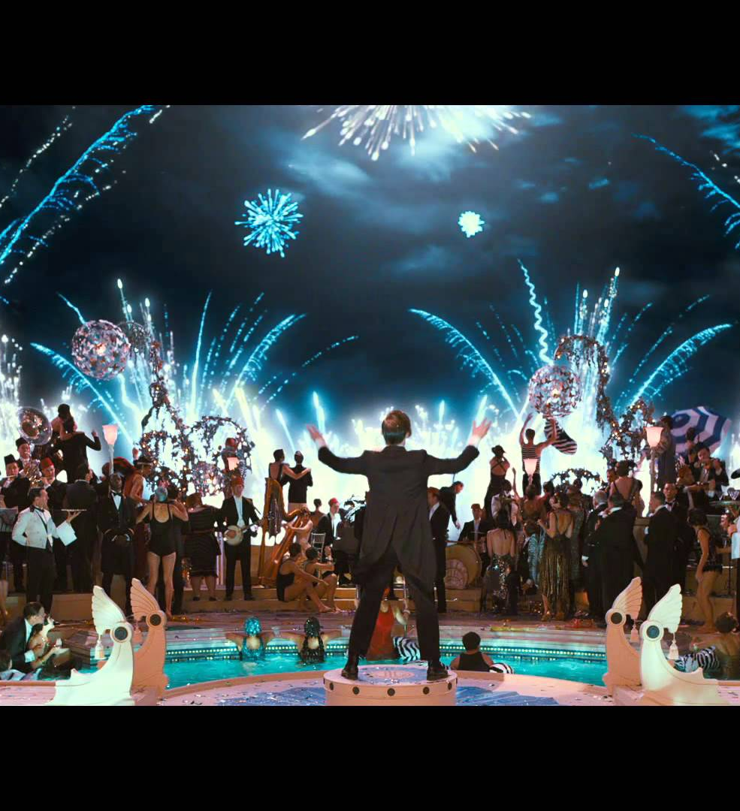
West Egg (Chapter 3)
New Money
Progressive
Extravagant
Inclusive
Meritocratic

Slide 10
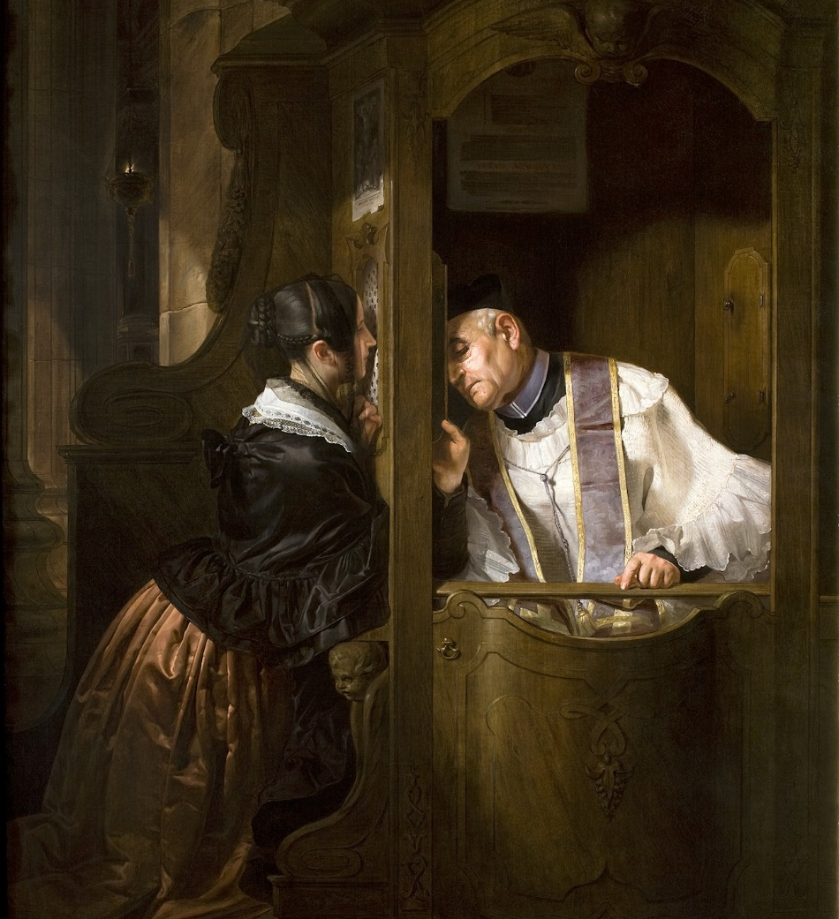
West Egg: Associated Characters
Nick Carraway
Quiet
A good listener
Related to rich people, but still needs to work

Slide 11
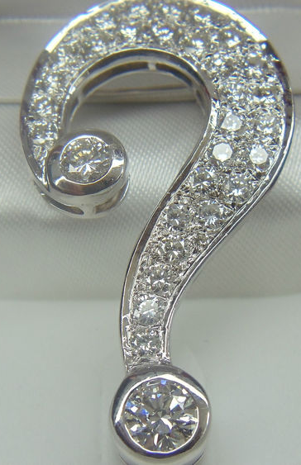
West Egg: Associated Characters
Jay Gatsby
Secretive
Mysteriously wealthy
Throws massive parties
Doesn’t drink

