Slide 1
Advanced Placement
English Language & Composition
Mrs. Rowland & Mrs. Simpson

Slide 2
Main Focuses of the Course
Reading: Students will read various types of text and enter conversations about meaningful issues, addressing the 4 fundamental questions:
  What is being said? (subject)
  To whom is it being said? (audience, occasion)
  How is it being said? (tone, style, organization)
  Why is it being said? (Exigence, PURPOSE)
Writing: Students will master the three types of essays:
  Synthesis essay: after reading several texts about a topic, students will craft their own argument that combines the given sources to support their thesis
  Rhetorical Analysis essay: students will analyze how the writer’s language choices contribute to the intended meaning and purpose of the text
  Open Argument essay: using evidence from experience, reading, observation, etc., students will create an evidence-based argument that responds to a given topic

Slide 3
Top 10 Reasons Why You Should Take AP English Lang & Comp According to Former Students…
Taught me “how to read” in a deeper sense—to see beyond
Opened me up to new ways of writing, including preparing me for the college essay
Provided great structure for writing well in all my other classes
Taught me new ways to manipulate language in my writing (new sentence structures, devices, etc.)
Developed my vocabulary and taught me how to use grammar well in my writing and speaking
Offered opportunities for me to choose what I wanted to read and write about
Promoted spirited discussions and tools for effective persuasion
Challenged and inspired students who “don’t want to be bored”
Fostered a collaborative work environment
Encouraged an inclusive and open atmosphere/culture

Slide 4
Want more information?
Mrs. Rowland: rowlandk@luhsd.net
Mrs. Simpson: simpsonc@luhsd.net
https://apcentral.collegeboard.org

Slide 5

About AP Classes
From The College Board Course Description:
AP Courses “enable students to pursue college level courses while still in high school”
“Modeled after a comparable college course”—this course is modeled after a college level rhetoric and composition class
“Concluded with a college-level assessment developed and scored by university faculty and experienced AP teachers”
“Most 4-year universities or colleges recognize AP in the admission process” and “grant students credit, placement or both based on successful AP Exam scores.”

Slide 6
AP Language & Composition
Focuses on rhetorical analysis of nonfiction texts and development of well-reasoned, evidenced based analytical arguments
Designed to help students become skilled readers of prose written in a variety of rhetorical contexts and to help students become skilled writers who compose for a variety of purposes
Exam has 1 hour of Multiple Choice reading and language analysis questions and 2 hours (+15 minutes reading time) of 3 essays:
  Synthesis essay
  Rhetorical Analysis essay
  Open Argument essay

Slide 7
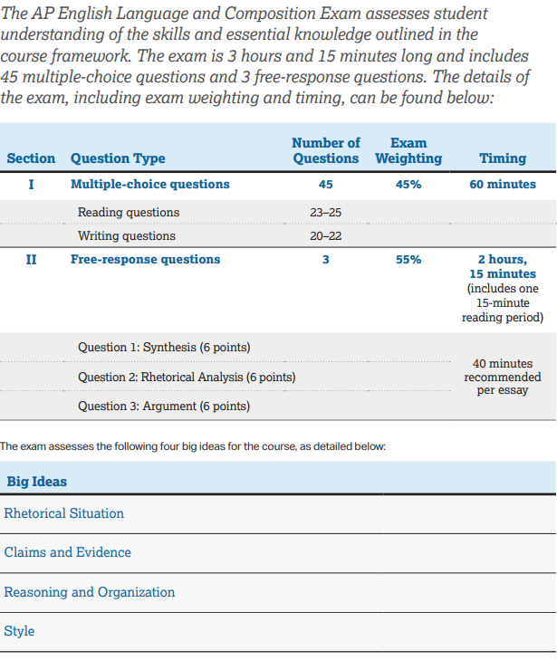

Slide 8
Reading
Students will read various types of text and enter conversations about meaningful issues.
Students will also gather and read source materials representing particular conversations and make their own reasonable, informed contribution to the conversation.
In reading another writer’s work, students will be able to address the 4 fundamental questions:
  What is being said? (subject)
  To whom is it being said? (audience, occasion)
  How is it being said? (tone, style, organization)
  Why is it being said? (Exigence, PURPOSE)

Slide 9
Writing
Synthesis
After reading several texts about a topic, students will compose an argument that combines and cites at least three of the sources to support their thesis.
Argument
Using evidence from experience, reading, observation, etc., students will create an evidence-based argument that responds to a given topic.
Rhetorical Analysis
Students will read a non-fiction text and analyze how the writer’s language choices contribute to the intended meaning and purpose of the text.
All essays are assessed using College Board’s
AP Language & Composition rubrics

Slide 10
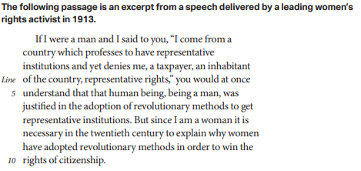
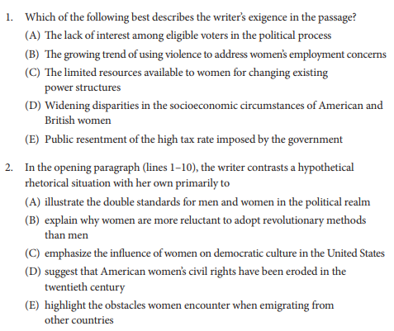
Multiple Choice Assesses Reading and Writing Skills
First two sentences of Passage 1 (of 4)
Question examples for Reading Skills

Slide 11
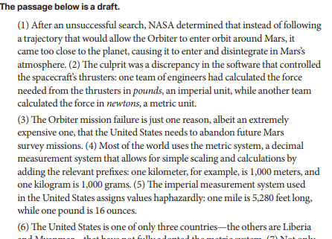
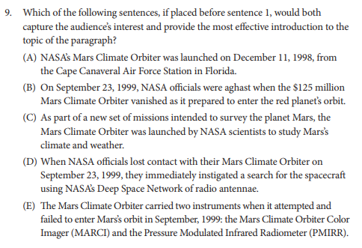
Multiple Choice Assessment of Reading Skills (NEW!)
Excerpt of Essay Draft Passage
Question example for Writing Skills

Slide 12
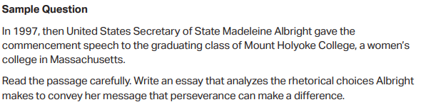
Examples of Writing prompts:
Rhetorical Analysis

Slide 13
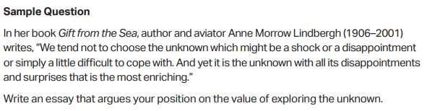
Examples of Writing prompts:
Argument

Slide 14
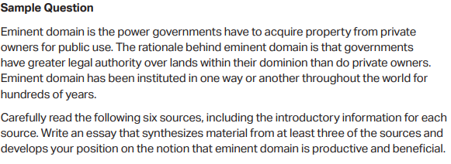
Examples of Writing prompts:
Synthesis

Slide 15
What you should know about AP Lang & Comp from the students:
Prepared me for the ACT and SAT
Taught me “how to read” in a deeper sense—to see beyond
Helped prepare me for college essay writing
Opened me up to new ways to write
Provided great structure for persuasion in all future papers
Taught me new ways to manipulate language in my writing (new sentence structures, devices, etc.)
Taught me how to use grammar to help my writing
Helped me develop vocabulary to use in my writing and speaking

Slide 16
What you should know about AP Lang & Comp from the students (cont.):
Enjoyable discussions
Reading and writing is assigned during summer and breaks
Is faster-passed than other classes, but I was able to adjust
For students who “don’t want to be bored” and are up for a challenge
Collaborative work environment
Atmosphere/culture is a class where kids want to be
There are a lot of essays
There are a lot of lengthy multiple-choice practice tests and times essays once the exam gets closer
Can be time consuming; students should be dedicated to and passionate about the class (“you can’t B.S.” ☺)

Slide 17
Want more information?
Mrs. Rowland: rowlandk@luhsd.net
Mrs. Simpson: simpsonc@luhsd.net
https://apcentral.collegeboard.org

