Slide 1
Chapter 12: How Congress Works
Read Chapter 12.1: Congress Organizes. Respond to the prompts:
Explain the roles of the Presiding Officers.
Speaker of the House:
president of the Senate:
president pro tempore:

Slide 2
Read Chapter 12.1: Congress Organizes. Respond to the prompts:
Explain the roles of the Party Officers.
floor leaders:
whips:

Slide 3
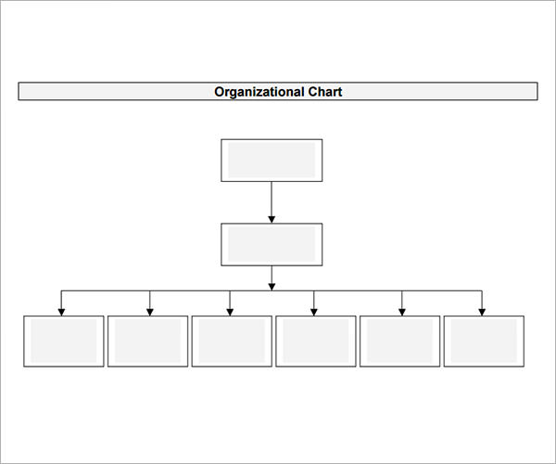
Read Chapter 12.1: Congress Organizes. Respond to the prompts: Complete the organization charts to identify current leadership in the Congress.

Slide 4
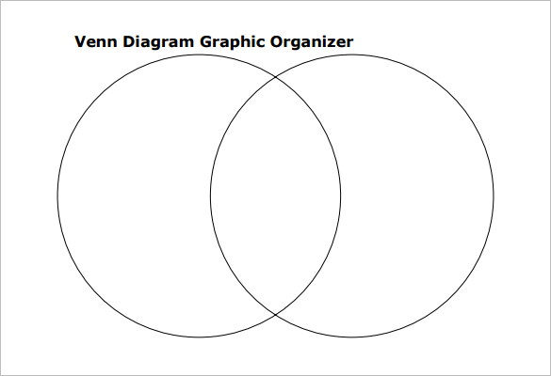
Read Chapter 12.1: Congress Organizes. Respond to the prompts: Complete the Venn diagram to compare the organizational structure of both houses of Congress.

Slide 5
Read Chapter 12.2: Committees in Congress. Respond to the prompt:
Differentiate between the following types of committees in Congress.
standing committee:
select committee:
joint committee:
conference committee:

Slide 6
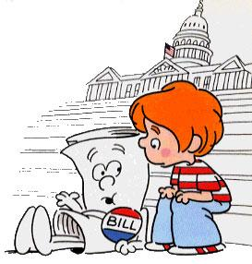
Preview
Read Chapter 12.3: How a Bill Becomes a Law. Respond to the prompt:
Complete the diagram to portray how a bill becomes a law.

Slide 7
floor of
________
floor of
_________
override
with _____
If versions of bill are same
if versions are not the same
override
with _____
___________
committee
______________
bill
bill becomes a ________

Slide 8
Complete the questionnaire by researching information related to your U.S. Representative at www.house.gov/representatives/find/

