Slide 1
Chapter 18
Global Issues

Slide 2
A. The United Nations
1. founded after WW2: prevent war, promote respect for human rts.
2. Security Council
a. 5 permanent members (US, GB, Russia, China, Fr, have veto power) 5 elected to 2yr terms
b. can impose decisions w/force
3. International Criminal Court: 33 countries (not US) prosecute genocide & ethnic cleansing

Slide 3
4. Keeping the peace: relies on “collective security” to prevent war; members provide troops for peacekeeping missions
5. 1968 Nuclear Policy Treaty: purpose to stop spread of nukes
6. Improving lives
a. sustainable development: tries to meet ppl’s needs w/out exhausting resources
b. Millennium Declaration: set specific goals to combat global poverty

Slide 4
B. IGOS (Intergovernmental Organizations)
1. Examples
a. United Nations
b. OPEC: 15 oil producing nations; have shared econ interests
c. NATO, ANZUS: focus on polit & econ issues
2. Problems: going w/majority vote means giving up control of your country’s for policy

Slide 5
C. NGOs (non-governmental organizations)
1. Help ppl in least developed nations
2. advocacy: spk out on issues related to human rts (landmines, etc)
3. advantages: flexible, can usually bring help more quickly than IGOs
4. disadvantages: Least Developed Countries (LDCs) have corruption, civil war & make competing demands

Slide 6
5. Example: CARE
a. created to help ppl after WW2
b. today: provide education, prevents AIDs, promotes access to clean H20, econ opportunities
c. helps 63 mill ppl in 93 countries
d. provides food, H20 & medical care to refugees

Slide 7
As a member of this, the US has veto power. It also has the power to impose decisions by force
Security Council

Slide 8
The Security Council has limited effectiveness because its five permanent members have the power to do this when they don’t approve
Veto

Slide 9
A downside of this type of organization is that they sometimes give up their sovereignty when they go along with the majority
IGO

Slide 10
These two organizations are examples of IGOs that focus on economic & political issues
NATO and ANZUS

Slide 11
This is an example of an IGO with shared economic interests
OPEC

Slide 12
This type of development helps the economy of developing countries without exhausting resources
Sustainable

Slide 13
This organization relies on collective security to carry out peacekeeping missions
United Nations

Slide 14
This declaration is supposed to help poor ppl around the world
Millennium

Slide 15
These organizations are usually flexible and able to get help to disaster victims quickly
NGOs

Slide 16
In these countries, civil unrest can hinder the efforts of NGOs in these countries because warring factions often make demands on staff members
Least Developed Countries

Slide 17
This court handles cases against individuals accused of crimes against humanity
International Court of Justice

Slide 18
D. Protecting Human Rights
1. UN Decl of Human Rts (non-binding): rt to work, own property, get an educ & have a decent st of living
2. Conventions are international agreements on matters that are important to most countries

Slide 19
3. Example: UN Convention of the Rts of the Child
a. rt to life & protection from abuse
b. 220 mill children work in harsh conditions & can’t go to school
c. hard to enforce in poor countries because families depend on child labor & govts worry that it might hurt the economy

Slide 20
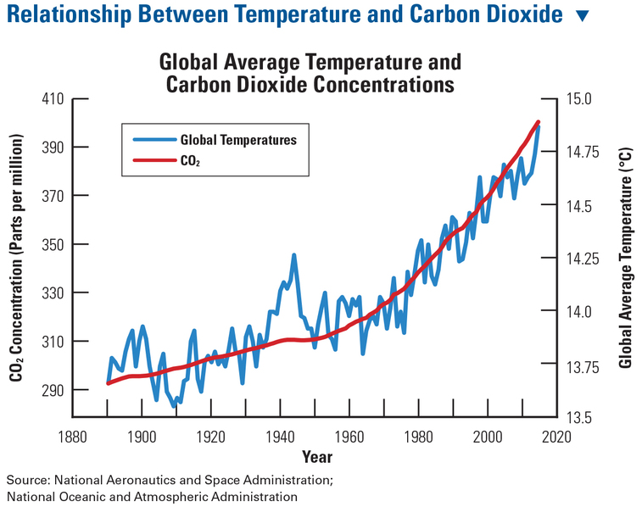

Slide 21
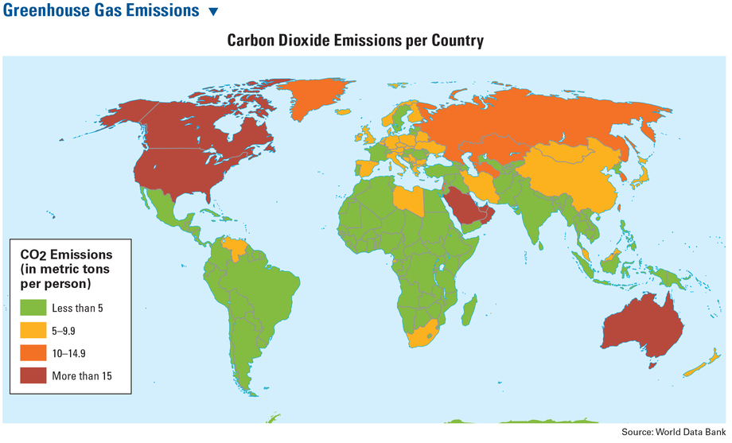

Slide 22
E. Environmental Issues
1. global warming: main cause is the burning of fossil fuels
2. International agreements
a. 1982 Earth Summit: created 1st international environ treaty
b. 1988 IPCC agreement sponsored research on climate change

Slide 23
c. 1997: Kyoto Protocol-37 nations agreed to reduce emissions by 18% & set mandatory emissions limits
d. 2015: Paris Peach Agreement: 55 nations incl US agree to limit emissions (US left in 2017)

Slide 24
3. US efforts
a. 2012: Pres Obama said cars should get 54.5 mpg by 2025 & set aside $ for research (2018: Trump cancelled it)
b. California is a ldr & has reduced emissions below 1990 levels w/ tax breaks for use of wind & solar

Slide 25
This organizations started out helping WW2 victims & now helps ppl all over the world
CARE

Slide 26
This document defines the basic rights that all ppl should enjoy
Universal Declaration of Human Rights

Slide 27
An international agreement on matters of broad interest is called this
Convention

Slide 28
The UN Convention on the Rts of the Child includes the rt of children to be protected from this
Abuse

Slide 29
Enforcing child labor laws is difficult because countries are worried this will suffer
Their economy

Slide 30
The United Nations has tried to address this by sponsoring research, setting emissions limits & crafting an international environmental treaty
Climate change

Slide 31
This is considered to be the source of global warming
Burning fossil fuels

Slide 32
Nations agreed to reduce greenhouse gas emissions when they signed this in 1997
Kyoto Protocol

