Slide 1
Chapter 17
The US and the World

Slide 2
A. Goals of foreign policy
1. Protecting nation’s security
2. Preserving world peace

Slide 3
3. Promote econ prosperity
a. more access to raw materials, can buy & sell more goods
b. globalization: trend toward less restricted trade
c. tries to stop illegal production of foreign goods
4. humanitarian ideals: promote freedom & human rts, reduce poverty

Slide 4
2. Soft power tools
a. diplomacy: managing communication between nations
1. ambassador: highest ranking long term representative to another country
2. diplomatic immunity: exemption from host country’s laws
3. summits & treaties: bilateral (2 countries), multilateral (3+ countries)

Slide 5
4. trade relations
a. cross border commerce shows desire for more contact between countries
b. most favored nation status (part of bilateral agreement) country gets all of the benefits of other countries (ex. Low tariffs)
5. cultural exchange: ppl to ppl contacts increase goodwill (scientists, educations, business, artists)

Slide 6
When two countries establish this shows desire to have more contact between their peoples.
cross-border commerce or trade relations

Slide 7
This official serves as one country’s highest-ranking, long-term representative to another country
Ambassador

Slide 8
Basic goals of U.S. foreign policy are promoting prosperity, preserving world peace and this
Protecting national security

Slide 9
Managing communication and relationships between nations is called this
Diplomacy

Slide 10
A most-favored-nation clause is most likely to appear in this type of agreement
Bilateral trade agreement

Slide 11
The United States protects economic interests by trying to stop this
Illegal production of foreign goods

Slide 12
Exemption from a host country's laws for ambassadors is called this
Diplomatic immunity

Slide 13
6. foreign aid: assist to poor countries ($30 bill)
a. devel of poor countries to promote econ reforms
b. security assist: protect US interests (ex. Prevent terrorism)
7. Humanitarian assistance: disasters, refugees, donations to international organizations, milit assistance

Slide 14
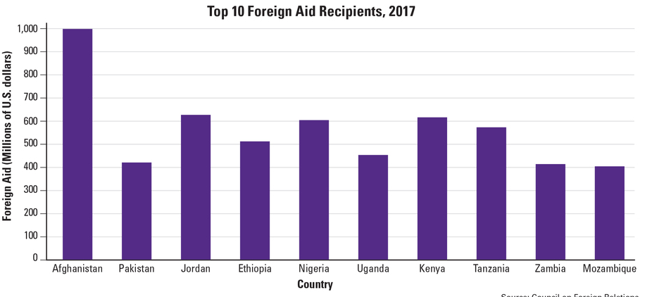

Slide 15
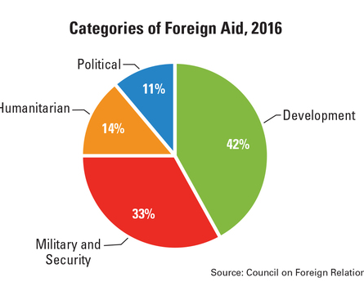

Slide 16
C. Hard power tools
1. purpose: to persuade another country to adopt a difft course of action & ensure national security
2. Intelligence gathering (CIA): gives Congress & the Pres reliable info about other countries & potential threats.
3. Covert action: a secret operation that supports our foreign policy

Slide 17
4. Boycotts and sanctions (refusal to buy goods from other countries)
a. purpose: to pressure another country to change its policies
b. punish other nations by hurting their economies

Slide 18
5. Military alliances (ex. NATO)
6. Armed force
a. when diplomacy fails
b. ex. 1999 ethnic cleansing (mass removal & killing of an ethnic group) in Kosovo
c. Afghanistan (2001), Iraq (2003)

Slide 19
Sending food to disaster victims in another country is an example of which of which type of assistance
Humanitarian

Slide 20
These and boycotts are used to punish another nation through its economy
Sanctions

Slide 21
In the intelligence section of the foreign policy bureaucracy, agencies help Congress and the executive branch by giving them reliable info about these
Other countries and potential threats.

Slide 22
Mass removal and genocide of an ethnic group in a specific region is called this
Ethnic cleansing

Slide 23
The goal of these is to pressure another country to change its policies
Sanctions

Slide 24
This is an example of a military alliance
NATO

Slide 25
In foreign policy, the aim of hard power tools is to do this
Persuade foreign countries to adopt certain policies

Slide 26
In U.S. foreign policy, forming military alliances and armed forces are used to ensure this
National security

Slide 27
Intelligence agencies use these to try to secretly influence what goes on in other countries
Covert actions

Slide 28
U.S. foreign policy helps advance humanitarian ideals by sending foreign aid to improve other countries, helping countries move closer to democracy & promoting these
Freedom and human rights

Slide 29
D. The Makers and Shapers
1. Bureaucracy
a. diplomacy: Dept of State is in charge of relationships w/foreign countries---ppl in foreign service (ambassadors, consulates) handles trade, passports & visas

Slide 30
b. intelligence (CIA, NSA) provide Congress & Pres. w/info about other countries
c. National Security: Dept of Defense carries out military action, NSC advises the president
d. Economy: Natl Econ Council advises the Pres. on trade issues

Slide 31
2. Congressional influence: (power of the purse) controls milit spending; uses $ to protect human rts & promote democracy
3. Public opinion: suppt for foreign wars declines over time

Slide 32
E. World View
1. Isolationism: withdraw from foreign affairs (after WW1)
2. Containment: Control aggressive nation (after WW2)
3. Disengagement: avoid milit actions, but ok with trade & foreign aid

Slide 33
4. Human Rights: protect others (Somalia, Kosovo)
5. Anti-terrorism: destroy terrorist groups & keep weapons of mass destruction (WMDs) away from them (post Sept 11)

Slide 34
Congress’ role in foreign policy is mainly to control this
Military spending

Slide 35
Issuing passports and visas is the responsibility of this department
Department of State

Slide 36
The worldview on foreign policy that focuses on controlling aggressive nations is called this
Containment

Slide 37
People who believe in this foreign policy think we should stay out of foreign affairs
Isolationism

Slide 38
This world view shaped President Bush’s foreign policy
Anti-terrorism

