Slide 1
Chapter 15
Courts, Judges & the Law

Slide 2
A. Judiciary Branch
1. Types of court cases
a. criminal: jury must unanimously agree “beyond a reasonable doubt” that defendant is guilty
b. civil: guilt is based on a “preponderance of evidence.”

Slide 3
2. Ppl in court
a. defendant: accused of a crime
b. prosecutor: works for the govt/ppl, gathers evidence to convict in criminal court
c. plaintiff: (civil court) has the “burden of proof” of wrongdoing

Slide 4
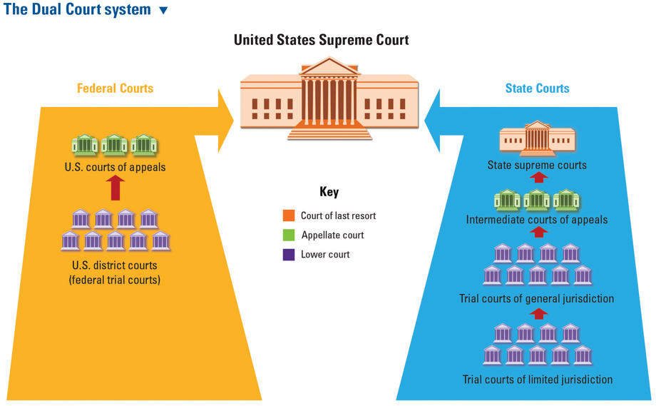

Slide 5
B. Dual Court system
1. Judicial Act of 1789 created a dual court system (Fed & State)
2. Jurisdiction
a. determines which court will decide the case
b. appellate jurisdiction: appellate court looks for “errors in the law” to determine if a case will be tried again

Slide 6
C. Federal courts
1. US district courts (bench trial: a case in which the judge decides the outcome)
2. US Appeals Courts: Panel of 3 judges decide if case merits appeal
3. Special courts: tax, military, trade, veterans & terrorist
4. Federal judges: nomin by Pres, approved by Senate, removed by impeachment

Slide 7
D. The Supreme Court
1. Selecting justices: Pres appoints→judicial committee holds hearings→Senate votes to confirm
2. Choosing cases
a. 9 justices meet to decide which cases to hear
b. ask for a writ of certiorari: an order by the Supreme Court directing a lower court to send record for a case they want to hear

Slide 8
3. Hearing cases
a. 30 min arguments from both sides
b. amicus curaie brief: an interest group might write this to show the court that the issue is important to more than just the plaintiffs & defendants

Slide 9
4. Decisions
a. serve as a precedent for future cases but can only be reversed if a future court reverses it
b. options
1. uphold lower court’s decision
2. send a case back to lower courts
3. reverse a previous decision

Slide 10
c. Opinions
1. majority opinion: most senior member of court who agrees with opinion writes this
2. minority opinion: most senior member of the court who disagrees with opinion writes this, also called dissenting opinion

Slide 11
3. Judicial philosophy
a. activism: see the Constitution as changing with the times; tends to be more liberal & support minorities & women
b. restraint: strict followers of Constitution, believe in “original intent” of founding fathers & tend to support conservative issues

