Slide 1

Chapter 14
The Federal Budget

Slide 2
A. Budget process
1. Important terms
a. balanced budget: expenses & revenue are =
b. budget surplus: extra money
c. budget deficit: not enough $; expenses exceed revenue
d. deficit spending: funding programs without $, get $ from borrowing, not tax revenue-→leads to a higher national debt

Slide 3
2. History
1. before 1921: Congress raised taxes & borrowed $ to pay for war
2. 1930s: deficit spending to pay for New Deal & World War II
3. 1973: impoundment: Nixon refused to spend money Congress approved for programs

Slide 4
2. Budget Impoundment Control Act of 1974
a. Legis & exec branch share control over budget spending
b. Created Congressional Budget Office (non- partisan): compares president’s budget to its estimate of future revenues & expenses
c. Congress issues a budget resolution, a set of guidelines that reflect Congress’ spending priorities

Slide 5
C. Phase 1: President submits budget proposal to Congress by 1st Monday in February
D. Phase 2: Congress crafts a budget resolution
E. Phase 3: Senate & House Appropriations Committee start work on Congress’ 13 appropriation bills (by March)
F. Phase 4: New Fiscal year begins
1. continuing resolution: can keep govt working past the deadline
2. budget crisis: Congress & president cannot agree & govt shuts down

Slide 6
B. Fed govt sources
1. individual income tax: lgst source of federal income
2. Social insurance taxes (Social Security, Medicare)

Slide 7
3. corporate income tax
4. progressive taxes: tax higher incomes at a higher percentage (ex. Income tax); good for poor
5. regressive taxes: tax is the same for all incomes (ex. Sales tax); good for rich

Slide 8
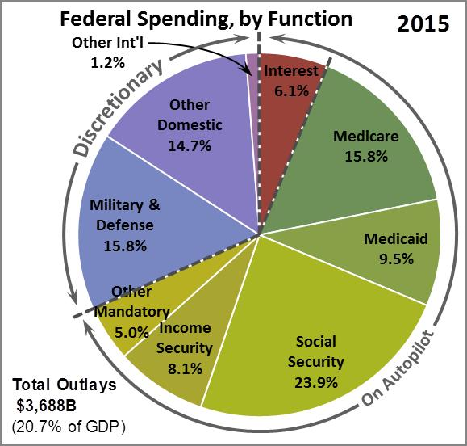
C. Spending
1. Federal:
mandatory: entitlements (Soc Sec, unempl, food stamps) & fed debt interest
discretionary (mostly military)

Slide 9
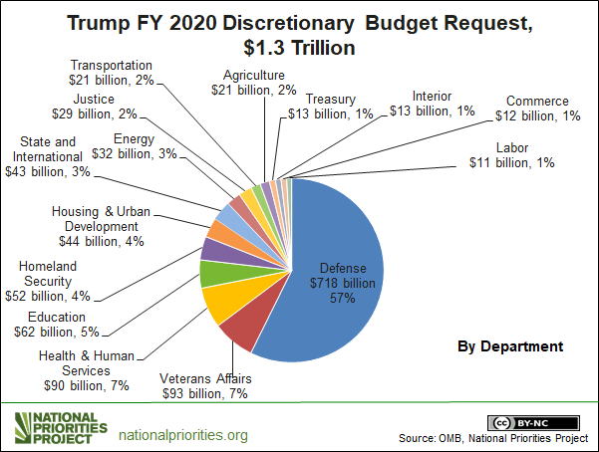

Slide 10
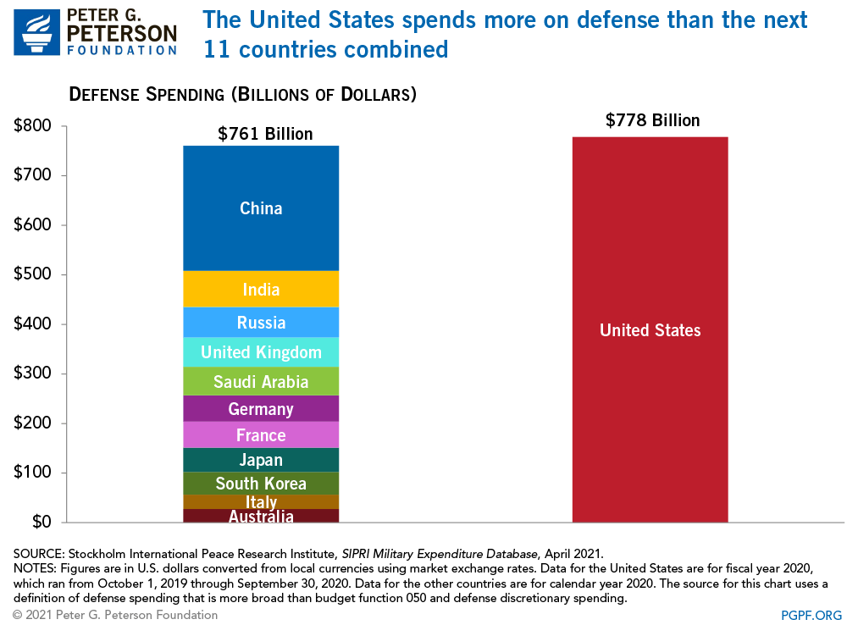

Slide 11
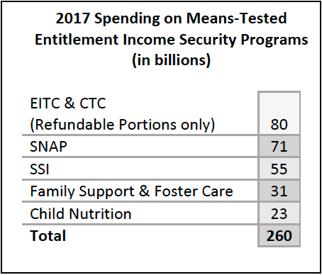

Slide 12
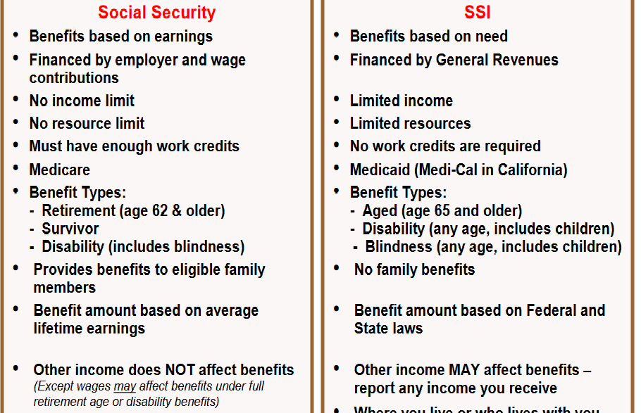

Slide 13
2. Discretionary (budget items that can be raised or lowered as Congress sees fit
a. largest category is military spending
b. earmarks: spending added to a bill that benefits one Congressional district (ex. $233 bill for bridge in rural Alaska)

Slide 14
3. State budgets: limit tax increases & require voters to approve tax hikes through referendum
4. Local spending
1. funds fire protection, educ & law enforcement
2. property taxes: tax property (state & local govts only)

