Slide 1

Chapter 10
Political Campaigns and Elections

Slide 2
A. The expansion of suffrage: who can vote
1. 1789: Only white males who owned property
2. 1870: 15th amendment: black Americans
3. 1919: 19th amendment: women
4. 1924: Indian Citizenship Act: Native Ams
5. 1965: Voting Rts Act: protected black Ams voting rights; elimin poll taxes & literacy tests
6. 1971: 26th amendment: 18yr olds
7. Must be a US citizen, legally registered, resident of a state

Slide 3
B. Types of primaries
1. closed: independent voters can’t vote
2. open: indep voters can vote

Slide 4
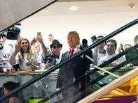
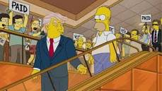
C. Running for office (self announcement is the most common way to become a candidate)
2015 & 1993
1. Estab a campaign org
2. Build a war chest ($ that can be used to be a move a campaign forward)
3. Reach out to voters: televised debates & radio ads

Slide 5
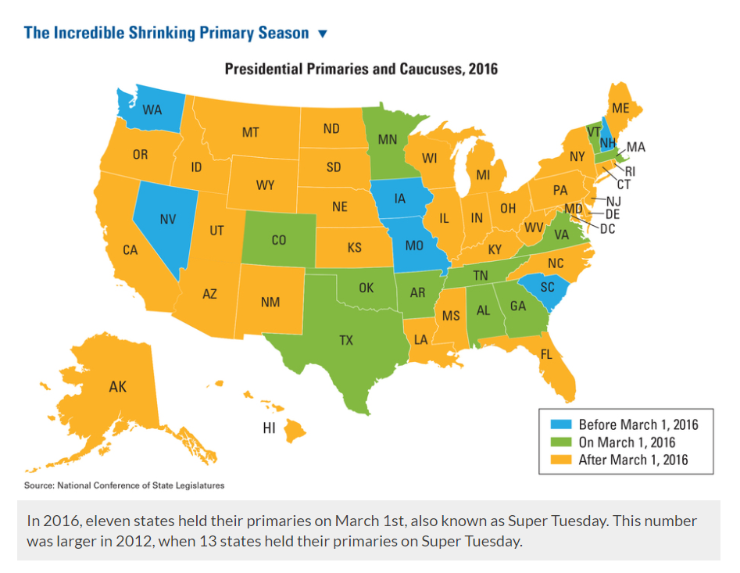

Slide 6
D. Types of elections
1. Presidential
a. best turnout
b. battleground states get the most attention because they are states with lots of EC votes & are politically divided
2. Midterm
3. Off year

Slide 7
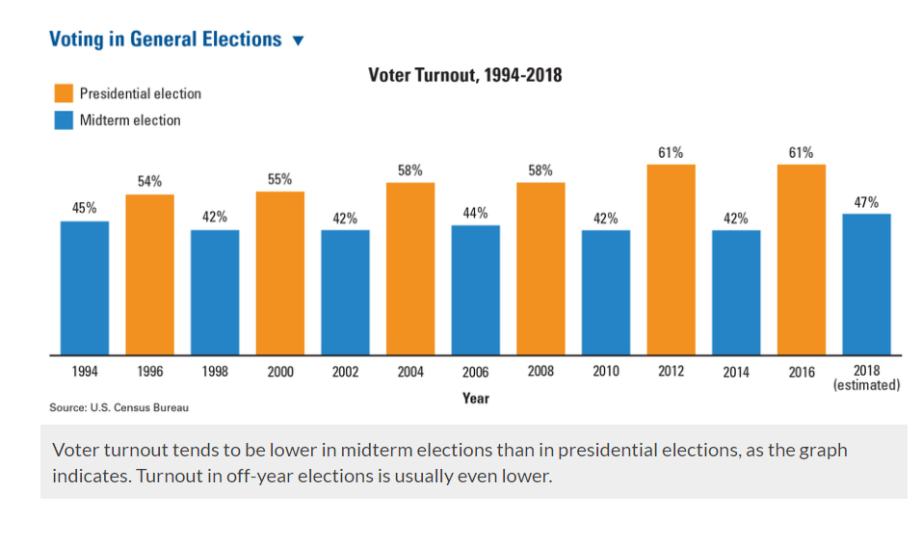

Slide 8
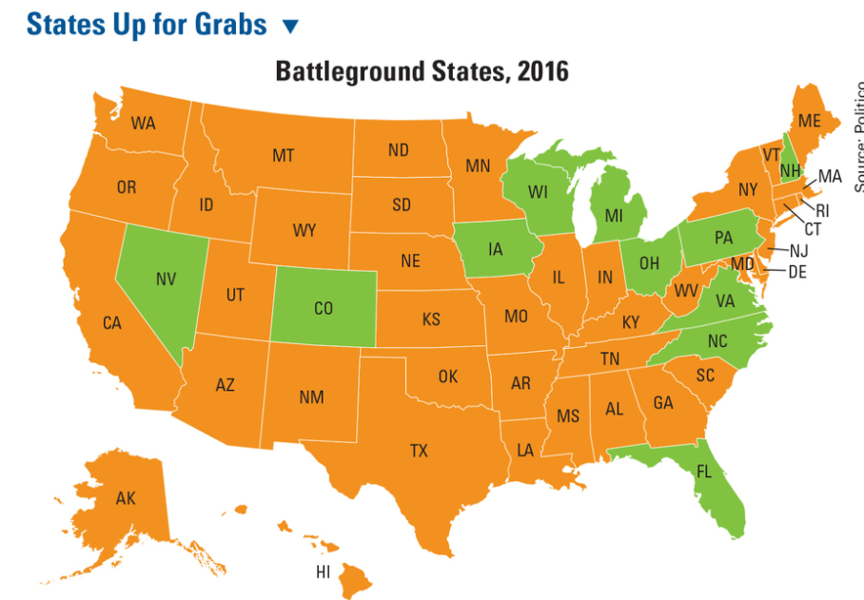

Slide 9
E. Electoral College
1. Electors not voters decide who becomes president
2. Each state gets one EC vote for each member in Congress (ex. Calif—53 members of Congress, 2 Senators= 55 EC votes)
3. Popular vote does not matter. Candidate can win plurality (majority) of popular votes & lose the election (Gore 2000, Clinton 2016)
4. Criticism: not democratic, rural states have more influence

Slide 10
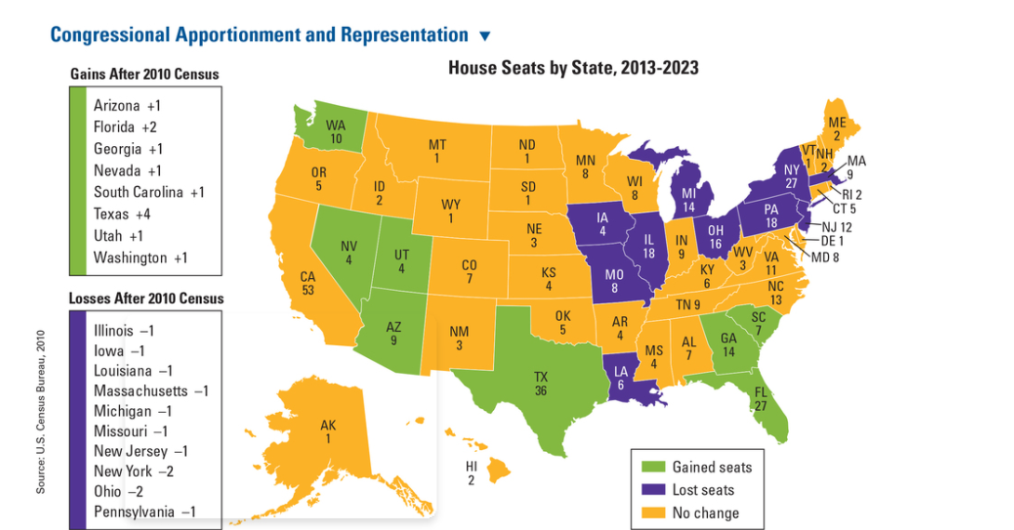

Slide 11
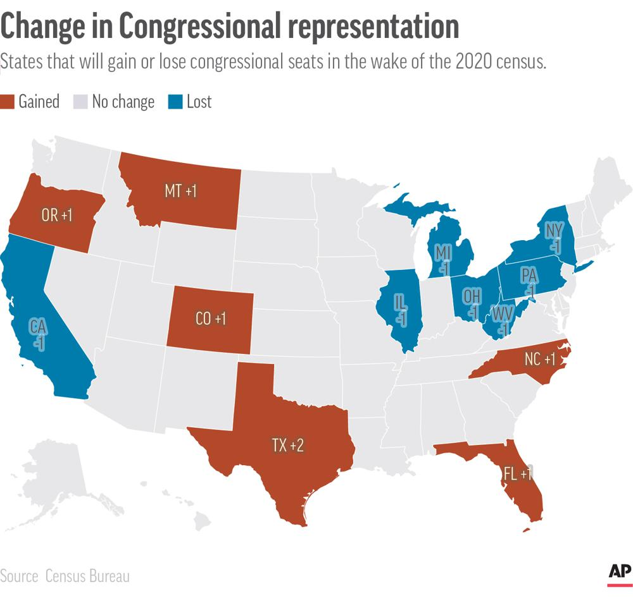

Slide 12
F. Financing the election
1. 2 strategies: ppl give $ to candidates they like, or give $ to both to insure access to the winner
2. Most $ comes from indiv citizens
3. Bipartisan Campaign Reform Act of 2002: limits soft $ ($ money for parties, but not candidates), issue ads (issue ads can’t endorse a candidate within 60 days of election)
4. 527 committees & Super PACs don’t have limits (Citizens United case, free speech)

Slide 13
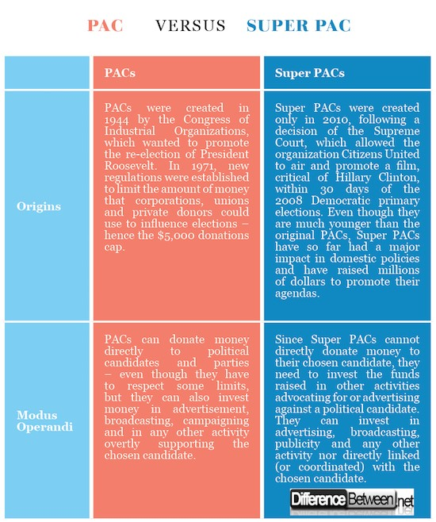

Slide 14
G. Who votes?
1. Old, educated, middle class & rich
2. Ppl decide who to vote for based on party affiliation, issues, candidates, incumbency (an incumbent is a person who is in office & running for re-election)
H. After primaries candidates must keep base motivated & attract middle of the road voters

