Slide 1

Chapter 9
Public Opinion & The Media

Slide 2
A. The Formation of Public Opinion (sum of many indiv views)
1. Individuals
a. Political socialization: process by which ppl form their polit values & attitudes

Slide 3
b. Agents of socialization: Family is the earliest & most important agent
2. Shaped by special interest groups, journalists & politicians

Slide 4
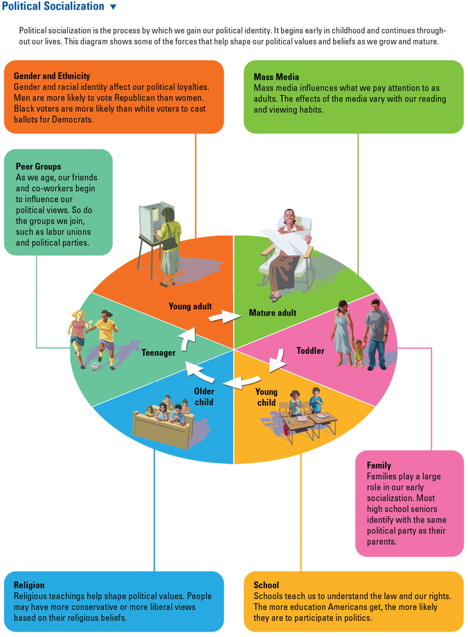

Slide 5
B. Measuring Public Opinion
1. Types of polls
a. straw polls
b. scientific sampling
1. more accurate than a straw poll because they contact a variety of ppl
2. a sm group of ppl who are representative of the entire popul
c. opinion poll

Slide 6
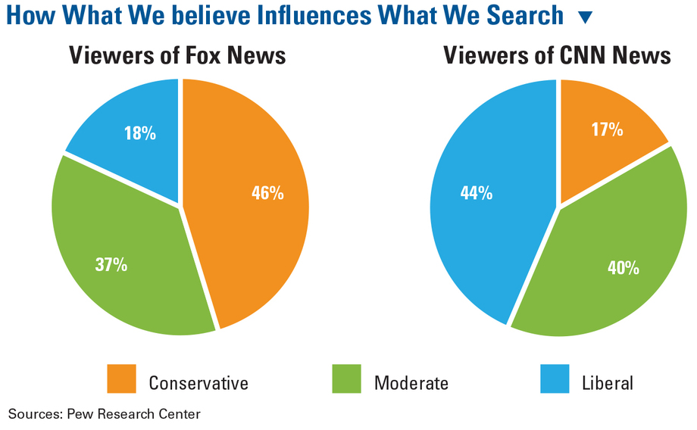

Slide 7
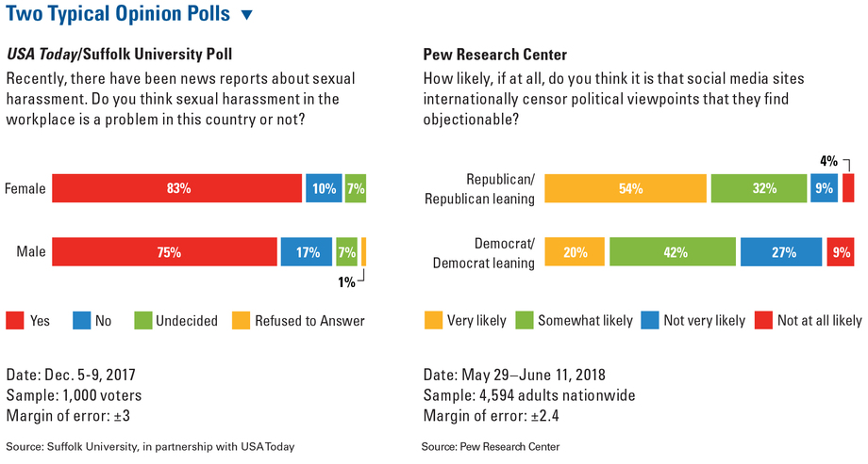

Slide 8
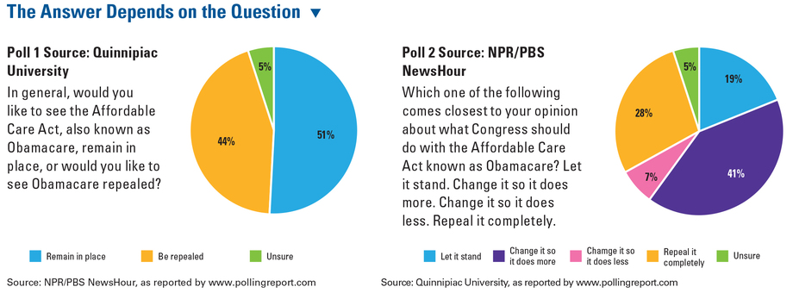

Slide 9
2. Polling process
a. random
b. margin of error can be reduced by asking more ppl
c. the results are close to the opinions of the popul as a whole
d. used by businesses, new organizations & politicians to measure public sentiment

Slide 10


Slide 11
3. Polling in political campaigns:
benchmark, tracking, exit & push polls
a. exit polls can determine voting patterns of men & women & are used to predict the winner before the polls closed

Slide 12
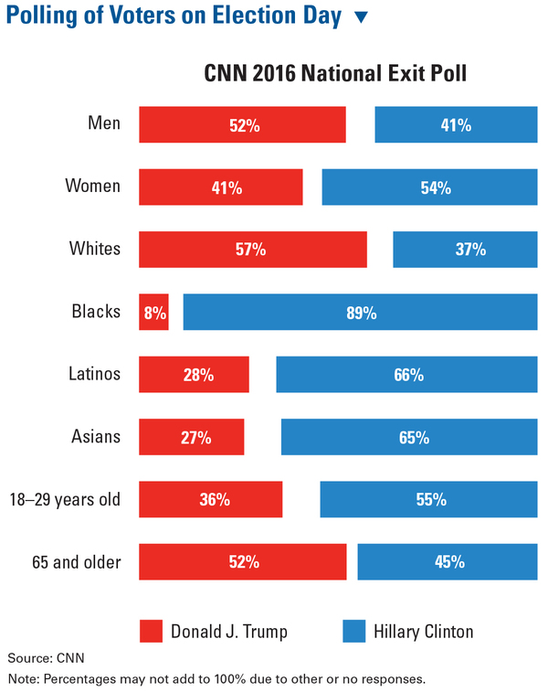

Slide 13
b. push polls try to push voters away from certain candidates by spreading damaging info about their opponents & are considered unethical

Slide 14
C. Impact of Mass Media on Public Opinion
1. Ways ppl get news today: print, broadcast & electronic

Slide 15
2. Role of free press in a democracy: founding fathers thought free press was important because it guarded against govt corruption & misuse of power

Slide 16
3. Influencing the media
a. staged event: candidates try to attract press coverage
b. spin: candidates try to convince reporters & the public that their views of events are correct
c. leak: to expose wrongdoing, stir up support for a proposal or spin the way an event is covered

Slide 17
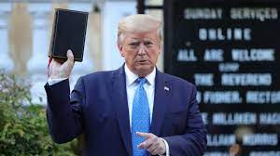

Slide 18
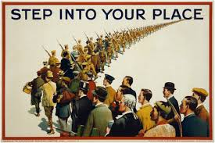
D. The Influence of the Media on Political Campaigns
1. persuasive techniques
a. bandwagon: takes advantage of ppls desire to conform

Slide 19
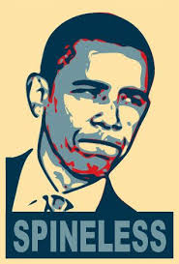
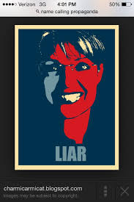
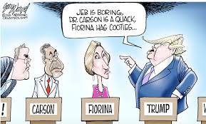
b. name calling

Slide 20
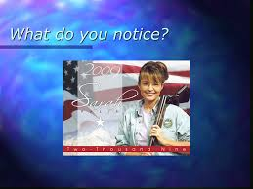
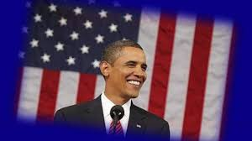
c. transfer: use of symbols to evoke emotion

Slide 21
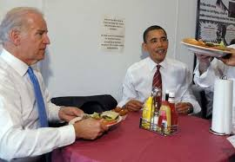
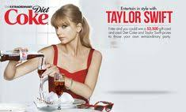
d. plain folks: everyday ppl & images
e. testimonial: a famous
person talking about a
candidate

Slide 22
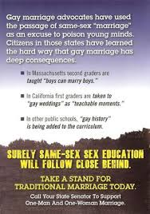
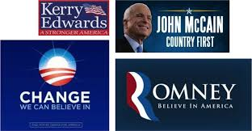
f. card stacking: use of statistics & evidence
g. glittering generalities: use of vague,
sweeping statements

Slide 23
2. Image making
a. the role of the media consultant is to advise candidates on how to present a positive image to voters
b. focus groups: used by media consultants to test campaign messages

Slide 24
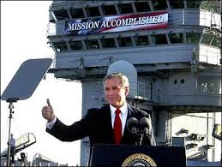
3. Attracting media coverage: photo opps attract press coverage (ex Pres Bush in 2003)

Slide 25
4. Media coverage of elections
a. horse races & soap operas
b. gotcha journalism: to catch candidates making a mistake or looking foolish
5. Negative campaigning (mudslinging) is effective

