Slide 1
Chapter 8
Parties, interest groups & public policy

Slide 2
A. Political parties in the US
1. primary goal: get their candidates elected; they also recruit candidates, support campaigns, inform voters, unite diverse interests
2. platforms: outlines party positions on important issues

Slide 3
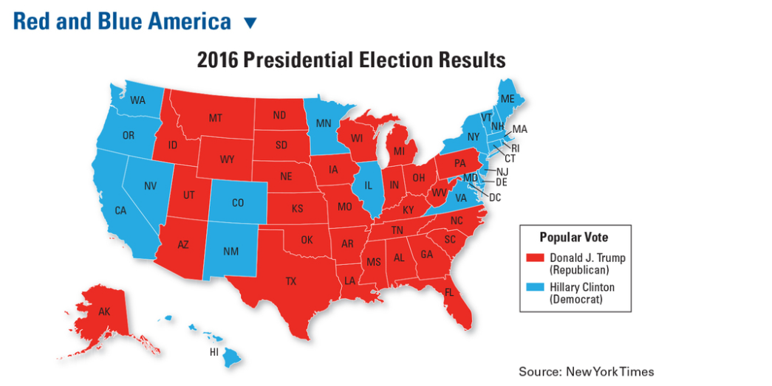

Slide 4
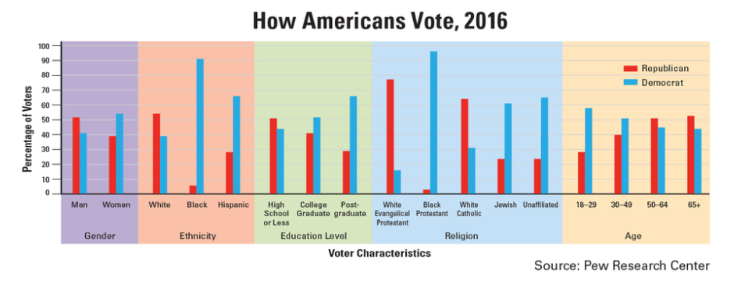

Slide 5
3. Structure of political parties
a. Today’s 2 party system
Issue | Democrats | Republicans
Size of national govt | Strong central govt | Strong state & local govt
Taxes | Tax rich more, poor less | Cut taxes
Regulation of business | More to protect workers, consumers & the environment | Less regulation of business, more profit
Social issues | Legal abortion, same sex marriage, gun control | No legal abortion, gun control or same sex marriage
Environment | For protection | Against protection

Slide 6
b. 3rd parties
1. Single issue (ex Rt to Life, Natl Women’s party)
2. Econ protest (ex Greenback, Populist)
3. Ideological (Socialist, Libertarian)
4. Splinter groups formed by ppl unhappy with majority parties (Progressive Bull Moose, States’ Rts Dixiecrats)
5. popular today: Socialist, Green Party, Independent

Slide 7
B. Interest (special interest) groups
1. Goal: to persuade elected officials to support their interests
2. Citizen groups: Sierra Club, ACLU

Slide 8
3. Political Action Committee (PAC)
a. main sponsors are interest groups
b. purpose: to collect contributions to fund political campaigns
4. Lobbyists: try to infl policy by persuading public officials to oppose or favor action on an issue

