Slide 1
Chapter 6
Federalism: National, State and Local Powers

Slide 2
A. Federal system
1. Division of powers
a. expressed powers: powers specifically granted to the natl govt, concurrent powers: both state & fed, reserved powers: powers for state only

Slide 3
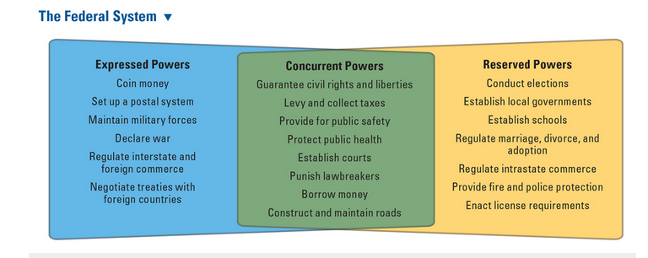

Slide 4
b. Full Faith & Credit Clause: requires that states recognize one another’s public actions
c. Privileges & Immunities Clause: states cannot discriminate against residents of other states

Slide 5
2. Benefits of Fed system
a. protect against tyranny of majority
b. promotes unity w/out uniformity
3. Drawbacks: it allows laws to be inconsistent from state to state

Slide 6
4. Federal funding/regulations
a. local govts get $ from feds, with strings attached
b. unfunded mandates: natl govt requires state or local govts to implement at their own expense

Slide 7
B. Evolution of Federalism
1. Dual: two levels of govt, each have defined responsibilities (layer cake)
2. Cooperative: federal, state & local govts work together (marble cake)

Slide 8
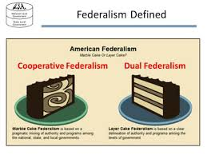

Slide 9
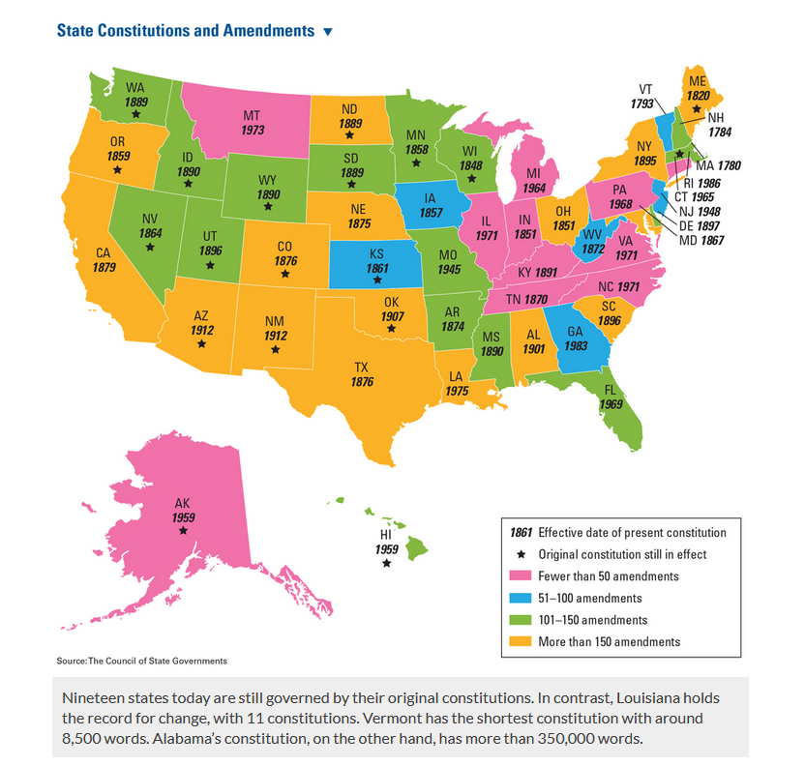
C. State Govts in the Fed system
1. State Constitutions
a. US Constit requires that every state constit be a “republican form of govt.” (voters choose reps)
b. amendments: legislature proposes amendment, voters approve it (3/4 approved)

Slide 10
c. quorum:​
1. fixed # of ppl that must be present to conduct business​
2. purpose: to prevent an unrepresentative minority for taking action​

Slide 11
C. Role of State Legislature
1. Pass laws & state budgets
2. redistricting: the redrawing of voting districts
a. apportionment
1. the distribution of seats in US Congress—state legislatures choose district boundaries
2. 1962: Baker vs. Carr: legislative apportionment is a state & fed matter

Slide 12
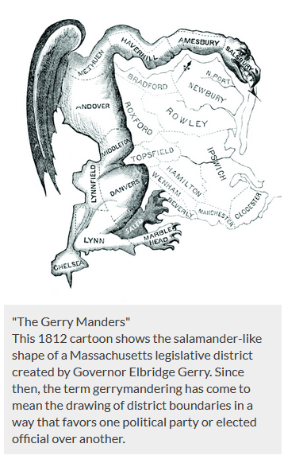
b. gerrymandering: drawing district boundaries to give one group an advantage

Slide 13
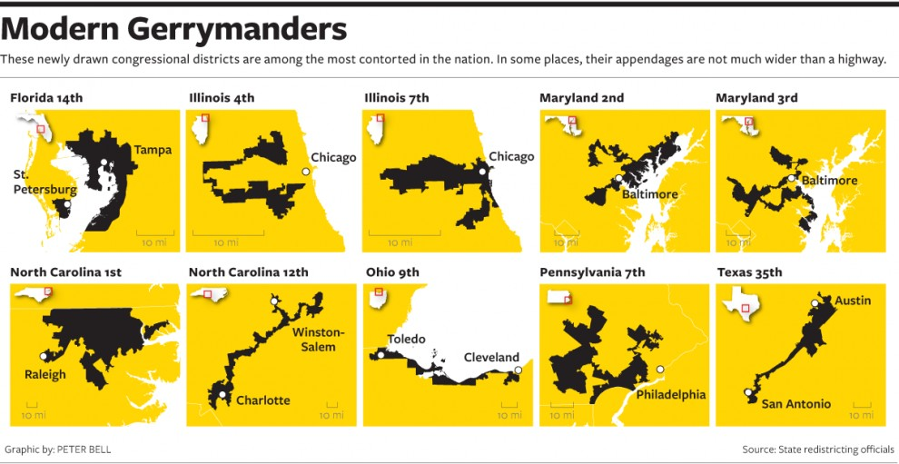

Slide 14
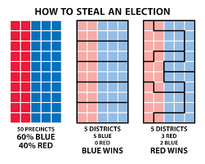

Slide 15
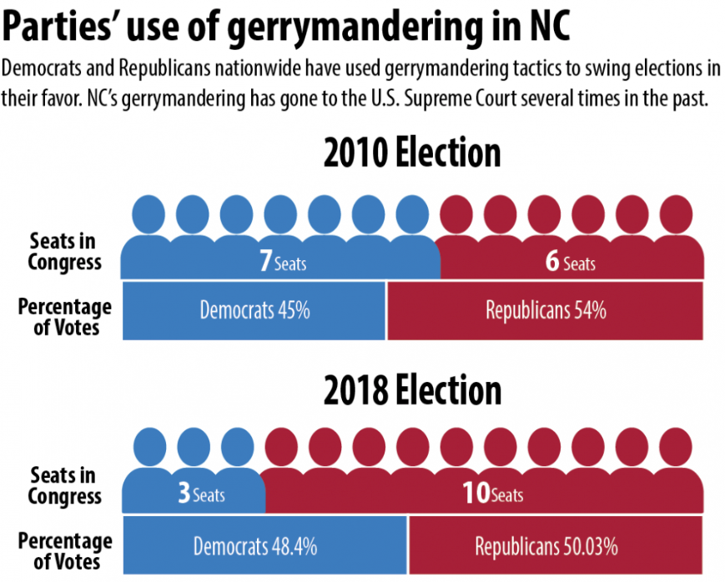

Slide 16
3.
2. 2019: Rucho vs. Common Cause & Lamone vs. Benisek: apportionment is a state matter only

Slide 17
D. Local Govts (Towns & cities)
1. mayor-council system: voters elect city council & mayor
2. council-manager system: elect city council & mayor, but city manager runs the govt (most common)

