Slide 1

Chapter 5
The Bill of Rights & Civil Liberties

Slide 2
A. Your rights
1. Civil liberties: protect you from the govt--freedoms govt can’t take away: speech, religion, assembly, voting rts
2. Civil rights: guarantees by the govt = treatment under the law, trial by jury

Slide 3
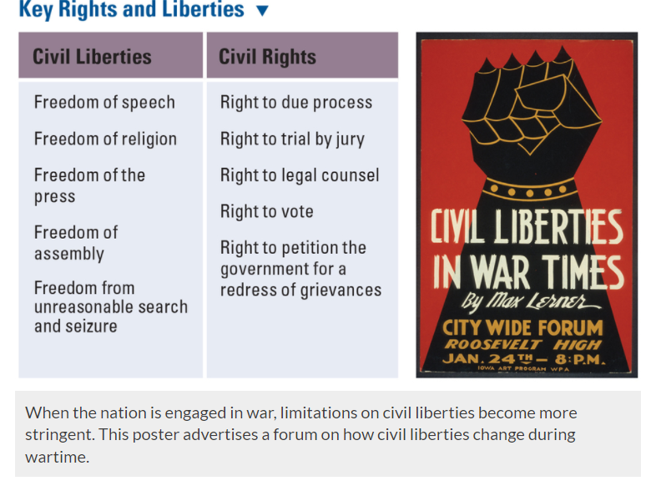

Slide 4
3. Bill of Rts: Supreme Court interprets them
4. Incorporation
a. apply the Bill of Rts to the states
b. Gitlow vs. New York: state laws cannot violate freedom of speech

Slide 5
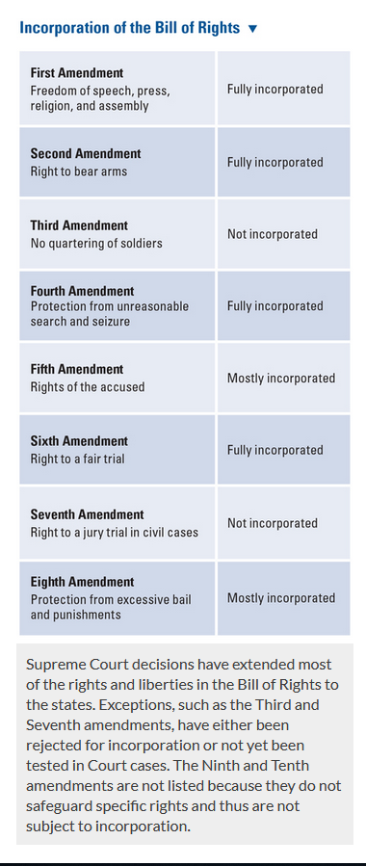

Slide 6
B. 1st Amendment rts
1. Freedom of religion
a. Estab Clause
1. guarantees separation of church & state
2. Lemon vs. Kurtzman: can’t use public $ for religious schools (1971) but can if its open to all faiths (2002 court decision)
b. Free Exercise Clause: ppl are free to choose their religion

Slide 7
2. Freedom of Speech
a. intent to cause harm: not protected
1. libel: publishing false info
2. slander: spreading false info
b. obscenity is not protected, but flag burning is

Slide 8
3. Freedom of press: essential to democracy; govt cannot prevent publication of certain material (“prior restraint,” is unconstitutional)

Slide 9
C. Protection Against Govt Abuses
1. 2nd amendment
a. rt to bear arms
b. Dist of Columbia vs. Heller: struck down a law prohibiting the registration & possession of firearm

Slide 10
2. 3rd amendment: protect’s the privacy of ppl’s homes
3. 4th amendment: need a warrant before searching private property

Slide 11
D. Your Rts in the Legal System
1. 5th amendment: rt to remain silent
2. 6th & 7th amendment
a. rt to a fair trial
b. Gideon vs. Wainwright: poor ppl must be provided with legal counsel

