Slide 1
Chapter 2 Comparing Forms of Govt

Slide 2
A. Totalitarian govts
1. Soviet communism
2. Fascism: power given to corporations--expansionist, nationalist, militaristic
3. Nazism: a type of fascism with an emphasis on racial superiority

Slide 3
B. Forms of govt today
1. monarchies
a. the oldest form of govt still in use today
b. efficient & clear succession

Slide 4
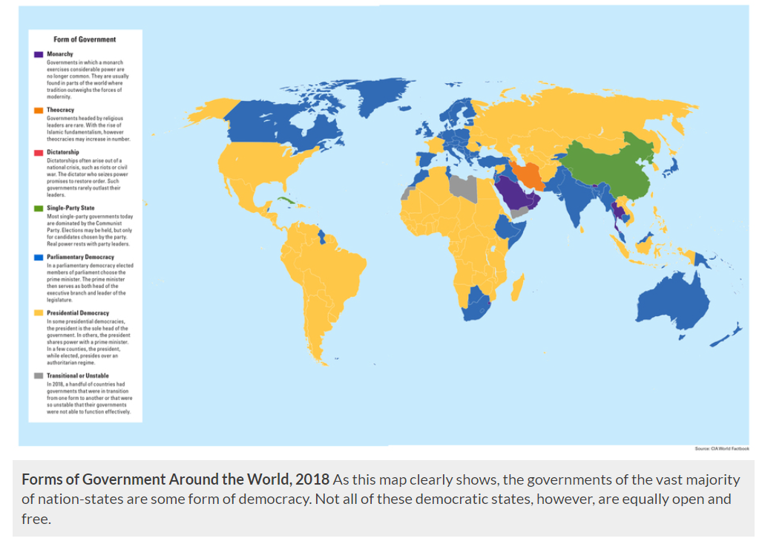

Slide 5
2. Dictatorships:
a. an indiv or sm group controls govt (take power, monarch inherits)
b. risk: abuse of power
3. Theocracies: religious govt; only Iran & Vatican City

Slide 6
4. Democracies
a. Representative democracies: give power to ordinary citizens when they elect their leaders
1. Parliamentary democ: parliam chooses prime minister (get more done, but no separation of exec & legis power)
2. Presidential democracy: exec branch (Pres) is separate from legislature

Slide 7
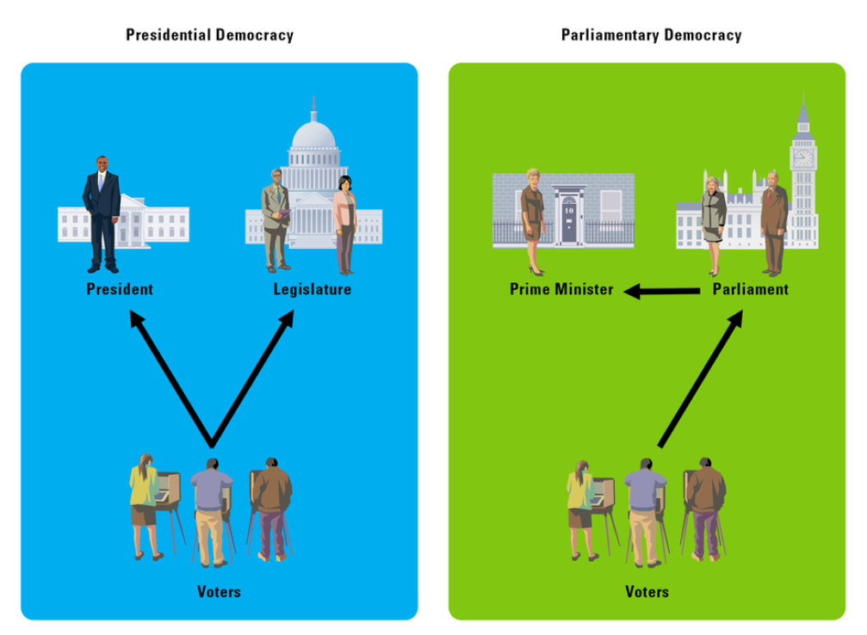

Slide 8
b. Direct democracy: each citizen has an = voice (ex. New England Town Hall)
c. Disadvantages
1. less efficient than monarchies, dictatorships & single party states
2. time consuming: elections, meetings

Slide 9
C. Distribution of power
1. Unitary system: power is centralized
2. Federal system
a. divides power between natl & state govt
b. more common in lg countries w/diverse populations
c. framers of Constit feared a central govt that was too powerful

Slide 10
3. Confederal system: local, regional power over central govt which is too weak to be effective

Slide 11
D. Economic Systems
1. Traditional: st of living is low & ppl barely meet their basic needs
2. Market (free enterprise, capitalism): production of goods & services is driven by profit motive, econ consumption & supply & demand

Slide 12
3. Command
a. govt planners decide how much of what to produce
b. communism & socialism: attempts to address the inequalities of industrial capitalism
4. Mixed
a. most common in world today
b. Ex. China & US

