Slide 1

Chapter 1
The Nature of Politics, Power & Govt

Slide 2
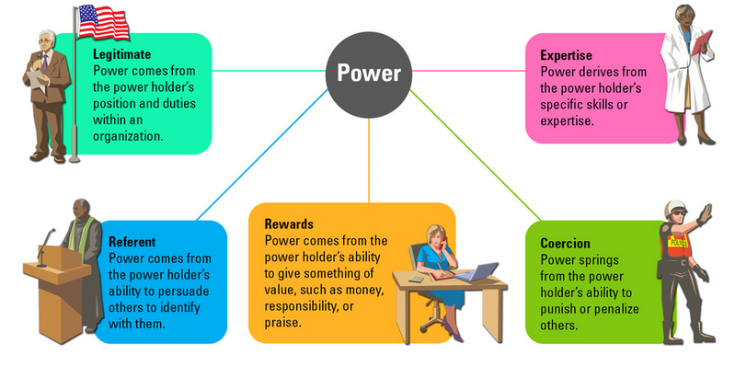
A. Power
1. the ability to get other ppl to do what we want them to do

Slide 3
2. central concern of all govts
3. govt: the institutions & officials organized to carry out public policy
B. authority: the legal rt to give orders to others & enforce rules

Slide 4
C. Legitimacy
1. depends on ppl’s acceptance of authority
2. Historical examples
a. Mandate of Heaven: Chinese ruler has it if he rules morally
b. Divine Rt of Kings: King is chosen by God
c. Social contract: if ruler abuses power, he should lose power

Slide 5

D. Purpose of govt: order, protection, providing public goods (something more than 1 person can consume w/out reducing the amount avail to others)
E. Coercion & revenue collection necessary to govern
Schools, roads, libraries, police, fire, natl parks, military

Slide 6
F. Nation state: indep country where ppl share a common culture
1. national sovereignty (rt to exercise power over a region or group)
2. code of law

Slide 7
G. Political activity: has a purpose, usually involves collective action (ppl working together)

Slide 8
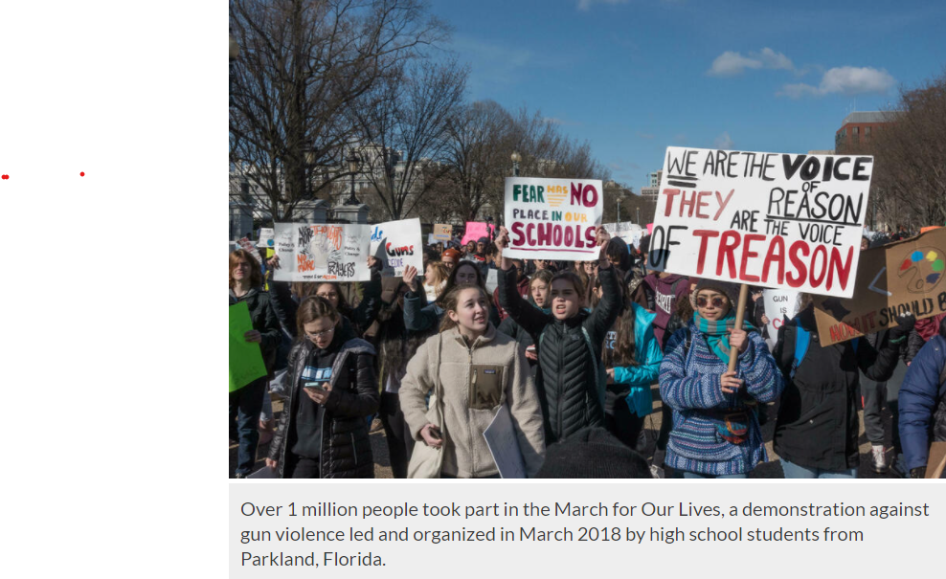

Slide 9
G. Political games
1. Horse trading (ex. Business deal)
2. Walkout (ex. Chavez used walkout to improve the lives of farm workers)
3. Power struggle (Machiavellian—a person who uses amoral tactics or tricks)
4. Demolition derby (ex. Rome destroyed Carthage)
5. Civil disobedience: shaming the opposition (ex. Gandhi)

