Slide 1
Chapter 12
Taxes and Taxation

Slide 2
A. Levying Taxes
1. Taxes: mandatory payment to the govt; the price we pay for civilization (rarely popular)
2. Economist Adam Smith said taxes should be equitable, convenient & efficient

Slide 3
3. Who pays taxes & why
a. ability to pay: taxed according to income/wealth
b. benefits received principle: gas tax, bridge tolls
4. Deadweight loss: cost to consumers & producers due to loss of sales is greater than the revenue (ex employee turns down a job because the tax burden is not worth it)

Slide 4
B. Types of taxes (tax base X tax rate = amount of tax due)
1. proportional taxes: everyone pays an equal share of tax burden (ex. 10%---greater sacrifice for poor ppl)
2. progressive tax: takes a larger share of income as income increases
3. regressive tax: (ex. Sales tax, % tax on goods) Poor ppl spend a larger portion of their income on taxable goods & services than rich ppl

Slide 5
4. individ income tax: lgest share of the tax revenue comes from income
a. not in constitution (16th amend)
b. IRS collects “withholding” taxes from wkrs
c. audit: when the IRS questions a taxpayers return

Slide 7
5. Payroll taxes: Soc Security, Medicare, unemployment, disability
6. Property taxes: based on a % of property value (changes if prop value changes); $ mostly spent on schools
7. Excise & luxury taxes: taxes on goods govt wants to regulate

Slide 8
C. How govt spends your money
1. Federal Revenue Sources: Indiv income, payroll, corporate, excise
2. Federal deficit: shortfall between govt expenditures in a given yr
a. Govt borrows $ (treasury & savings bonds)
b. When govt spends too much it borrows $ by selling bonds

Slide 9
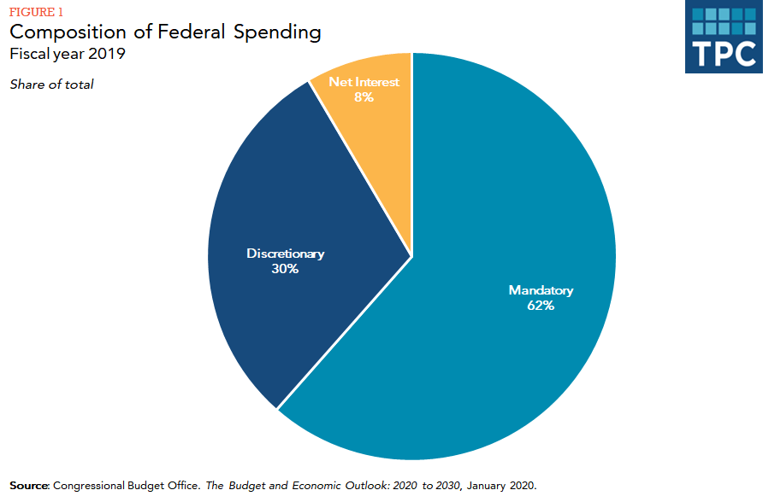

Slide 10
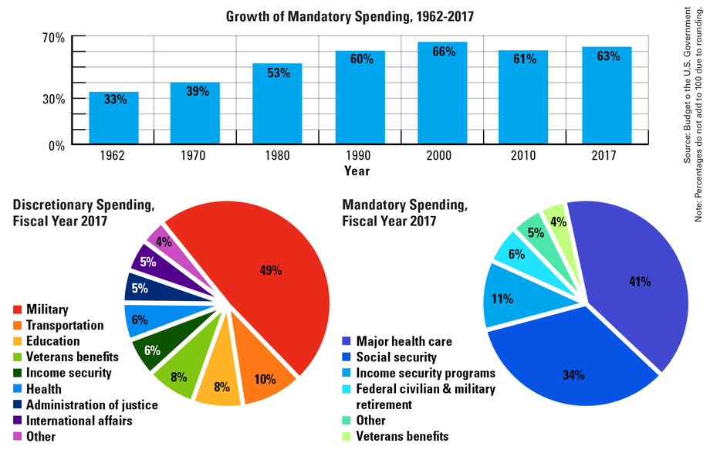

Slide 11
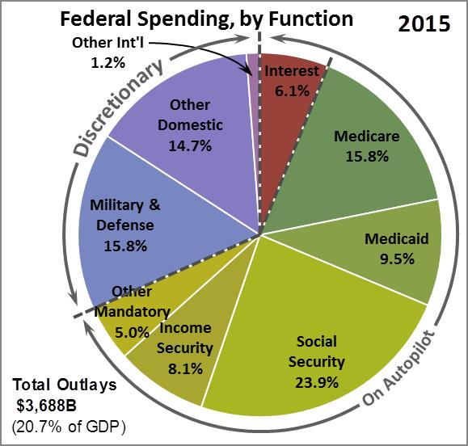

Slide 12
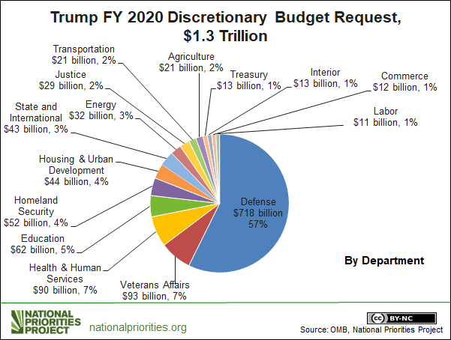

Slide 13
D. Govt Spending
1. Federal
a. mandatory (required by law; entitlements & interest on the national debt)
b. discretionary

Slide 14
2. State & local revenue sources
a. property, sales & lotteries
b. tax referendum: citizens play a larger role in tax policies through referendums
c. local tax $-→education, law enforcement, fire protection

