Slide 1

Chapter 11
Government and the Economy

Slide 2
A. Protecting Property Rights
1. Private ownership encourage ppl to take care of their prop
2. Eminent domain: a exception to prop rts
a. 5th amend Taking Clause ensures due process & compensation
b. Kelo vs. City of New London: its ok to take prop for redevelopment if it has public benefit

Slide 3
B. Govt Regulation: Laws that try to infl the econ to behave in a + way
1. Anti-trust division of the Dept of Justice is responsible for preventing price fixing & bid rigging

Slide 4
2. Protecting consumers
a. Upton Sinclair shed light on unsafe meatpacking--→Food & Drug Admin
b. Ralph Nadar wrote about dangerous cars-→Natl Hwy Traffic Safety Admin
c. Dodd-Frank Wall St Reform & Consumer Prot Act (2010) to protect consumers in financial mkts

Slide 5
d. Protecting savers & investors: FDIC, SEC
e. Protecting workers
1. Dept of Labor protects workers econ rts & physical safety
2. OSHA: estab led to a 60% drop in wrkplace deaths since 1971

Slide 6
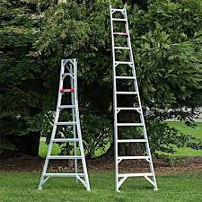
The general slope of grain in flat steps of minimum dimension shall not be steeper than 1 in 12, except that for ladders under 10 feet in length the slope shall not be steeper than 1 in 10 . . . Local deviations of grain associated with otherwise permissible irregularities are permitted.

Slide 7
3. Probs w/govt regulation
1. overregulation
2. regulatory capture: when regulatory agencies become domin by industries they regulate & act in the industry’s best interest

Slide 8
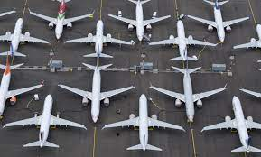
James Hall, the former National Transportation Safety Board chairman, explained in the Times, in 2005 the FAA turned its safety certification responsibilities over to the manufacturers themselves (if manufacturers met some requirements). In plain speak, this means that Boeing got to decide if Boeing’s airplanes were safe enough to fly — with little additional oversight.
The FAA said the purpose of this change was to save the aviation industry roughly $25 billion between 2006 to 2015.

Slide 9
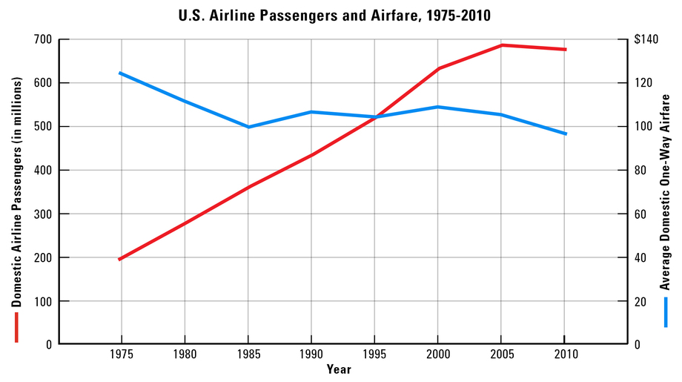
Figure 11.2B Graphing Gains from Airline Deregulation Before 1978, the Civil Aeronautics Board controlled both domestic airline routes and fares. After the deregulation that year, any domestic airline judged “fit, willing, and able,” was allowed to fly any U.S. route at any price.
• Note the drop in average fares, as calculated in 2005 dollars.
• With lower fares, the number of Americans flying increased between 1975 and 2010.
-

Slide 10
C. Externalities & Public Goods
1. Supporting Positive Externalities: Subsidies (grants, vouchers) & Public Provision (postal service, air traffic control)
2. Limiting Neg Externalities
a. command & control (rules) vs. mkt based (tax incentives) policies

Slide 11
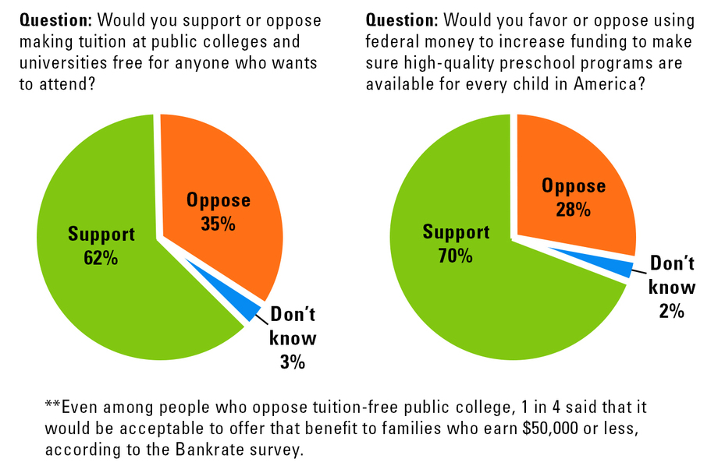
Figure 11.3A Analyzing Public Opinion on Education Funding student loans and preschools are ways for governments to promote the positive externalities created by an educated citizenry. The survey results here show public opinion on some of these issues.
• The left-side graph shows support for a subsidy, providing low-interest loans.
• The right-side graph shows support for a public provision, providing preschools.

Slide 12
b. cap & trade
1. cap on businesses that pollute
2. pollution permits: allow firms to pollute a certain amt
3. firms than can cut pollution may sell to firms that can’t cut pollution

Slide 13
3. Negative Externalities & the Tragedy of the Commons: ppl have limited incentive to protect property they do not own.

Slide 14
4. Preserving Common Resources
a. toll (fee for using roads reduce use)
b. quota (ex. fishing)
c. privatization: gives the owner incentive to preserve the resources

Slide 15
D. Govt Promotes Econ Well Being
1. History
a. Depress→New Deal regulation & govt intervention
b. WW2: more indiv & corporate taxes for milit production
c. Employment Act of 1946: Fed govt promotes employment & production

Slide 16
2. Govt promotes econ stability
a. goal: job security, goods & services readily avail, producers & consumers can plan for the future
b. econ stimulus (ex. 2008 IRS mailed $600 checks to 130 mill households)

Slide 17
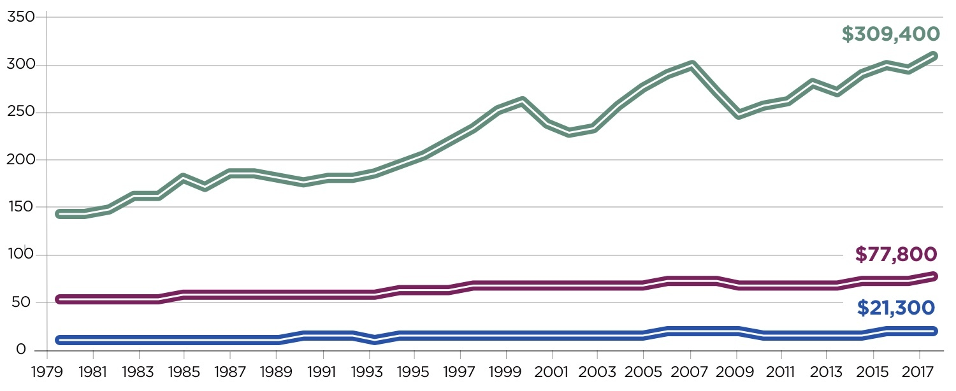
Highest quintile (top 20% of income distribution)
Middle quintiles (20% to 80% of income distribution)
Lowest quintile (bottom 20% of income distribution)

Slide 18
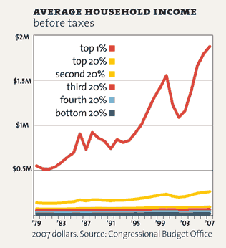

Slide 19
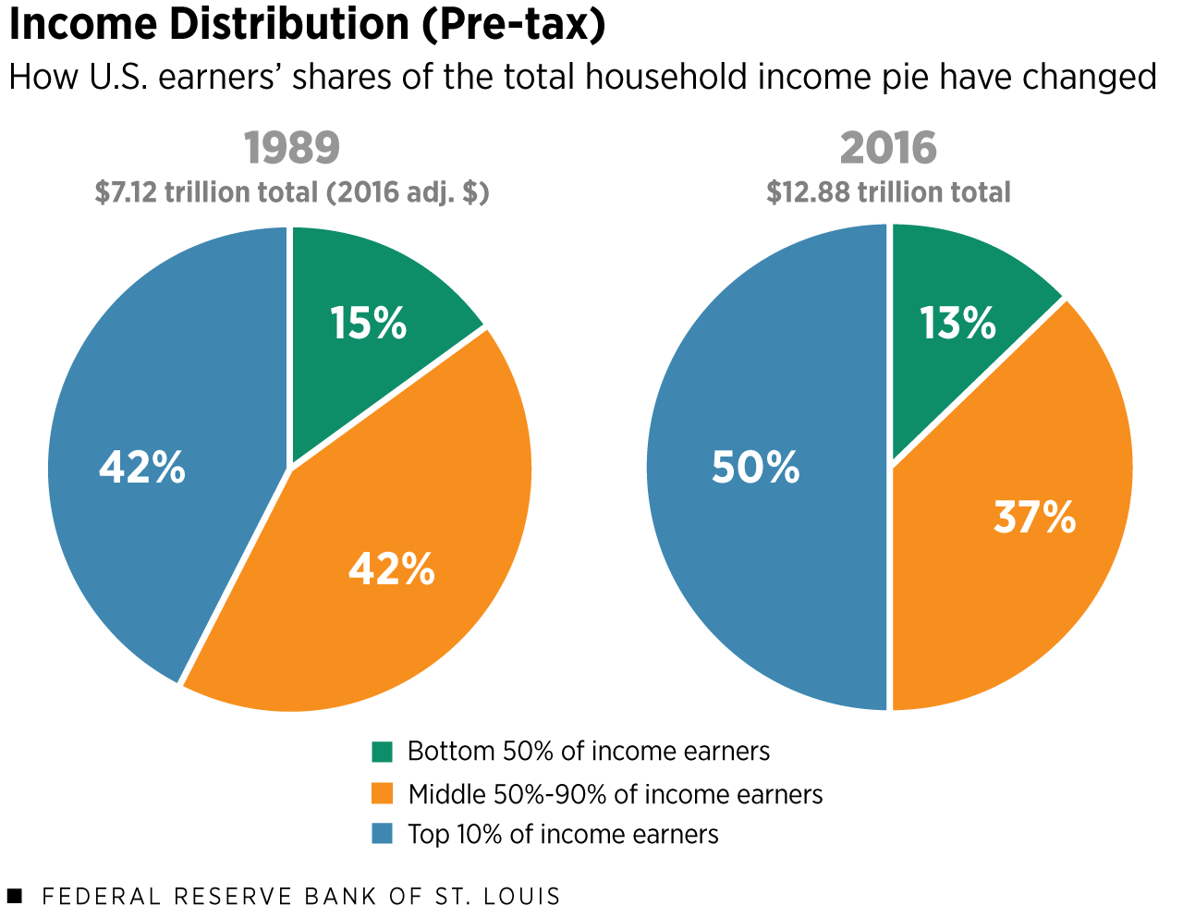

Slide 20
3. Income redistribution: goal: to lift ppl out of poverty
a. Welfare (TANF)
1. cash, food stamps, public housing, school lunches
2. policymakers try to help ppl transition from welfare→self-sufficiency by providing educ & job training
b. Unemp insurance

Slide 21
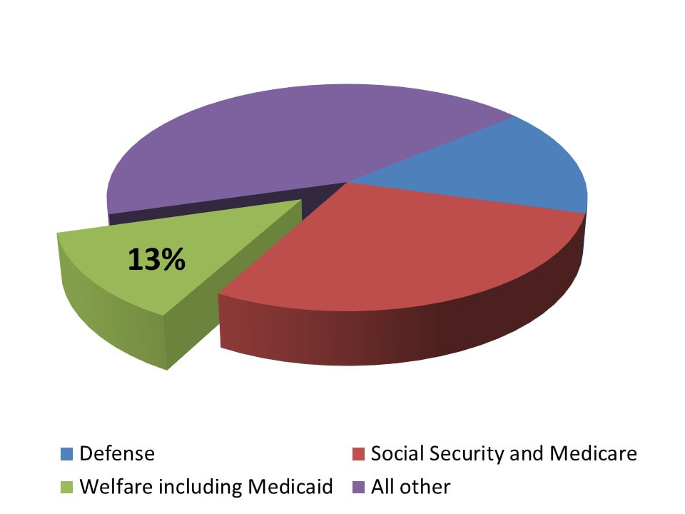

Slide 22
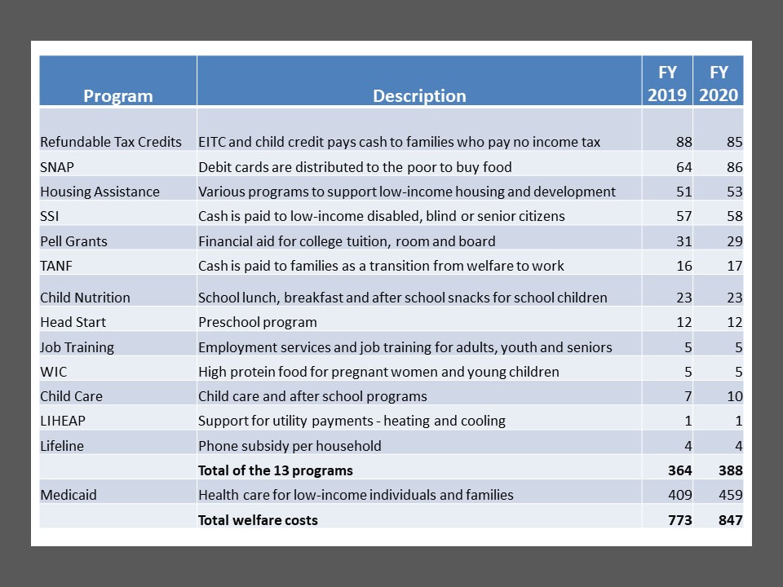

Slide 23
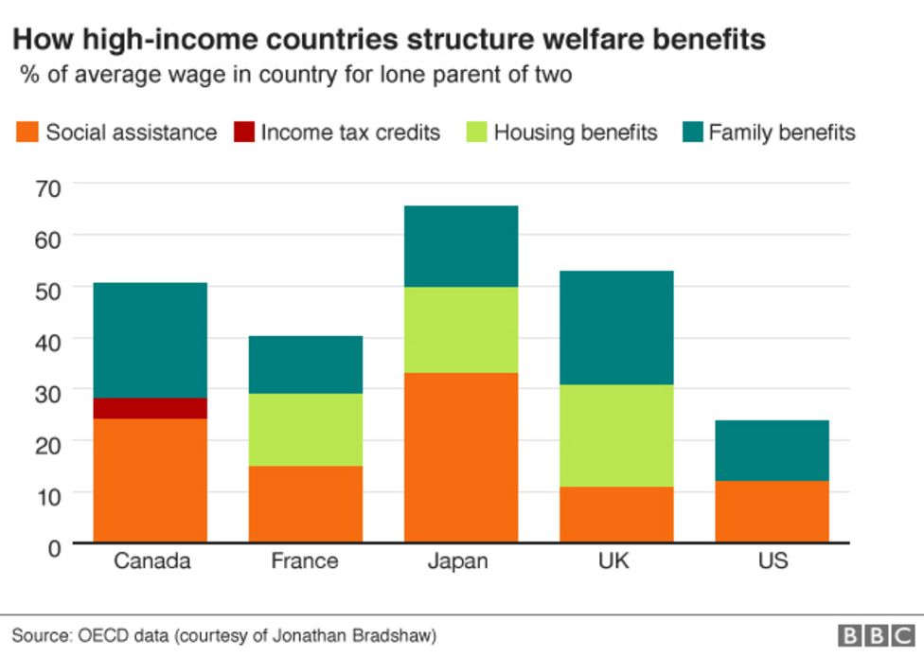

Slide 24
4. Consequences of anti-poverty policies
a. means tested programs: ppl have little incentive to get a job because they lose health & other benefits
b. critics warn that programs promote dependence & reduce ppl’s ability to become self-sufficient

