Slide 1

Chapter 8
Money, Banking, Saving and Investing

Slide 2
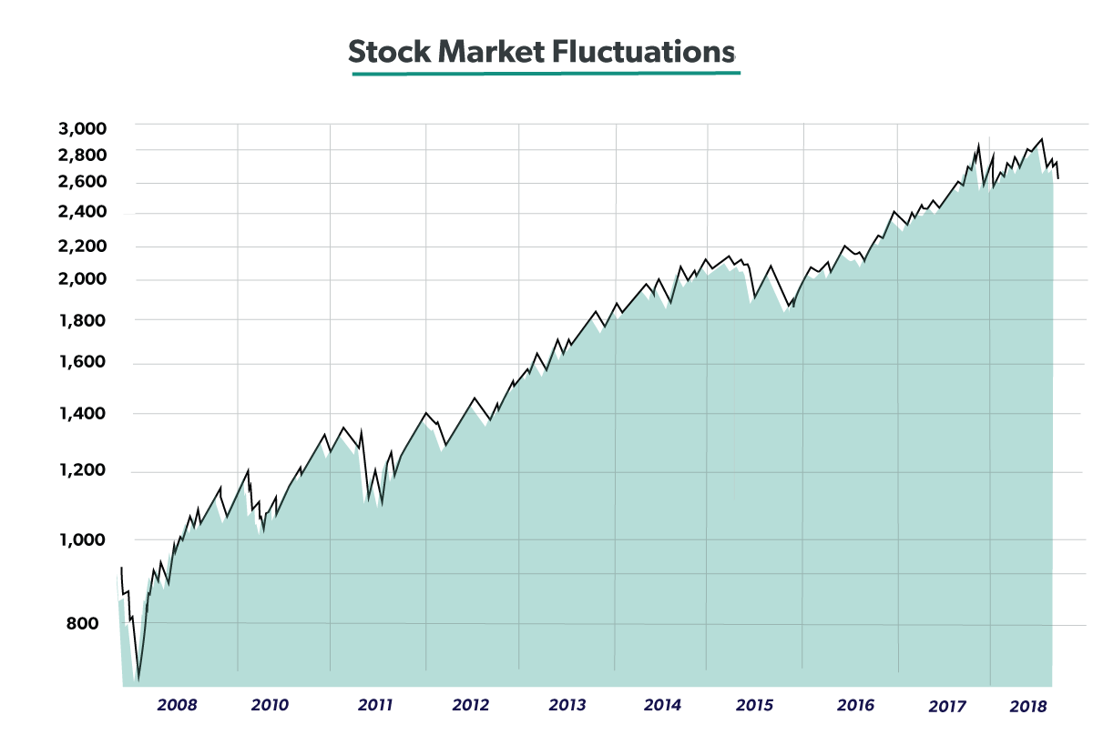
A. Stocks
1. shareholders: ppl who buy stocks
2. dividend: a portion of profits pd to shareholders
3. real rate of return: annual % of return adjusted for inflation

Slide 3
4. bull mkt: stock mkt up
5. bear mkt: stock mkt down
6. stock mkts: New York Stock Exchange (NYSE), NASDAQ
7. prospectus: financial info provided by a firm issuing stock in their company

Slide 4
B. Banking system: main function: bring together borrowers & savers
1. deposits
a. checkable (write a check, like using cash), no interest
b. savings: less available to spend, more interest paid
c. time (Certificate of deposit or CD): earns the most interest, can’t take it out without penalty

Slide 5
2. loans
a. commercial loan: usually to buy property or new equipment for business
b. consumer: usually for cars or expensive items
c. mortgage: to buy real estate

Slide 6
3. Federal Reserve
a. plays an important role in controlling $ supply
b. primary customers: private banks
c. fractional reserve banking: banks keep a portion of deposits in reserve & make loans with the rest

Slide 7
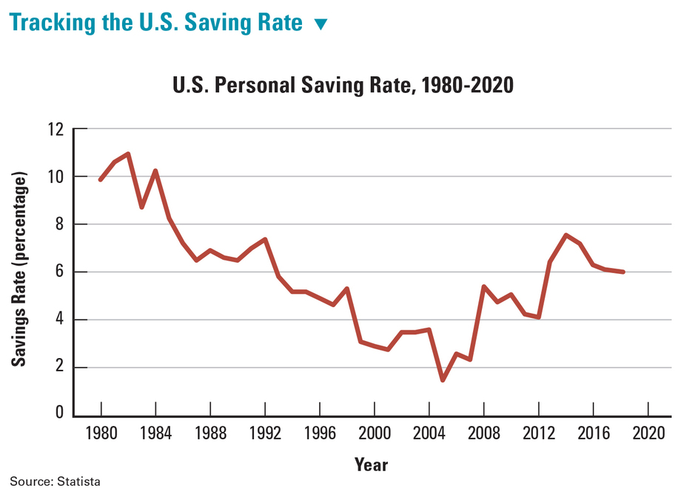
C. Benefits of saving $ (average 6% in US)
1. can help you reach important goals
2. can help you weather hard times

Slide 8
3. can help you fund retirement (most ppl need all 3 below)
a. Social security
b. personal savings
c. company funded plans
d. helps the economy grow (personal savings provides funds for business investment)
e. best way to save: put “savings” into your monthly budget

Slide 9
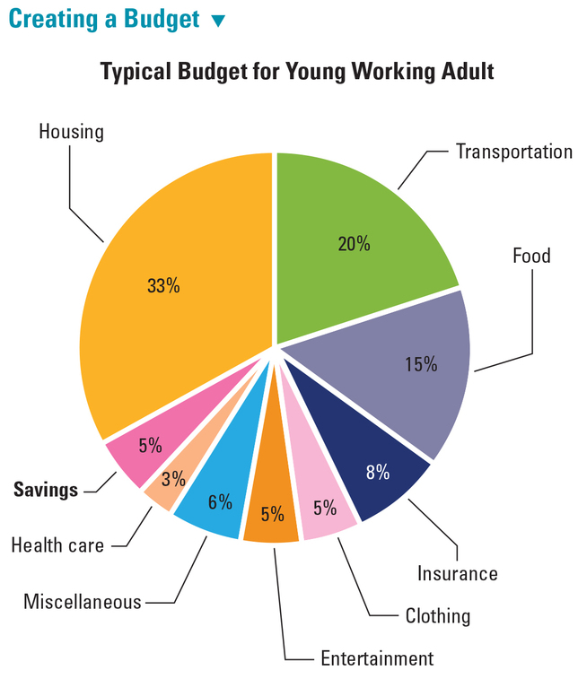

Slide 10
D. Investing your savings
1. an investment that has a high potential to make $ also has a high risk for loss
2. Securities (stocks & bonds); generally 8% profit
3. compounding interest: the ability of an investment to generate earnings that can be reinvested to earn still more earnings

Slide 11
4. Rule of 72: 72 = 18yrs 4% Interest rate
5. govt bonds: low risk investment, low return
6. junk bonds: high risk investment (company might fail), high return

Slide 12
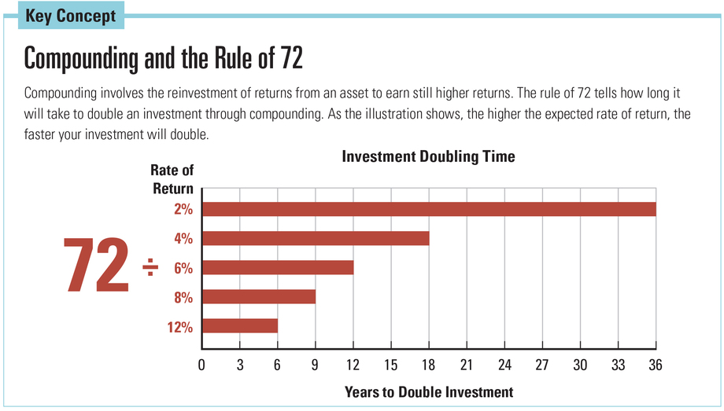

Slide 13
E. Mutual funds
1. a collection of securities chosen by a group of professional fund managers
2. benefit: diversification which reduces risk, less risky than buying individual stock
3. market index: measures changes in the value of a group of stocks, bonds, etc. (ex Dow Jones Industrial, S & P 500)
4. asset allocation: can choose high risk or low risk

