Slide 1
Chapter 6
Markets, Equilibrium & Prices

Slide 2
A. Market equilibrium
1. The amount of a product sold matches the amount ppl want to buy (watermelon example)

Slide 3
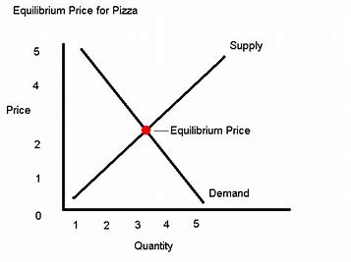
2. Equilibrium price: when buyers purchase exactly how much sellers are willing to sell

Slide 4
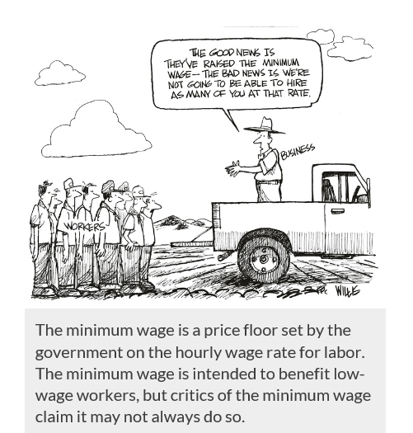
B. Role of prices: prices allocate scarce resources efficiently
C. Govt intervention (price controls)
1. economists say they are inefficient

Slide 5
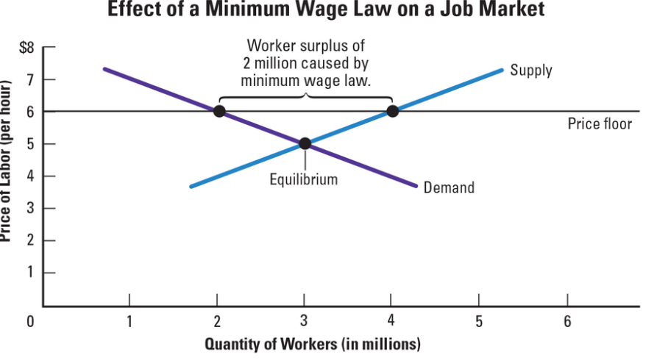
2. Price floor: govt sets minimum price consumers can pay for a good or service
a. example: minimum wage (the lowest amount that can be legally paid to wkrs for an hour of work)
b. causes a surplus

Slide 6
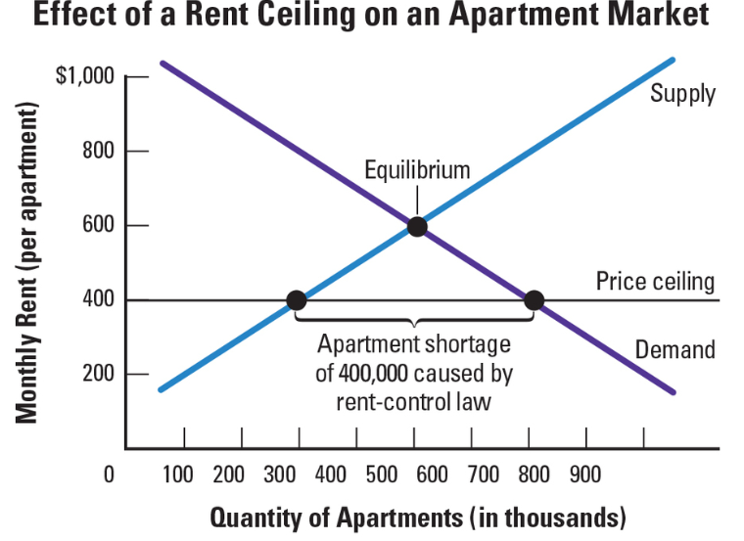
3. Price ceiling: govt sets a maximum price consumers can pay for a good or service
a. example: rent control
b. causes a shortage

Slide 7
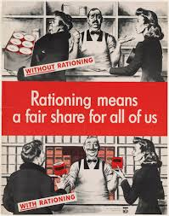
C. Rationing
1. govts impose rationing when essential are in short supply (flour, oil, gas) (ex. WWII)
2. purpose: to make sure everyone has access to scarce goods

Slide 8
D. Difficult to end price controls
1. there is public pressure to intervene when prices rise or fall quickly
2. ppl believe price controls lead to equity
3. politicians do not want to end price controls if voters support them

