Slide 1

Chapter 3
Economic Systems

Slide 2
A. Economic questions (economic systems decide)
1. What to produce?
2. How to produce?
3. For whom to produce?

Slide 3
B. Economic goals
1. Freedom (laissez-faire: producers & consumers are relatively free from govt intervention) (mkt econ)
2. Efficiency (mkt econ)
3. Equality (command)
4. Growth (mkt)
5. Security (command)
6. Stability (traditional)

Slide 4

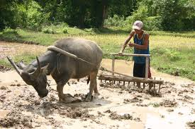
C. Types of economies
1. Traditional: ppl do what ancestors did

Slide 5
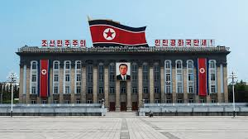
2. Command economy (Socialist/Communist): govt decides who produces how much of what (ex. N Korea)
a. govt owns land & capital & everyone has a job
b. central planners could not manage every detail→shortages, long lines for food & necessities (ex. Soviet Union)

Slide 6
3. Market economy (free enterprise system)
a. individuals own the factors of production & decide what to produce & how much
b. govt protects property rts & enforces contracts
c. sellers motivated by profit motive

Slide 7
D. Mixed Economic Systems (ex. US, Canada, China)
1. Most successful economies are mixed(Australia is freest economy, China: command →mkt)

Slide 8
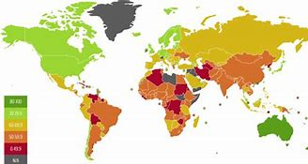

Slide 9
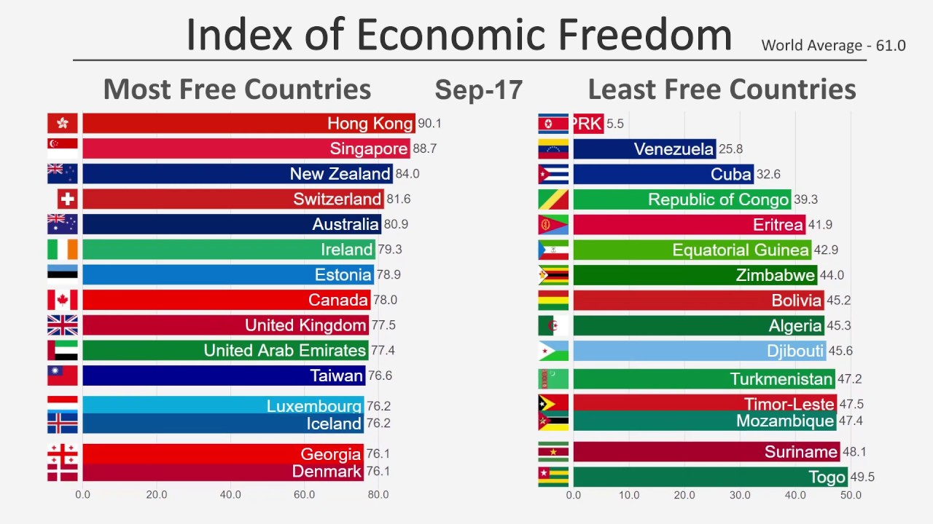

Slide 10
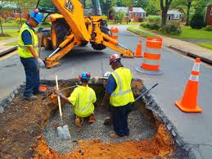
2. Need govt intervention (regulations are sometimes expensive to implement) to provide the things the marketplace does not
a. public works
b. social safety net (ex transfer payments like Soc Security)

Slide 11

3. Protects property, including intellectual property:
patents & copyrights encourage innovation by guaranteeing that inventors & artists can profit from their creations

