Slide 1

Chapter 2
Economic Decision Making

Slide 2
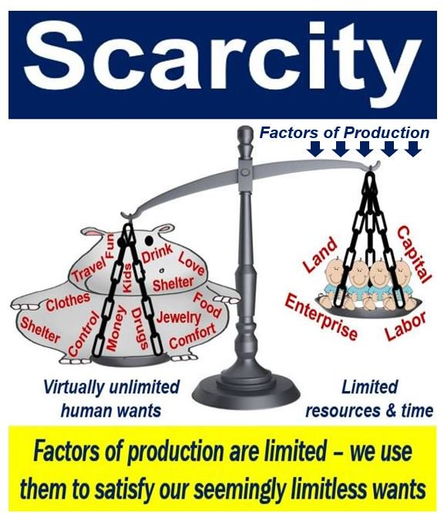
A. Scarcity
1. wants are unlimited, resources are limited
2. scarcity occurs when there are limited resources to meet unlimited wants (permanent)

Slide 3
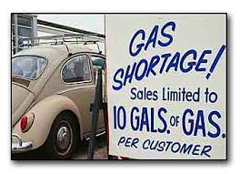
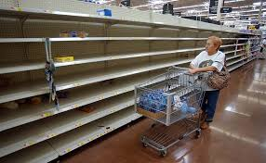
3. shortage: when a good or service is unavailable; temporary increase in demand causes a shortage

Slide 4
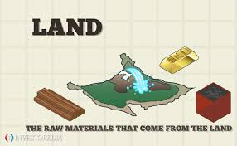
B. Factors of production
1. Land: natural resources used to produce goods & services

Slide 5
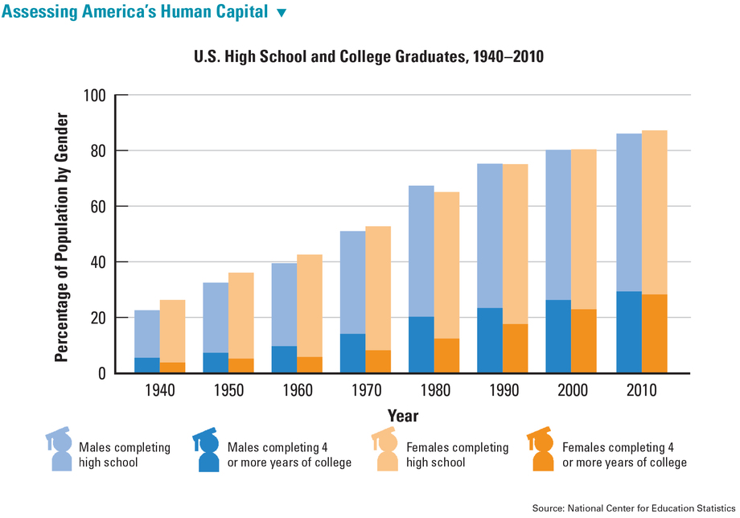
2. labor: (human capital) A country with more human capital is a richer nation

Slide 6
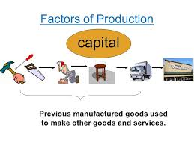
3. capital: tools, machines, buildings

Slide 7
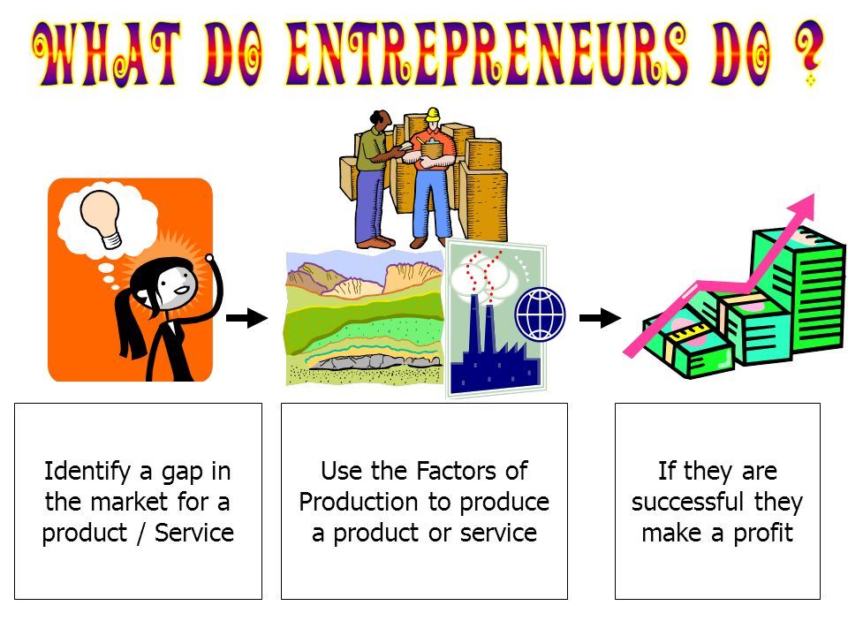
4. entrepreneurship: an entrepreneur is an innovator, strategist & risk taker

Slide 8
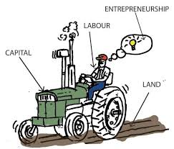

Slide 9
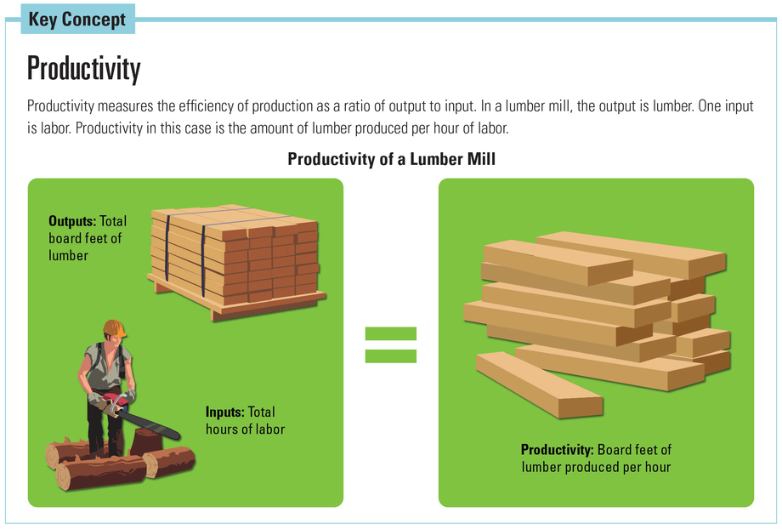
C. raising productivity: give less input for the same output or same input for more output

Slide 10

D. Deciding what to give up
1. Opportunity cost: the value of the best thing we give up when we choose

Slide 11
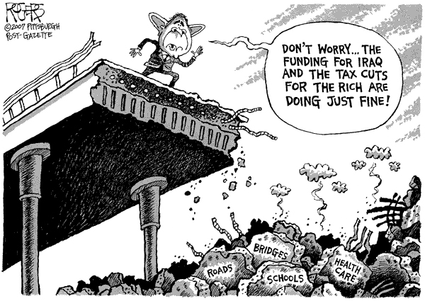

Slide 12
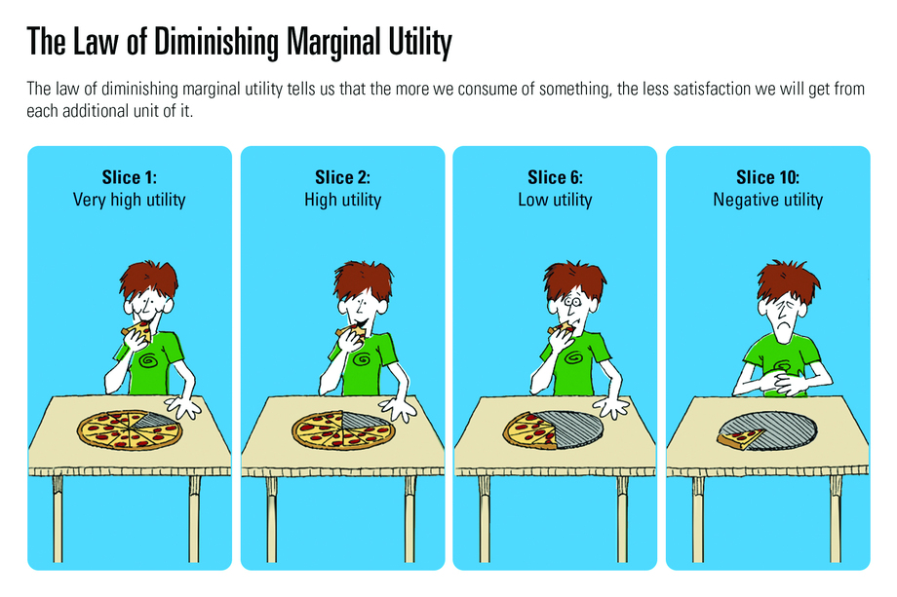
2. marginal utility: the increase in satisfaction you get from one additional unit of a good or service
3. law of diminishing marginal utility: if the quantity of the good increases, the marginal utility decreases

Slide 13
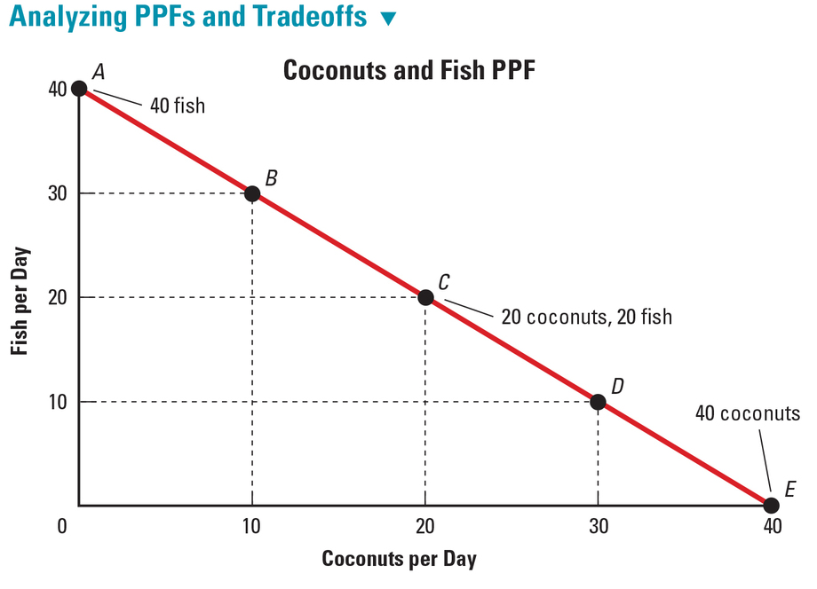
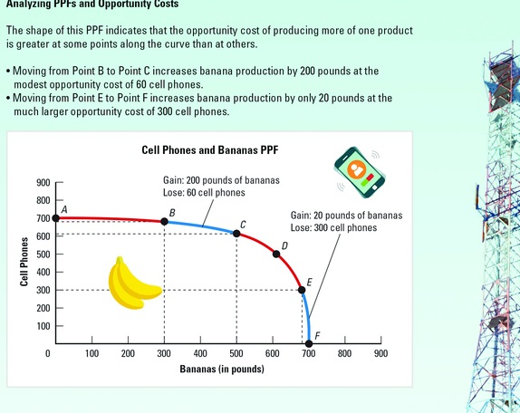
E. Production Possibilities Curve or Frontier
1. an economic model in the form of a line graph that shows how an economy might use its resources to produce 2 goods & services
2. the line or frontier shows the most efficient production

Slide 14
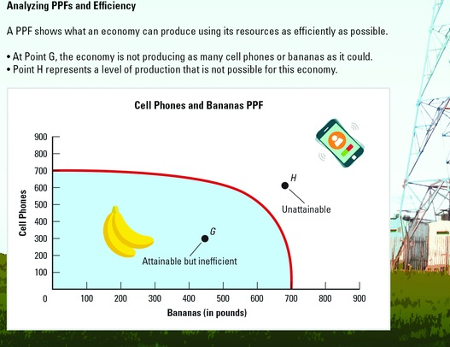
3. outside the curve: unattainable production
4. inside the curve: inefficient production

Slide 15
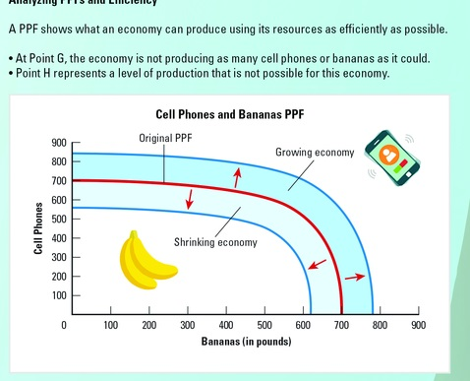
5. economy grows→ curve shift right
6. economy contracts→ curve shifts left

Slide 16
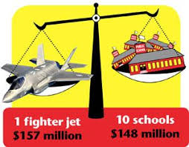
7. guns vs. butter example: we can produce more for military or more for consumers

Slide 17
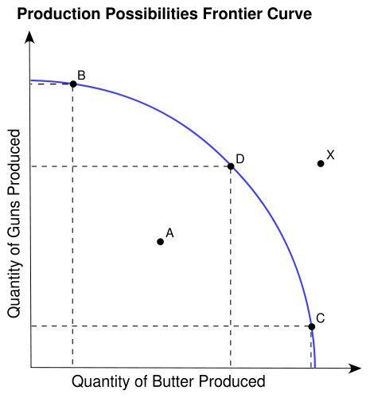
max output due to efficient use of resources
max output due to efficient use of resources
unattainable output given available resources
underutilization or inefficient use of resources
max output due to efficient use of resources

