Slide 1
Chapter 1
An Economic Way of Thinking

Slide 2
A. Economy: the system that manages limited resources
1. macroeconomics: workings of economy has a whole (stk mkt, empl rate, etc)
2. microeconomics: individual household decisions
3. economic enigmas: puzzles or riddles explained by econ analysis

Slide 3
B. Adam Smith
1. Competition results in more choices for consumers
2. the regulating force in a free market system is competition
3. invisible hand: the power of markets to provide goods & services at prices ppl are willing to pay

Slide 4
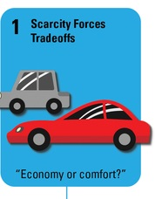
C. 7 Principles of economics
1. scarcity forces trade off
2. cost vs. benefit analysis

Slide 5
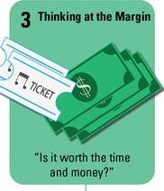
3. thinking at the margin (marginal benefit: what you gain by adding or subtracting one more unit)
4. incentives matter

Slide 6
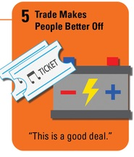
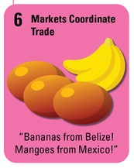
5. trade makes ppl better off
6. mkts coordinate trade (Mkt: a place where buyers meet sellers; can be a sm store, online, etc.)

Slide 7
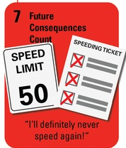
7. future consequences count

Slide 8
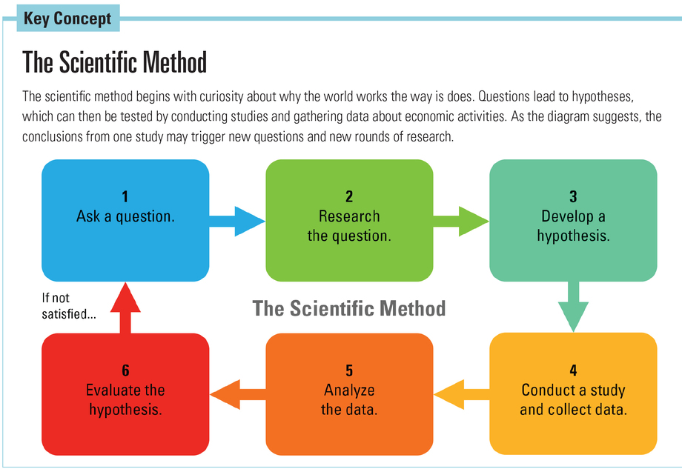
D. Studying economics
1. scientific method

Slide 9
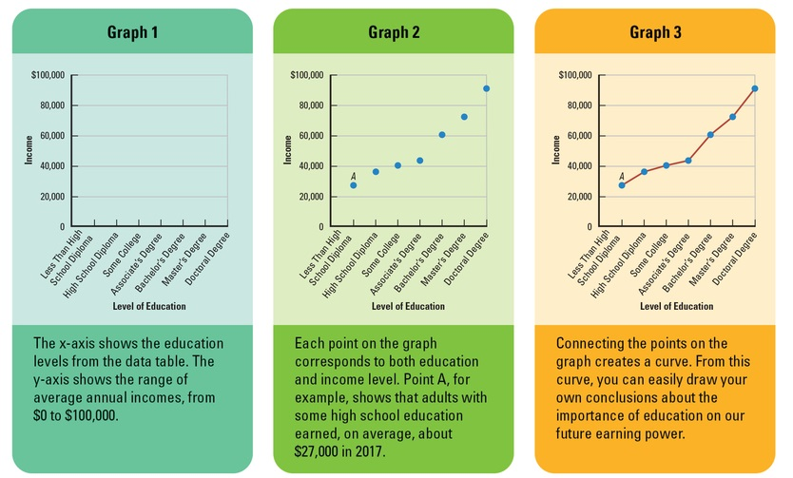
2. graphs

Slide 10
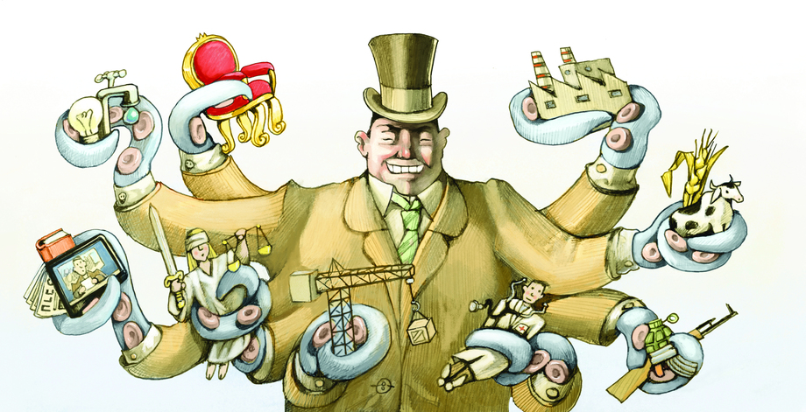
3. economic models (explain past events, predict future events)

