Slide 1


Byzantine cultural life was based on the traditions of these two ancient civilizations

Slide 2
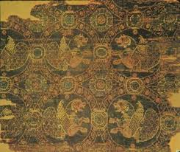
The primary exports in the Byzantine Empire were cloth, carpets & this

Slide 3
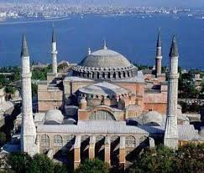
Colored mosaics, painted icons & these were strengths of Byzantine culture

Slide 4
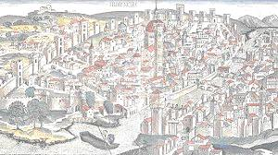
This class was large & wealthy but was less powerful than the bureaucracy

Slide 5
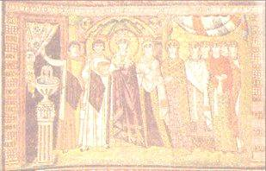
The Byzantine bureaucracy was like this country’s because it was open to talented commoners

Slide 6
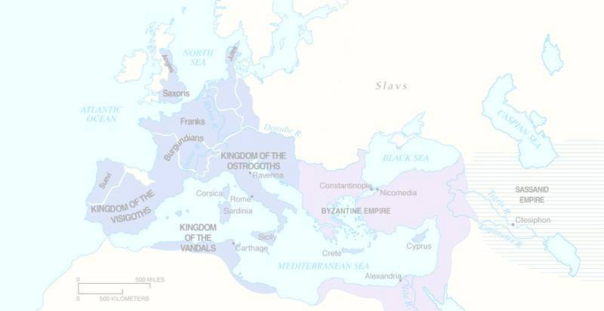
The Byzantine government recruited troops by giving them this in return for military service

Slide 7
After the seventh century, this group threatened the Byzantine Empire

Slide 8
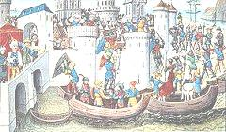
Merchants from this city rerouted crusaders to attack Constantinople during the 4th Crusade

Slide 9
This city was the only major urban area & economic center during the Byzantine era

Slide 10
Constantine moved the eastern capital in this century to protect the richest part of the Roman Empire

Slide 11

This empire lasted a thousand years, estab a cultural center in
Constantinople, & spread culture to Russia & the Balkans

Slide 12
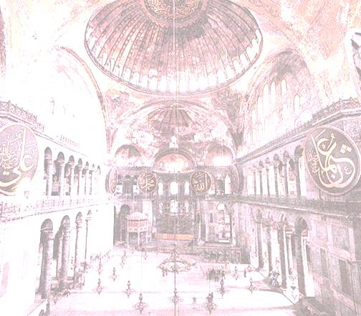
The Byzantine empire began with the estab of this city

Slide 13
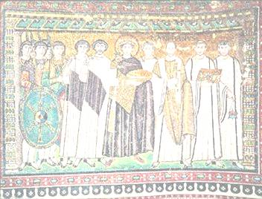
The result of this ruler’s wars were more taxes, reconquest of N Africa & Italy, estab of a cultural center & a weaker defense in the East

Slide 14
The result of war with Arab Muslims was higher taxes & a loss of land for this group

Slide 15
The Byzantine bureaucracy employed eunuchs, was influence by aristocrats & hired lots of these to make sure ppl were loyal

Slide 16
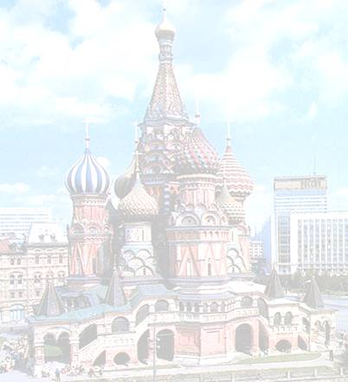
Russians were converted by their ruler to this type of Christianity

Slide 17
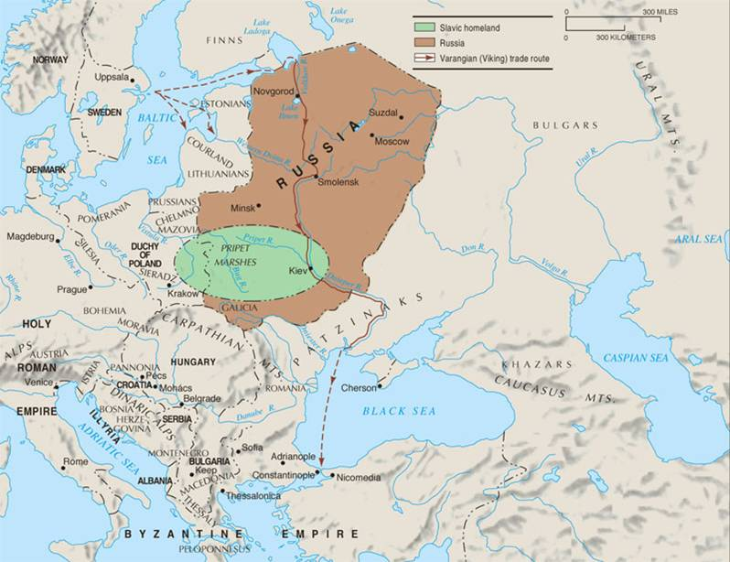
This region’s religious, cultural, social & economic patterns developed separately from Western Europe

Slide 18
The invasion of this group did not threaten the Russian nobility or the Eastern Orthodox faith

Slide 19
This Christian church was controlled by the state. It outlawed icons, then gradually restored their use

Slide 20
Vladimir I feared this in Roman Catholicism and chose Eastern Orthodox instead

Slide 21
Bread and this were the major issues in the disagreement between E and W when the churches split in 1054

Slide 22
Both Eastern & Western Europe replaced animism with monotheism, had a Greco Roman past & spread this faith

Slide 23
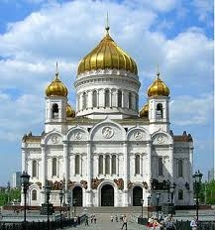
The Russian Orthodox Church adopted the use of Greek & Slavic languages, monasticism & the veneration of these

Slide 24
Form of Christianity that emerged in the Byzantine Empire & has different organization & culture than the Roman church is called this

