Slide 1
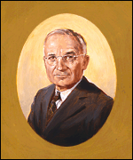
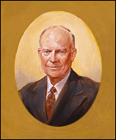
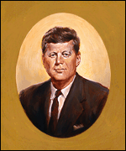
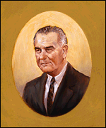
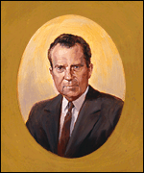
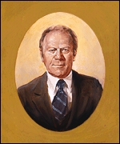
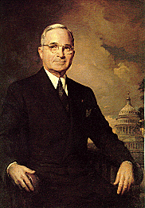
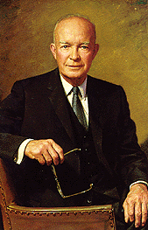
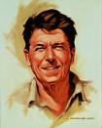
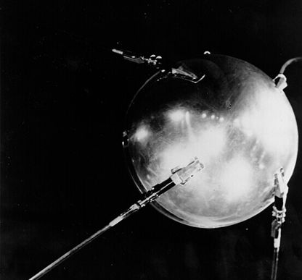
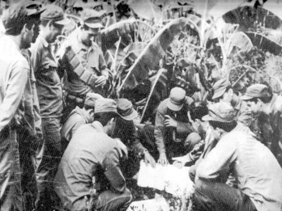
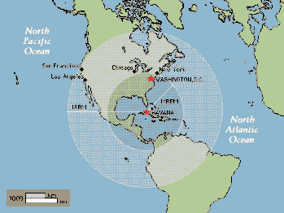
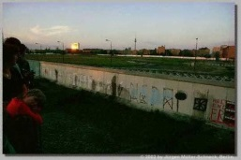
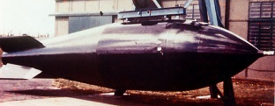
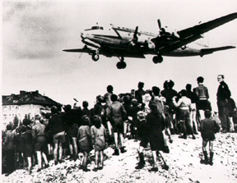
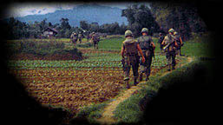
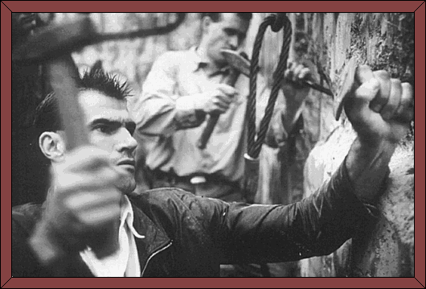
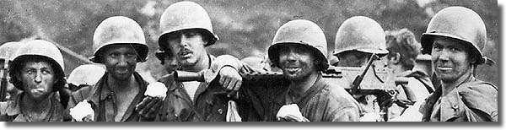
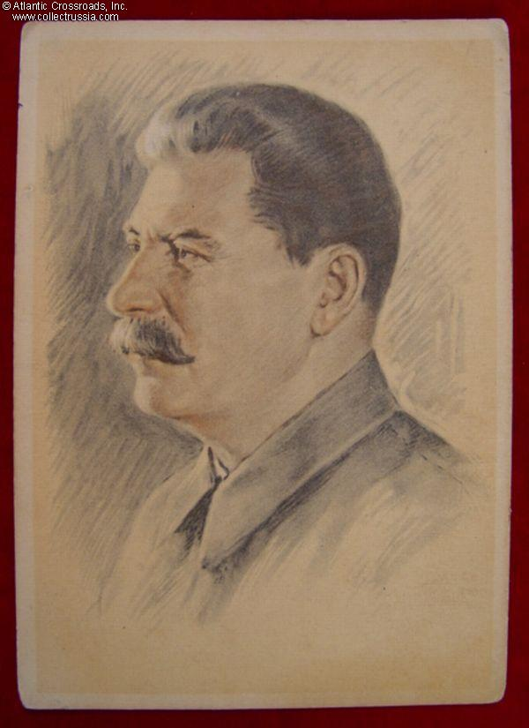
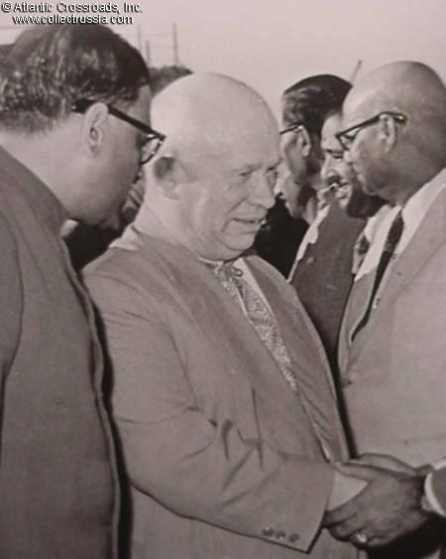
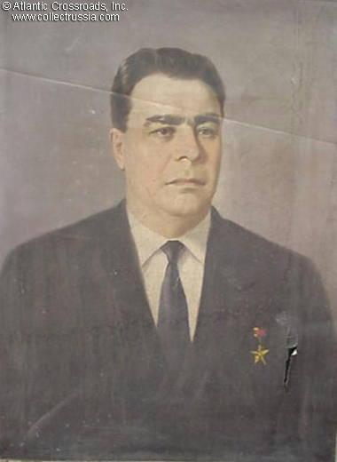
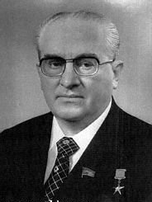
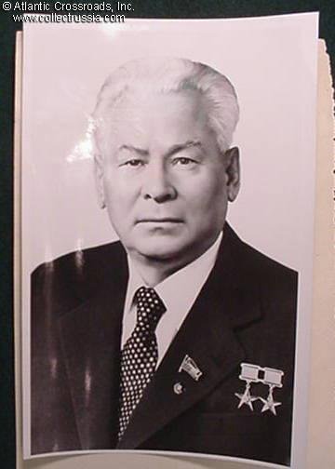
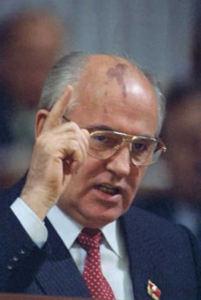
Cold War

Slide 2
Harry Truman
33rd President of the United States
Strong belief in containing Communism. Keep communism from spreading.
Demonstrated by U.S. involved in:
  the Berlin Airlift,
  NATO,
  Marshall Plan,
  Truman Doctrine.
U.S. President
from 1945-1953

Slide 3
Dwight Eisenhower
34th President
Obtained a truce in Korea and while trying to ease the tensions of the Cold War,
Increased tensions with Eisenhower Doctrine – becoming involved in the middle east
"America is today the strongest, most influential, and most productive nation in the world."
U.S. President from
1953 -1961

Slide 4
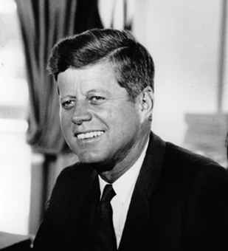
John F. Kennedy
35th President
Aggressive role in the Cold War.
Started American involvement in Vietnam,
the Cuban MissileCrisis, and
the Bay of Pigs invasion of Cuba,
President when the Berlin Wall is built.
U.S. President from
1961-1963

Slide 5
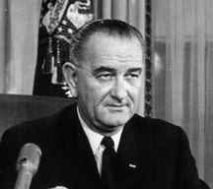

Lyndon B. Johnson
36 President hours after the assassination of John F. Kennedy.
During re-election campaign, Johnson promised to withdraw troops from Vietnam.
However, violated campaign promises and increased U.S. involvement in Vietnam, for fear he would be the first President to lose a war.
popularity plummeted and he did not run for re-election.
President from
1963 - 1969

Slide 6
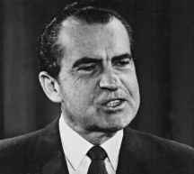
Richard M. Nixon
37th President
Carried out Vietnamization plan ending the war and removed American troops from Vietnam.
Negotiated and signed the SALT treaty limiting the amount of missiles the US and USSR have.
President from 1969 - 1974

Slide 7
Gerald Ford
38th President.
In foreign affairs acted vigorously to maintin U. S. power and prestige after the collapse of Cambodia and South Vietnam.
Preventing a new war in the Middle East remained a major goal;
  By providing aid to both Israel and Egypt,
  Helped persuade the two countries to accept a truce agreement = Not fight.
Detente with the Soviet Union continued.
  With Soviet leader Leonid I. Brezhnev set new limitations upon nuclear weapons.
1974-1977

Slide 8
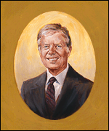
Jimmy Carter
39th President
Championing for human rights was coldly received by the Soviet Union and some other nations.
Established full diplomatic relations with the People's Republic of China
completed negotiation of the SALT II nuclear limitation treaty with the Soviet Union.
Setbacks, The Soviet invasion of Afghanistan caused problems
  suspended plans for ratification of the SALT II pact,
  U.S. boycott of the 1980 Olympic Games.
1977-1981

Slide 9
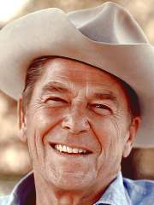
Ronald Regan
40th President
Synonymous with America in the 1980s.
Attacked the Soviet Union = “Evil Empire.”
Increased defense spending, focusing on new missiles, new bombers, and subs that could carry nuclear weapons. In
1983 announced the Strategic Defense Initiative (SDI) = “Star Wars.”
  SDI creation of a satellite shield in space to destroy and intercept incoming missiles.
  challenged the Soviets to increase the Arms Race knowing they couldn’t compete with U.S. productivity.
Helped to end Cold War
President from
1981 - 1989

Slide 10
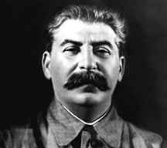
Joseph Stalin
A ruthless dictator,
First Cold War Soviet Premier.
Start of the Cold War from actions at the Yalta Conference.
Promoted, distrust and competition between East and West.
Aggressive against other nations to spread communist and Soviet agenda
Elevated tensions between East and West escalating the Cold War.
Joseph Stalin was leader of the Soviet Union from 1926 until 1953.

Slide 11
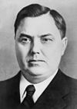
Georgy Malenkov
1953 -1955
Leader after Stalin
Forced to resign by Khrushchev

Slide 12
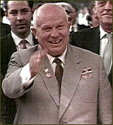
Nikita Khrushchev
Khrushchev elevated tensions by allowing the building of the Berlin Wall
Provided funds and materials to communist North Vietnam during the war.
Presided over the Cuban Missile Crisis in part as a response to the Bay of Pigs.
Kennedy’s main adversary throughout his presidency.
leader of the Soviet Union
from 1955 till 1964 when he was fired.

Slide 13
Leonid Brezhnev
Created "Brezhnev Doctrine," = Moscow's right to intervene in the affairs of other socialist states.
Supported those against the U.S. around the world; Vietnam, the Middle East and the Third World.
Peace was declared in 1972, when he and President Nixon signed the SALT treaty, but it was short-lived.
By 1979, approved the Soviet invasion of Afghanistan.
Spent on defense and aerospace industries, at the expense of agriculture and economy,
economic productivity and the standard of living fell into a slow but steady decline.
1964-1982

Slide 14
Yuri Andropov
Ruled for only15 months before his death,
Tried to improve the efficiency of the Soviet economy.
Remained in the war in Afghanistan.
Tried to persuade Europe not to allow U.S. President Reagan to station missiles in Germany.
1982 15 months – Hospitlized

Slide 15
Konstantin Chernyenko
February 1984 -1985 till his death
Prepared the ground for his protégé: Mikhail Gorbachev.
Turn to production of consumer goods
Loosened Andropov's strict political control.

Slide 16
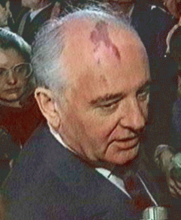
Mikhail Gorbachev
From the start, strives for reforms.
Two key phrases of the Gorbachev era:
  "glasnost" (openness)
  "perestroika" (reform).
Realized the Soviet Union could not compete,
Wanted an end to the arms race with the West.
Caused tension in the Soviet Union. Between reformer and conservatives
Soviet Leader from
1985 – 1990
Wins Nobel Peace Prize for helping to end the Cold War. 1990

Slide 17

Nuclear Weapons
On July 16, 1945 U.S tests first atomic bomb and use it on Japan August 6, and 9th
Forces U.S. and U.S.S.R to consider the use of their nuclear weapons carefully.
Two sides compete to become more powerful than the other = arms race.
Both become so powerful that they could destroy the whole world. = MUTUAL ASSURED DESTRUCTION

Slide 18
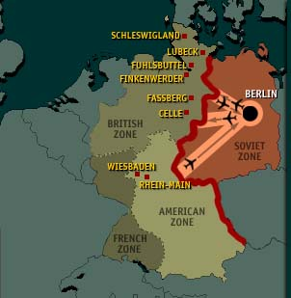

Germany Divided
1945 Stalin, Churchill, and Roosevelt meet at the Yalta Conference to discuss what will happen next.
Decide on free elections in Poland and divide up Germany into 4 zones.
  The U.S, Britain, and France = West. Western Germany was democratic while
  Eastern Germany = Stalin’s control and communist.

Slide 19
BERLIN AIRLIFT
After World War II. Each Ally controlled a zone in Germany, and Berlin, which was surrounded by the Soviet zone.
Cooperation brakes down in 1947 and early 1948.
Three Western powers decided to join together and create 1 West German government.
Soviets try to stop Allies by arassing Western traffic to and from Berlin
Lead to Berlin blockade and the allies flying in supplies to Berlin, = known as the Berlin Airlift.

Slide 20
THE KOREAN CONFLICT
North Korea and South Korea divided along the 38th parallel end of WWII.
North Korea invades South Korea 1950.
  Leader Kim Il Sung = communist and supported by the Soviet Union, and China.
South Korea and its leader Syngman Rhee were supported by the United States.
The UN authorized sending troops to help under the command of U.S. general Douglas MacArthur.

Slide 21
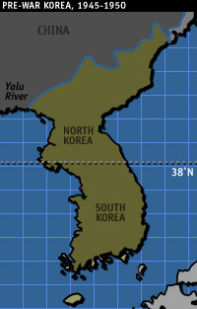
THE KOREAN CONFLICT
North Korea pushes South Korean all the way to the tip of Korea creating the Pusan Perimeter.
MacArthur’s troops pushes back out of Pusan all the way to the North.
  MacArthur ready to celebrate
  BUT the Chinese sent 1 million volunteers across and U.S. troops were pushed again back into South Korea
The war continued back and forth
Ended in a stalemate in June of 1953.
The U.S still has military in South Korea.

Slide 22

October 4, 1957 the Soviet Union launched Sputnik a communications satellite.
first man-made object ever sent into space.
kick off the space race and elevated Cold War tensions
Frightened U.S. citizens due to privacy concerns

Slide 23
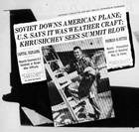
U-2 Incident
U-2 spy plane was designed to fly extremely high to not be detected.
But on May 1, 1960 the USSR shot down a U-2 Plane
The pilot Gary Powers was captured.
The U.S. denied it was spying and reported that Powers was studying weather and accidentally went into USSR air space.
The evidence proved that (U.S) Powers had been spying.
Khrushchev demands an apology and the U.S. stop future flights.
Eisenhower agreed to stop flights but did not apologize!

Slide 24

Berlin Wall
During the 1950’s an outflow of refugees from East Germany( Soviet controlled) move into West Germany (Allies controlled).
  10,000 to 20,000 people per year from 1950-1961. (100,000-200,000)
In November 1958, Khrushchev issues an ultimatum = Western powers have six months to agree to withdraw from Berlin and make it a demilitarized city.
The sides could not reach an agreement.
East Germany stockpiles materials for the building of the Berlin Wall.
Aug 13, 1961 at mid-night the wall went up. The city is closed off!

Slide 25

BAY OF PIGS
The Bay of Pigs was an unsuccessful attempt in 1961 to overthrow Fidel Castro’s regime.
Before invasion, the CIA destroyed parts of Cuba’s air force.
  The plan was to land at the Bay of Pigs with support from an anti-Castro force and overthrow Castro without anyone knowing that the U.S. was involved.
On April 17, 1961-1500 exiles with U.S. weapons landed at the Bay of Pigs.
They were meet by Fidel’s army with no back up.
It was a huge embarrassment for the Kennedy administration, because it did not work

Slide 26
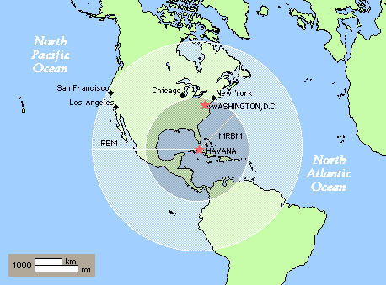
Cuban Missile Crisis
13 day stalemate in Oct. 1962.
The conflict was over Soviet supplied missile installations in Cuba.
The World’s Closest approach to Nuclear War.
First started when the United States discovered that Cuba had installed Soviet missiles capable of carrying nuclear weapons.
The United States responded by imposing a naval blockade of Cuba and demanded that the missiles be removed.
After negotiations the Soviets turned around and the missile were removed

Slide 27
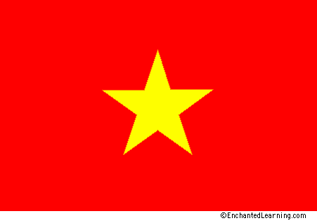
VIETNAM WAR
Started as a conflict between France and Vietnam.
In July 1954, France was forced to leave Vietnam.
The country was divided along the 17th parallel.
U.S. pledge that we would not allow any nation to fall to Communism.
  The U.S. supported President Ngo Dinh Diem of Vietnam.
  Soviets, and Chinese backed Ho Chi Minh.

Slide 28
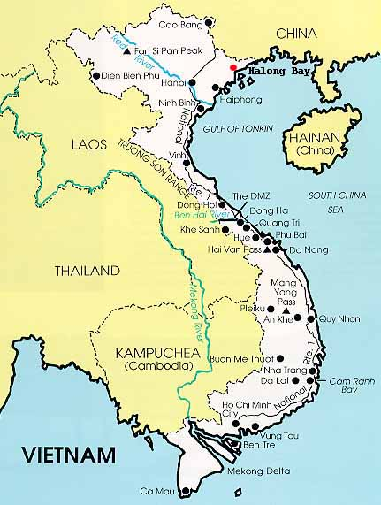
VIETNAM WAR
The first U.S. troops arrived in 1965.
US troops increased almost 200,000 in a year.
Also in February 1965, the US began regular bombing raids of North Vietnam, “Rolling Thunder”.
This was a tough battle, the South Vietnamese leadership was weak and unstable, and the desires of the people seemed to favor communism.
The war would continue until Nixon’s “Vietnamization” and the cease-fire that followed in January 1973.
But by April 1975 Vietnam fell to Communism

Slide 29
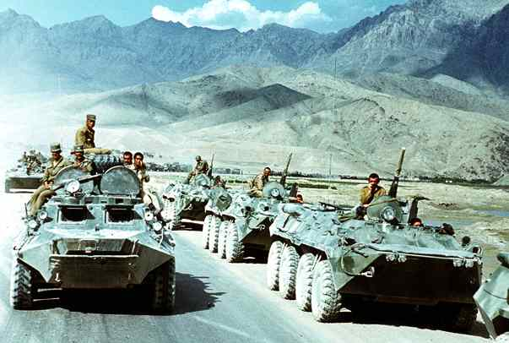
Afghanistan
1950’s Soviet Union influenced government
1979 Soviets invade afraid communist government will fall
Thought it would be quick but got stuck
US supported the rebels afraid communist would block oil
Gorbachev withdrew troops in 1989

Slide 30
FALL OF BERLIN WALL
November 9, 1989, the Border separating Western from Eastern Germany was effectively opened.
The days that followed large groups of individuals with their hands and with machinery, started physically tearing down the wall.
The Fall of the Berlin Wall AFTER STANDING FOR ALMOST 30 YEARS, will always be used as a symbol for the end of the Cold War.

