Slide 1

Latinos Unidos
Presenting on
Equality

Slide 2
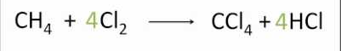
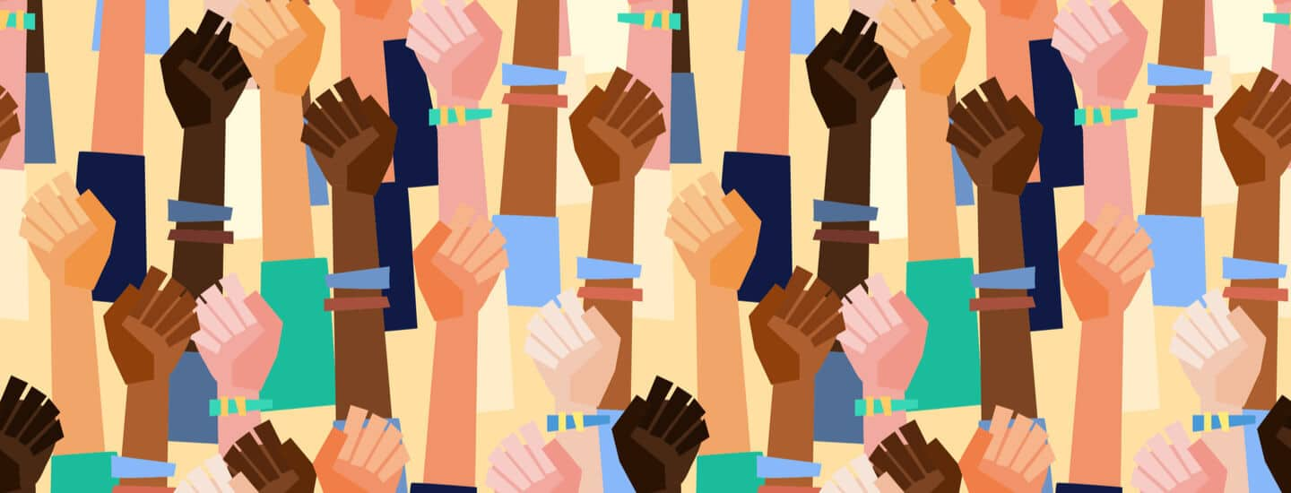
What is Equality?
a symbolic expression of the fact that two quantities are equal; an equation
-and-
the state of being equal, especially in status, rights, and opportunities

Slide 3
Different Types of Equality

Slide 4

Economic Equality
Economic equality is the belief that people should receive the same rate of pay for a job, regardless of race, gender, or other characteristics that are not related to their ability to perform the task.
Economic equality between men and women
Rich , poor or in between
Being taxed at the same rate
EVERYONE has the same access to the same wealth!

Slide 5

Social Equality
Social equality is when certain goods and responsibilities are divided evenly across a society
We have always had unequal divisions
divided based on factors such as gender, race and class, creating unequal societies
work to bring about equality for all people in society
Notes:
in the history of the Earth it has always had unequal divisions
work to bring about equality for all people in society so that these divisions do not create better opportunities for only a select few

Slide 6
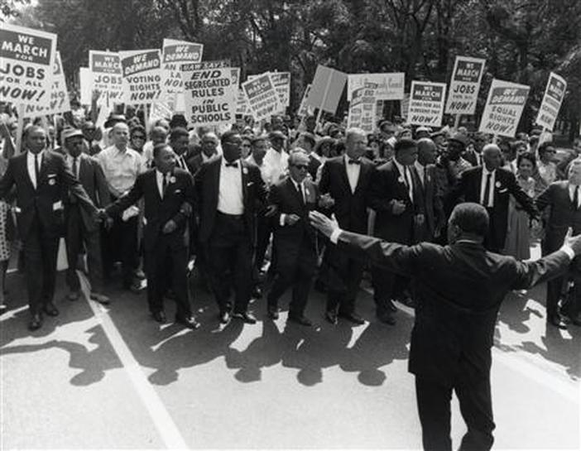
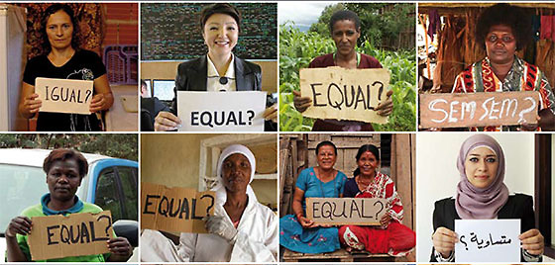
Political equality
Political equality is when society is equal with the political powers
There have been many people throughout time that have tried to make the political powers equal with society
An example is women’s right to vote, women had to stand up for themselves in order to be able to vote
There can’t be political equality without actual equality
In order to get political equality there can’t be any more discrimination, racism and injustice

Slide 7
Discrimination
Discrimination is when you judge or give prejudicial treatment to someone solely based off thier sex, race or age.
People of race such as Asian, Hispanic, European often face different types of discrimination.
Among these types are racial slurs, not being able to get a job, being looked down upon, or in general seen as a “ menace of society”
However what people don’t realize is that being ethnically different is actually a blessing. For example studies have shown that people who are bilingual have a quicker brain function and are easier to multitask at things. This causes alot of inequality between races and people
Before you think about making any of these, or even discriminating someone, think about “ why are you doing it?” and “ what would you do if someone made those about you?”

Slide 8

