Slide 1
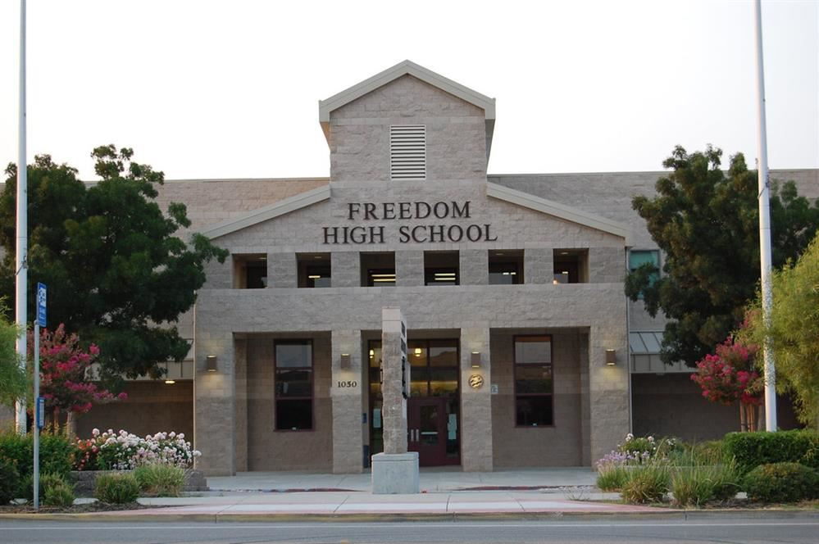
Welcome to Freedom High
School’s 8th Grade Parent Night
Principal : Steve Amaro
Principal: Dr. Steve Amaro
Notes:
Kelly

Slide 2
Our Mission: Freedom High School will provide a range of educational experiences for all students to acquire the key knowledge and skills to become critical and innovative thinkers who are college and career ready.
Our Vision:
  1. Be a Professional Learning Community which fosters innovation and enables students and staff to reach their maximum potential.
  2. Prepare all students for success after high school by offering challenging coursework with targeted student support.
  3. Provide a safe and nurturing environment designed around student needs which promotes respect for all.
  4. Provide multiple avenues for the community to participate in the education of our students.
Notes:
Kelly

Slide 3
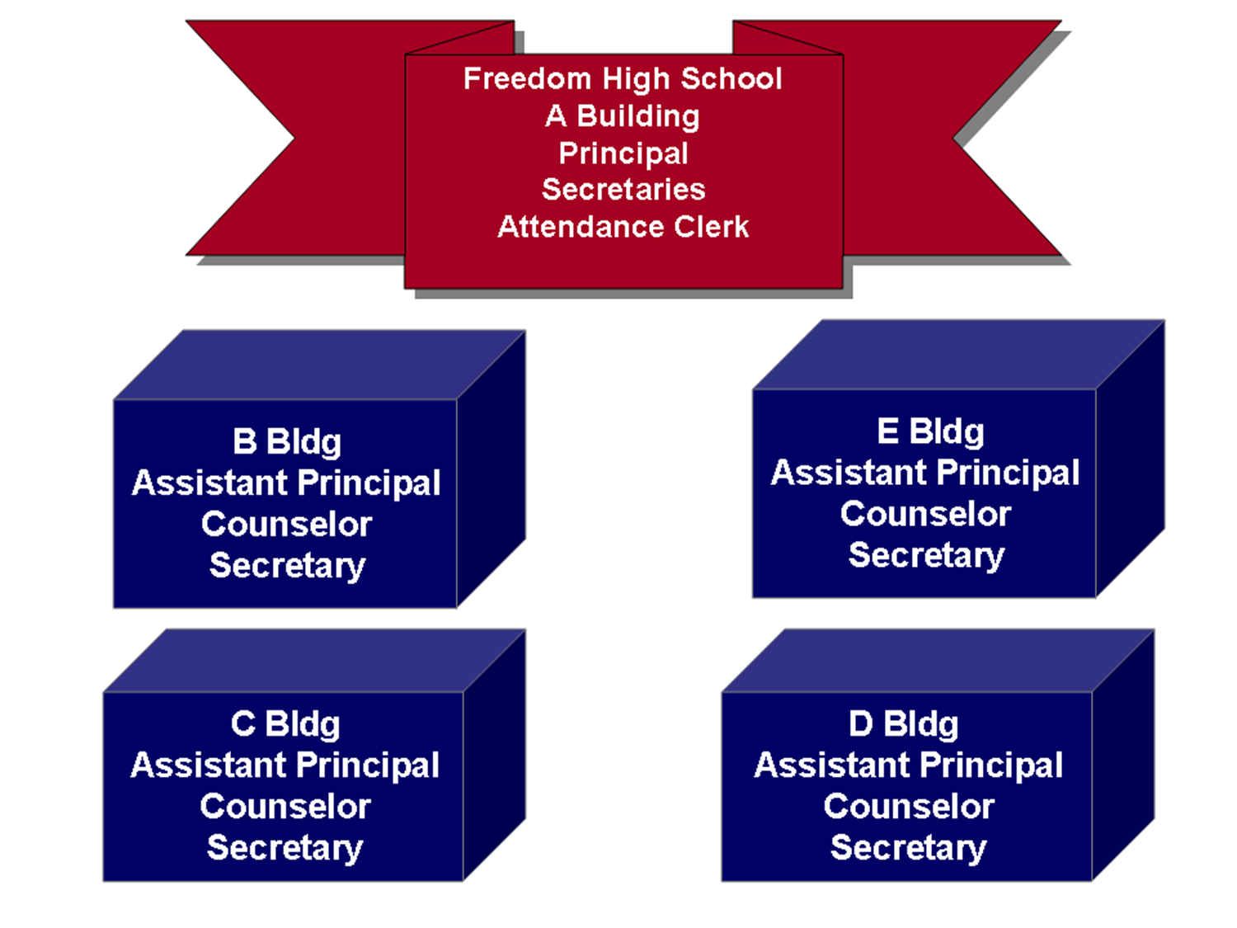
Your student will randomly be placed in one of four core building communities.
B, C, D or E
Your student will experience a smaller, more personal educational community while attending FHS.
Notes:
Frank

Slide 4
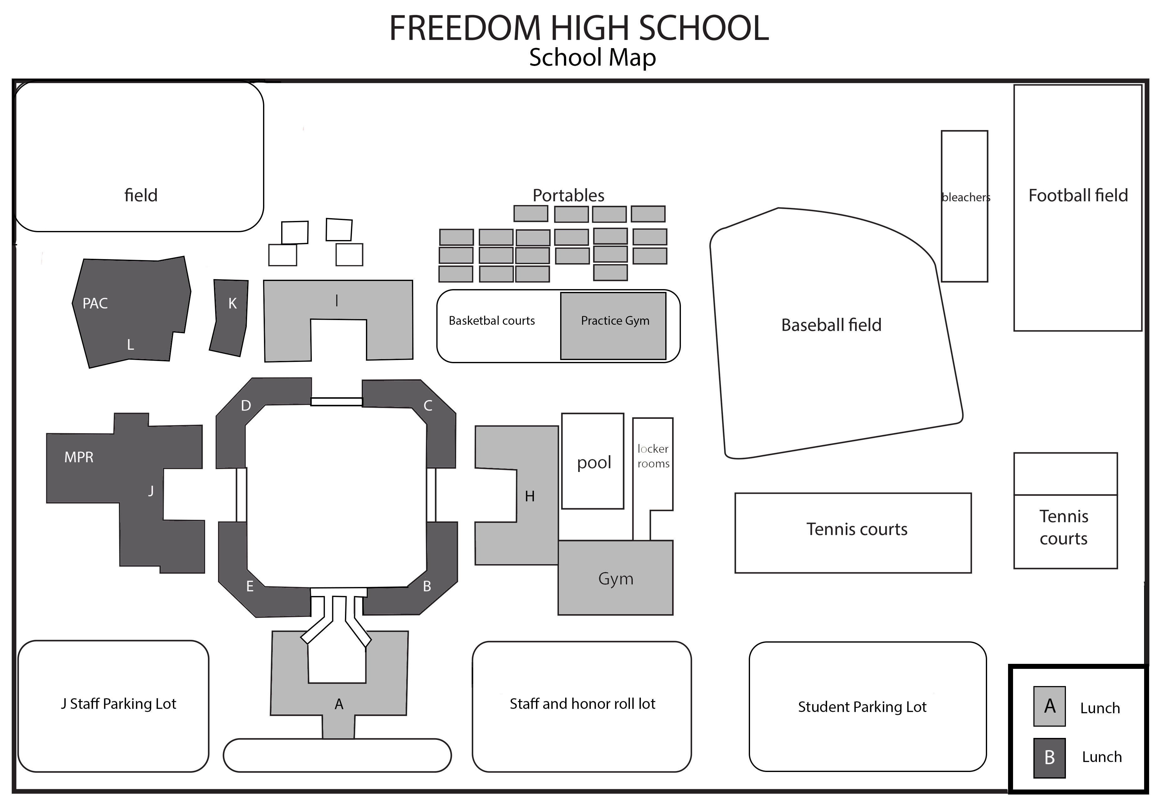
Notes:
Frank

Slide 5

Bell Schedule 2024-2025
2024-2025 Student start time is 8:30 am
Regular Rotating A/B Day M-W
Professional Development Day
Rally Schedule Day
Minimum Day
Finals Schedule Day
Traditional Day
Example
Regular Rotating Day
Time | A-Day | B-Day
8:30 - 9:59 | 1 | 5
10:06 - 11:38 | 2 | 6
11:38 - 12:08 | Lunch A | Lunch A
11:45 - 1:14 | 3B | 7B
12:15 - 1:44 | 3A | 7A
1:14 - 1:44 | Lunch B | Lunch B
1:51 - 3:20 | 4 | 8
PDD Late Start
Time | A-Day | B-Day
8:30 - 9:40 | PDD | PDD
9:40 - 10:51 | 1 | 5
10:58 - 12:14 | 2 | 6
12:14 - 12:44 | Lunch A | Lunch A
12:21 - 1:32 | 3B | 7B
12:51 - 2:02 | 3A | 7A
1:32 - 2:02 | Lunch B | Lunch B
2:09 - 3:20 | 4 | 8
Notes:
maria

Slide 6
What is a credit?
For each semester course your student passes they will earn 5.0 credits. Credits can also be referred to as units. Study Hall does not earn credit.
To pass a class your student must earn a D or better. If you receive an F, you will fail the class, and earn 0.0 credits.
Your student needs to earn 270 credits in specific subject areas to earn a Freedom High School diploma.
Notes:
maria

Slide 7

How can my student be successful?
Attend classes every day and be on time.
Complete all class work and homework.
Ask their teachers and family for help/attend after school Homework HELP in B119.
Stay informed.
Use their daily planner.
Develop healthy habits.
Notes:
Erricka

Slide 8
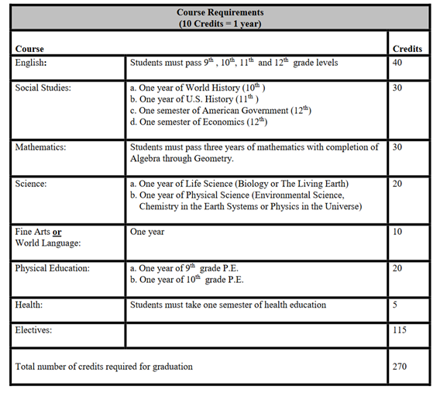

Graduation Requirements
Notes:
Erricka

Slide 9
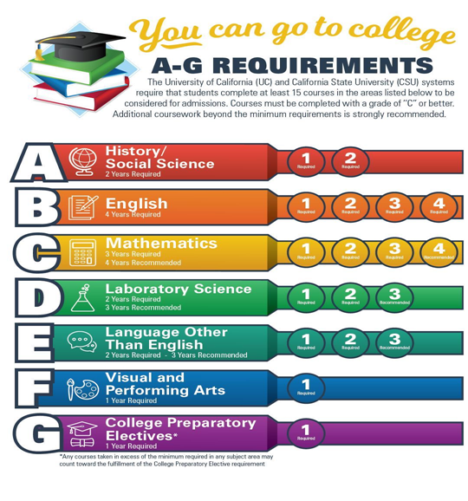
CSU/UC Admission Requirements
A-G are the college eligibility requirements, they are different from High School graduation requirements.
Refer to these courses if your student is planning on attending a 4-Year college after high school.
Students must earn C’s or better in these courses
UC’s are designed to accept top 12% of students academically and CSU’s top 33%
Notes:
Angela

Slide 10

The CA State Seal of Biliteracy
All students must complete 4 years of English and get a 3.0 or above overall GPA in those classes.
OR
Option 1: State Assessment: Pass the California Assessment with “standard met” achievement level.
Option 2: Advanced Placement (AP) Assessment: Pass an English AP examination with a score of 3 or higher (AP English Language and Composition, AP English Literature or Composition, or AP Seminar).
Option 3: International Baccalaureate (IB) Assessment: Pass an English IB examination with a score of 4 or higher.
Option 4: SAT: Achieve a score of 480 or above on the Evidence-Based Reading and Writing section

Slide 11


AP Human Geography
For students who want to take a challenging course, an Advanced Placement course called AP Human Geography is a college level course that is available to freshmen. This is in place of World Cultures.
Students must take the AP Exam in May at the end of the course.
Expect to spend 1-2 hours of homework per night for each AP class.
Notes:
Tracy

Slide 12

Career Technical Educational (CTE) Pathways
These courses will prepare your student for specific industry workforce jobs.
Examples of jobs these pathways can prepare your student for: web designer, art director, animal control worker, raspatory therapist, childcare worker, etc.
When taking these courses, you are demonstrating College and Career Readiness.

Slide 13

Freedom Athletics
8th Grade Parent Night
Notes:
Sandy

Slide 14

Athletic Opportunities by Season
Notes:
Sandy

Slide 15
Athletic Clearance
Athletic physicals should be completed after June 1, 2024 AND require a physician or chiropractor clearance signature dated after June 1, 2024
Physical may be uploaded to www.athleticclearance.com after June 1, 2024
Parent signed CONFIRMATION SHEET from www.athleticclearance.com and upload to your registration.
All physical physician clearance forms must be on file to participate in tryouts.
Parent Driver & Student Rider Forms – turned in to coach.
Volunteers – Coach Approval, TB Test, DOJ/FBI Fingerprints, NFHS Coaching Course, Concussion Course, Sudden Cardiac Arrest ,Heat Acclimation Course, CPR and First Aid, Mandatory Reporting Training, Sexual Harassment Training.
Handbooks for Parents, Athletes, & Coaches are online at school and district website.
Notes:
Sandy

Slide 16



Clubs and Advisors
There are many ways your student can get involved!
Encourage them to take the time to investigate our club offerings and meet the club advisors.
Research shows a positive correlation between campus involvement and academic achievement.
Notes:
Dana

Slide 17
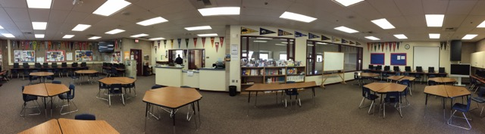
College and Career Coordinator
Mrs. Cartwright
Career Exploration
College Applications
College Entrance Tests (SAT/ACT)
Practice exams (PSAT/PreACT)
Scholarships
Work Permits
Financial Aid Information
Notes:
Alice

Slide 18
Middle School Registration Visits
(During School Day)
Freedom Counselors will meet with 8th grade students and pass out Course Request Forms. They will review all materials and answer questions to help with the course request process.
Counselor Visit Dates:
Tuesday 1/23/24: Delta Vista
Wednesday 1/24/24: Knightsen and Old River
Thursday 1/25/24: O’Hara
Thursday 1/25/24: Adams
Tuesday 1/30/24: Bristow
Edna Hill
Notes:
gerthy

Slide 19
How to Read a Course Catalog
Beginning Art Course #1506
Level: 9-12
Length: Year-Long (10 credits)
Prerequisite: None
Graduation: Fine Arts requirement or elective credit
College Prep: VAPA (f) requirement
No previous art experience is necessary for this beginning level art class. All projects are based on learning the elements of art (line, shape, form, value, color, space, texture) using a variety of art media. The principles of design are also introduced.
Notes:
gerthy

Slide 20
Help your student(s) fill out the bottom portion of the course request form.
Several of the classes are prefilled because they are requirements.
For electives be sure to look at the VAPA (Visual and Performing Arts) and CTE (Career Technical Educational) pathways handout.
Return the course request forms to your middle school.
These are due February 5th.
Notes:
CTE: Select career courses that can help you explore possible future career options.
gerthy

Slide 21
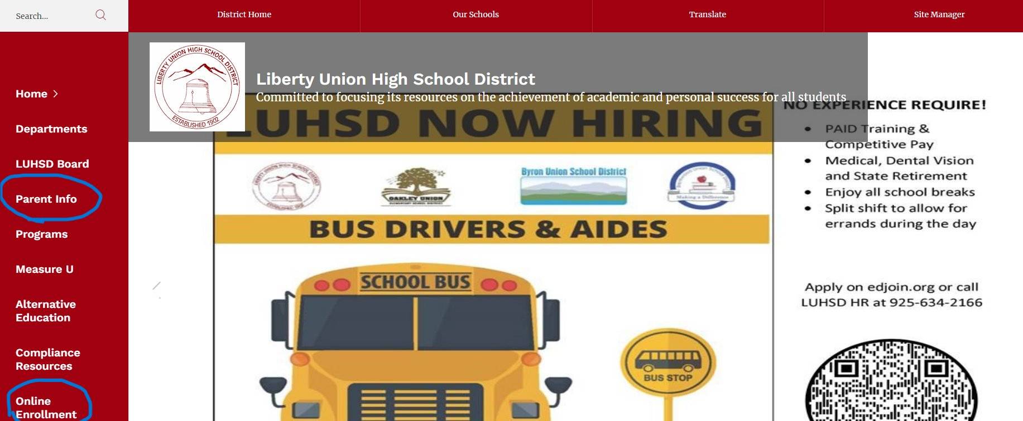
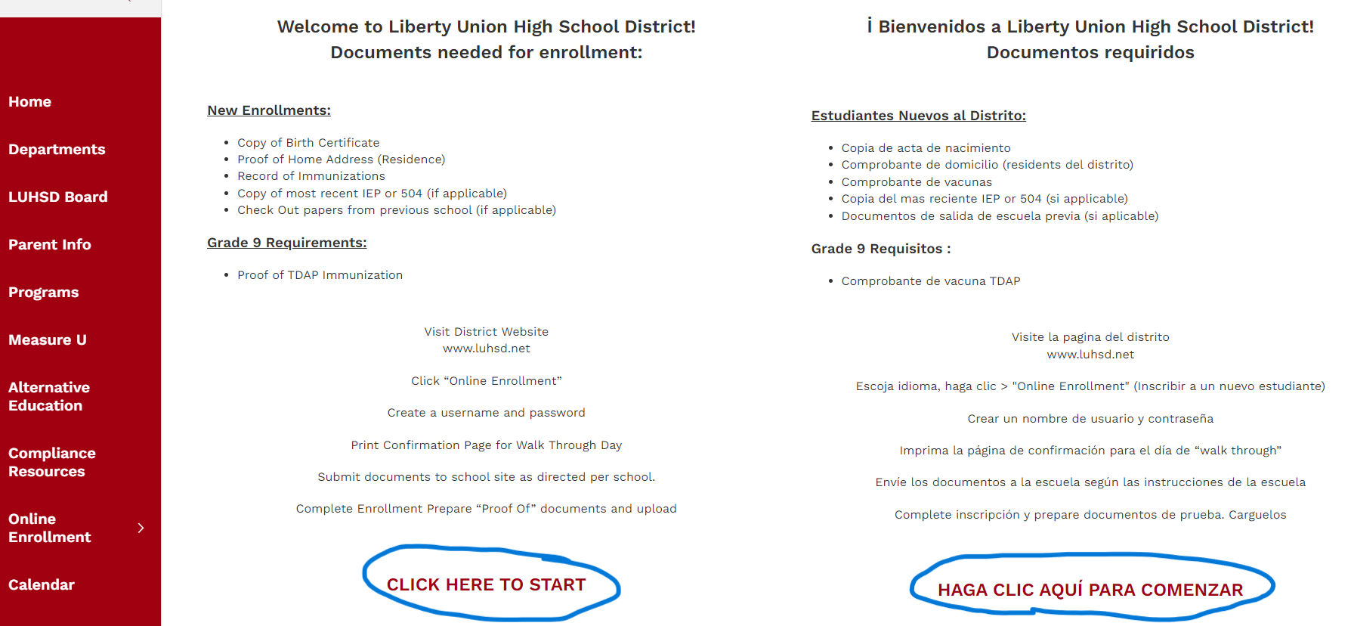
Online Enrollment
Start at LUHSD.net
Click "Online Enrollment"
Click "Click here to start"
Click "Enroll a new student"

Slide 22
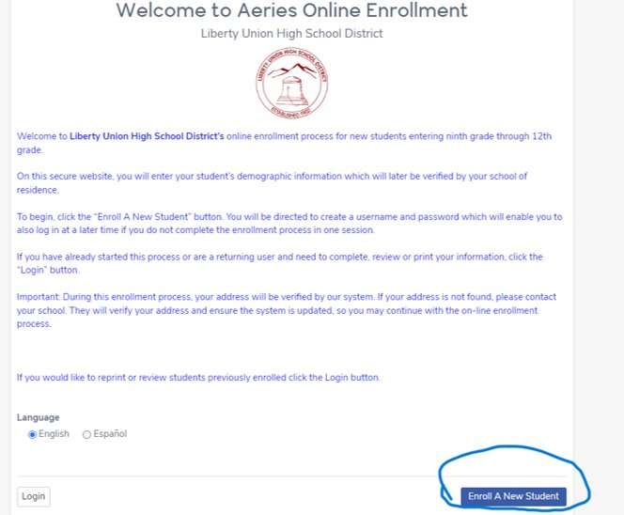
Online Enrollment
Follow the steps to upload required documents.

Slide 23
Freshman Walk Thru
Over the summer, Freedom will notify you of your Walk Thru date (usually late July).
It is important that you clear your calendar to be able to attend one of the Walk Thru dates.
What happens at Walk Thru?
  You’ll get acquainted with our campus
  You’ll receive a preliminary schedule
  Purchase PE clothes
  Get your Student ID Card
Notes:
maggie

Slide 24


Thank You for Attending & Investing In Your Student’s Education!
Visit the Counseling Tab on the FHS Website for tonight’s presentation and other Counseling Information
Notes:
Counselors

