Slide 1
Heritage High School
Course Request
2025-2026
9th-11th grade

Slide 2
Agenda
Review Packet
Course Request Form, Transcript, Course Offerings sheet
Reminders
Opportunities
Form Review
Online Course Request Tutorial

Slide 3
Course Request 2025-2026
Use the course catalog ​
​
Counselors will not be setting up student/parent meetings for registration​
​
Take this seriously - you may get your alternate electives!​
Yearlong classes are YEAR LONG! No dropping at or during the semester.
VAPA-If planning to be A-G eligible
AP courses- talk to teachers, summer homework
Repeating core if failed
Strategies for growth

Slide 4
Forms required
Staff Assistant (Juniors - Seniors)
Requirements: Overall 2.0 GPA, teachers' signature/approval
Peer Tutor (Sophomores- Seniors)
Requirements: Overall 2.0 GPA, 3.0 GPA in subject, teachers' signature/approval
Unscheduled Periods (Juniors – Seniors)
Requirements: Must be on track for graduation, Juniors = 1 unscheduled period, Seniors = up to 2 unscheduled periods
*Forms available in all SLC offices. Must attach to Course Request form and fully filled out including PARENT SIGNATURE.*

Slide 5
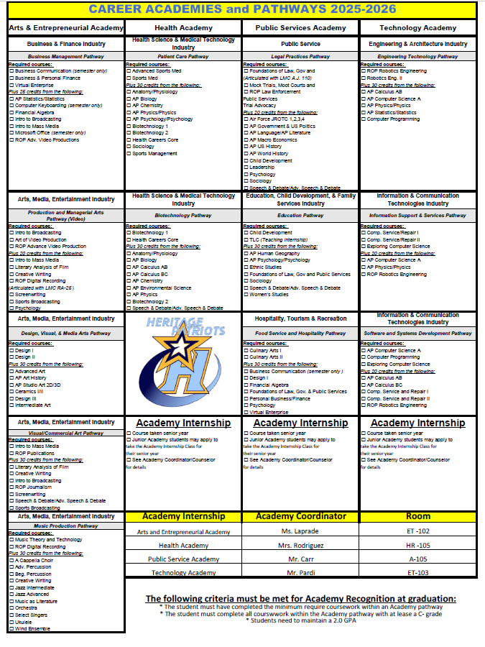
Academy Reminders
Student responsibility
Academy Internships: applications are due 2/13 (Seniors Only) - Please see your Advisor for further questions
Advisors: ​
Ms. Rodriguez – Health – HR 105​
Mr. Pardi –Technology – ET 103​
Ms. LaPrade – Arts and Entrepreneurial – ET 102​
Mr. Carr – Public Service – A105

Slide 6
Academic Opportunities
New Class at Heritage
LMC Dual Enrollment
English 100 & English College Elective Seniors only (PM Unscheduled)
Fire Science I & II Juniors & Seniors (PM Unscheduled)
Political Science & Social Justice Studies Juniors & Seniors (PM Unscheduled)
American Sign Language I & II Juniors & Seniors (AM Unscheduled)
*Spots are limited – not guaranteed, must complete unscheduled form*
Self Defense Strategies and Tactics
AP Cyber Security – Networking Fundamentals

Slide 7
Leadership mandatory interest meetings!!!
Interested in running for Class Office or ASB Office?
You must attend a meeting on either 1/21 or 1/24 at lunch in ES-101 for rules and applications.
Interested in Link Crew, ASB Leadership and PLUS?
Attend meeting on either 1/22 or 1/23 at lunch in the theater for information and applications.
*To be considered for Link Crew, ASB Leadership and PLUS, students must list the class as one of their 8 classes on their course selection sheet*

Slide 8
Reminders​
Write legible (clear/neat)​
Use a pencil or erasable pen​
Transcript will help you choose classes​
Complete each section ​
Include Course #’s for all classes​
Use course offerings list​
Choose courses you can handle​
Must have parent signature
Complete all 3 sections
​
Select
Core Classes
History, English, Math
Due Date:
January 31, 2025
Select
Elective Classes
Additional Science Class, World Language, VAPA, etc.
Select
(4) Alternate Electives
Must add 4 different alternate electives

Slide 9
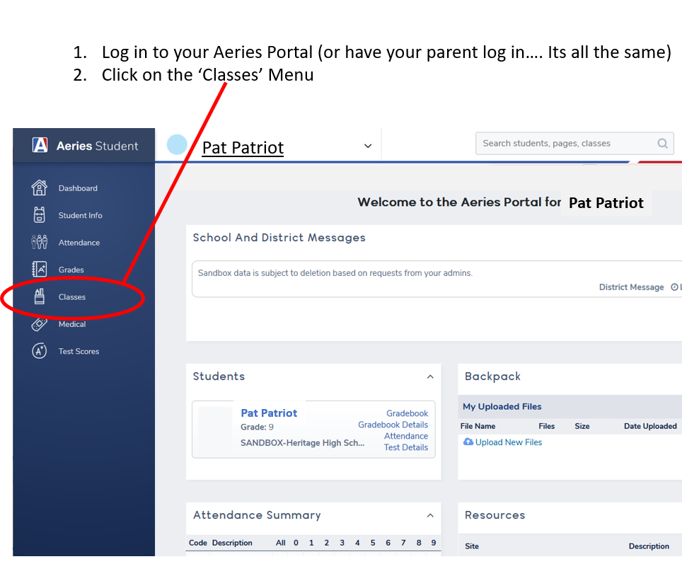
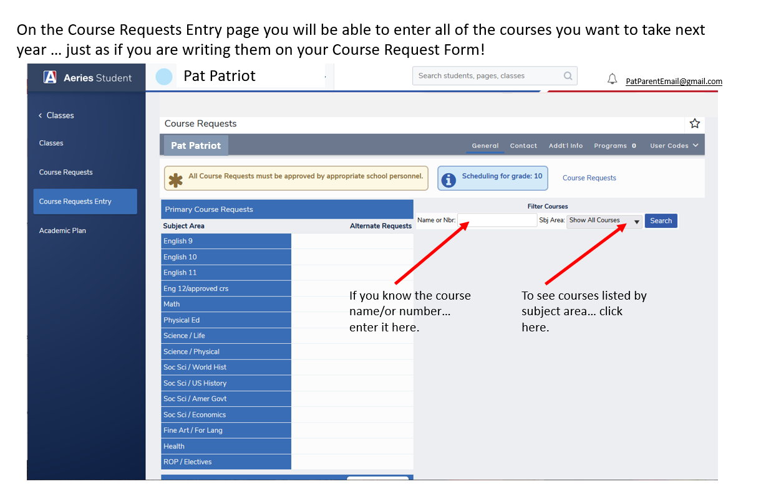
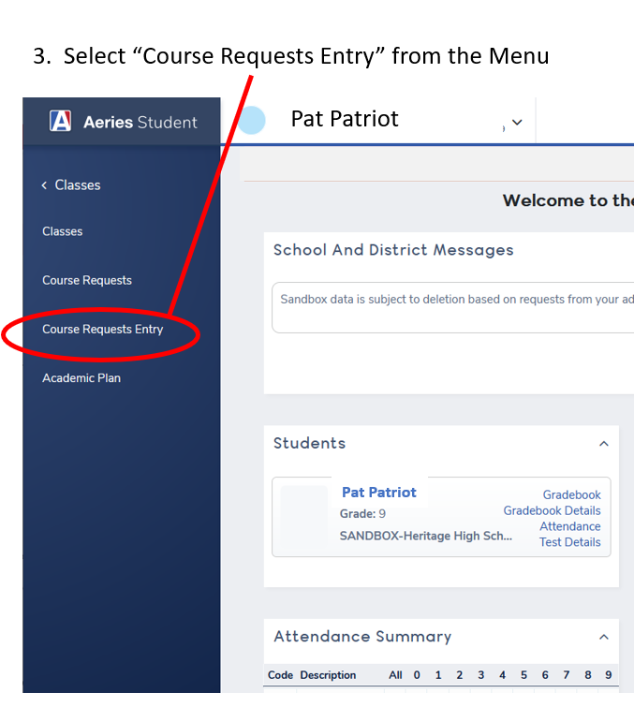
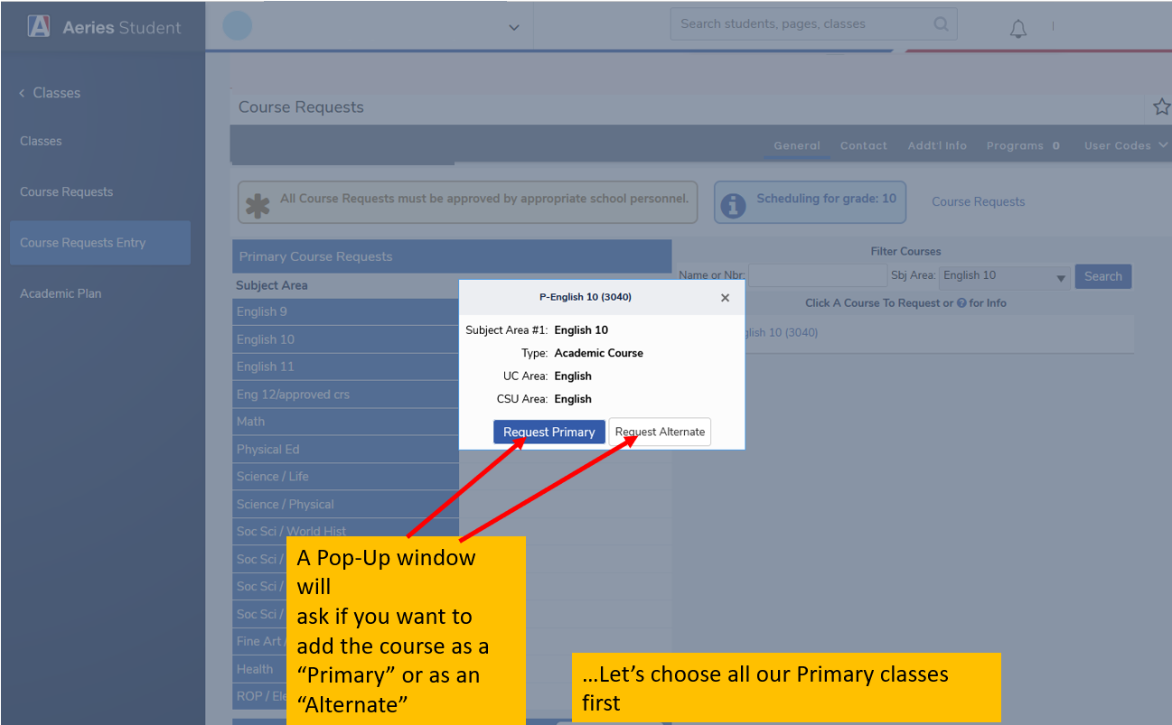
Online Course Request Instructions
Step 1: Log into Aeries and click on Classes
Step 3: Type in your classes in the search and select the course you want
Step 2: Select Course Requests Entry
Step 4: Make sure you select "Primary" for all your core classes

Slide 10
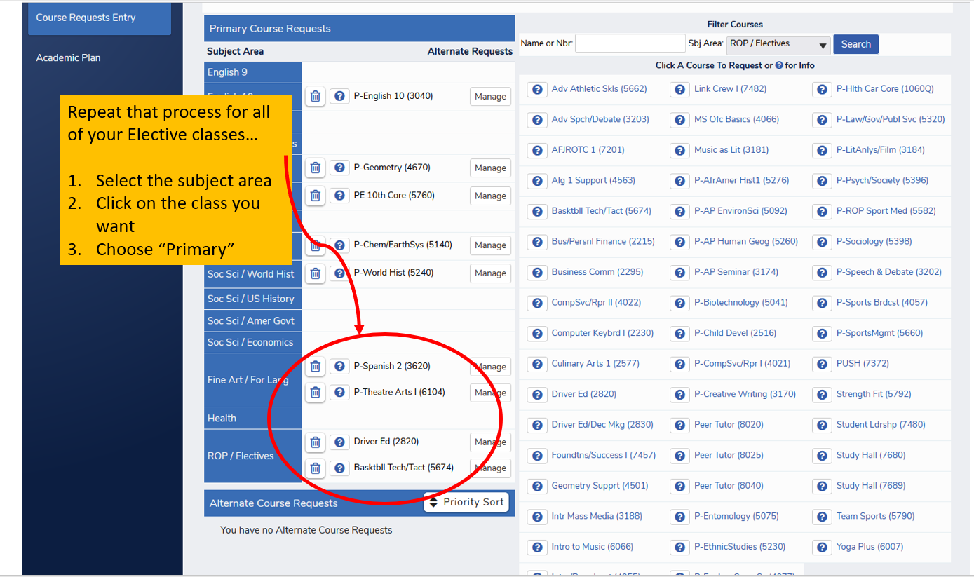
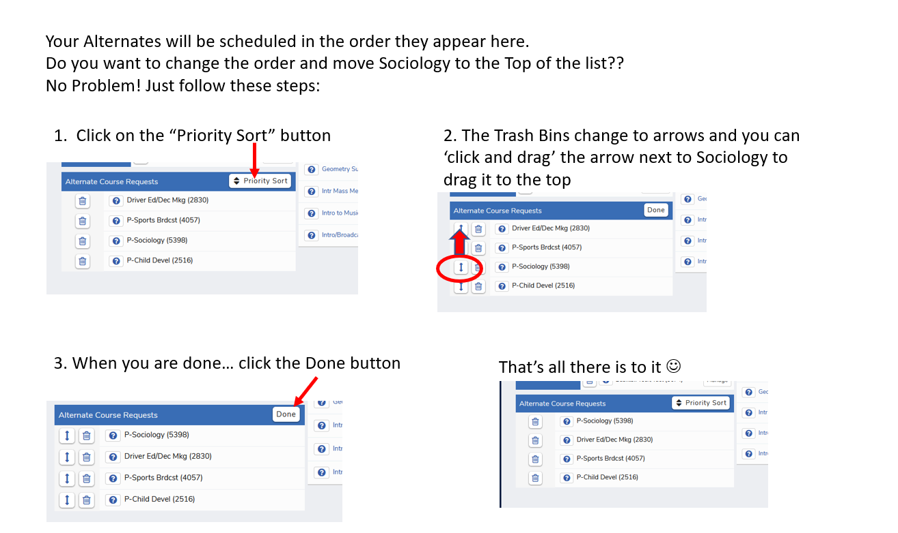
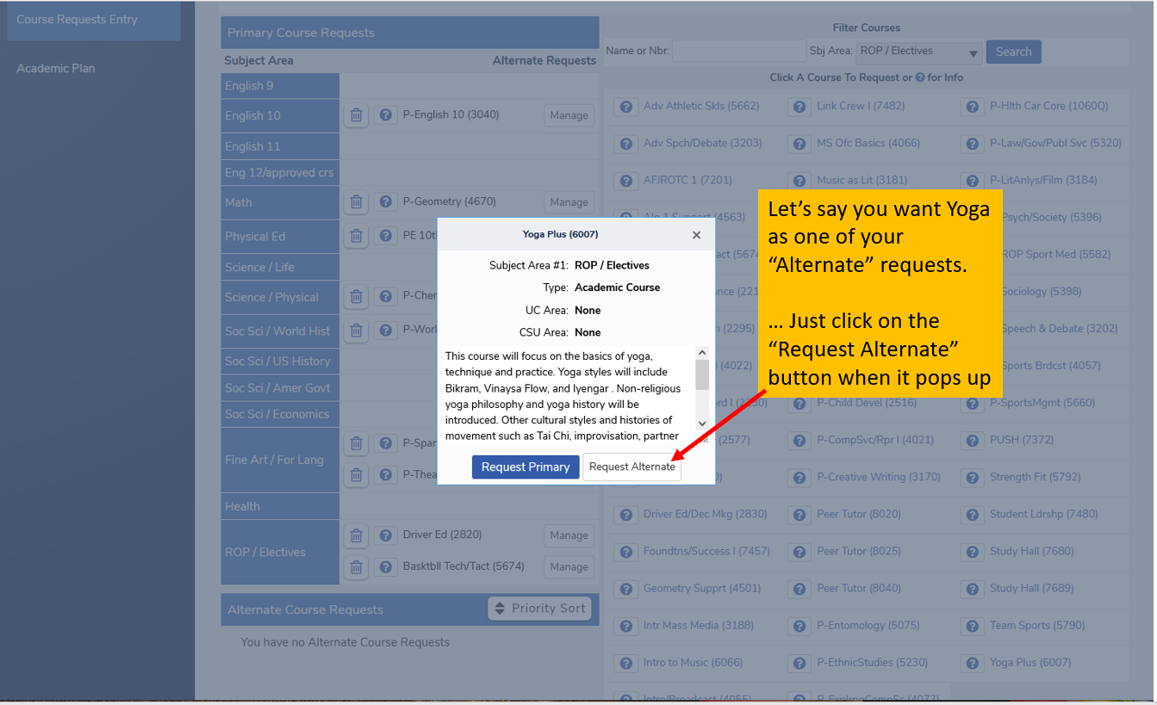
Online Course Request Instructions
Step 5: Pick your first-choice electives and choose "Primary"
Step 7: Sort your alternates in the order you prefer these classes
Due Date:
January 31, 2025
Step 6: Select your alternate electives

Slide 11
Due Date & Reminders
January 31,2025
Change Request Reminders
Form and Online Course Request must be completed entirely
Must have parent signature
Turn in completed forms to your assigned SLC office
*Incomplete forms will not be accepted
*Take a picture of your form or make a copy before turning it in as a reminder*
No teacher changes​
No class changes​
No period swapping​
Form and Online Course Request must be completed entirely
Must have parent signature
Turn in completed forms to your assigned SLC office
*Incomplete forms will not be accepted

