Slide 1
Larsen Middle School
BIENVENIDOS A Larsen
6th Grade Orientation

Slide 2
Exploratory Period Options
Band - full year
Orchestra - full year
Chorus - full year
Rotation- 4 classes (1 quarter of year for each class)
> Art
> Family & Consumer Science(Cooking)
> Computer
> Project Lead the Way (PLTW)
Avid - full year

Slide 3
What is AVID?
AVID stands for Advancement Via Individual Determination and takes the place of the exploratory rotation. It prepares students with academic potential, for success in advanced high school classes and in college.
AVID uses trained tutors twice a week to conduct study seminars with the goal of supporting students with accelerated coursework.

Slide 4
The AVID Student
Is academically “in the middle”
Has good attendance and school behavior
Wants to attend college
Enrolls in rigorous college preparatory classes (Challenge/AP/Honors)
Maintains at least a “C” average
Takes notes, maintains an organized binder
Participates in weekly tutorials during class time

Slide 5
Benefits of AVID
    Increases opportunity to enroll and succeed in Honors/AP level coursework in high school
    Provides strategies to help raise test performances in classes and for the PSAE/ACT/SAT
    Helps students with organizational and note-taking skills
    FREE tutoring during Avid class

Slide 6
Sample 7th Grade Schedule
    1st Per: Reading or Spanish
    2nd Per: English
    3rd Per: PE
    4th Per: Lunch
    5th Per: Exploratory/ Avid
        Art/PLTW/Comp/FACS, Band, Orch, Chorus
    6th Per: Math
    7th Per: Science
    8th Per: History

Slide 7

AVID Elective Class
A full year elective credit class
Focus on Writing, Inquiry, Organization, Collaboration, Reading
College exploration
Enhances students success in all other classes

Slide 8
A Typical AVID Week
    Mon & Wed Avid curriculum – strategy work to be used in all classes
    Tues & Thurs - tutoring sessions in specific content areas
    Fridays - Career and college readiness activities

Slide 9

Learning Strategies
Writing to Learn
Reading to Learn
Cornell Note-taking
  2 column notes
  Used in all classes
WICOR
  Writing
  Inquiry
  Collaboration
  Organization
  Reading

Slide 10
Tutoring
Twice each week during AVID class
7-8 students to each tutor ratio
Paid and volunteer tutors from local colleges and the community
Focus on high-level questioning and collaboration
Supports students success in challenging classes

Slide 11
AVID Binder
Teaches and reinforces organizational skills
Evidence of class notes from all classes
Checked weekly in AVID class

Slide 12

College Exploration
College preparatory high school schedule
Speakers
College Visits
Information on college applications & financial aid

Slide 13
What Happens to
AVID Students???
AVID students are more likely to enroll in AP classes and Honors classes
AVID students are more likely to complete a college-readiness curriculum
AVID students are more likely to be accepted by a 4-year college and stay in college

Slide 14
Now What??
Complete AVID Application
Bring Application and Course Selection sheet with you to Larsen MS for your INTERVIEW!
Interviews will be conducted at LARSEN MS on December 18th and 20th
Upon selection to the AVID program, parents and students sign acceptance form.
Follow AVID curriculum
Go to college
THE SKY’S THE LIMIT!!!

Slide 15
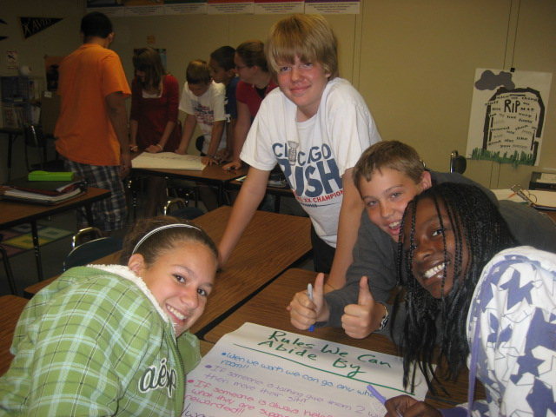
QUESTIONS???
www.avidcenter.org

