Slide 1
Human Resources
rodney gilmore, ED.D
Associate superintendent
for Human Resources

Slide 2
2013-2014 HIGHLIGHTS
Employees by Bargaining Unit | Number of Employees
Administrators | 48
Teachers | 523
Teaching Assistants | 128
United Public Service Employees | 75

Slide 3
2013-2014 HIGHLIGHTS Continued….
Employees by Bargaining Unit | Number of Employees
Civil Service (security, clerical, food service, lunch monitors, community aides, attendance aide, nurses) | 266
(Security Aide – Full Time) | 51
(Security Aide – Part Time | 40
(Food Service – Full Time) | 39
(Food Service - Part Time) | 7
(Lunch Monitors) | 42
(Nurses) | 14
(Community/Attendance Aides) | 7
(Clerical) | 66
TOTAL | 1,040

Slide 4
Let’s Compare
2013-2014 | 2014-2015
Employee Assistance Program (Limited utilization of services) Relationship and family issues, depression, stress, anxiety, eating disorders, substance abuse, debt restructuring, real estate and landlord concerns, divorce, financial planning, and family violence, etc. | Employee Assistance Program Enhance the utilization of services: Administrators’ retreat Faculty meetings Union meetings Monthly newsletter
Digitalization of ACTIVE files | Digitalization of all INACTIVE files

Slide 5
Let’s Compare
2013-2014 | 2014-2015
AESOP (Substitute Teacher Management System) Limit substitutes to 130 hours per month Parallel implementation with payroll | AESOP (Substitute Teacher Management System) Move to paperless implementation with payroll Improve accuracy of staff attendance report
Procurement of Highly Qualified Candidates In-district/local advertisement BOCES Diversity Fair NY Times Advertisement Educational Week Amsterdam News OLAS | Procurement of Highly Qualified Candidates Out of State Job Fairs Site Visits to Prospective Candidates National Advertisements of Job Vacancies Succession Plan (Training of Future Leaders)
My Learning Plan (OASYS Platform for Teachers) Electronically record all classroom observations/evaluations Input State, Local, and Other Measure scores for teacher evaluation Upload reports to State Education Department | My Learning Plan (OASYS Platform for Teachers) Enhance platform to include line to input Student Learning Objective scores.

Slide 6

Let’s Compare
My Learning Plan (MPPR Platform for Principals) Electronically record all principal observations/evaluation data Input State, Local, and Other Measure scores for Principals Upload report to State Education Department | My Learning Plan (MPPR Platform for Principals) Better alignment of Goal Setting with the MPPR

Slide 7

Let’s Compare
Office of Personnel Website (Currently the following links are available) APPR Plan Dignity Act for All Students 175 Hours Requirement American Disability Act Forms | Office of Personnel Website (Enhancement of website by including the following): Form a committee with representatives from all bargaining units to developing a comprehensive electronic handbook to include; but not limited to the following: Employment Practices Asbestos Notification, Contact with Media, Course Approvals, Employment Opportunities, Equal Employment Opportunity, Exit Interviews, Hiring Procedures, Sexual Harassment of Students and Staff, Student Discipline, Worker’s Compensation, etc. Benefits Cancer Screening, Insurance, Retirement Plan, etc. Time Off AESOP, Bereavement Days, FMLA, Jury Duty, Military Leave, Personal and Family Days, Sick Days, Vacation, etc. Pay Practices Attendance, Absence Procedure, Claim Forms, Direct Deposit, Expense Reimbursement, Overtime, Payroll Period, Travel Claim Forms, etc. Conduct & Policies Accident Forms, Conferences and Workshops, DASA, Dress Code, Drug Free School Zone, Fingerprinting, Personnel Files, Purchase Orders, Smoking, Visitors, and Social Networking, etc.

Slide 8
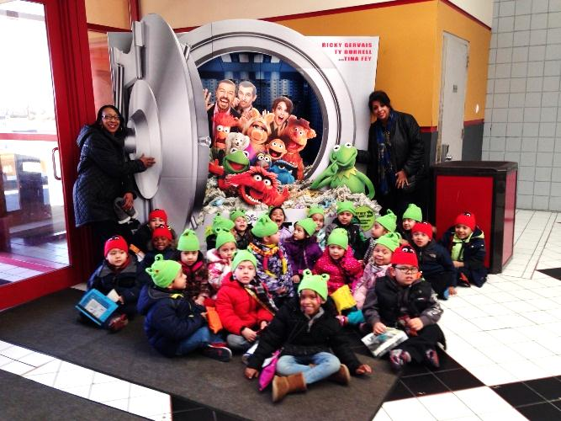
ELEMENTARY SCHOOLS
Barack Obama, David Paterson, Franklin, Front, Jackson Annex,
Jackson Main, Prospect, Marshall

Slide 9
2013 - 2014 Highlights
Front, Jackson Annex, and Jackson Main were successfully converted to house grades 1-5
Prospect School re-opened; it has an enrollment of 565 kindergarten students. The overflow of students, approximately 135 students, are attending Franklin School
Pre Kindergarten Program is back together and occupies Marshall School
One assistant principal and two math teachers at each elementary school K-5
ELA and Math curricular address common core learning standards with appropriate resources and materials for students’ success
Professional Development for staff included one full day and four half days to address the rigor of common core learning standards
Utilization of the Depth of Knowledge wheel to develop higher level questions that tap in to students critical thinking skills
Math modules are used to address the six shifts in math standards; students have learned how to solve multi-step problems, choosing the appropriate concept for application and develop speed and accuracy

Slide 10
2013 - 2014 Highlights cont..
Academic Vocabulary (Three Tier System) allows students to access grade level complex text
For ELA, schools use a combination of reading in content area, Reading Street, and the NYS ELA modules to help students become fluent readers, increase comprehension, and think more critically
Close Read activities allow students to engage in rich and rigorous evidence based conversations about text. Student are exposed to a balance of information and literary text.
Writing includes writing from sources to inform and make arguments
Guided Reading – students receive instruction at their instructional level two – three times per week
Elementary Science is addressed through the Science 21, an inquiry based approach to teaching
Social Studies content is covered utilizing the SS/ELA Putman BOCES curriculum and NYS Social Studies Framework

Slide 11
Highlights 2013-2014 cont..
All elementary students, with exception of Pre K, receive Music, Art, Media, and Physical Education at least once a week
Parent Curriculum Forum was held November 4, 2013; Each content area P-12 director gave a curriculum update for their area
Each elementary school hosted parent workshops, the topics covered were: math modules, ELA, and test-taking strategies
Elementary students showcased their talents in the following district wide events: Winter Wonder Land, Hero/Heroine, and Music in Our Schools featuring the Philharmonic Orchestra
Jackson Main students were a part of the team that came in third place in the Long Island Robotics Competition; they also participated in the Nassau County Bar Association Mentoring Program
Some of our elementary bands and choruses have performed for the village and other agencies

Slide 12
2013 - 2014 Highlights
Franklin School’s band was thanked for 17 years of performances by the US Department of Transportation Federal Aviation Administration
All elementary schools participated in the Mayor’s “Why I Want to Be the Mayor of Hempstead Village” contest; as well as Senator Hannon’s “There Ought to be a Law” Long Island competition
New after school programs at David Paterson include: Girls’ Empowerment and Sign Language; Jackson Annex also started a Girls’ Club to encourage young girls to make right choices
All grade 1-5 schools had an “I Can Academy” to address RTI and test preparedness
Read Across America was celebrated at: Jackson Annex, Franklin, and Prospect Schools
Jackson Annex students art work was featured at the Art Supervisors Association Nassau All-County Art Festival at Adelphi
School Beautification is being addressed by the staff, parents, and students at: Jackson Annex, Franklin, and David Paterson

Slide 13
Highlights 2013-2014 cont..
Elementary students in all schools are able to participate in an after school club of their choice
All elementary schools celebrated Hispanic Heritage and African American History; students gained a better understanding of one another’s culture and history
Behavior modification systems are in place to reduce the number of infractions and decrease suspensions

Slide 14

ELA and Math Initiatives
ELA
Core Reading Program:
Reading Street and Engage NY ELA Modules
Support Materials:
Leveled Books
Grade Level Appropriate Trade Books
Ready New York CCLS Instruction
Fundations
Sidewalks
Orton-Gillingham
Instructional Technologies:
Reading A to Z (Raz Kids)
Lexia
Star Fall
Wilson
System 44 (Special Education)
MATH
Core Math Program
NY Math Modules
Support Materials
EnVision by Pearson
Manipulatives
Teacher selected
Instructional Technologies
Fastt Math (build fluency)

Slide 15
Elementary Field Trips
Educational field trips provide students with a hands-on opportunity to learn more about topics covered in class. Other trips allowed students to have fun, with their peers. Some of the trips students attended or will attend this school year are:
Educational: FUN:
Long Island Children’s Museum Boomers
Cradle of Aviation Bowling
Zoo - Bronx/Central/Queens Movies
Liberty Science Center Skating
Tours of New York City Lazer Land
Museums of the City of New York Lake Compounce
American Museum of Natural History Adventure Land
Vanderbilt Museum and Planetarium Boat rides
Old Bethpage Restoration Plays at Hofstra, Queens, Molloy and Sacred Heart
Museum of Mathematics Family Fun Day
Medieval Times BBQs in the Park
Sony Wonder Technology Lab
White Post Farms
Lego Land Discovery Center
Hoyt Farm Natural Preserve
Brookhaven Ecology Center
Broadway Plays – Matilda, Christmas Spectacular
Tilles Center
When students return from the trip, they are expected to complete an activity about their experience based on common core learning standards.

Slide 16
Our Elementary Students, Staff and Parents in Action

Slide 17
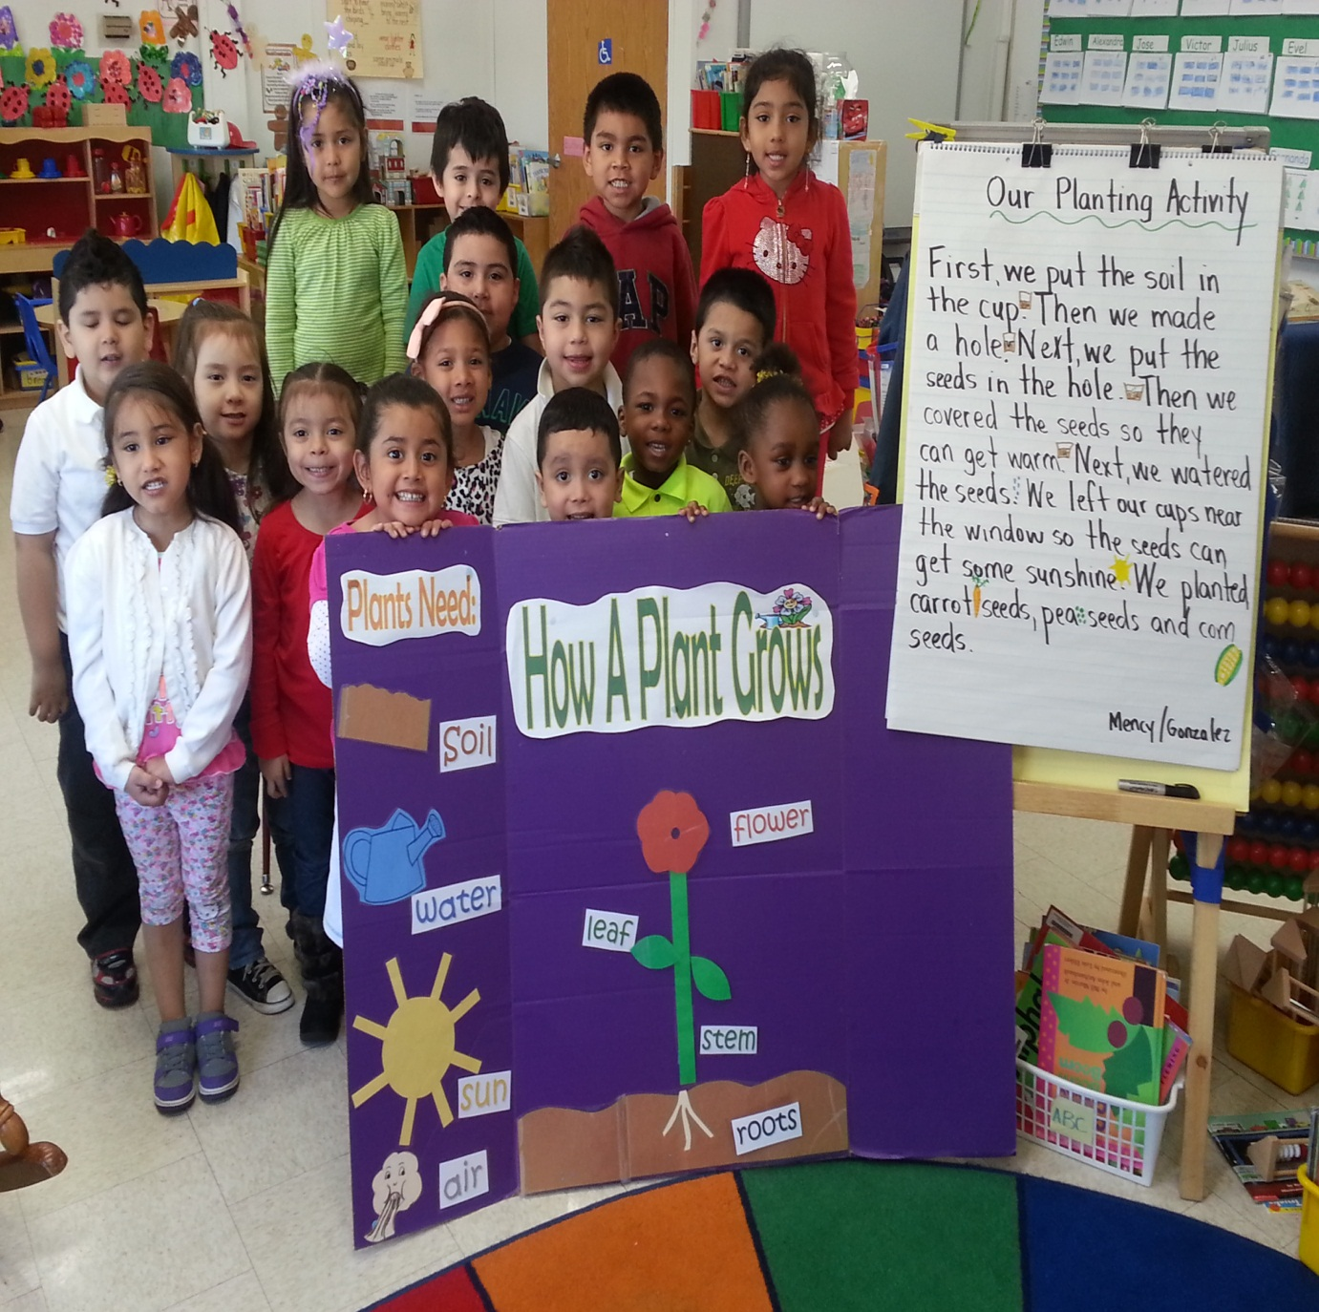
Mrs. Mency’s Pre K students learned about parts of the plant, how to plant seeds, and what plants need to grow.

Slide 18
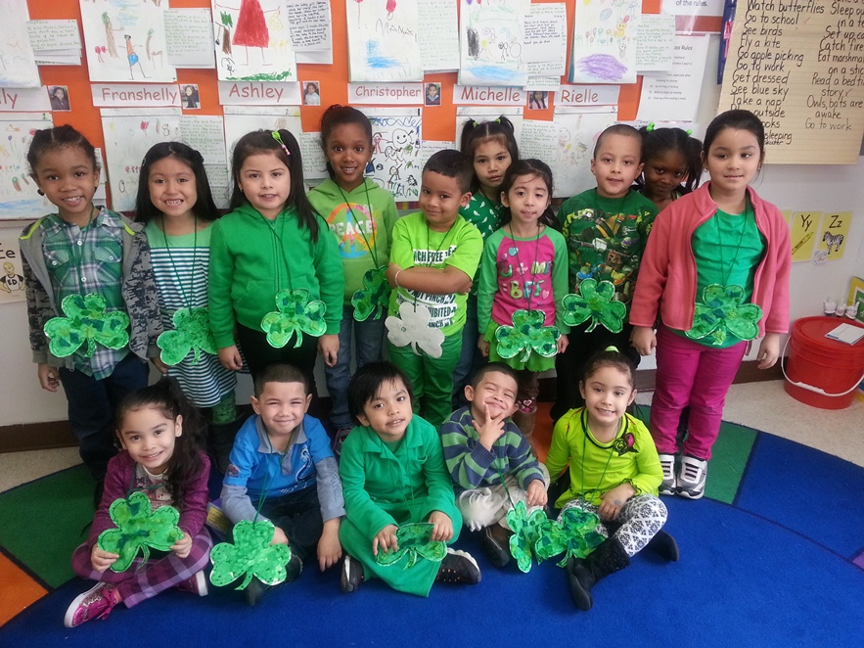
Pre K celebrates St. Patrick’s Day by wearing GREEN and creating a three leaf clover.

Slide 19
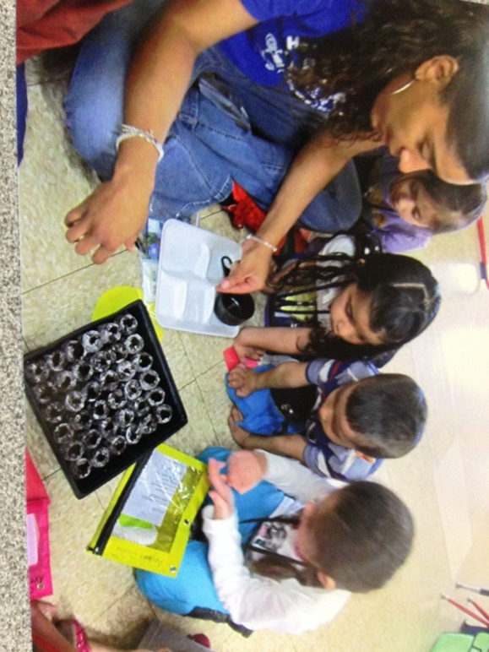
Ms. Whitfield and Ms. Williams pre-k class studied living and non-living things. They discussed the signs of spring and also discussed flowers growing and butterflies flying. The teacher and teaching assistant allowed all students to be active participants of the process. They planted seeds and watched the seeds grow into beautiful flowers. They are now in the process of replanting the flowers for Mother’s Day baskets and making Mother’s Day cards.

Slide 20
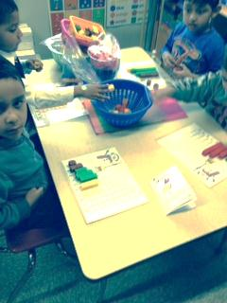
PreK students engaged in a common core math activity using lego cubes. They created AB and ABB patterns.

Slide 21
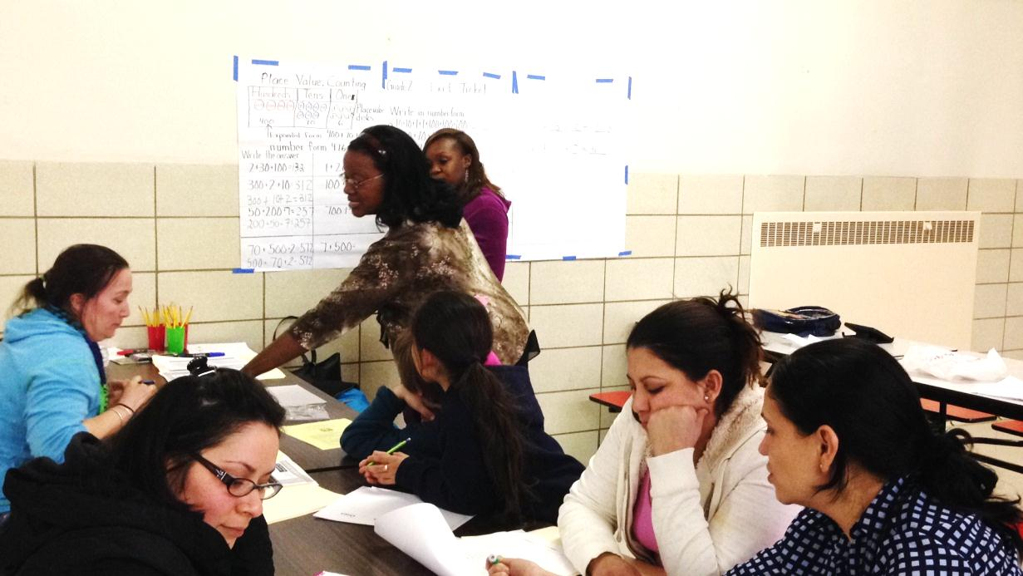
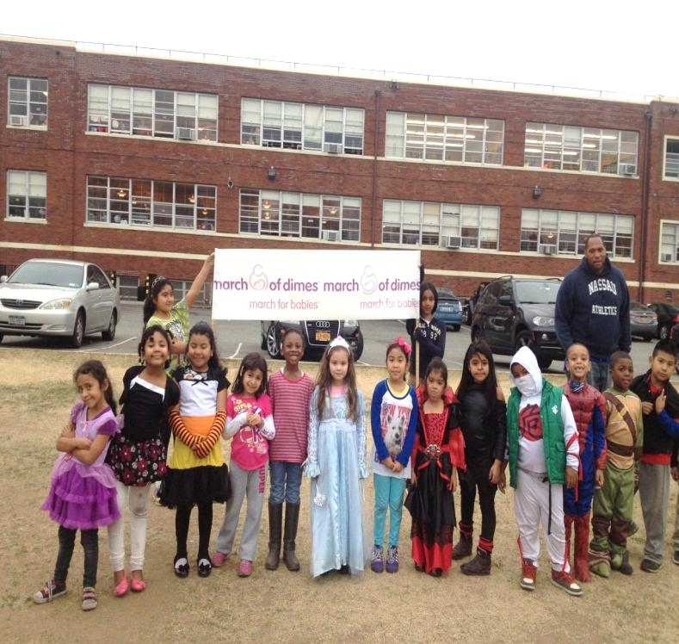
Front School March of Dimes Walk-a-thon; they raised money to help infants with birth defects.
Front School parents and teachers examining the Math Common Core modules and shifts at a Parent Workshop.

Slide 22
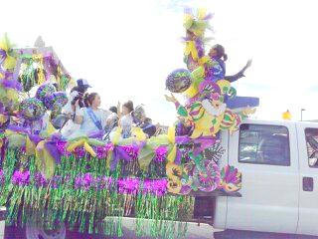
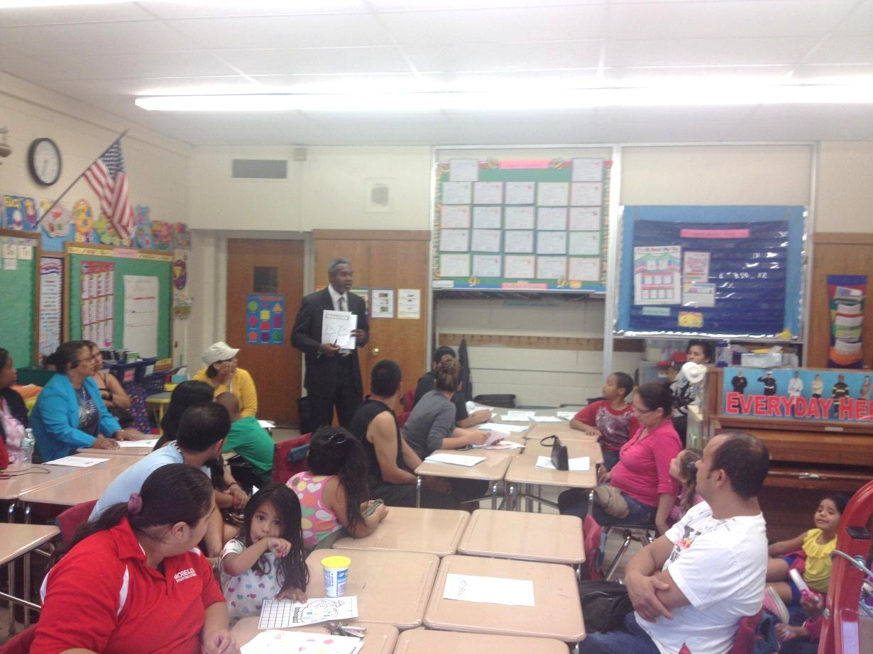
Mr. Keith Hart, 1st grade teacher at Front Street School providing parents with information during Back to School Night.
Front School Homecoming float “won first place” in the float competition.

Slide 23
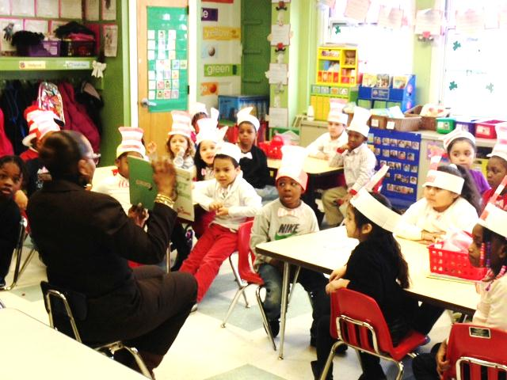

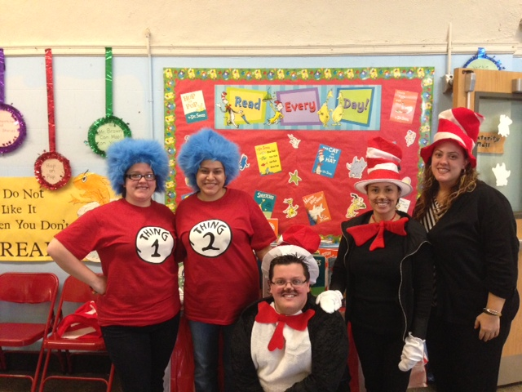
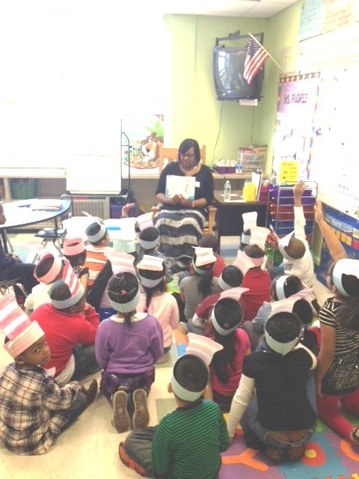
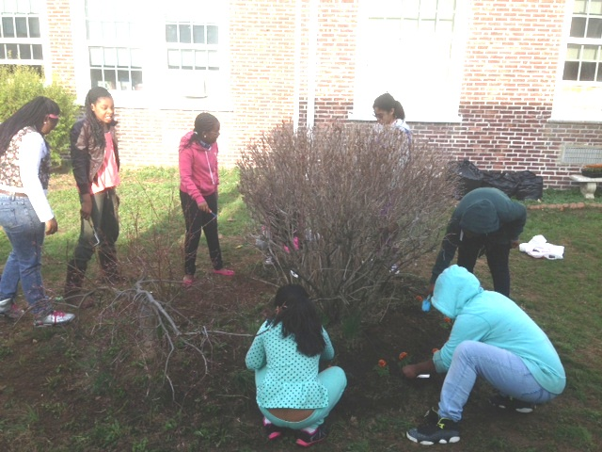
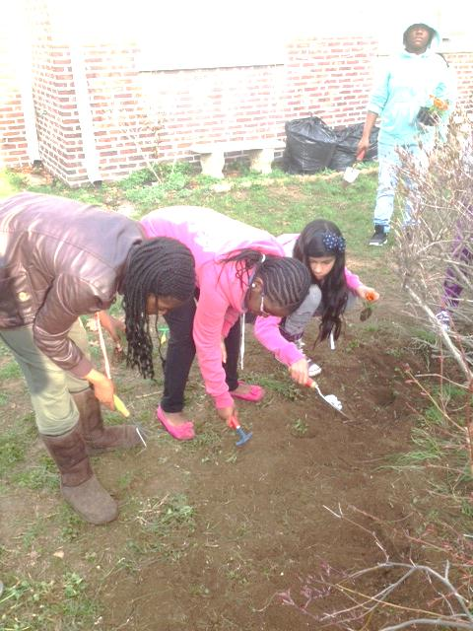
Franklin School Earth Day
Dr. Seuss’
Read Across America Day

Slide 24
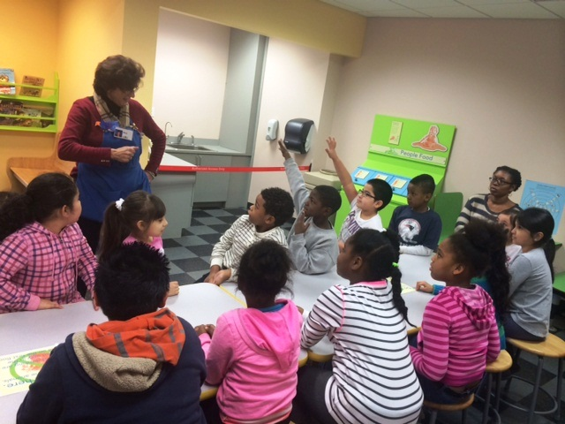
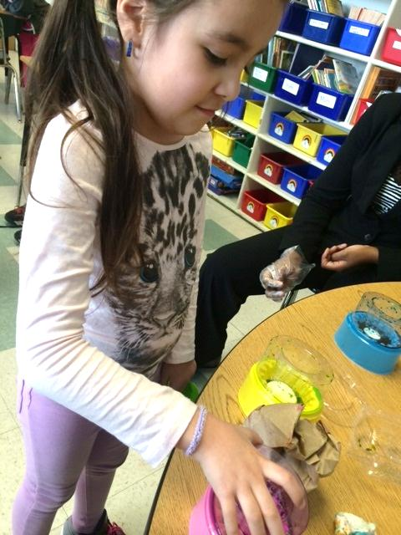
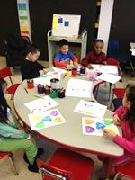

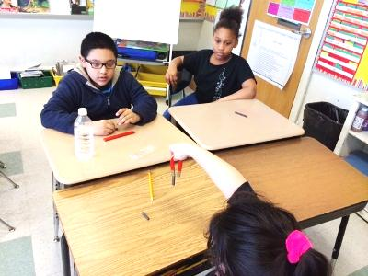
Franklin School Activities
Our Future Scientists and Mathematicians

Slide 25
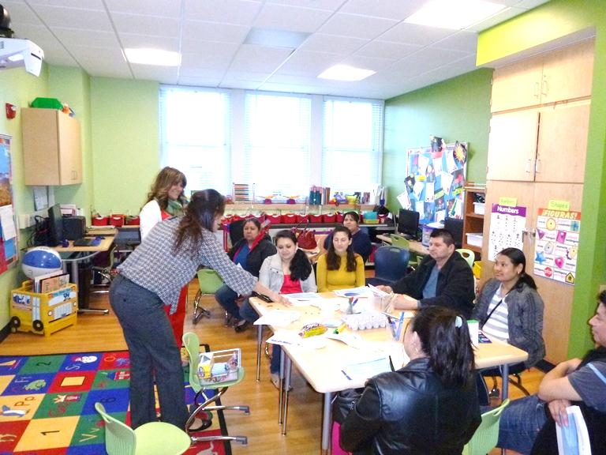
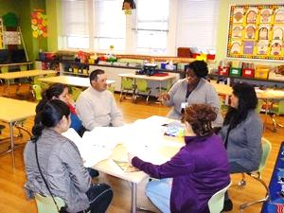
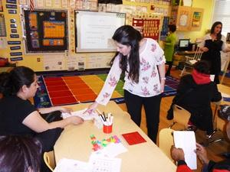
Prospect School Parent University
On Wednesday April 9th parents filled the hallways for our first annual Parent University. For two hours, parents had the opportunity to attend 3 different workshops run by faculty at Prospect. Workshops included Reading Readiness, Fundations, Homework Help, Writing, Oral Language, Math, Social & Emotional Learning, Health and Fitness, and Library resources. During the workshops, parents could be seen using math materials, sounding out words, and even playing with a sight word beach ball! Parents received important information about how to support their child's learning at home.

Slide 26
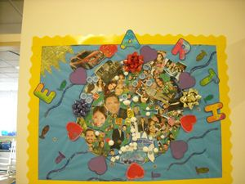
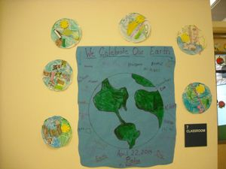
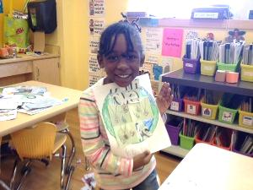
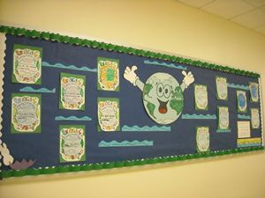
EARTH DAY AT PROSPECT SCHOOL
It was a very exciting day!!
April 22, 2014
Students were exposed to the joys and advantages of recycling and cleaning up our environment. In the morning, students heard a poem titled "Earth Day Mix up" giving them an example of what they can do to help celebrate Earth Day. In the afternoon, students heard another poem titled "What You Can Do" giving them examples of ways to help keep our earth clean. Throughout the afternoon there was planting using milk cartons, mosaic creations using "trash", videos about recycling, and various other activities which the students participated in all while being serenaded by songs about cleaning up our environment.

Slide 27
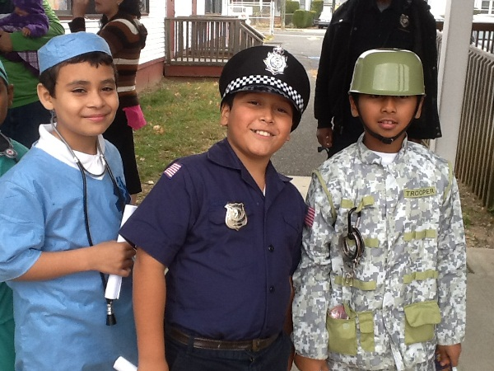
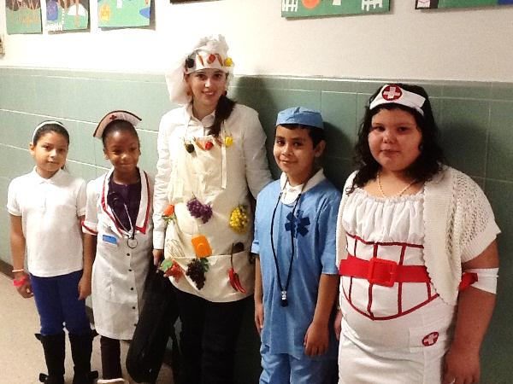
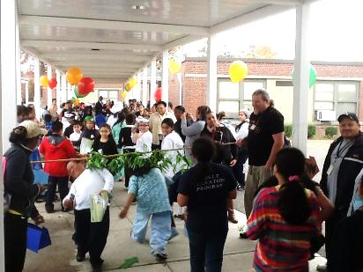
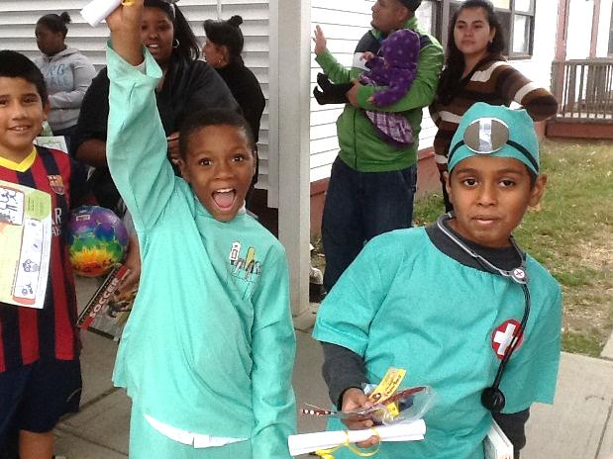

Jackson Annex students and staff dressed up as different professionals. Students researched the careers and presented to their class. All of the students marched in a parade on school grounds for their family to see. The students also participated in games and activities throughout the day.

Slide 28
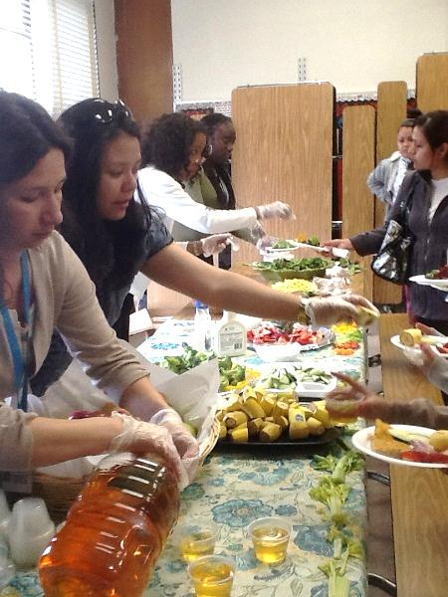
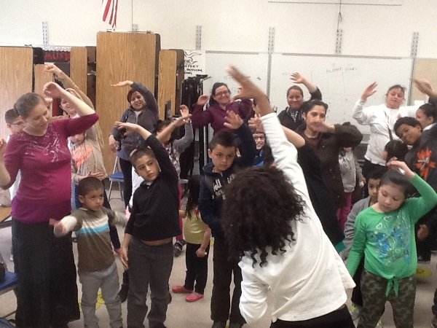
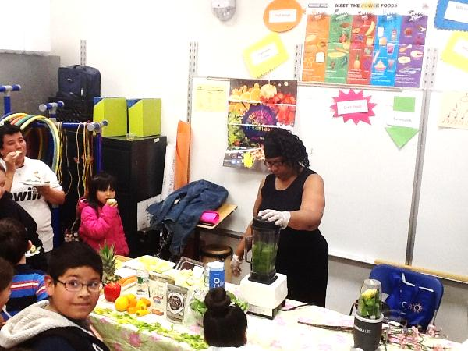
Jackson Annex
Health and Wellness Day

Slide 29
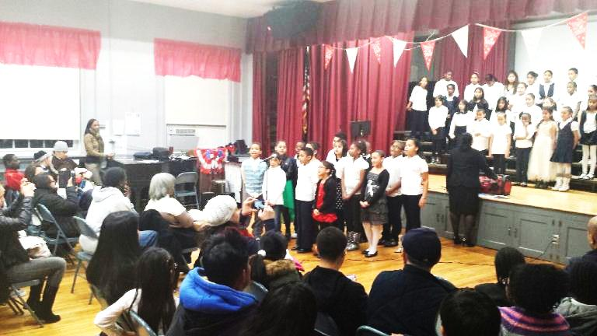
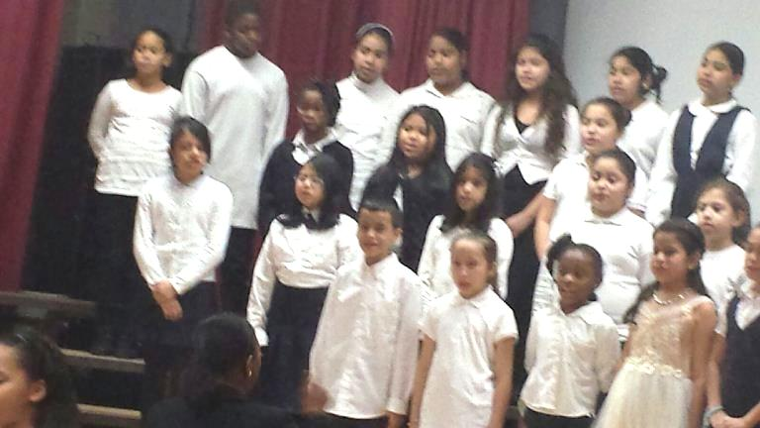
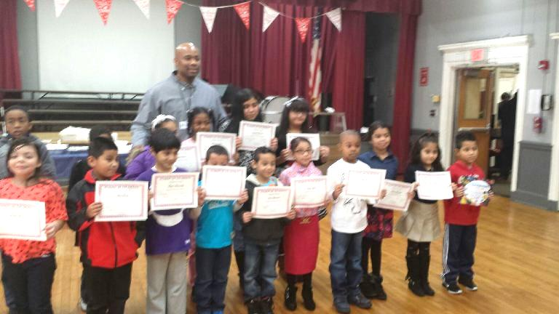
David Paterson’s Choir sings for their Black History Program
Mr. Rush presents the students of the month with their congratulations certification

Slide 30
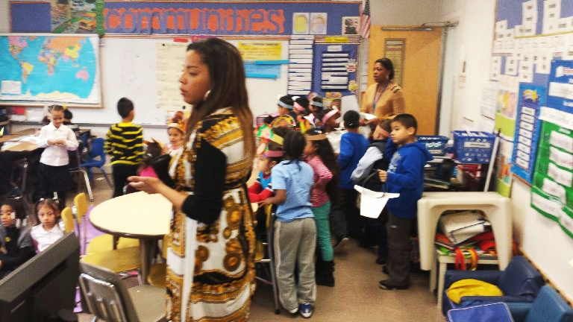
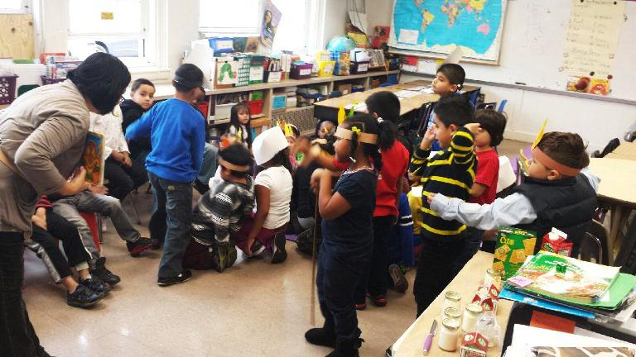
...98, 99, 100!!
David Paterson’s First Grade students participate in 100th Day of School activities.

Slide 31


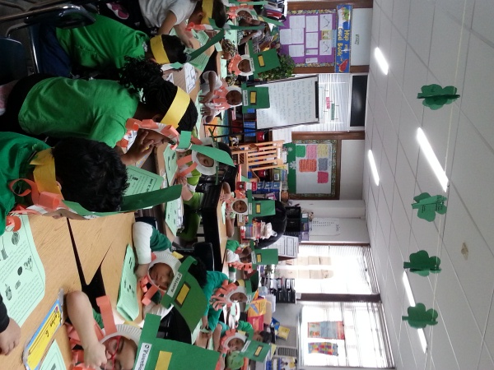
Jackson Main Chinese New Year
Students learn about
St. Patrick’s Day

Slide 32
Plans for 2014 -2015
Maintain current elementary grade configurations
Continue with NYS Math Modules P-5
Full implementation of the Social Studies/ELA curriculum for grades K-2 utilizing leveled text to address students’ instructional needs
iRead Scholastic on line reading support for grades Pre K and K; Fundations for grade K to build early literacy skills
Reading Street Common Core Program for grades 3-5, incorporating the NYS ELA Expeditionary Learning Curriculum
Continued use of Ready CCLS Instruct for test readiness

Slide 33
Plans for 2014-15 cont..
Renew licenses for Raz kids, Fastt Math, Wilson, and Systems 44
District developed science curriculum using new Science Common Core Standards, literacy, and hands-on materials; this will eliminate Science 21 which is a very costly and underused program
Start after school (I CAN ACADEMY) in October
Math teachers for grades Pre K and K; staff developers for (P-1; 2-4; 5-6)
One Elementary and Secondary ELA staff developer to work with Director of ELA

Slide 34
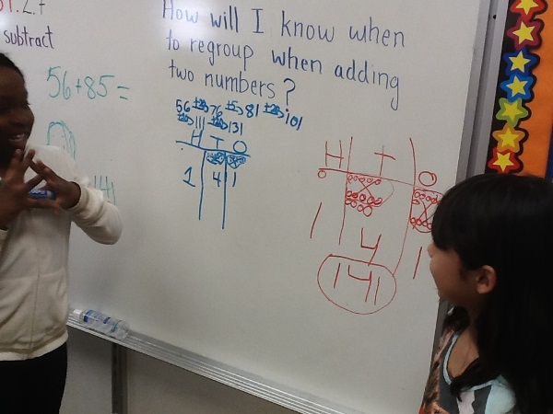
Our students are modeling how to work together to solve a problem. I look forward to our spirit of continuous collaboration and cooperation, because “TOGETHER, WE CAN ACHIEVE MORE!”

Slide 35
School Improvement, Accountability and Funded update
Dr. Nichelle l. rivers, executive director

Slide 36
2013-2014 HIGHLIGHTS
STEM Academies
  Saturday robotics and game design classes for students in grades 3-8
  Our robotics team placed 3rd place at the Aldephi University Nassau County Middle School Robotics competition
  STEM Summer Enrichment Camp held at the Cradle of Aviation 8:30-2:30 daily (Garden City, NY)
  Week 1: July 7-11 for students in 3rd/4th
  Week 2: July 14-18 for students in 5th/6th
  Week 3: July 21-25 for students in 7th/8th
Notes:
2 students were from Jackson Main (Kyle 4th, Jarrod 5th) other members were 6th, 7th and 8th

Slide 37
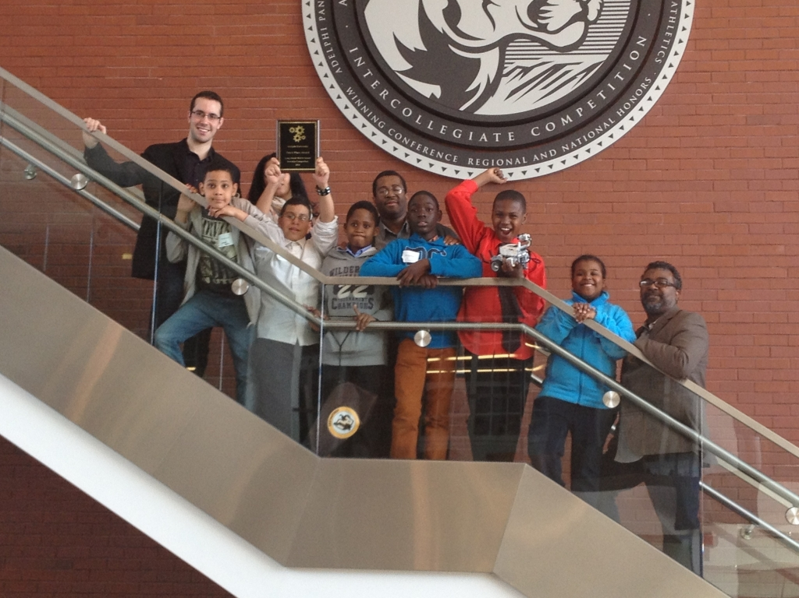
ROBOTICS 3rd place TEAM

Slide 38
More highlights
Farmingdale State College Partnership: Smart Scholars Program
  Currently have 44 students in the program
  Attend college level courses at Farmingdale and at the high school
  Students attended STEM Diversity Summit on March 21, 2014 at Farmingdale
  June 14, 2014 our students will attend CNN’s Engineering World Conference in NYC
  2 college visits are scheduled for June and July
Notes:
2013-2014 courses
Aviation History, Basic Writing, Composition and Rhetoric, Visual Communication (film)
2014-2015 courses
Aviation History, Basic Writing, Career Exploration, Composition & Rhetoric, Composition & Literature, Computer Concepts & Applications, Energy Sustainability and Environment, Intro to Criminal Justice, Freshman Experience, Visual Communication (film)

Slide 39
Current grants
UPK: $2,087,301
Teachers of Tomorrow: $146,000
Teacher Center: $27,836
IDEA 611: $1,614,409
IDEA 619: $60,577
SIG: $210,000
EPE
SIG/STEM $120,000
RtI: $100,000
Child Nutrition: $181,980
Title IA: $1,891,369
Title IIA: $437,327
Title IIIA LEP: $289,702
Liberty Partnership Program (LPP): $20,000
Systemic Support for District Turnaround: $118,084
Race to the Top (RTTT): $567,387
Federal & State funding total: $10,850,270
Notes:
EPE: Employment Preparation Education
Title I funds: support after school programming and parent involvement and parent engagement activities in all schools.
Purchased Spark PE with RTTT funds

Slide 40
Pending grants
Extended Learning Time Grant: $1,077,000 (NYSED)
School Improvement Grant for HS: $1,000,000 (NYSED)
School Improvement Grant for MS: $1,000,000 (NYSED)
Revitalizing Hempstead through the Arts (RHttA): $2,200,000 (USDOE)
Artful Access to Academics (AAA): $1,200,000 (USDOE)

Slide 41
Snapshot of ABGS
1,313 students
58% Latino, 40% Black, 1% Asian, 1% White
14% Limited English Proficient
15% Students with disabilities
76% Economically Disadvantaged
94% student attendance rate
68% of staff hold a Master’s degree or higher

Slide 42
2013 data reveals
GRADE | ELA | MATHEMATICS
6TH | 52%, 42%, 6% | 61%, 32%, 7%
7TH | 62%, 32%, 6% | 73%,21%, 5%
8TH | 62%, 33%, 5% | 67%,28% 6%
Level 1: well below Level 2: below proficient Level 3 & 4: proficient/excellent

Slide 43
ABGS Middle School
Daily Instructional walk-throughs
  Do now’s
  Rigor and relevance
  Quads
  Think, write, pair, share
Positive Afterschool Assessment Program (PAAP)
Parent workshops
Saturday Academy
Weekly CEP meetings
Regents Review
Weekly Common planning time (horizontal)
Principal’s writing challenge
ELA department (book study group)
Principal meets with student council monthly
Peer support team meets every other week (positive school morale)
Notes:
Falling in love with close reading
Strategies for close reading

Slide 44
Plans for 2014-2015
Complete the District Comprehensive Education Plan (DCIP)
Work with schools to complete 2014-2015 School Comprehensive Education Plans (SCEP)
Continue to partner with Hofstra University
Partner with Roosevelt School District
Continue partnership with Farmingdale State College
Locate and apply for grants to support student achievement throughout the district

Slide 45
Pupil Personnel Services and Support Programs
Deborah DeLong, LCSW-R
Assistant Superintendent for Pupil Personnel Services

Slide 46
2013-2014 HIGHLIGHTS
Hempstead High School
Physical building: Exceptionally clean; floors polished at all times; bathrooms immaculate; halls without trash or debris.
Cohesive Administrative Team: Executive Principal; 3 Assistant Principals; Dean of Students
Student attendance improved by 15%.
State Education Department’s recognition of the increase in advanced placement opportunities: The number of courses were increased from 8 to 12. In addition, this year the high school established a partnership with St. John’s University and upon completion, the corresponding grades will be accepted at almost any college/university in the country.

Slide 47
2013-2014 HIGHLIGHTS
Comprehensive Alternative to Restoring Excellence (C.A.R.E.) Program: This is an evening program that use to be essentially for students who were suspended on a long term basis. However, this year the majority of the students are attending for credit recovery and regents preparation.
Increase in Honor Roll students: The number of honor roll students during 2nd quarter increased by 100% (200 to 400).
Suspensions: The number of suspensions were reduced by 50%.
Graduation Rate: At this juncture it is anticipated that the graduation rate for school year 2013-14 will be approximately 50%, increased from last year’s 38%.
  Last year, 60% of our students received a Regents Diploma
  10% received an Advanced Regents
  24% received a local diploma
  6% received an IEP diploma

Slide 48
2013-2014 HIGHLIGHTS
Pupil Personnel Services
Instructional Support Teams (ISTs): The building level ISTs continue to provide services to regular education students for a variety of difficulties. Referrals are made if needed.
Nurses’ Unit: In addition to daily routines and annual state requirements, this year the nurses sponsored an Asthma Prevention & Treatment Project. This program involved students, parents and staff.
Individual Student Crises: Assistant Superintendent for PPS clinically intervened with extreme building level cases throughout the year.
Teenage Pregnancy Project: Pregnant teens receive assistance and follow-up services through the High School Team Center as opposed to BOCES.

Slide 49
2013-2014 HIGHLIGHTS
Incarcerated Youth Project: Students who are incarcerated and who have been recently released are tracked for proper educational follow-up.
“Hands Across Hempstead” an Interagency – District Collaborative
McKinney Vento Project: This program ensures educational continuity and services to displaced families.

Slide 50
Plan for 2014-2015
Staff development for clinicians, particularly in the areas of student discipline and other social/emotional issues.
More structured Team Center Activities (Hands Across Hempstead)
Increased services to pregnant teens.
Closer work with ISTs

Slide 51

Hempstead Public Schools
Special Education Update
2013-14
Presented by Allison D. Hernandez, Assistant Superintendent for Special Education

Slide 52
Hempstead Special Education Statistics

Slide 53
2013-14 Special Education Data

Slide 54
2013-14 HIGHLIGHTS
Resource Room Teacher for Kindergarten
Increased productivity/annual review completion
Increase in Declassifications rates
Increase in returning students to the district
Increase in instructional classroom time (push in)
In Compliance with Due Process Regulations

Slide 55
2013-14 HIGHLIGHTS
Resource Room Teacher for Kindergarten
Increased productivity/annual review completion
Increase in Declassifications rates
Increase in returning students to the district
Increase in instructional classroom time (push in)
In Compliance with Due Process Regulations

Slide 56
PLAN FOR 2014-2015
Preschool Early Intervention
Committee on Preschool Special Education*
Strategic Savings $ Plan
Inform Community on Early Intervention birth to age 2 and Preschool Services ages 3-5
Collaborate with Marshall School to establish community screenings and Parent Connections
Recruit and Increase the number of CPSE referrals
Create alliances with local hospitals/medical clinics
* Paid by Nassau County

Slide 57
PLAN FOR 2014-2015
Committee on Special Education (ages 5-21)
Elementary Grades K-5
Secondary Grades 6-12
Develop Kindergarten inclusion class
Support Response to Intervention (RtI) initiatives
Reduce the number of initial referrals
Provide on-going professional development
Establish Transition classes split/day school
  Work experience
  Vocational training
  Job training
Parent workshop on post secondary outcomes
Develop educational criteria for new graduation credentials for SWD’s
Improve special education instruction and service delivery by hiring dually certified/bilingual teachers

Slide 58
GOALS FOR 2014-2015
Overall Operations
Establish classes for specific disabilities ex: Autism, Inclusion
Build Parent Connections
Expand services/capacity to educate and service our students
Increase preschoolers receiving CPSE services
Return students to district when appropriate
Collaborate with Special Education PTA
Decrease dependency on outside providers
Secure additional funding resources
Maintain compliance with special education state regulations
Save $$$$$$$$$$$$$$$$$$

Slide 59
Information Technology Department
Daniel Espina
Executive Director of Technology and MIS

Slide 60

2013-2014 HIGHLIGHTS
Updated classroom computers
  Completed the deployment of 1300+ new computers 100+ printers
Prospect School
  New computers and interactive digital display boards
  New security system
  New phone system
Updated data center equipment

Slide 61

2013-2014 HIGHLIGHTS
Partnership with Nassau BOCES Model Schools
  Interactive digital display board training
  Powerschool workshops
  Powerteacher workshops
How effective use of technology improves efficiency
Re-Launch Prospect School website

Slide 62
PLAN FOR 2014-2015
Restructure IT Department
  Align staffing with district needs
    Utilize a combination of support form BOCES, Outside Vendors, and internal support staff.
  Physical server and workstation upgrades
    Reconfigure entire systems and network environment
    Upgrade Microsoft Exchange server
    Upgrade administrative and support staff workstations
  Implement new Voice over IP (VoIP) solution
  Evaluate systems that improve security
    Visitor management systems
    Video surveillance

Slide 63
PLAN FOR 2014-2015
Implement Schooltool – new student management system
  Introduce parent and student portal
Re-launch all schools websites with current content
Focus on professional development
  Fundamental use of computer technology
  Understand the instructional technology environment
  Improve communication and collaboration
  Identify tools and applications that enhance teaching and learning

