Slide 1
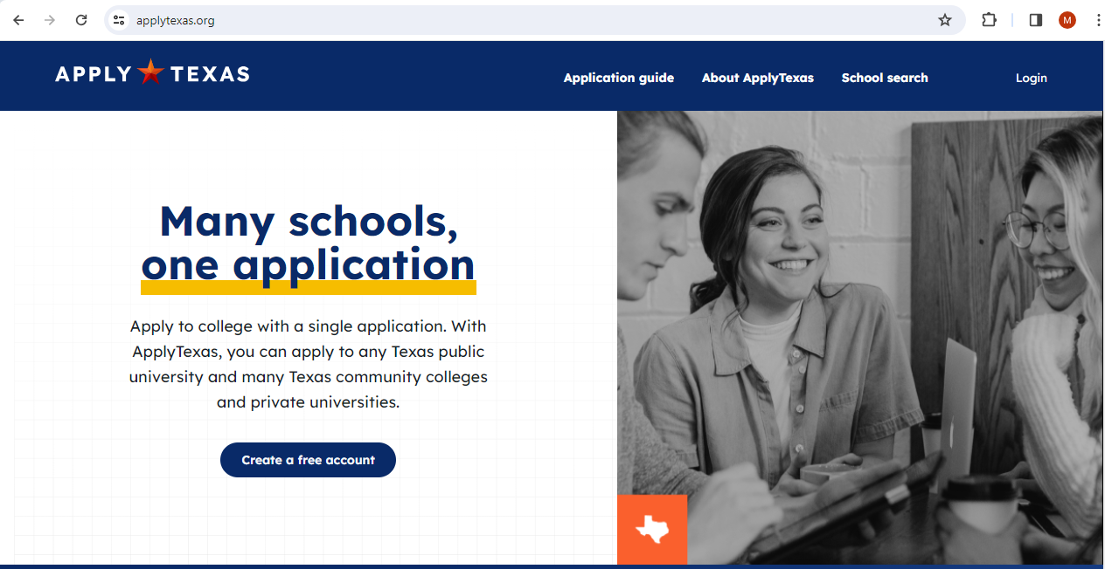
Applying for Dual Credit at NCTC www.ApplyTexas.org

Slide 2
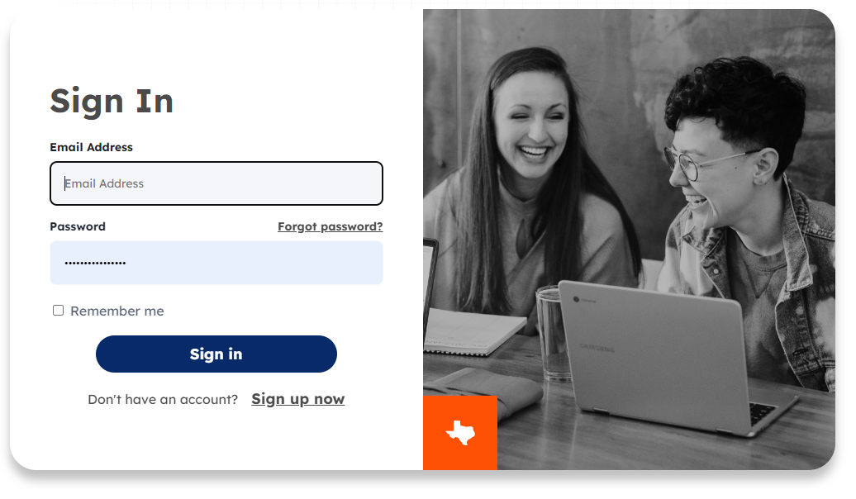
New Student?

Slide 3
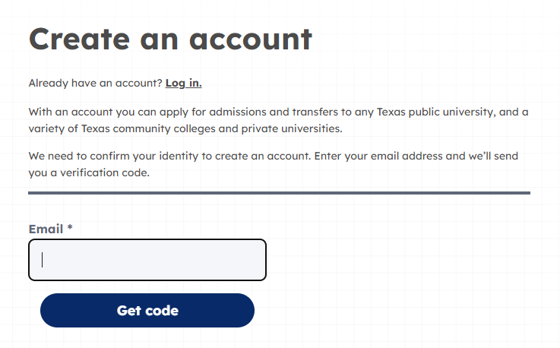
1. Enter an email address that you check.
2. Click.
3. Check your email for your verification code.

Slide 4
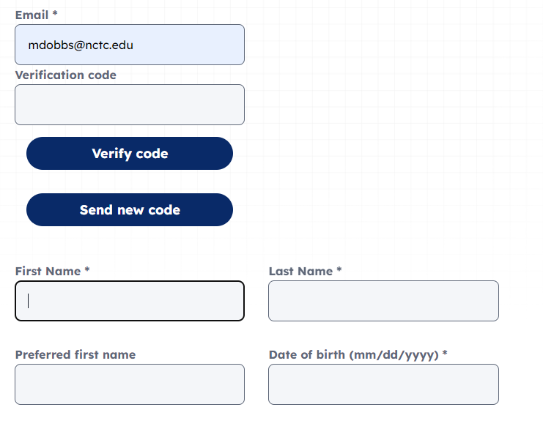
1. Enter the verification code sent to your email
2. Click to verify
3. Enter your personal info

Slide 5
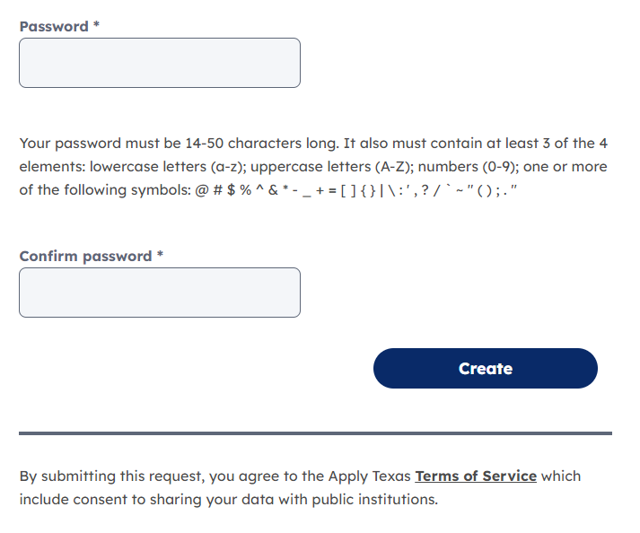
Create a Password that meets requirements described below.
Tip: Write your password down so that you have it for later!
Click

Slide 6

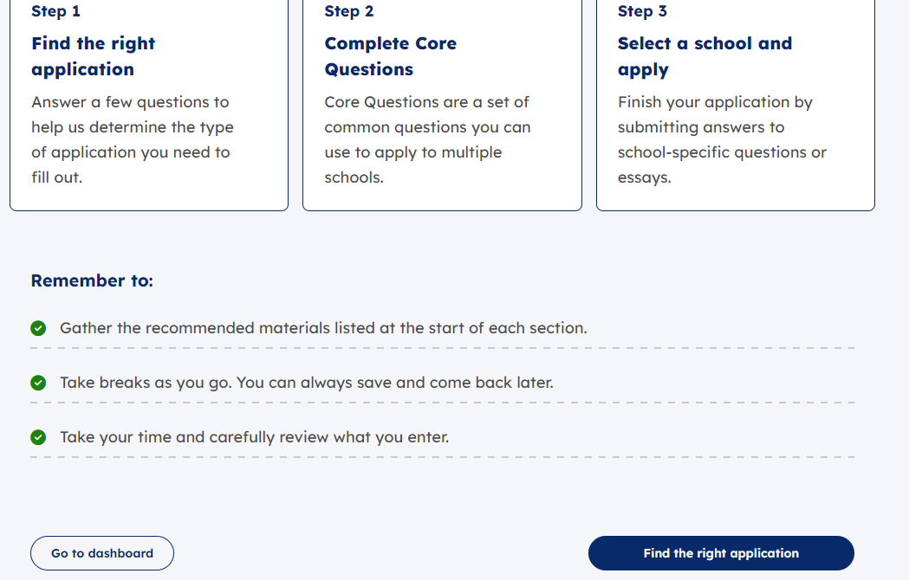
Scroll down to “Find the Right Application” button & click.

Slide 7
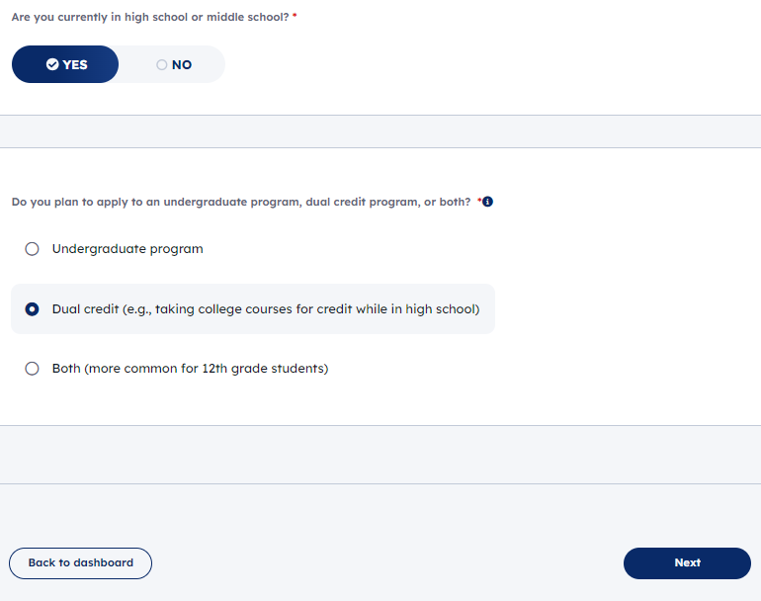
Select YES
Select Dual Credit
High School Status
Click Next

Slide 8
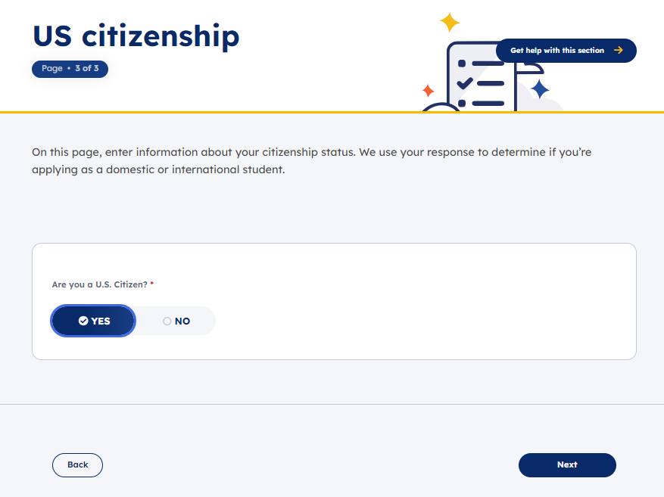
Only choose NO if you are NOT a US Citizen.
*Non-citizens will be prompted to answer additional questions. Ask if you need help.
Click Next

Slide 9
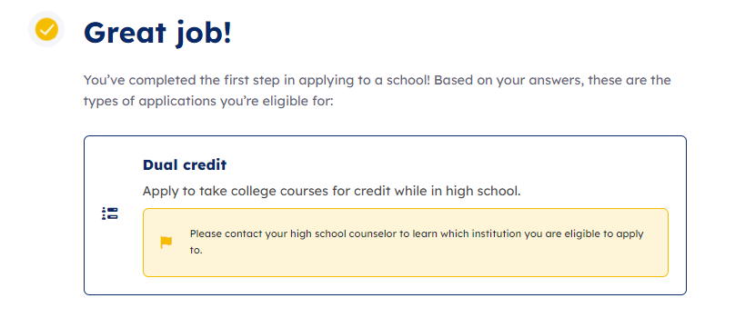
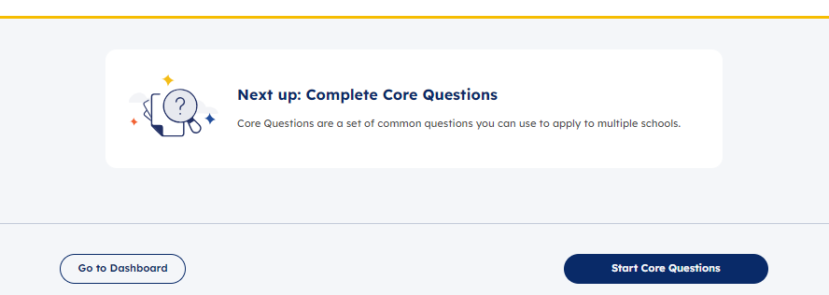
Scroll down to “Start Core Questions” button & Click

Slide 10

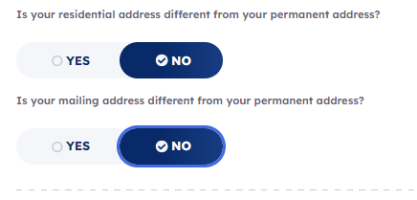
About You Section
Your Name – Enter your legal name and if desired, preferred name.
Address Information
  Enter your permanent address and click
  Typically NO to:
  If YES, enter residential or mailing address as prompted.

Slide 11
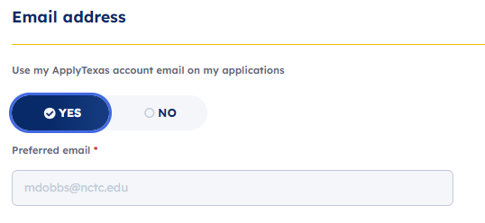
YES

Slide 12
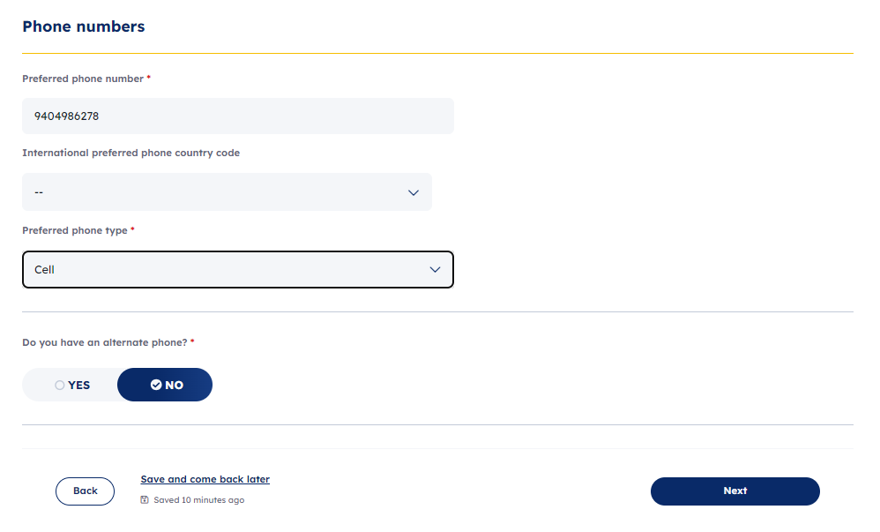
Enter YOUR cell number if you have one.
Cell numbers enable NCTC to send you reminders via text message.
Optional
Click Next

Slide 13
Background
Enter Date and place of birth.
Enter gender, race, ethnicity or “Prefer not to say.”

Slide 14
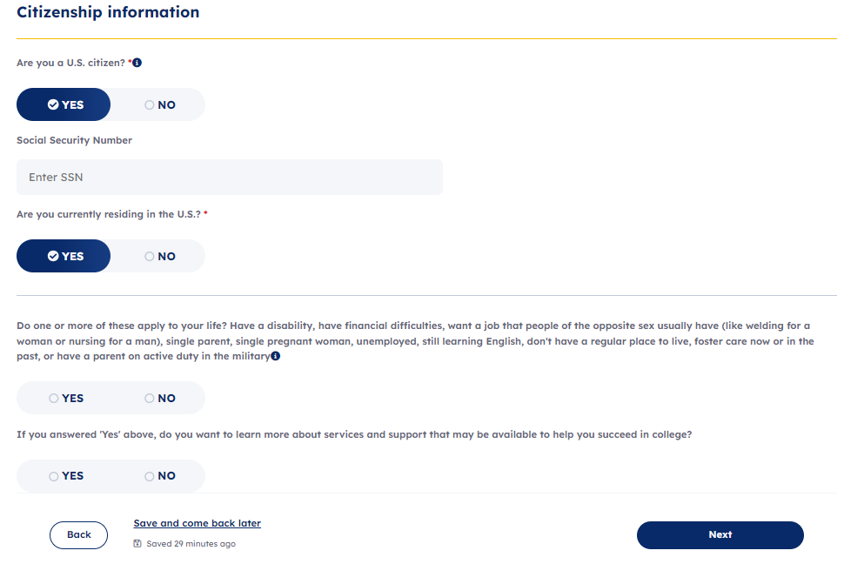
Only choose NO if you are NOT a US Citizen. Additional residency questions will appear.
REQUIRED>>>>>
Enter your social security number if you have one. This assists with processing at the college. Skipping this will flag you for additional verification paperwork.
Optional Questions
Click Next

Slide 15
Background Continued
Military Status – Optional to Answer
Foster Care
Language – Optional to add languages you speak

Slide 16


Household
Parents or guardians
  Add at least one parent or guardian info –
  option to add 2nd parent/guardian
  Gross income – you can SKIP this question
  Emergency Contact – provide your parent/guardian’s information
  and click and then

Slide 17
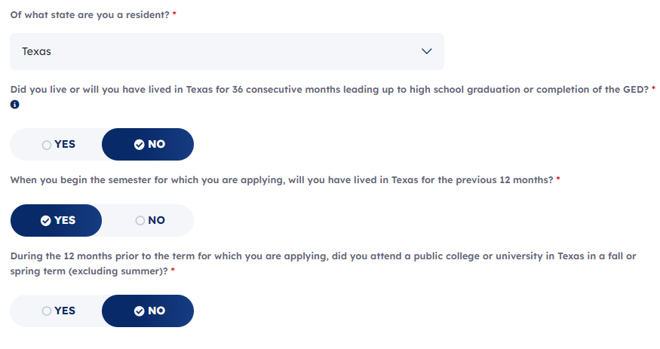
Texas Residency
VERY IMPORTANT TO ANSWER CORRECTLY!
If you are unsure, ask a dual credit success coach.
NO. You will not have graduated HS when you start classes.
Answer this question for yourself. Typically YES.
NO unless you took Dual Credit with another college/university. In that case, answer YES.

Slide 18
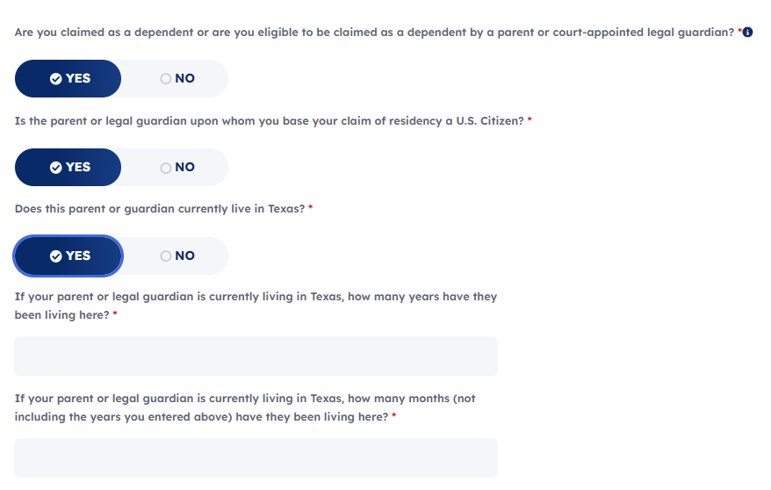
YES
Answer correctly YES/NO. Ask if you are not sure.
Very important to answer this YES! If you have a question, consult with a Dual Credit Success Coach.
You can estimate if you don’t know.
Put 0 if previous question was 1 year or more.

Slide 19
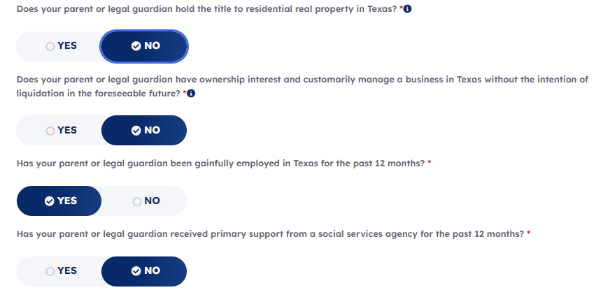
Select Yes or No. If yes, prompted to enter date acquired. Put YES if parents are buying or own a house.
Select Yes or No. If yes, prompted to enter date acquired.
Typically YES. Ask us if you are not sure!
Food stamps, disability, etc… Select Yes or No.

Slide 20
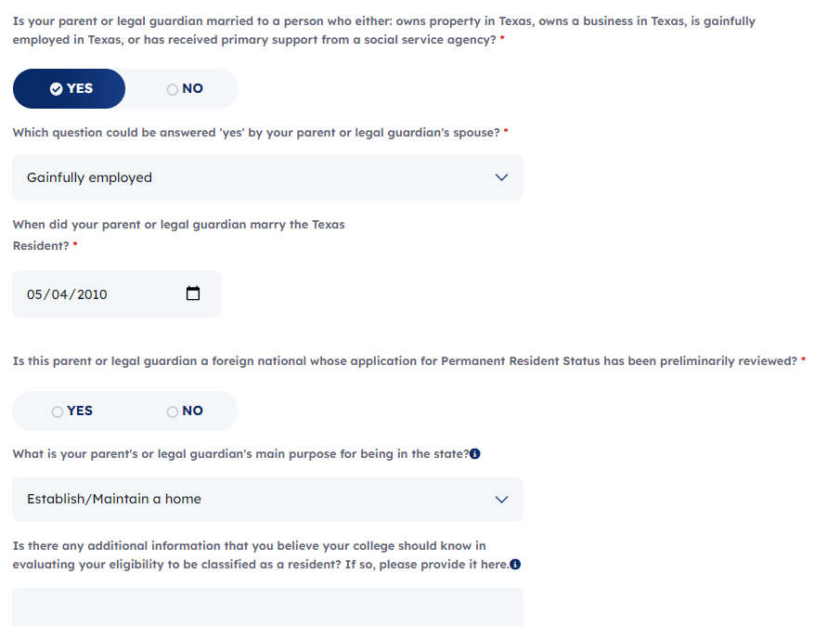

Frequent scenarios: Both parents work? Then, Yes. Both parents own your house? Then, Yes. Parent not married? Then no.
Pick one if prompted
You can estimate if you don’t know.
Answer if prompted
You can leave this blank.

Slide 21
Family Obligations
Answer for yourself

Slide 22
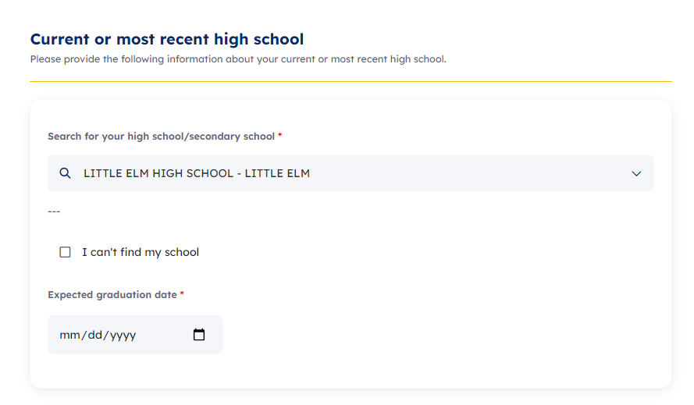
Select the high school that you will be attending once enrolled in dual credit.
You can estimate the month & day if you don’t know. Make sure to put the right year of your graduation.

Slide 23
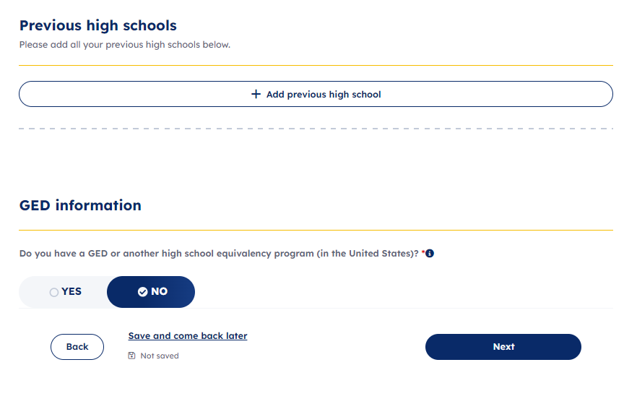
SKIP
NO
Click Next

Slide 24
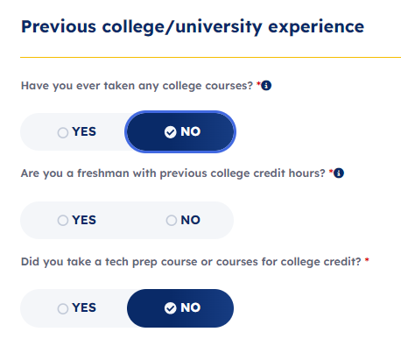
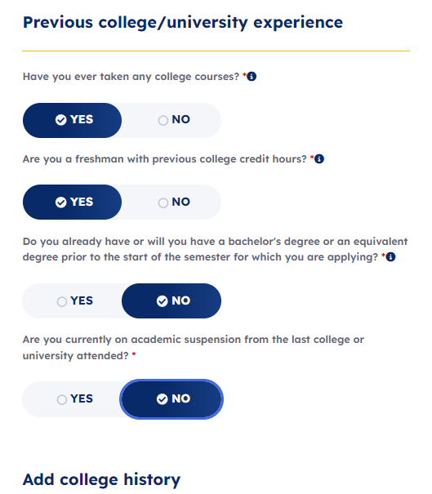


If this is your first time taking dual credit, answer NO.
If you have taken dual credit with another college, answer YES.
Provide the name of the college/university where you took Dual Credit previously.

Slide 25
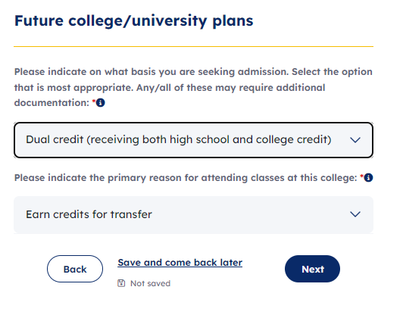

Slide 26

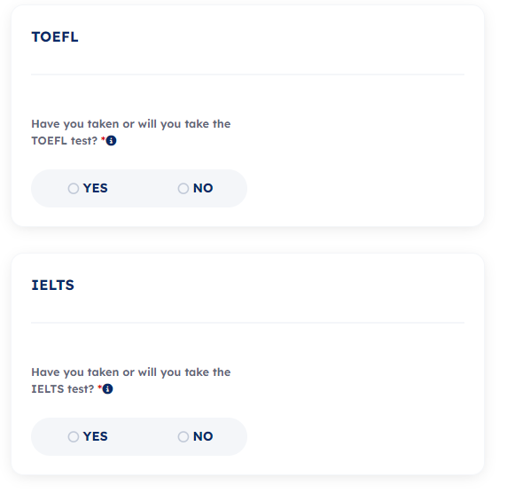
Advanced certifications
Entrance Exams
NO
NO

Slide 27
Activities and Achievements
SKIP extracurriculars, volunteer activities, awards and honors.
NCTC does not consider these things for dual credit admission.

Slide 28
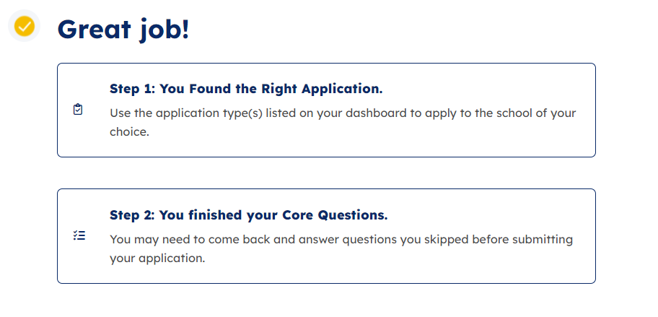
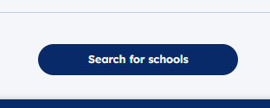
Scroll down to “Search for Schools” button & Click

Slide 29
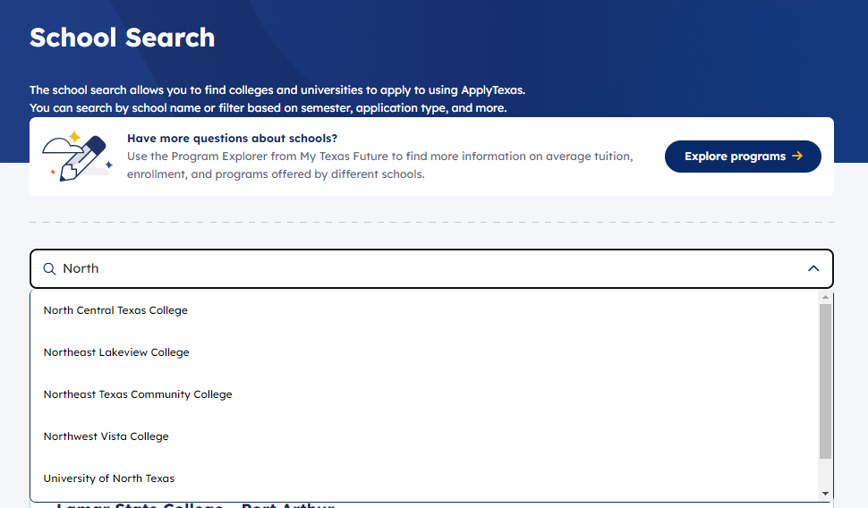
Type North in search bar. Then click
NORTH CENTRAL TEXAS COLLEGE

Slide 30
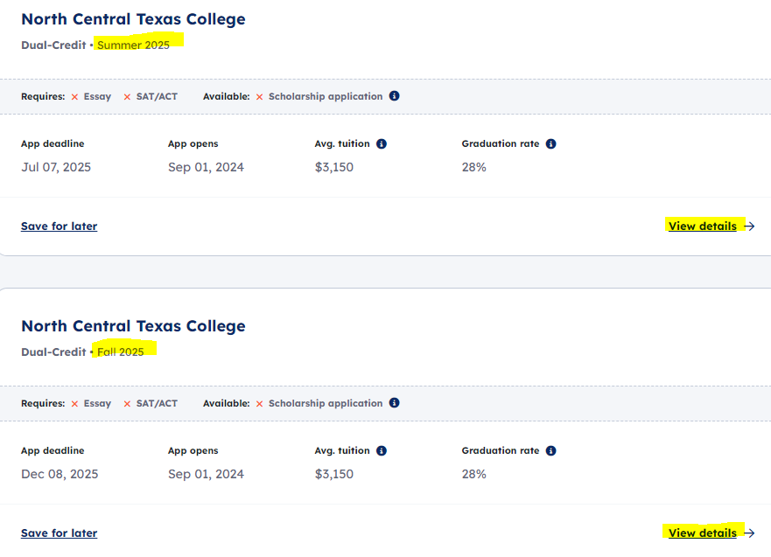
Scroll down to view all available application terms.
Click View Details for your desired start term.
Fall 2025 start? Click View Details here.

Slide 31
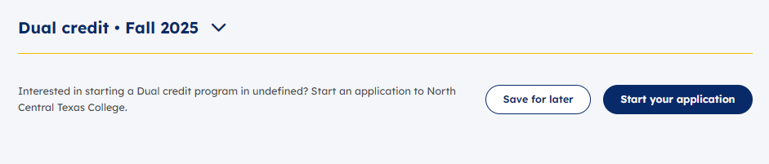
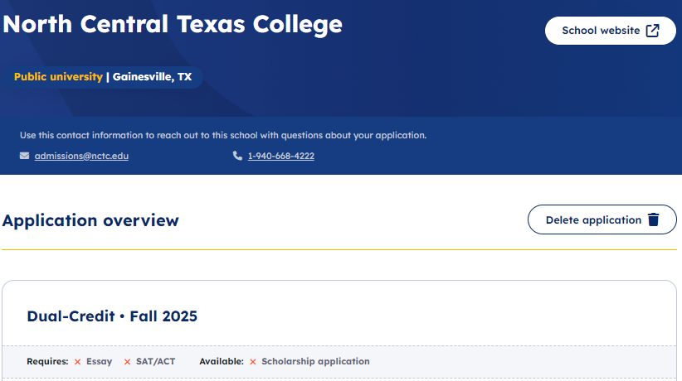



1. Click.
2. Is your start term correct?
3. Scroll down to “Next” button & Click.

Slide 32
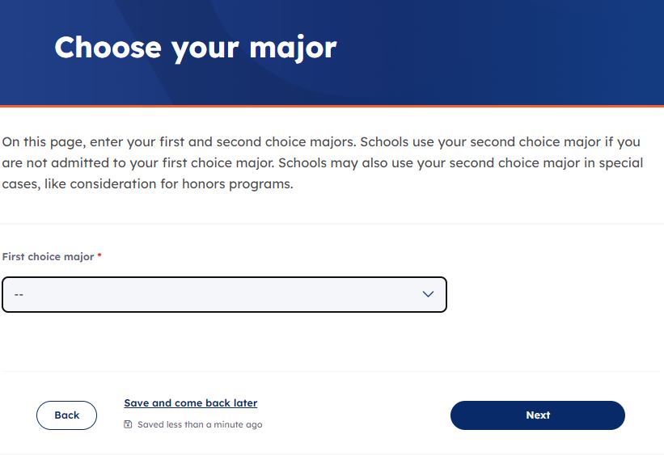
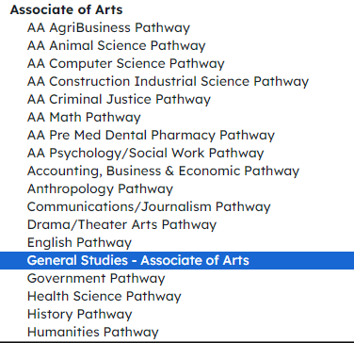
Select General Studies – Associate of Arts from dropdown menu.
Click

Slide 33


Questions with an asterisk (*) are required. Others, you may skip.
Campus > Pick the campus closest to where you live
  Lewisville ISD: pick Flower Mound
  All other Denton County public schools: pick Corinth
International Student > NOT APPLICABLE
SKIP Marital Status, College Prep Courses, ESL, Single Parent, Homemaker, Public Assistance questions
Employment > NOT Seeking Employment
Disability > Answer for yourself
Scholarship > VERY IMPORTANT TO MARK YES!
SKIP remaining questions
After answering questions

Slide 34

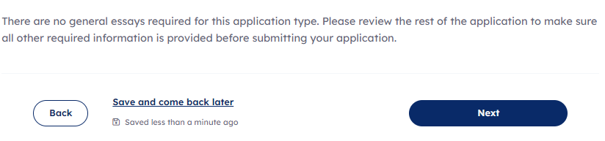
Click

Slide 35
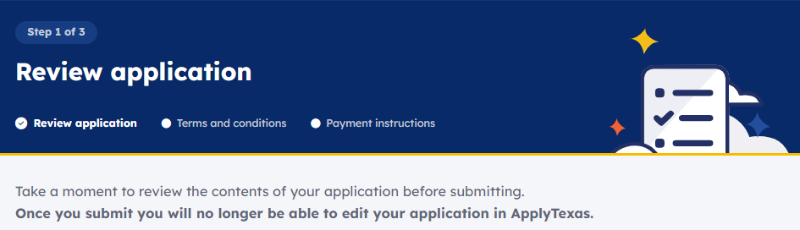
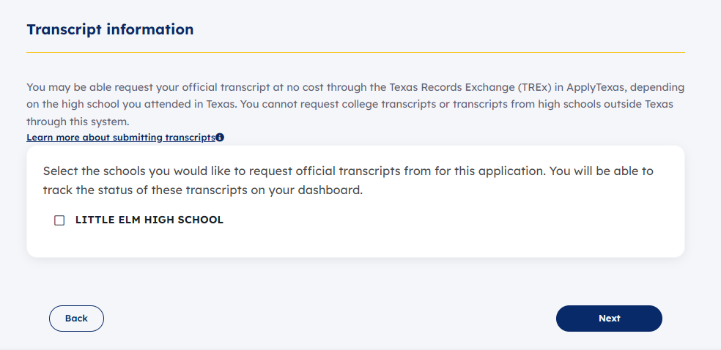
Scroll down to review
1. If available, check box to send transcript.
2. Click

Slide 36
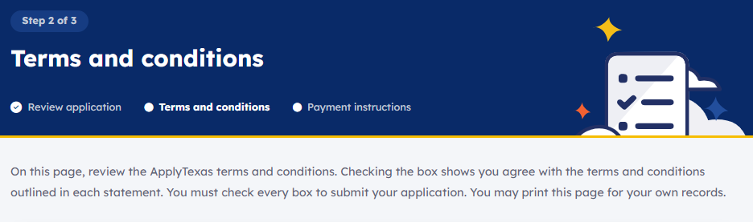
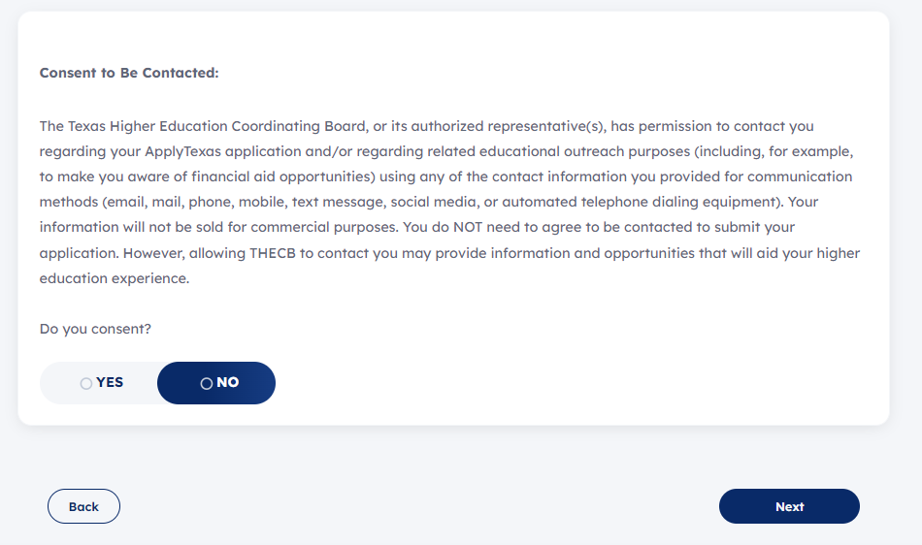
Read statements & check boxes.
Click.

Slide 37

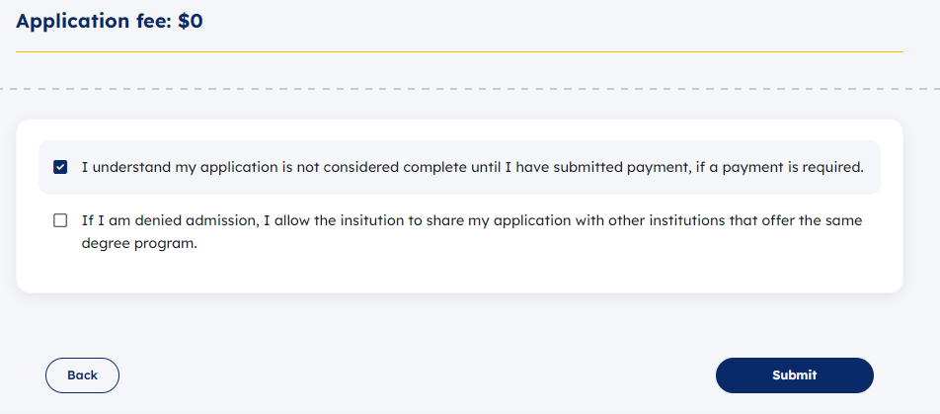
NCTC Application is free!
Check first box.
Click & Done!

