Slide 1

Welcome to our Student Council meeting!
Please sign in and have a seat! ☺

Slide 2
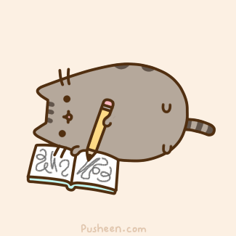
Applications!
These were due LAST FRIDAY!
If you do not turn them in by the end of today, you will not be able to join Student Council.
Please remind your teachers to return their recommendations to either Ms. Vines or Sra. N. Griffin.

Slide 3

Point System!
This year your Student Council membership will depend on a Point System.
Each month there will be opportunities to earn points by doing things such as going to school games, attending every StuCo meeting, wearing our StuCo shirts, participating in Spirit Days, etc.
You must earn a certain number of points each month in order to stay an active member of StuCo.

Slide 4
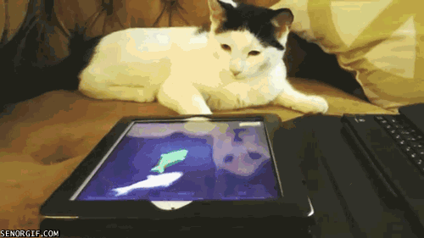
Do you want to be an officer???
We have 5 officer positions open
  President
  Vice President
  Secretary
  Treasurer
  Public Relations Officer

Slide 5
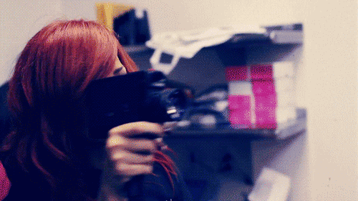
How do I become an officer?
You will need to create a 1-2 minute long video that includes the following:
  Your name
  What officer position you are running for
  Why you think you would be a good candidate for this position
Videos will need to be submitted to Google Classroom by Tuesday 9/26/17.
We will then watch the videos at the next meeting and vote for the candidates we think will do the best job in that position.

Slide 6

Sign up for Google Classroom and Remind 101!
Google Classroom:
  Go to classroom.google.com.
  Sign into your Google account.
  Click the + in the top right corner to add a class.
  Enter this code: uxrfx8
Remind 101:
  Text @kkbc3g to 81010

Slide 7
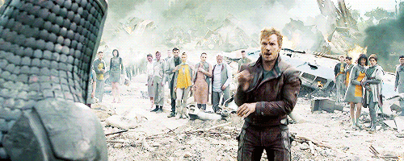
Leopardpalooza!!!
This year, our Leopardpalooza (Formerly Leopard Family Fun Night) will be on November 16, 2017.
It is our responsibility to organize this event and make sure that it runs smoothly.
We need you all to think of some fun activities that StuCo can be in charge of!
  For example, last year we ran the Bake Walk, Hot Chocolate Bar, Karaoke Booth, etc.

Slide 8
Pep Rally / Hispanic Heritage Month Assembly!
Pep Rally:
  We need 2 volunteers from each grade level to compete in a fun game for the Pep Rally.
  We also need 2 8th graders to volunteer to interview some of the athletes.
Hispanic Heritage Month Assembly:

Slide 9
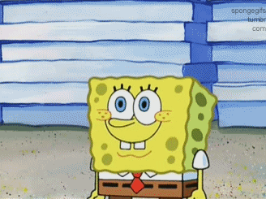
Next Meeting??
Thursday, September 28, 2017, before and after school in room 126.
There we will vote for Officers as well as discuss our ideas for Leopardpalooza.
Don’t forget! If you haven’t turned in your application, you need to do so by the end of TODAY!

