Slide 1

DDD TRANSITION PLANNING
TO HELP FAMILIES NAVIGATE THE SYSTEM & SERVICES
A Walk Through Transitioning Into The Division of Developmental Disabilities (DDD) system
Monique T. Lewis-Hawkins
Executive Director

Slide 2

TYPE AN EMOJI THAT REPRESENTS HOW YOU ARE FEELING TODAY

Slide 3

UNDERSTANDING THE ADULT SERVICE SYSTEM
When a person transitions from the School Service System to the Adult System Services are NOT Entitlements
A Person must Qualify/Eligible for Services

Slide 4
UNDERSTANDING THE ADULT SERVICE SYSTEM
Who qualifies for DDD in NJ?
Functional Criteria: To meet the criteria and qualify for DDD services as an adult in NJ, your child (or loved one) must have a chronic developmental disability (which can be physical and/or intellectual) that manifested (developed) prior to age 22 and is a lifelong condition.
EXAMPLES autism, behavior disorders, brain injury, cerebral palsy, Down syndrome, fetal alcohol syndrome, intellectual disability, and spina bifida.
A mental illness doesn't typically interfere with cognitive abilities whereas a developmental disorder may impact a person's ability to learn or to understand certain thoughts
(Developmental Disabilities Assistance and Bill of Rights Act of 2000)

Slide 5


* APPLY FOR MEDICAID ELIGIBILITY
* APPLY FOR DDD ELIGIBILITY
* COMPLETE NJCAT
* COMPLETE THE AGENCY SELECTION FORM
Children Graduating & Aging Out of The School System
Steps

Slide 6

ACCESSING ADULT SERVICES FROM THE NJ DIVISION OF DISABILITIES
Step
Apply for Medicaid Eligibility
www.nj.gov/humanservices/ddd/ services/medicaideligibility.html
Your local County Board of Social Services
Social Security and Medicaid
County Medicaid
For additional help contact: DDD. MediEligHelpdesk@dhs.state.nj.us

Slide 7

ACCESSING ADULT SERVICES FROM THE NJ DIVISION OF DISABILITIES
Step
Apply for DDD Eligibility
Community Services Offices
Flanders: 973-927-2600
Freehold 732-863-4500
Mays Landing: 609-476-5200
Newark: 973-693-5080
Patterson: 973-977-4004
Plainfield: 908-226-7800
Trenton: 609-292-1922
Voorhees: 856-770-5900
To download the application go to:
www.nj.gov/humanservices/ddd/services/appl/index.html

Slide 8

ACCESSING ADULT SERVICES FROM THE NJ DIVISION OF DISABILITIES
Step
Complete the NJCAT
The NJCAT assessment is divided into categories:
Medical
Behavioral
Self Care
*NJCAT DRIVES THE BUDGET
      Tier from A – E
      Acuity

Slide 9
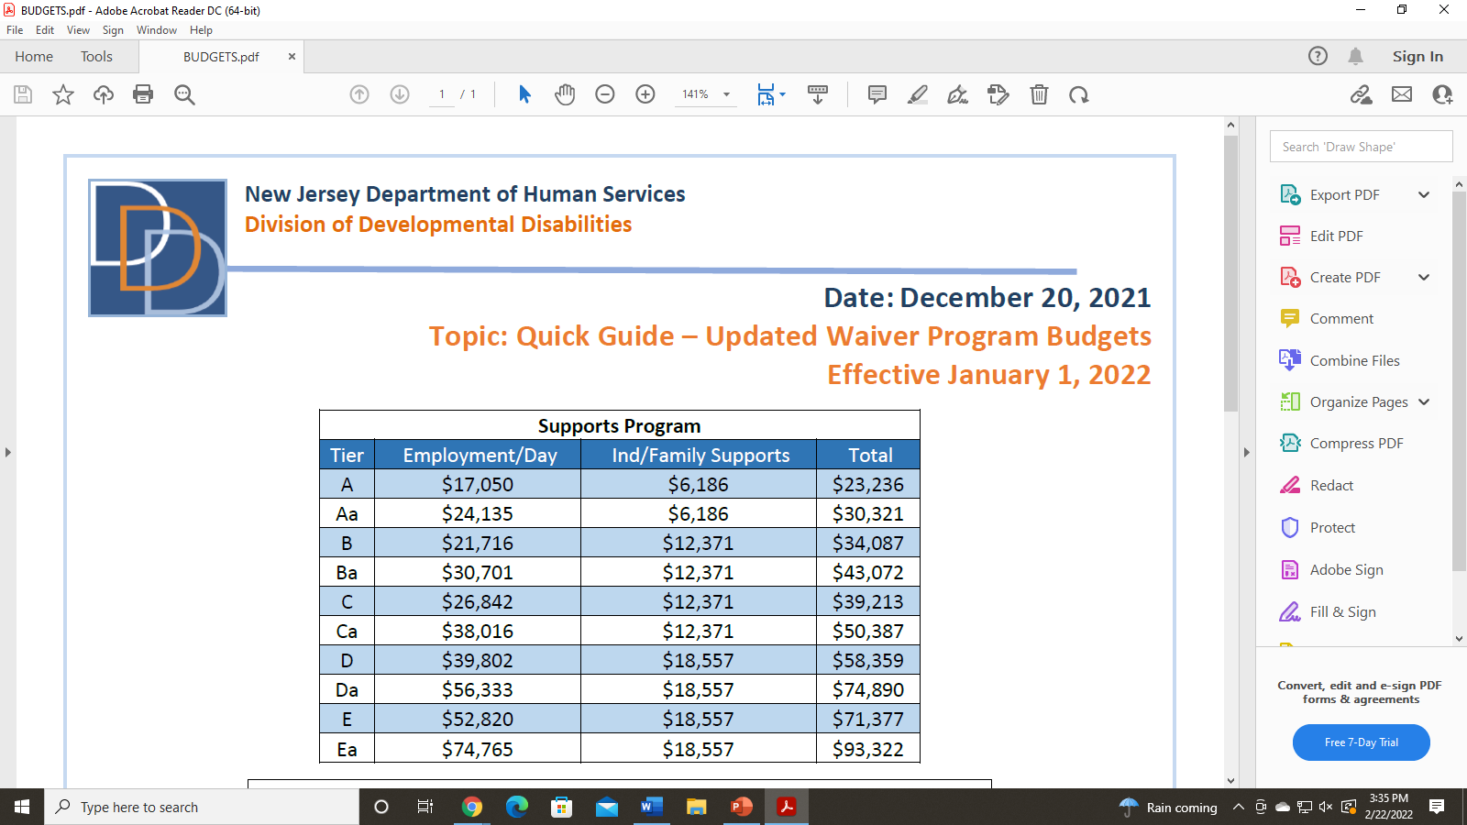
BUDGET

Slide 10
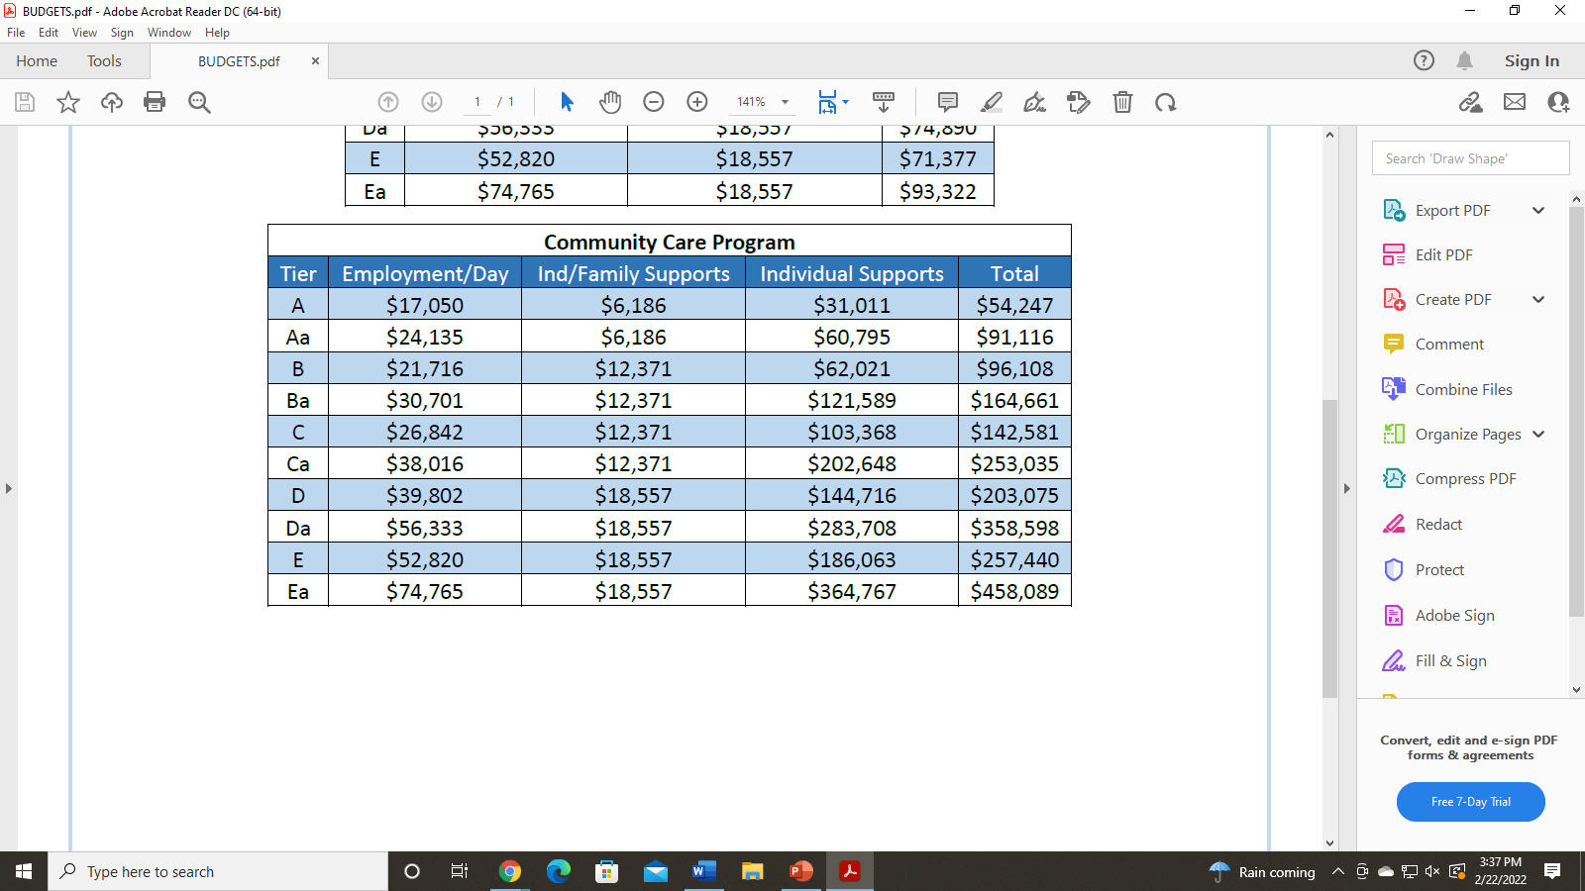
APPLY APPLY APPLY!
BUDGET

Slide 11


ACCESSING ADULT SERVICES FROM THE NJ DIVISION OF DISABILITIES
Step
Complete a Support Coordination Agency Selection Form

Slide 12

* APPLY FOR MEDICAID ELIGIBILITY
* APPLY FOR DDD ELIGIBILITY
* COMPLETE NJCAT
* COMPLETE THE AGENCY SELECTION FORM
Children Graduating & Aging Out of The School System
Step
REVIEW

Slide 13

Organization Qualified by DDD to Assist Participants in Gaining Access to the Services and Supports
They Need
Support Coordination Agencies
What is a Support Coordination Agency ?

Slide 14

Support Coordination Agencies
Employ Support Coordinators
Identify a persons needs
Develop plans
Locate Services
Monitor Supports
Respond to Emergencies
What is a Support Coordination Agency ?

Slide 15
HOW DOES A FAMILY FIND A LIST OF SUPPORT COORDINATION AGENCIES?
Google NJ DDD Support Coordination Agencies
DDD website
Is accepting new families!
Everyone Deserves An Equal Opportunity
732-641-0660
www.EqualOpportunitySupportServices.org

Slide 16

HOW DOES A FAMILY CHOOSE?
What is a Support Coordination Agency ?

Slide 17
ADVISING FAMILIES HOW TO
CHOOSE A SUPPORT COORDINATION AGENCY
Ask
What is important to their child?
People
Places
Interests

Slide 18
WHAT SUPPORTS DOES THEIR CHILD NEED AS AN ADULT ?
Safety
Health
Finances
Behavior
Daily Living
Transportation
Community Inclusion
Wellness
Ask

Slide 19

WHAT DO THEY WANT FROM A SUPPORT COORDINATOR?
An agency that recognizes what's important to thier child, can identify what they need and want - then put a plan in place to achieve those desires

Slide 20


HOW MANY PEOPLE DOES THE AGENCY SUPPORT?
Questions to ask Support Coordination Agencies

Slide 21

WHAT IS THIER TURNOVER RATE?
Questions to ask Support Coordination Agencies

Slide 22


HOW DOES THE AGENCY MATCH PEOPLE WITH SUPPORTS COORDINATORS?
Questions to ask Support Coordination Agencies

Slide 23

HOW LONG HAS THE AGENCY PROVIDED SERVICES?
Questions to ask Support Coordination Agencies

Slide 24

HOW LONG DOES THE AGENCY RESPOND TO AFTER HOUR NEEDS?
Questions to ask Support Coordination Agencies

Slide 25


Slide 26

Which agency understands their child's disability?
Which agency seems to be responsive?
Which agency seems to have the skills and knowledge you are looking for?
Which agency seems to have dedicated people?
What did you think about the agencies you interviewed?

Slide 27
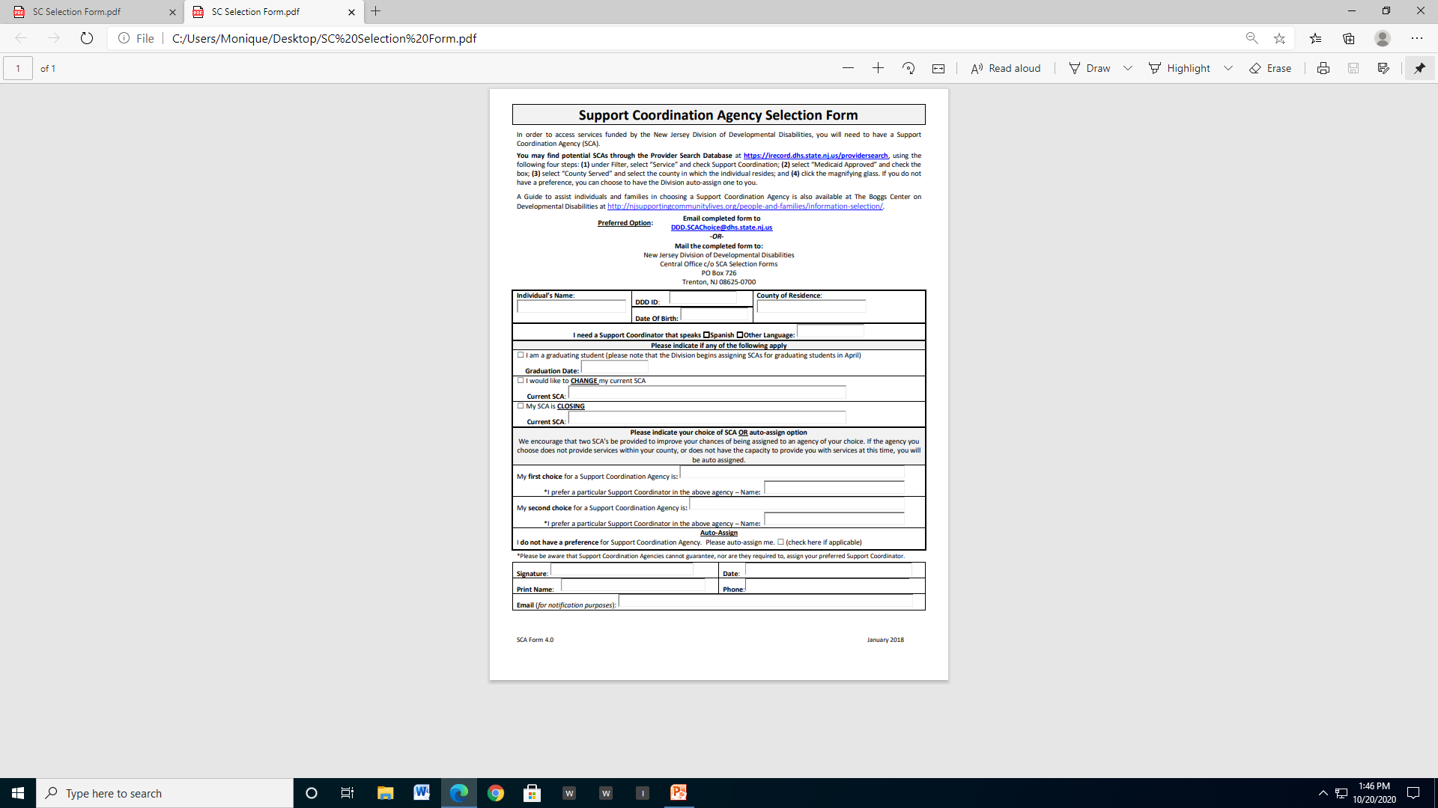
Submitting Their Selection

Slide 28
1. APPLY FOR MEDICAID ELIGIBILITY
2. APPLY FOR DDD ELIGIBILITY
3. COMPLETE THE NJCAT
4. SELECT A SUPPORT COORDINATION AGENCY
Another
Step review

Slide 29
SEPTEMBER – JUNE
WEBINARS
EXPOS
TRAININGS
PCP TOOL
CARE MANAGEMENT
Planning and Preparation

Slide 30
FEBRUARY – MARCH
Planning and Preparation
Select a
Support Coordination agency or one will be
auto assigned!

Slide 31
APRIL
DDD WILL ASSIGN
A SUPPORT COORDINATION AGENCY
Planning and Preparation

Slide 32
HOW DOES DDD WORK ?
Assigned budget is managed through a computer program called Irecord
Irecord keeps all of your DDD information (personal / budget info etc.)
The Support Coordinator has access to Irecord
When you want to access your budget
Add services

Slide 33
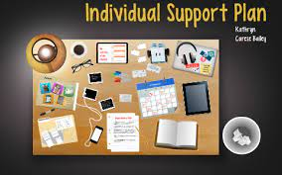

MAY – JUNE
ISP DEVELOPED
Work with assigned Support Coordination agency to identify services

Slide 34


Slide 35

ASSISTIVE TECHNOLOGY
An item, piece of equipment, or product system used to increase, maintain, or improve an individual’s functional capabilities

Slide 36

BEHAVIORAL SUPPORTS
Counseling, behavioral intentions, and / or diagnostic evaluations / consultations to help an individual manage their behaviors and learn to interact with others.

Slide 37

CAREER PLANNING
Employment planning to help an individual get and keep a job

Slide 38

COGNITIVE REHABILITATION
Therapeutic cognitive activities to help an individual with a neurological impairment learn new and different ways to function

Slide 39

COMMUNITY BASED SUPPORTS
One-to-one direct support that promotes increased independence, productivity, enhanced family functioning, and inclusion in the community

Slide 40

COMMUNITY INCLUSION SERVICES
Direct support to assist a group of 2-6 individuals in educational, enrichment, or recreational activities

Slide 41

COMMUNITY TRANSITION SERVICES
Set-up expenses for an individual transitioning from an institutional setting to a less restrictive living arrangement where the individual will be responsible for living expenses

Slide 42

DAY HABILITATION
Education/training that assists an individual in gaining the skills needed to participate in the community (problem-solving skills, self-help skills, social skills, adaptive skills, daily living skills)

Slide 43

ENVIRONMENTAL / VEHICLE MODIFICATIONS:
Physical adaptations to the private residence of an individual/family to ensure the health, welfare, and safety of the individual or to enable the individual to function with greater independence in their residence

Slide 44

FISCAL MANAGEMENT SERVICES:
Assistance with disbursement of funds for Self-Directed Employees and fiscal
accounting (referred to as Fiscal Intermediary, or FI)

Slide 45




GOODS AND SERVICES
Services, equipment, or supplies not provided through other waiver program services, or other resources that address an identified need

Slide 46



INTERPRETER SERVICES:
Face-to-face support to assist an individual to integrate more fully with community-based
activities and employment

Slide 47
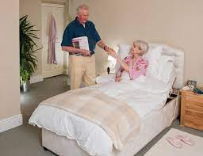
NATURAL SUPPORTS TRAINING

Slide 48
SPECIAL NEEDS COLLEGE PROGRAMS
Arc of Somerset Achievement Zone at Raritan Valley Community College
Bergen Community College - Turning Point Program
Brookdale Community College - KACH Program
College Of Saint Elizabeth
County College of Morris
Drew University
Fairleigh Dickinson University-
Compass Program
Kean University- College Steps
Mercer County Community College DREAM program
Ramapo College- Enhance Program
Rowan/Gloucester County College Adult Center for Transition
Rutgers University -The College Support Program
Seton Hall University
Sussex County Community College- LACE program
Stockton University- Learning Access Program
The College of New Jersey

Slide 49
HOW TO GET STARTED?
After assigned to a Support Coordination you will receive a call within 3 days
Schedule a meeting to develop a plan and discuss services
Support Coordinator will reach out to providers
Exploratory plan
Plan approved in 30 days
Services start

Slide 50
GUARDIANSHIP
COMMUNITY HEALTH LAW PROJECT
PROVIDES LEGAL AND ADVOCACY SERVICES TO NJ RESIDENTS WITH DISABILITIES.
Guardianship
Social Security
Welfare
Food stamps
Medicaid
Medicare
Insurance issues
Housing
Landlord-tenant disputes
Foreclosure
Debt collection
Child support
Domestic violence
Contact
Essex - 973-680-5599 Union - 908-355-8282

Slide 51
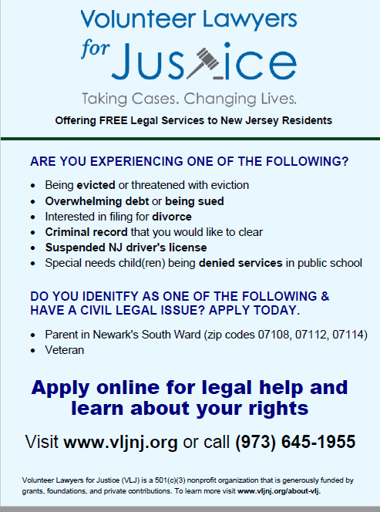

Slide 52
GUARDIANSHIP RESOURCES AND INFORMATION
Bureau of Guardianship Services-guardianship services for DDD eligible consumers
NJ Judiciary- website provides forms to file for guardianship, information, training and report forms
Perform Care- provides access to services for children under 21 years old, from NJ’s Children’s
NJ Surrogates- websites
Guardianship Services of NJ Inc.-provides assistance with Pro-Se guardianship for a fee
Community Health Law Project-Legal assistance for individuals receiving services from DDD.
Guardianship Association of NJ (GANJI)
Rutgers, School of Law-law school students assist

Slide 53


Slide 54
ACCESSING ADULT SERVICES FROM THE NJ DIVISION OF DISABILITIES
Everyone Deserves An Equal Opportunity
732-641-0660
www.EqualOpportunitySupportServices.org

Slide 55
INFORMATION FOR THIS PRESENTATION HAS BEEN ADAPTED FROM
The Boggs Center on Developmental Disabilities “Selecting a Support Coordination Agency”
The PA Training Partnership for People with Disabilities and Families, Temple University/UCEDD. “Choosing a Support Coordination Organization”.
Maryland, Developmental Disabilities Administration, Dept. of Health and Mental Hygiene
National Resource Center for Participant Directed Services. (2010). “Developing and Implementing Participant Direction Programs and Policies: A Handbook.”
NJ Division of Developmental Disabilities, Graduates Timeline

