Slide 1
Welcome to ELAC!
¡Bienvenidos a ELAC!
به ELAC خوش آمدید!
Добро пожаловать в ЭЛАК
LEADERSHIP WORKSHOP
SUBHEAD
English Learners Advisory Committee
November 19, 2024
DATE

Slide 2
Introductions
LEADERSHIP WORKSHOP
SUBHEAD
Allen Sims -- Principal KHS and PCDS
Emma Falcon -- Community Schools Facilitator
Carla Davis -- Community Schools Coordinator
Janie Munson -- English teacher
Ellen Chrismer -- Instructional Coach
Parents
.
DATE

Slide 3
Activity -- Four Corners
LEADERSHIP WORKSHOP
SUBHEAD
If everyone could please stand up,
We will be answering the following questions:
DATE

Slide 4
What grade is your student in?
Do you feel like you get the updates to events and activities?
Preferred mode of communication
Notes:
Notes: Parents like phone/text and fliers at dropoff. They feel like they are informed about events. More training is needed on ParentSquare.

Slide 5
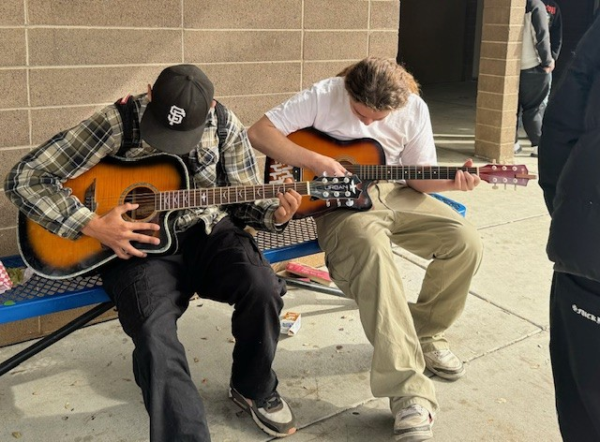
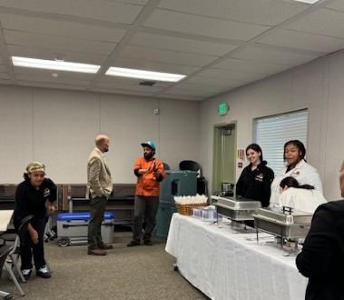
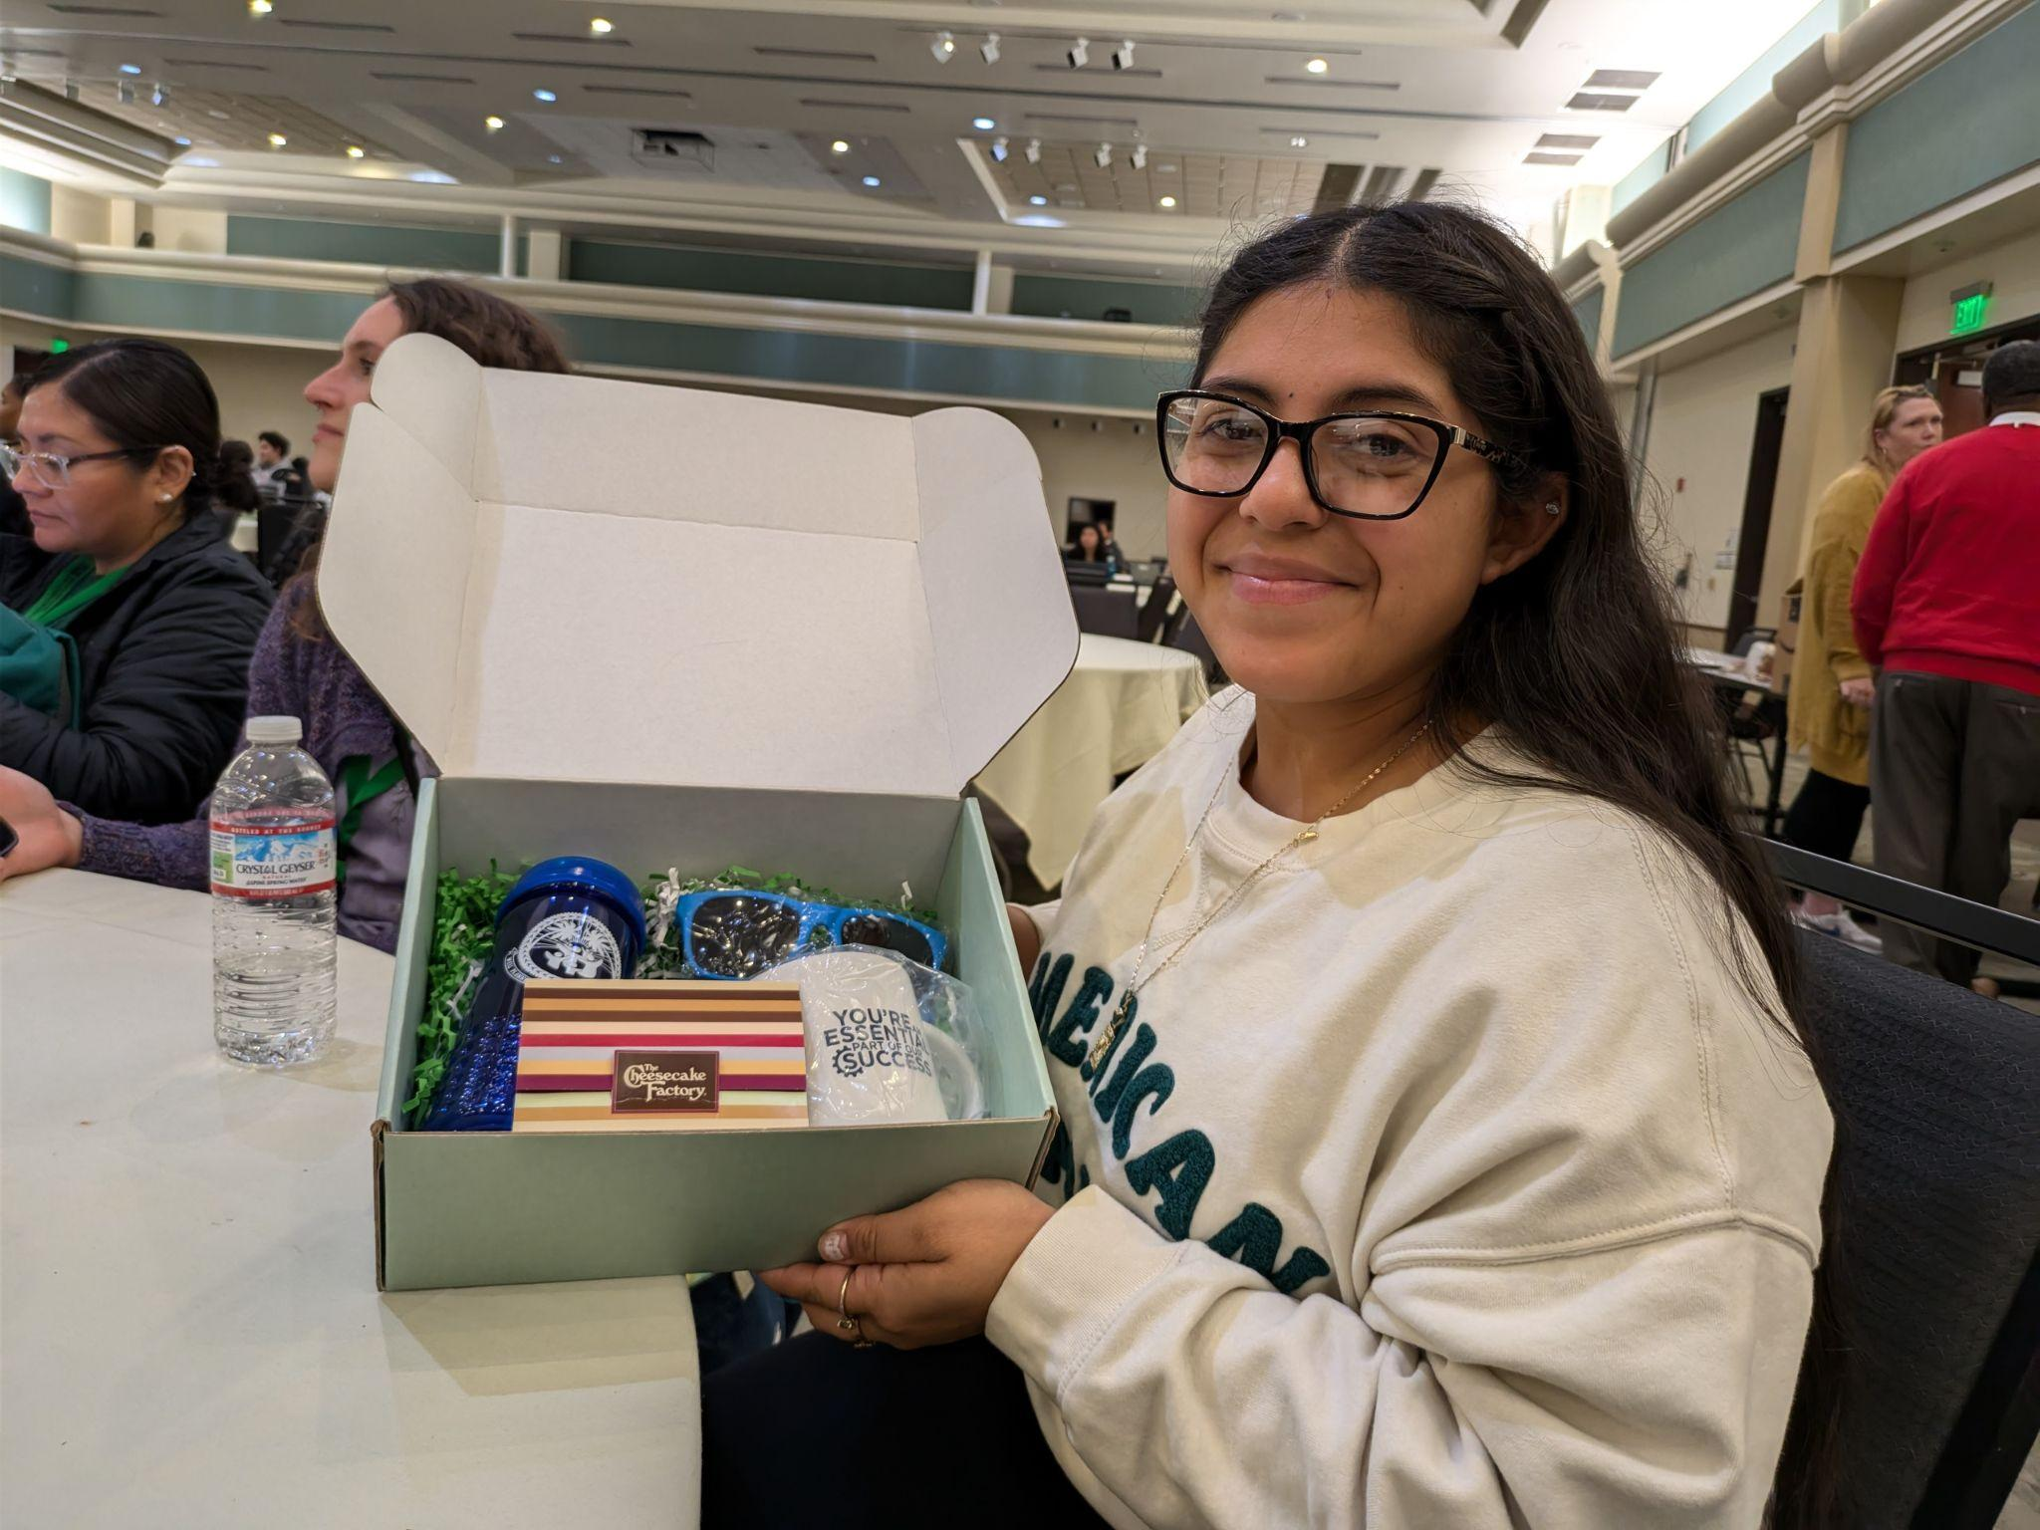
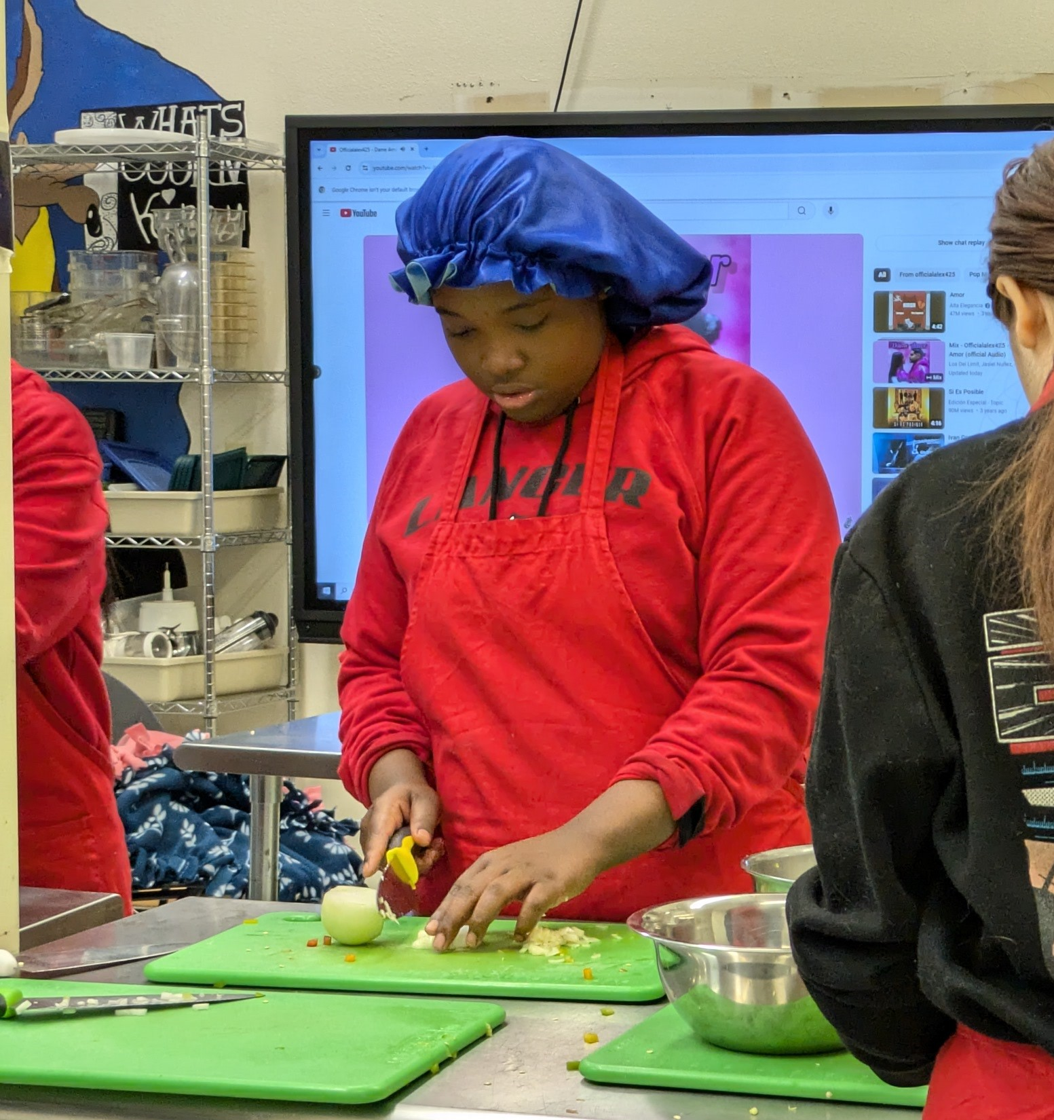
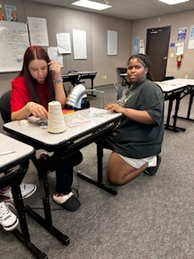
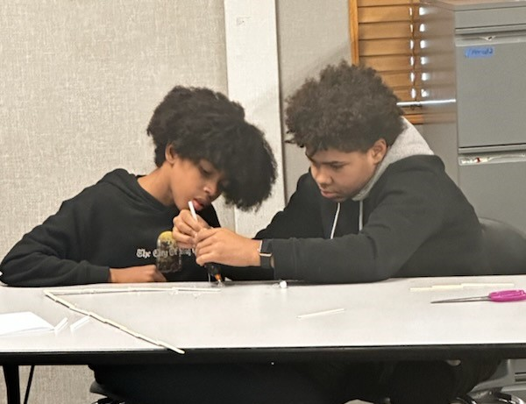
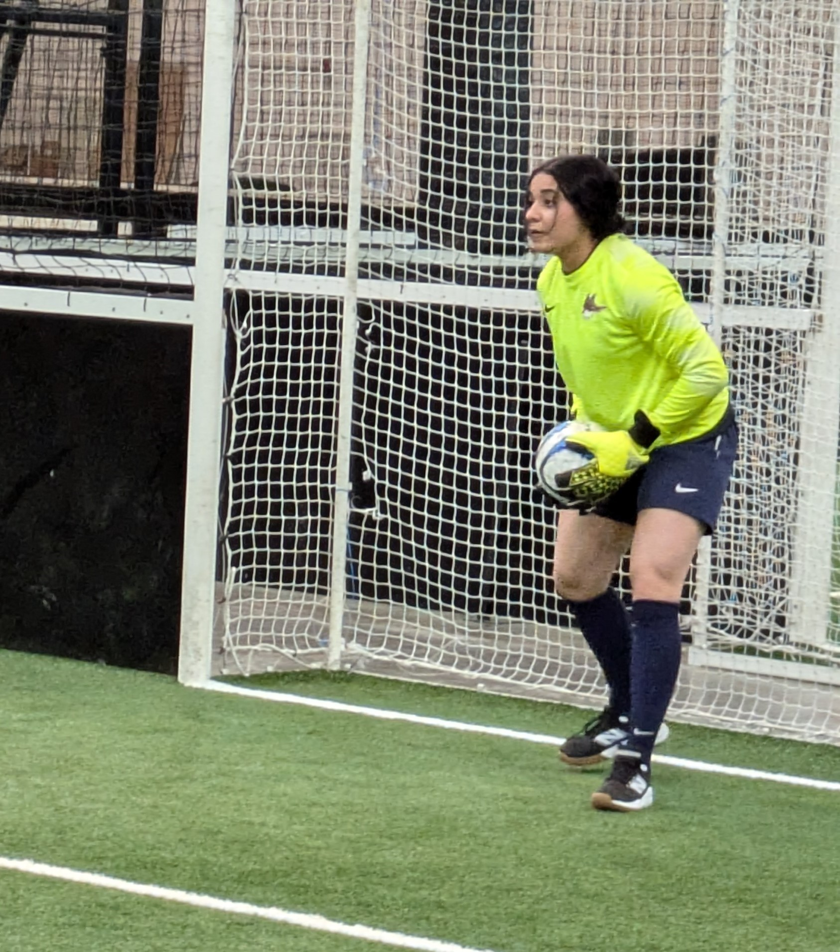
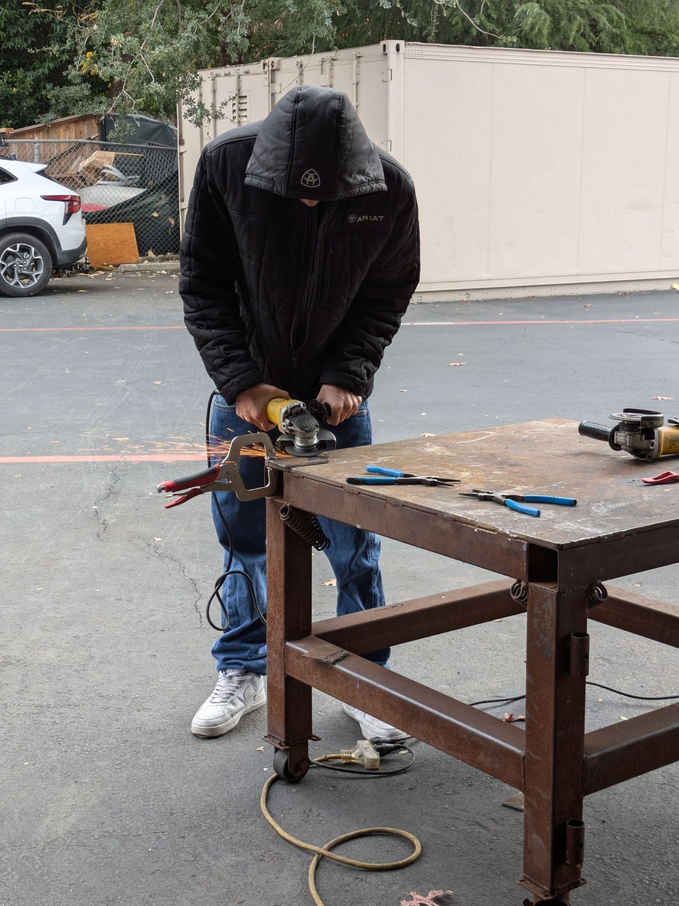
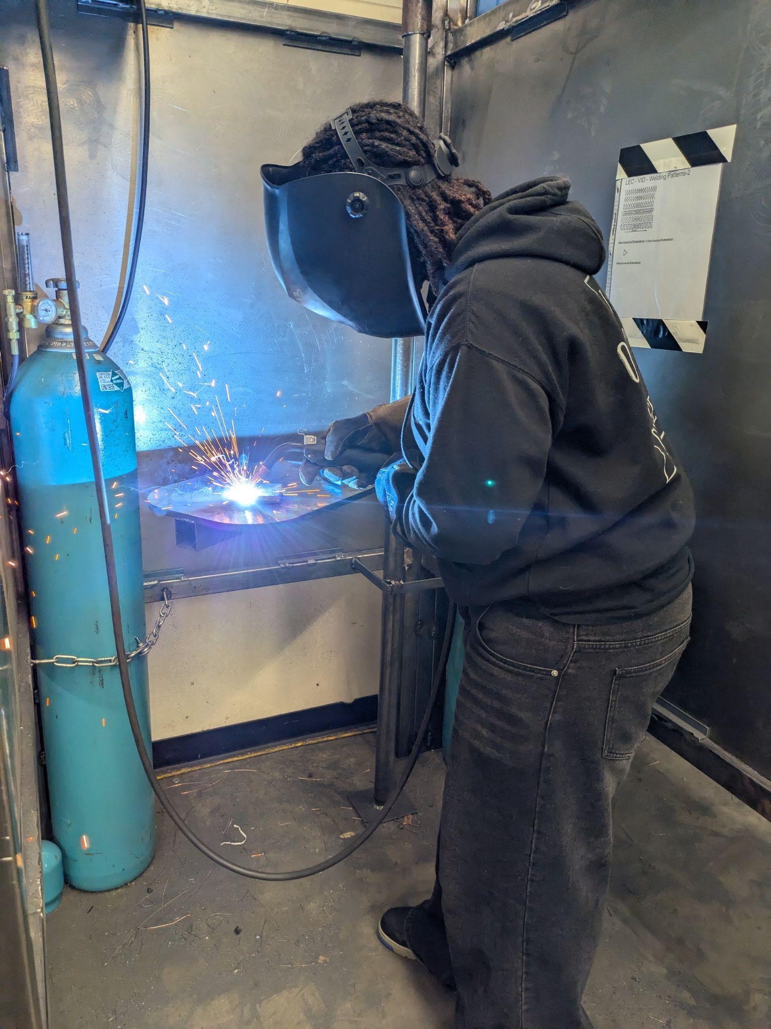
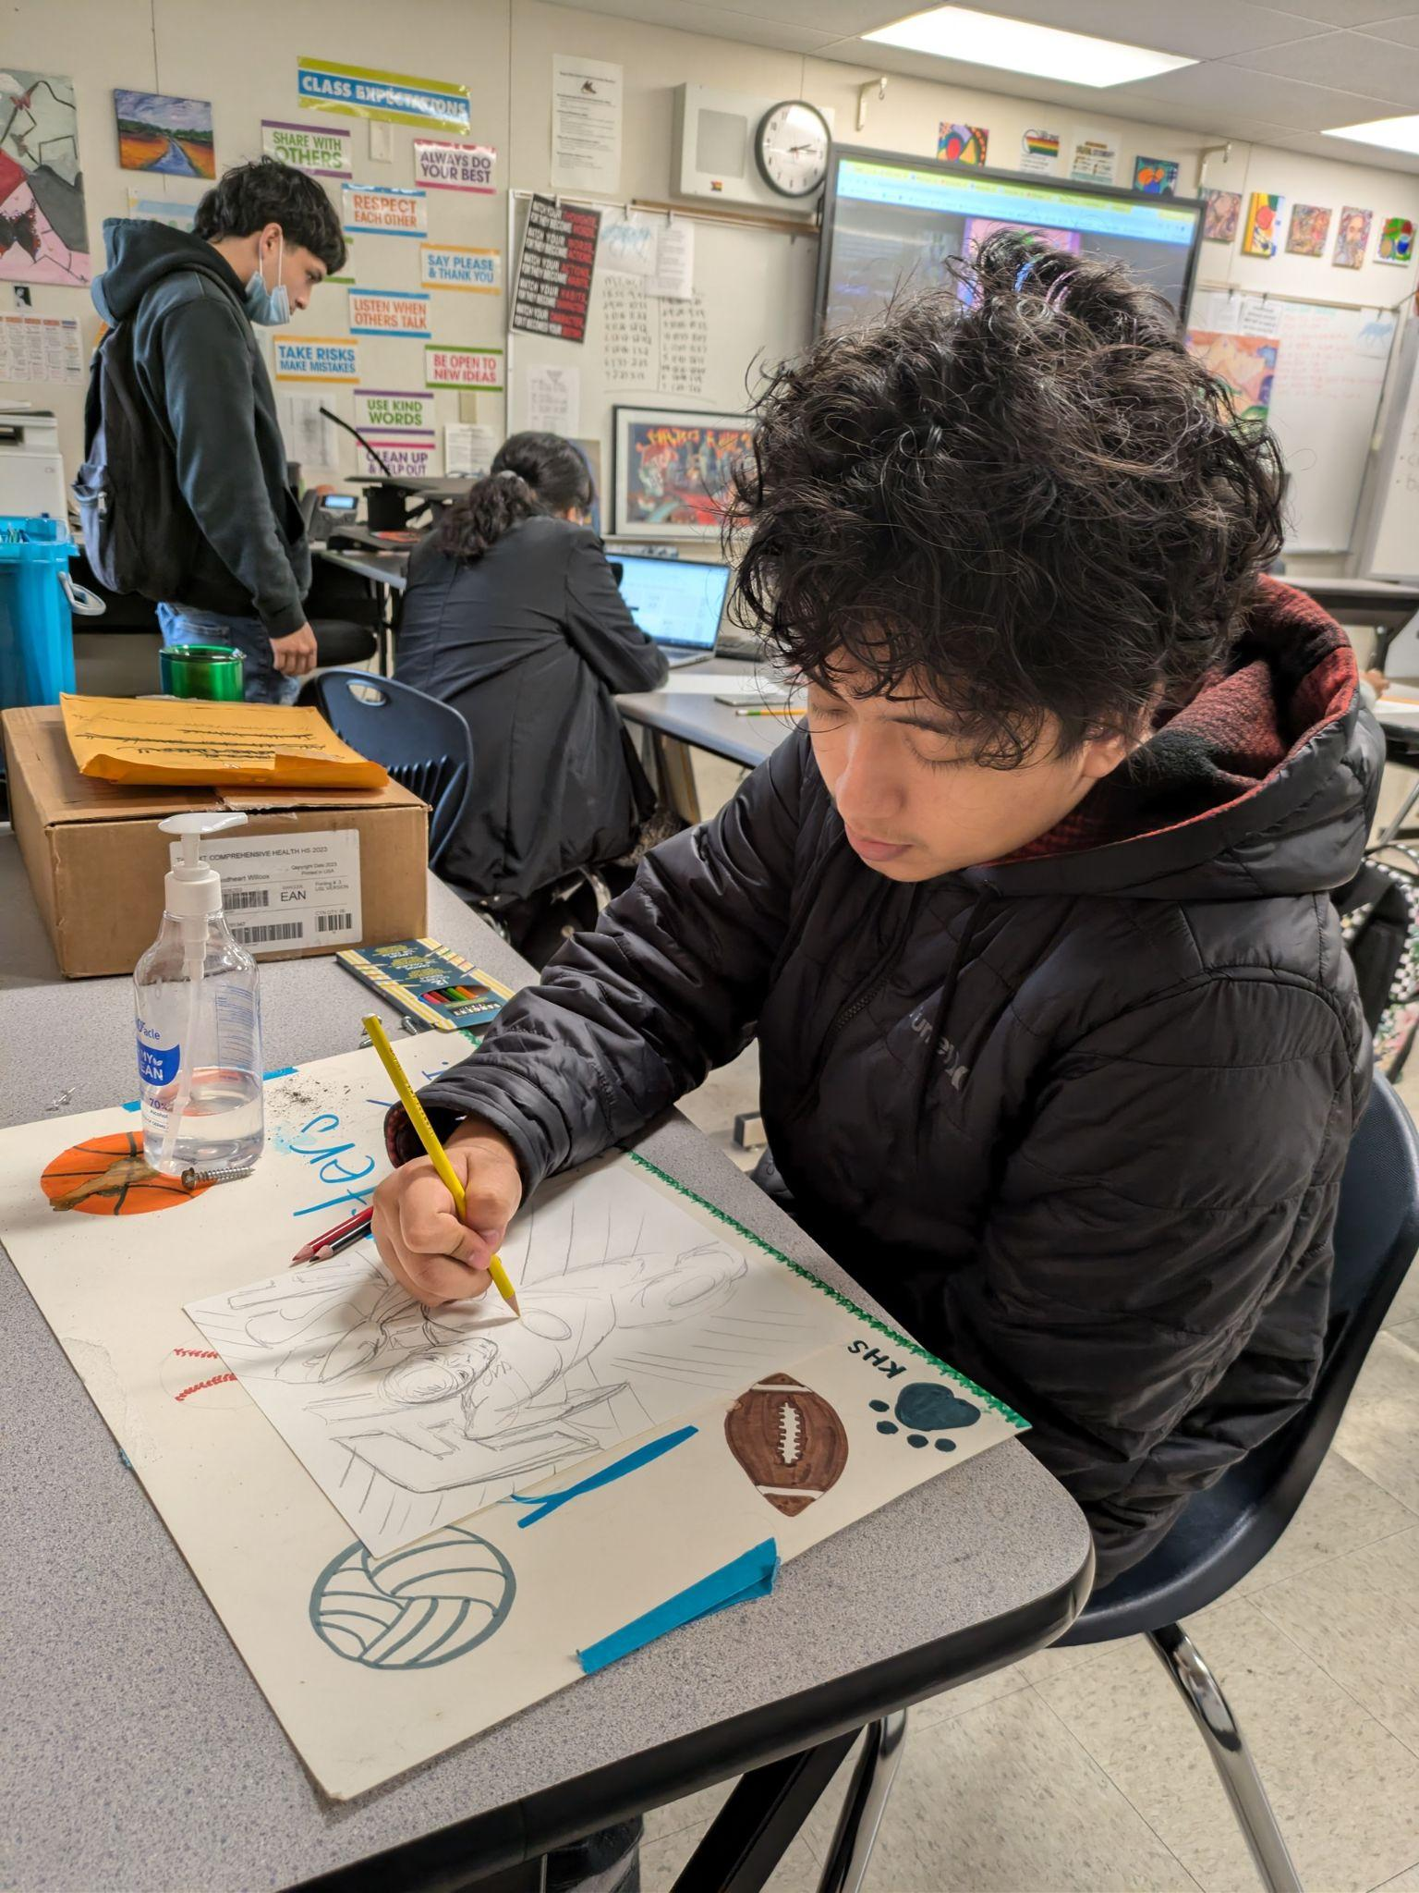
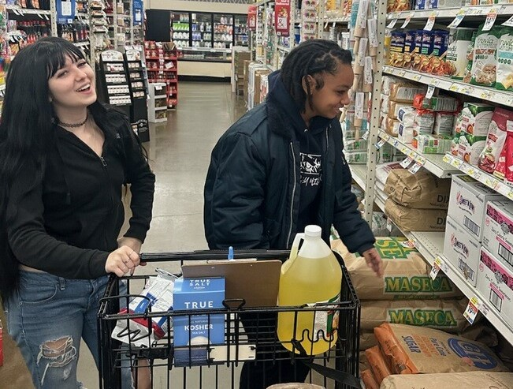
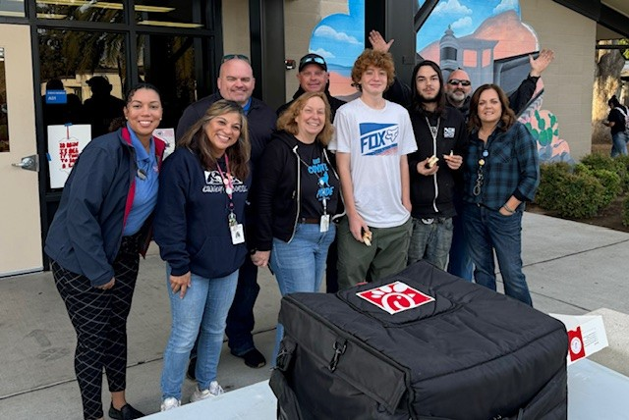
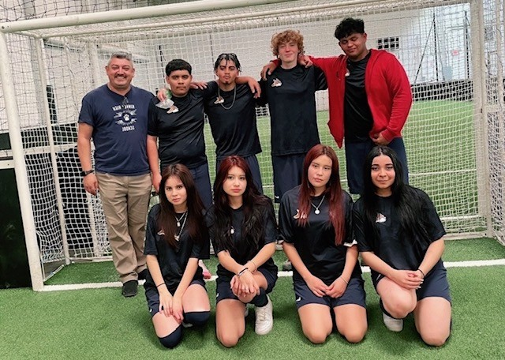
LEADERSHIP WORKSHOP
SUBHEAD
DATE
Notes:
Student Melany Perez talked about her experience on the soccer team, which she thinks should be continued next year. She is happy to see students who are not normally involved in extracurricular activities (our ELs) participate.

Slide 6
Announcements:
Testing -- ELPAC for all English Learner students beginning Feb. 24
CAASPP (English and Math for 11th graders) CAST -- (science for 12th graders) beginning March 31.
2 ) District Needs Assessment -- please share with friends, at church, etc. This is for families of all students at Title I schools to share their voices and concerns.
Notes:
Discussion centered on preparation for the exams. Teachers will begin working with students on the Interim Assessments after Thanksgiving break. Parents received copies of the needs assessment.

Slide 7
Academics
At KHS and
Prospect
LEADERSHIP WORKSHOP
Thoughts:
How do students make up credits at KHS?
How do students make review at Prospect?
SUBHEAD
What are your questions?
What supports do students learning English have in the classroom?
DATE
What is a formative assessment? What is a summative assessment?
Notes:
Prospect parent had questions about review. Her daughter was enjoying Prospect and thriving. She was concerned about the review that would send her back to CHS. Allen Sims, principal said he would meet with the student and talk to her about her concerns.

Slide 8
School Site Council
LEADERSHIP WORKSHOP
Agenda items
SUBHEAD
01 Choose a District Advisory Rep
02 Goals for next year-continue with Art, dual enrollment
03 Strength & Needs Activity (SSC & ELAC)
Community Schools Grant
04 Questions and comments
05 Adjournment
DATE

Slide 9
Carla Davis, Community Schools Coordinator
-Prospect CS Grant Info
-Family Feedback Poster Activity
LEADERSHIP WORKSHOP
SUBHEAD
What we love about our school Lo que nos encanta de nuestra escuela | Questions we have about our school Qué preguntas tienes para tu escuela
What DO I give to our school? Que le dasa tu escuela? | What CAN I give to our school? Qué puedes donar a tu escuela?
What we love about student learning Lo que nos encanta de aprender | Questions we have about student learning Preguntas que tenemos sobre el aprendizaje
DATE

Slide 10
Next Meeting Feb. 25
LEADERSHIP WORKSHOP
Agenda items?
SUBHEAD
01
02
03
04
DATE

