Slide 1
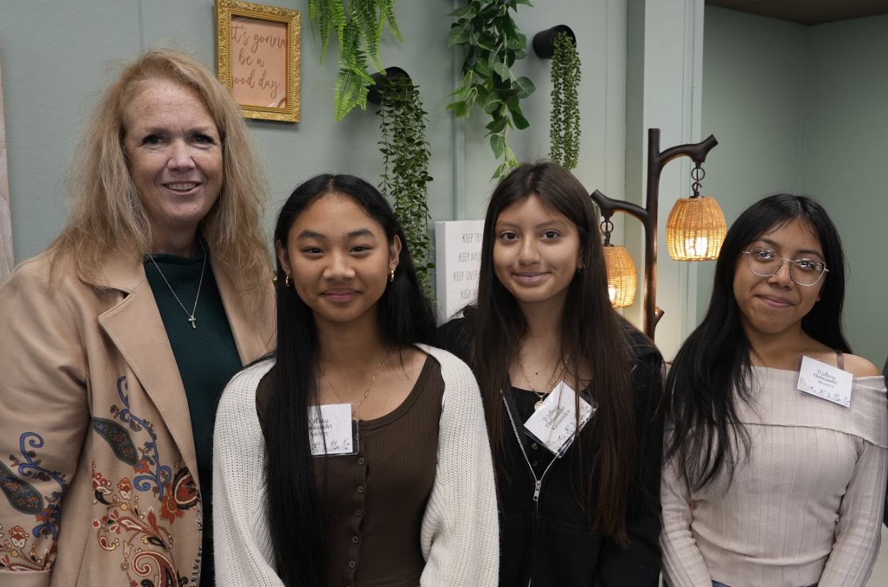
Sharon Brown
Principal
Adam Stickles
Vice-Principal
Notes:
Here’s an outline for a recruitment meeting slide presentation tailored to your school’s activities, programs, and values. Each slide includes suggestions for making it visually engaging and interactive.
Slide 1: Welcome to [Your School Name]!
Content: Introduce the school, mission statement, and a warm welcome.
Design: Use a school logo, bright visuals, and a dynamic photo collage of smiling students participating in activities.
Engagement: Include a countdown timer or fun fact about the school to kick things off.
Slide 2: A Vibrant School Community
Content: Showcase key activities (Turkey Trot, dances, Hallow-STEAM, STEAM Night, Book Fair, College Trips, Movie Nights, Math Night, College Night).
Design: Use an animated calendar or interactive infographic highlighting the events by season.
Engagement: Add a short video montage of past events.
Slide 3: Our Achievements
Content: Highlight awards the school has won, improved test scores, and successes from targeted interventions.
Design: Include award icons, bar charts for test score growth, and quotes from students or parents.
Engagement: Use a spinning trophy animation or live poll: “Which success excites you most?”
Slide 4: House System: Building Positive Culture
Content: Explain the house system, point system for positive behavior, and incentives.
Design: Show a leaderboard or visual of house mascots/colors.
Engagement: Live quiz where attendees guess which house is currently leading.
Slide 5: Clubs & Activities for Every Passion
Content: List clubs (Anime, Korean, GSA, Dance, Art) and special programs (MESA, AVID).
Design: Use colorful icons for each club with student testimonials or photos.
Engagement: Add a QR code linking to a sign-up sheet or club showcase video.
Slide 6: Award-Winning Sports Programs
Content: Highlight the school’s sports achievements and programs.
Design: Dynamic action shots, team photos, and stats for recent championships.
Engagement: Play a short clip of a game-winning moment.
Slide 7: Elective Offerings
Content: List electives (STEAM, Band, AVID, Leadership) and extended day opportunities (7 periods, Envisioneers after school).
Design: Create a “Choose Your Path” flowchart or carousel of elective spotlights.
Engagement: Include a live poll: “Which elective would you choose?”
Slide 8: STEAM Integration & CTE Pathways
Content: Discuss how STEAM is integrated into classes and how it connects to Career Technical Education pathways in high schools.
Design: Use a diagram showing progression from middle school to high school to careers.
Engagement: Include a stat about STEM underrepresentation (e.g., percentage of women/minorities in STEM fields).
Slide 9: Why These Opportunities Matter
Content: Emphasize the importance of providing opportunities in a high-need area.
Design: Use comparative charts (e.g., community wage stats vs. access to advanced programs) and impactful photos.
Engagement: Add a reflective question: “What future do you envision for your child?”
Slide 10: Aligned to GEAR UP Values
Content: Define GEAR UP values: Globally Aware, Empowered, Academically Courageous, Reflective, Upstanding, Problem Solver.
Design: Use icons and student quotes/stories exemplifying each value.
Engagement: Add an interactive slide where families can type what value resonates most with them.
Slide 11: Success in Action
Content: Showcase student projects, accomplishments, and testimonials.
Design: Create a digital scrapbook or slideshow with captions.
Engagement: Encourage parents/students to share their aspirations in a digital survey link.
Slide 12: Let’s Work Together!
Content: Explain how families can get involved and next steps (enrollment process, contacts).
Design: Use a simple, clear call-to-action slide with contact details and QR codes.
Engagement: Provide a fun photo booth for parents/students to take pictures with school props post-meeting.
Bonus Tips for Fun & Creative Slides
Animations: Use smooth transitions, animated icons, and text for visual appeal.
Live Polls/Interactive Elements: Use tools like Mentimeter, Slido, or Kahoot to engage attendees.
Themes: Choose a consistent and lively theme aligned with the school’s branding.
Background Music: Add soft, upbeat instrumental music to set a welcoming tone.
Let me know if you'd like help creating specific slides!

Slide 2
At Ocala STEAM Academy it is our mission to provide a quality and well-rounded education that will support students in reaching their full potential.
Our staff is committed to serving and promoting each student’s academic success, social and personal growth, and career aspirations through a rigorous curriculum that is both challenging and engaging.
Notes:
Here’s an outline for a recruitment meeting slide presentation tailored to your school’s activities, programs, and values. Each slide includes suggestions for making it visually engaging and interactive.
Slide 1: Welcome to [Your School Name]!
Content: Introduce the school, mission statement, and a warm welcome.
Design: Use a school logo, bright visuals, and a dynamic photo collage of smiling students participating in activities.
Engagement: Include a countdown timer or fun fact about the school to kick things off.
At Ocala STEAM Academy it is our mission to provide a quality and well-rounded education that will support students in reaching their full potential. Our staff is committed to serving and
promoting each student’s academic success, social and personal growth, and career aspirations through a rigorous curriculum that is both challenging and engaging.
Slide 2: A Vibrant School Community
Content: Showcase key activities (Turkey Trot, dances, Hallow-STEAM, STEAM Night, Book Fair, College Trips, Movie Nights, Math Night, College Night).
Design: Use an animated calendar or interactive infographic highlighting the events by season.
Engagement: Add a short video montage of past events.
Slide 3: Our Achievements
Content: Highlight awards the school has won, improved test scores, and successes from targeted interventions.
Design: Include award icons, bar charts for test score growth, and quotes from students or parents.
Engagement: Use a spinning trophy animation or live poll: “Which success excites you most?”
Slide 4: House System: Building Positive Culture
Content: Explain the house system, point system for positive behavior, and incentives.
Design: Show a leaderboard or visual of house mascots/colors.
Engagement: Live quiz where attendees guess which house is currently leading.
Slide 5: Clubs & Activities for Every Passion
Content: List clubs (Anime, Korean, GSA, Dance, Art) and special programs (MESA, AVID).
Design: Use colorful icons for each club with student testimonials or photos.
Engagement: Add a QR code linking to a sign-up sheet or club showcase video.
Slide 6: Award-Winning Sports Programs
Content: Highlight the school’s sports achievements and programs.
Design: Dynamic action shots, team photos, and stats for recent championships.
Engagement: Play a short clip of a game-winning moment.
Slide 7: Elective Offerings
Content: List electives (STEAM, Band, AVID, Leadership) and extended day opportunities (7 periods, Envisioneers after school).
Design: Create a “Choose Your Path” flowchart or carousel of elective spotlights.
Engagement: Include a live poll: “Which elective would you choose?”
Slide 8: STEAM Integration & CTE Pathways
Content: Discuss how STEAM is integrated into classes and how it connects to Career Technical Education pathways in high schools.
Design: Use a diagram showing progression from middle school to high school to careers.
Engagement: Include a stat about STEM underrepresentation (e.g., percentage of women/minorities in STEM fields).
Slide 9: Why These Opportunities Matter
Content: Emphasize the importance of providing opportunities in a high-need area.
Design: Use comparative charts (e.g., community wage stats vs. access to advanced programs) and impactful photos.
Engagement: Add a reflective question: “What future do you envision for your child?”
Slide 10: Aligned to GEAR UP Values
Content: Define GEAR UP values: Globally Aware, Empowered, Academically Courageous, Reflective, Upstanding, Problem Solver.
Design: Use icons and student quotes/stories exemplifying each value.
Engagement: Add an interactive slide where families can type what value resonates most with them.
Slide 11: Success in Action
Content: Showcase student projects, accomplishments, and testimonials.
Design: Create a digital scrapbook or slideshow with captions.
Engagement: Encourage parents/students to share their aspirations in a digital survey link.
Slide 12: Let’s Work Together!
Content: Explain how families can get involved and next steps (enrollment process, contacts).
Design: Use a simple, clear call-to-action slide with contact details and QR codes.
Engagement: Provide a fun photo booth for parents/students to take pictures with school props post-meeting.
Bonus Tips for Fun & Creative Slides
Animations: Use smooth transitions, animated icons, and text for visual appeal.
Live Polls/Interactive Elements: Use tools like Mentimeter, Slido, or Kahoot to engage attendees.
Themes: Choose a consistent and lively theme aligned with the school’s branding.
Background Music: Add soft, upbeat instrumental music to set a welcoming tone.
Let me know if you'd like help creating specific slides!

Slide 3
Our Achievements
Santa Clara County Hoffman Award Recipient
California Golden Bell Recipient
STEM Culture of Innovation Award
Outstanding STEAM Program
Outstanding STEAM Program Award
1:1 Implementation and Technology Integration
Notes:
Slide 3: Our Achievements
Content: Highlight awards the school has won, improved test scores, and successes from targeted interventions.
Design: Include award icons, bar charts for test score growth, and quotes from students or parents.
Engagement: Use a spinning trophy animation or live poll: “Which success excites you most?”
Slide 4: House System: Building Positive Culture
Content: Explain the house system, point system for positive behavior, and incentives.
Design: Show a leaderboard or visual of house mascots/colors.
Engagement: Live quiz where attendees guess which house is currently leading.
Slide 5: Clubs & Activities for Every Passion
Content: List clubs (Anime, Korean, GSA, Dance, Art) and special programs (MESA, AVID).
Design: Use colorful icons for each club with student testimonials or photos.
Engagement: Add a QR code linking to a sign-up sheet or club showcase video.
Slide 6: Award-Winning Sports Programs
Content: Highlight the school’s sports achievements and programs.
Design: Dynamic action shots, team photos, and stats for recent championships.
Engagement: Play a short clip of a game-winning moment.
Slide 7: Elective Offerings
Content: List electives (STEAM, Band, AVID, Leadership) and extended day opportunities (7 periods, Envisioneers after school).
Design: Create a “Choose Your Path” flowchart or carousel of elective spotlights.
Engagement: Include a live poll: “Which elective would you choose?”
Slide 8: STEAM Integration & CTE Pathways
Content: Discuss how STEAM is integrated into classes and how it connects to Career Technical Education pathways in high schools.
Design: Use a diagram showing progression from middle school to high school to careers.
Engagement: Include a stat about STEM underrepresentation (e.g., percentage of women/minorities in STEM fields).
Slide 9: Why These Opportunities Matter
Content: Emphasize the importance of providing opportunities in a high-need area.
Design: Use comparative charts (e.g., community wage stats vs. access to advanced programs) and impactful photos.
Engagement: Add a reflective question: “What future do you envision for your child?”
Slide 10: Aligned to GEAR UP Values
Content: Define GEAR UP values: Globally Aware, Empowered, Academically Courageous, Reflective, Upstanding, Problem Solver.
Design: Use icons and student quotes/stories exemplifying each value.
Engagement: Add an interactive slide where families can type what value resonates most with them.
Slide 11: Success in Action
Content: Showcase student projects, accomplishments, and testimonials.
Design: Create a digital scrapbook or slideshow with captions.
Engagement: Encourage parents/students to share their aspirations in a digital survey link.
Slide 12: Let’s Work Together!
Content: Explain how families can get involved and next steps (enrollment process, contacts).
Design: Use a simple, clear call-to-action slide with contact details and QR codes.
Engagement: Provide a fun photo booth for parents/students to take pictures with school props post-meeting.
Bonus Tips for Fun & Creative Slides
Animations: Use smooth transitions, animated icons, and text for visual appeal.
Live Polls/Interactive Elements: Use tools like Mentimeter, Slido, or Kahoot to engage attendees.
Themes: Choose a consistent and lively theme aligned with the school’s branding.
Background Music: Add soft, upbeat instrumental music to set a welcoming tone.
Let me know if you'd like help creating specific slides!

Slide 4
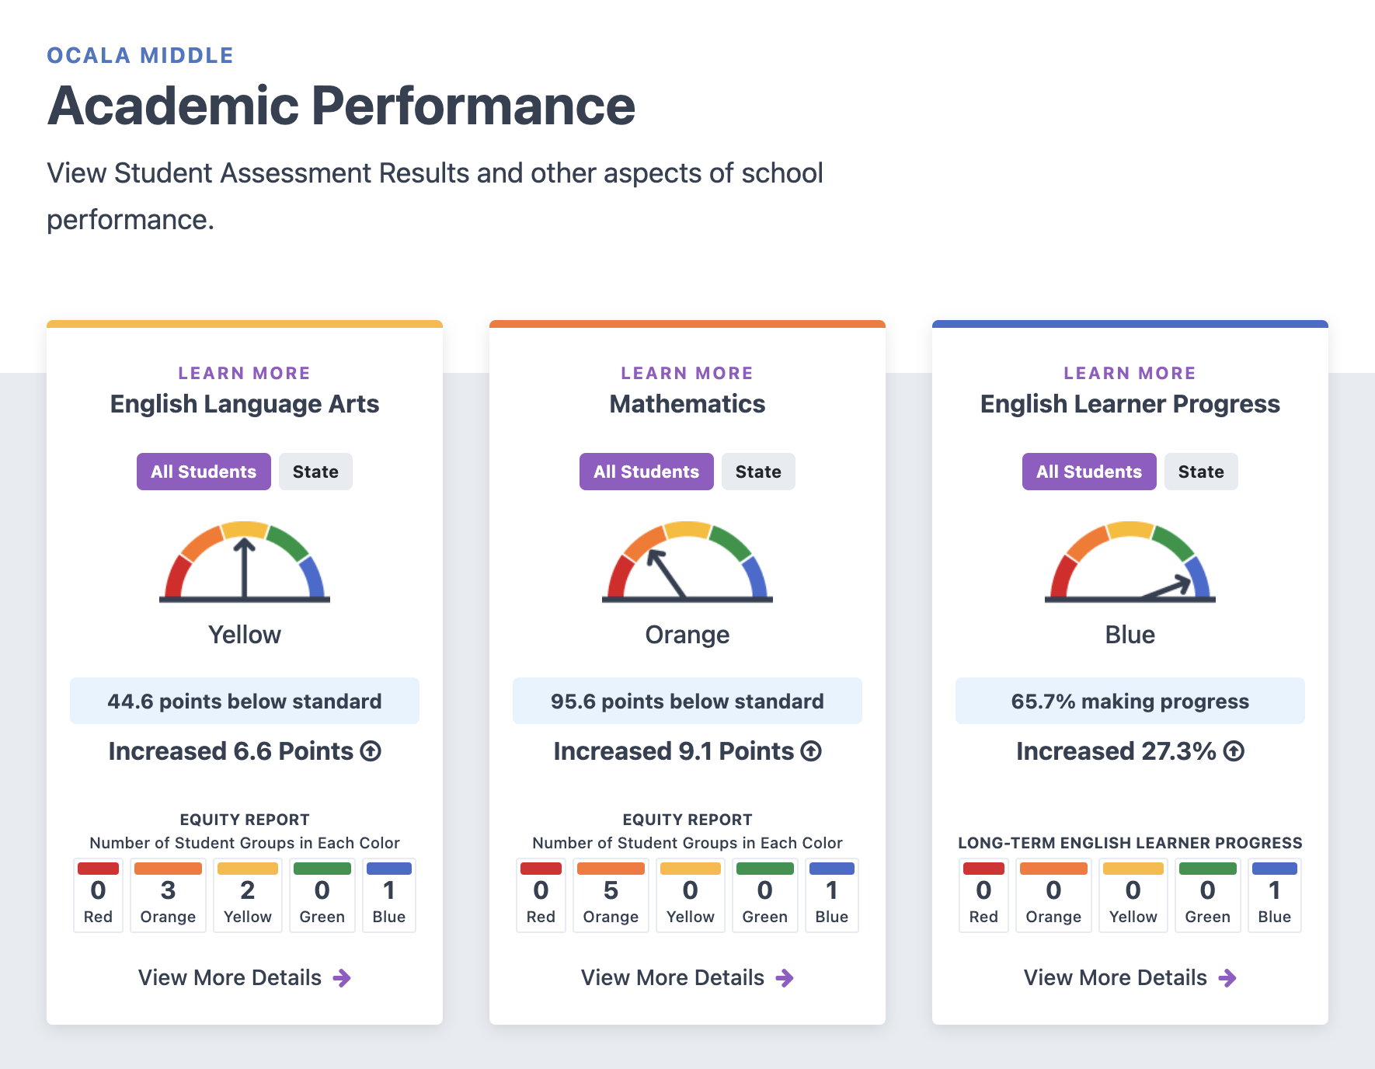
Notes:
Slide 3: Our Achievements
Content: Highlight awards the school has won, improved test scores, and successes from targeted interventions.
Design: Include award icons, bar charts for test score growth, and quotes from students or parents.
Engagement: Use a spinning trophy animation or live poll: “Which success excites you most?”

Slide 5
MTSS - Multi Tiered System of Support
Academic Counseling
Community Liaison
Alum Rock Counseling Center
Fly Program
Girl Scouts
Paws
Full time Wellness room clinician
Safe Schools
Positive Based Intervention System (PBIS)

Slide 6
A Vibrant School Community
Hallow-STEAM
STEAM Night
Movie Nights
Dances
Book Fair
Turkey Trot
College Night
Math Night
Lunch Time Activities
Notes:
Slide 2: A Vibrant School Community
Content: Showcase key activities (Turkey Trot, dances, Hallow-STEAM, STEAM Night, Book Fair, College Trips, Movie Nights, Math Night, College Night).
Design: Use an animated calendar or interactive infographic highlighting the events by season.
Engagement: Add a short video montage of past events.
Slide 3: Our Achievements
Content: Highlight awards the school has won, improved test scores, and successes from targeted interventions.
Design: Include award icons, bar charts for test score growth, and quotes from students or parents.
Engagement: Use a spinning trophy animation or live poll: “Which success excites you most?”
Slide 4: House System: Building Positive Culture
Content: Explain the house system, point system for positive behavior, and incentives.
Design: Show a leaderboard or visual of house mascots/colors.
Engagement: Live quiz where attendees guess which house is currently leading.
Slide 5: Clubs & Activities for Every Passion
Content: List clubs (Anime, Korean, GSA, Dance, Art) and special programs (MESA, AVID).
Design: Use colorful icons for each club with student testimonials or photos.
Engagement: Add a QR code linking to a sign-up sheet or club showcase video.
Slide 6: Award-Winning Sports Programs
Content: Highlight the school’s sports achievements and programs.
Design: Dynamic action shots, team photos, and stats for recent championships.
Engagement: Play a short clip of a game-winning moment.
Slide 7: Elective Offerings
Content: List electives (STEAM, Band, AVID, Leadership) and extended day opportunities (7 periods, Envisioneers after school).
Design: Create a “Choose Your Path” flowchart or carousel of elective spotlights.
Engagement: Include a live poll: “Which elective would you choose?”
Slide 8: STEAM Integration & CTE Pathways
Content: Discuss how STEAM is integrated into classes and how it connects to Career Technical Education pathways in high schools.
Design: Use a diagram showing progression from middle school to high school to careers.
Engagement: Include a stat about STEM underrepresentation (e.g., percentage of women/minorities in STEM fields).
Slide 9: Why These Opportunities Matter
Content: Emphasize the importance of providing opportunities in a high-need area.
Design: Use comparative charts (e.g., community wage stats vs. access to advanced programs) and impactful photos.
Engagement: Add a reflective question: “What future do you envision for your child?”
Slide 10: Aligned to GEAR UP Values
Content: Define GEAR UP values: Globally Aware, Empowered, Academically Courageous, Reflective, Upstanding, Problem Solver.
Design: Use icons and student quotes/stories exemplifying each value.
Engagement: Add an interactive slide where families can type what value resonates most with them.
Slide 11: Success in Action
Content: Showcase student projects, accomplishments, and testimonials.
Design: Create a digital scrapbook or slideshow with captions.
Engagement: Encourage parents/students to share their aspirations in a digital survey link.
Slide 12: Let’s Work Together!
Content: Explain how families can get involved and next steps (enrollment process, contacts).
Design: Use a simple, clear call-to-action slide with contact details and QR codes.
Engagement: Provide a fun photo booth for parents/students to take pictures with school props post-meeting.
Bonus Tips for Fun & Creative Slides
Animations: Use smooth transitions, animated icons, and text for visual appeal.
Live Polls/Interactive Elements: Use tools like Mentimeter, Slido, or Kahoot to engage attendees.
Themes: Choose a consistent and lively theme aligned with the school’s branding.
Background Music: Add soft, upbeat instrumental music to set a welcoming tone.
Let me know if you'd like help creating specific slides!

Slide 7
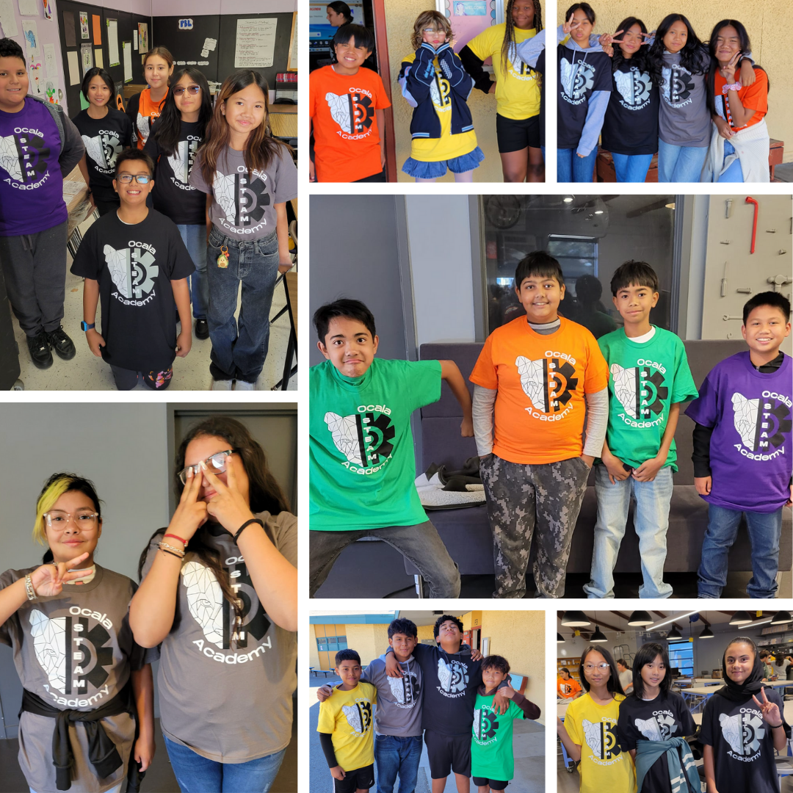
Building Positive Culture:
Ocala House System
Notes:
Slide 4: House System: Building Positive Culture
Content: Explain the house system, point system for positive behavior, and incentives.
Design: Show a leaderboard or visual of house mascots/colors.
Engagement: Live quiz where attendees guess which house is currently leading.
Slide 5: Clubs & Activities for Every Passion
Content: List clubs (Anime, Korean, GSA, Dance, Art) and special programs (MESA, AVID).
Design: Use colorful icons for each club with student testimonials or photos.
Engagement: Add a QR code linking to a sign-up sheet or club showcase video.
Slide 6: Award-Winning Sports Programs
Content: Highlight the school’s sports achievements and programs.
Design: Dynamic action shots, team photos, and stats for recent championships.
Engagement: Play a short clip of a game-winning moment.
Slide 7: Elective Offerings
Content: List electives (STEAM, Band, AVID, Leadership) and extended day opportunities (7 periods, Envisioneers after school).
Design: Create a “Choose Your Path” flowchart or carousel of elective spotlights.
Engagement: Include a live poll: “Which elective would you choose?”
Slide 8: STEAM Integration & CTE Pathways
Content: Discuss how STEAM is integrated into classes and how it connects to Career Technical Education pathways in high schools.
Design: Use a diagram showing progression from middle school to high school to careers.
Engagement: Include a stat about STEM underrepresentation (e.g., percentage of women/minorities in STEM fields).
Slide 9: Why These Opportunities Matter
Content: Emphasize the importance of providing opportunities in a high-need area.
Design: Use comparative charts (e.g., community wage stats vs. access to advanced programs) and impactful photos.
Engagement: Add a reflective question: “What future do you envision for your child?”
Slide 10: Aligned to GEAR UP Values
Content: Define GEAR UP values: Globally Aware, Empowered, Academically Courageous, Reflective, Upstanding, Problem Solver.
Design: Use icons and student quotes/stories exemplifying each value.
Engagement: Add an interactive slide where families can type what value resonates most with them.
Slide 11: Success in Action
Content: Showcase student projects, accomplishments, and testimonials.
Design: Create a digital scrapbook or slideshow with captions.
Engagement: Encourage parents/students to share their aspirations in a digital survey link.
Slide 12: Let’s Work Together!
Content: Explain how families can get involved and next steps (enrollment process, contacts).
Design: Use a simple, clear call-to-action slide with contact details and QR codes.
Engagement: Provide a fun photo booth for parents/students to take pictures with school props post-meeting.
Bonus Tips for Fun & Creative Slides
Animations: Use smooth transitions, animated icons, and text for visual appeal.
Live Polls/Interactive Elements: Use tools like Mentimeter, Slido, or Kahoot to engage attendees.
Themes: Choose a consistent and lively theme aligned with the school’s branding.
Background Music: Add soft, upbeat instrumental music to set a welcoming tone.
Let me know if you'd like help creating specific slides!

Slide 8
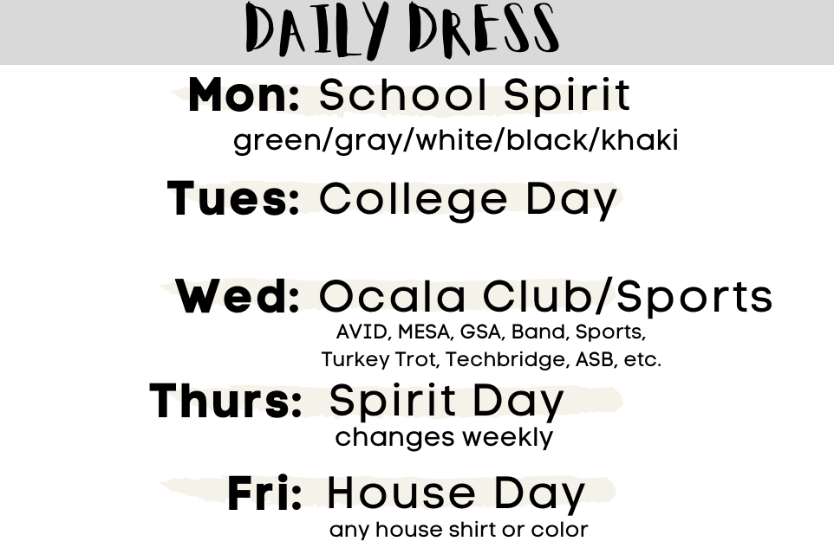

Slide 9
Bell Schedule @ Core classes

Slide 10
Dress Code School PE

Slide 11
Clubs & Activities for Every Passion
ASB
GSA
Korean Club
Art Club
Dance Club
Anime Club
Notes:
Slide 5: Clubs & Activities for Every Passion
Content: List clubs (Anime, Korean, GSA, Dance, Art) and special programs (MESA, AVID).
Design: Use colorful icons for each club with student testimonials or photos.
Engagement: Add a QR code linking to a sign-up sheet or club showcase video.
Slide 6: Award-Winning Sports Programs
Content: Highlight the school’s sports achievements and programs.
Design: Dynamic action shots, team photos, and stats for recent championships.
Engagement: Play a short clip of a game-winning moment.
Slide 7: Elective Offerings
Content: List electives (STEAM, Band, AVID, Leadership) and extended day opportunities (7 periods, Envisioneers after school).
Design: Create a “Choose Your Path” flowchart or carousel of elective spotlights.
Engagement: Include a live poll: “Which elective would you choose?”
Slide 8: STEAM Integration & CTE Pathways
Content: Discuss how STEAM is integrated into classes and how it connects to Career Technical Education pathways in high schools.
Design: Use a diagram showing progression from middle school to high school to careers.
Engagement: Include a stat about STEM underrepresentation (e.g., percentage of women/minorities in STEM fields).
Slide 9: Why These Opportunities Matter
Content: Emphasize the importance of providing opportunities in a high-need area.
Design: Use comparative charts (e.g., community wage stats vs. access to advanced programs) and impactful photos.
Engagement: Add a reflective question: “What future do you envision for your child?”
Slide 10: Aligned to GEAR UP Values
Content: Define GEAR UP values: Globally Aware, Empowered, Academically Courageous, Reflective, Upstanding, Problem Solver.
Design: Use icons and student quotes/stories exemplifying each value.
Engagement: Add an interactive slide where families can type what value resonates most with them.
Slide 11: Success in Action
Content: Showcase student projects, accomplishments, and testimonials.
Design: Create a digital scrapbook or slideshow with captions.
Engagement: Encourage parents/students to share their aspirations in a digital survey link.
Slide 12: Let’s Work Together!
Content: Explain how families can get involved and next steps (enrollment process, contacts).
Design: Use a simple, clear call-to-action slide with contact details and QR codes.
Engagement: Provide a fun photo booth for parents/students to take pictures with school props post-meeting.
Bonus Tips for Fun & Creative Slides
Animations: Use smooth transitions, animated icons, and text for visual appeal.
Live Polls/Interactive Elements: Use tools like Mentimeter, Slido, or Kahoot to engage attendees.
Themes: Choose a consistent and lively theme aligned with the school’s branding.
Background Music: Add soft, upbeat instrumental music to set a welcoming tone.
Let me know if you'd like help creating specific slides!

Slide 12
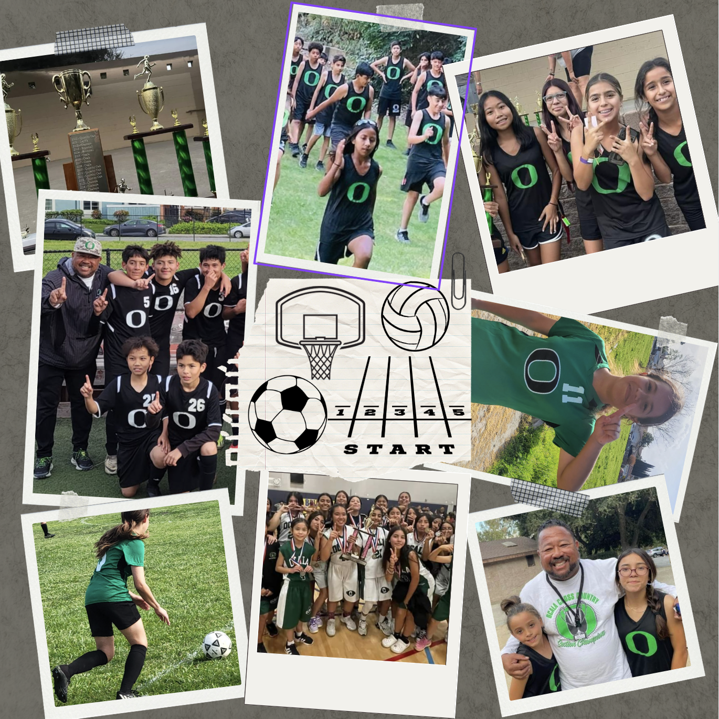
Award Winning Sports Program
Wrestling
Cross Country
Boys and Girls
Basketball
Volley Ball
Soccer
Track
Notes:
Slide 6: Award-Winning Sports Programs
Content: Highlight the school’s sports achievements and programs.
Design: Dynamic action shots, team photos, and stats for recent championships.
Engagement: Play a short clip of a game-winning moment.
Slide 7: Elective Offerings
Content: List electives (STEAM, Band, AVID, Leadership) and extended day opportunities (7 periods, Envisioneers after school).
Design: Create a “Choose Your Path” flowchart or carousel of elective spotlights.
Engagement: Include a live poll: “Which elective would you choose?”
Slide 8: STEAM Integration & CTE Pathways
Content: Discuss how STEAM is integrated into classes and how it connects to Career Technical Education pathways in high schools.
Design: Use a diagram showing progression from middle school to high school to careers.
Engagement: Include a stat about STEM underrepresentation (e.g., percentage of women/minorities in STEM fields).
Slide 9: Why These Opportunities Matter
Content: Emphasize the importance of providing opportunities in a high-need area.
Design: Use comparative charts (e.g., community wage stats vs. access to advanced programs) and impactful photos.
Engagement: Add a reflective question: “What future do you envision for your child?”
Slide 10: Aligned to GEAR UP Values
Content: Define GEAR UP values: Globally Aware, Empowered, Academically Courageous, Reflective, Upstanding, Problem Solver.
Design: Use icons and student quotes/stories exemplifying each value.
Engagement: Add an interactive slide where families can type what value resonates most with them.
Slide 11: Success in Action
Content: Showcase student projects, accomplishments, and testimonials.
Design: Create a digital scrapbook or slideshow with captions.
Engagement: Encourage parents/students to share their aspirations in a digital survey link.
Slide 12: Let’s Work Together!
Content: Explain how families can get involved and next steps (enrollment process, contacts).
Design: Use a simple, clear call-to-action slide with contact details and QR codes.
Engagement: Provide a fun photo booth for parents/students to take pictures with school props post-meeting.
Bonus Tips for Fun & Creative Slides
Animations: Use smooth transitions, animated icons, and text for visual appeal.
Live Polls/Interactive Elements: Use tools like Mentimeter, Slido, or Kahoot to engage attendees.
Themes: Choose a consistent and lively theme aligned with the school’s branding.
Background Music: Add soft, upbeat instrumental music to set a welcoming tone.
Let me know if you'd like help creating specific slides!

Slide 13
Elective Offerings
Band
AVID
STEAM
Leadership
Notes:
Slide 7: Elective Offerings
Content: List electives (STEAM, Band, AVID, Leadership) and extended day opportunities (7 periods, Envisioneers after school).
Design: Create a “Choose Your Path” flowchart or carousel of elective spotlights.
Engagement: Include a live poll: “Which elective would you choose?”
Slide 8: STEAM Integration & CTE Pathways
Content: Discuss how STEAM is integrated into classes and how it connects to Career Technical Education pathways in high schools.
Design: Use a diagram showing progression from middle school to high school to careers.
Engagement: Include a stat about STEM underrepresentation (e.g., percentage of women/minorities in STEM fields).
Slide 9: Why These Opportunities Matter
Content: Emphasize the importance of providing opportunities in a high-need area.
Design: Use comparative charts (e.g., community wage stats vs. access to advanced programs) and impactful photos.
Engagement: Add a reflective question: “What future do you envision for your child?”
Slide 10: Aligned to GEAR UP Values
Content: Define GEAR UP values: Globally Aware, Empowered, Academically Courageous, Reflective, Upstanding, Problem Solver.
Design: Use icons and student quotes/stories exemplifying each value.
Engagement: Add an interactive slide where families can type what value resonates most with them.
Slide 11: Success in Action
Content: Showcase student projects, accomplishments, and testimonials.
Design: Create a digital scrapbook or slideshow with captions.
Engagement: Encourage parents/students to share their aspirations in a digital survey link.
Slide 12: Let’s Work Together!
Content: Explain how families can get involved and next steps (enrollment process, contacts).
Design: Use a simple, clear call-to-action slide with contact details and QR codes.
Engagement: Provide a fun photo booth for parents/students to take pictures with school props post-meeting.
Bonus Tips for Fun & Creative Slides
Animations: Use smooth transitions, animated icons, and text for visual appeal.
Live Polls/Interactive Elements: Use tools like Mentimeter, Slido, or Kahoot to engage attendees.
Themes: Choose a consistent and lively theme aligned with the school’s branding.
Background Music: Add soft, upbeat instrumental music to set a welcoming tone.
Let me know if you'd like help creating specific slides!

Slide 14
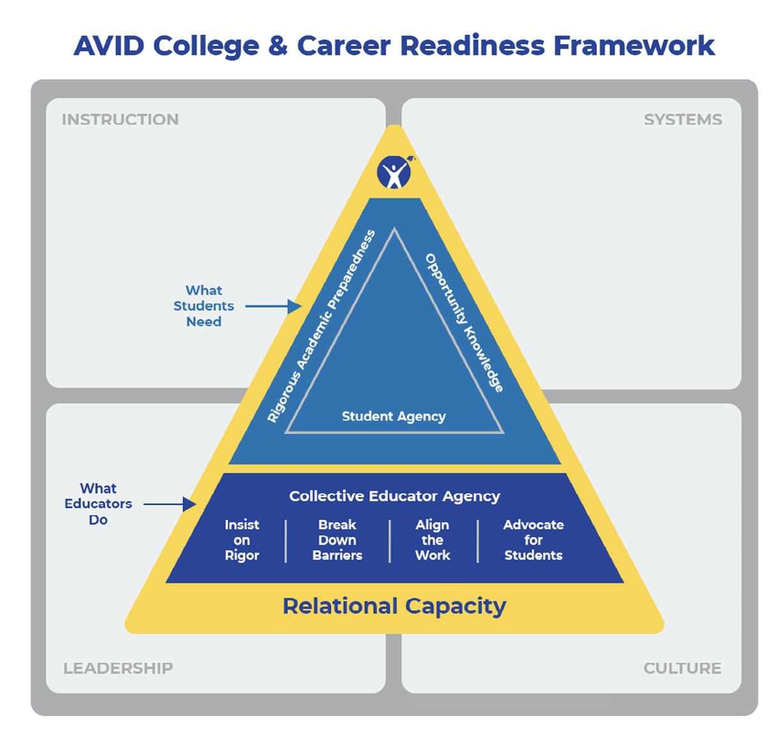
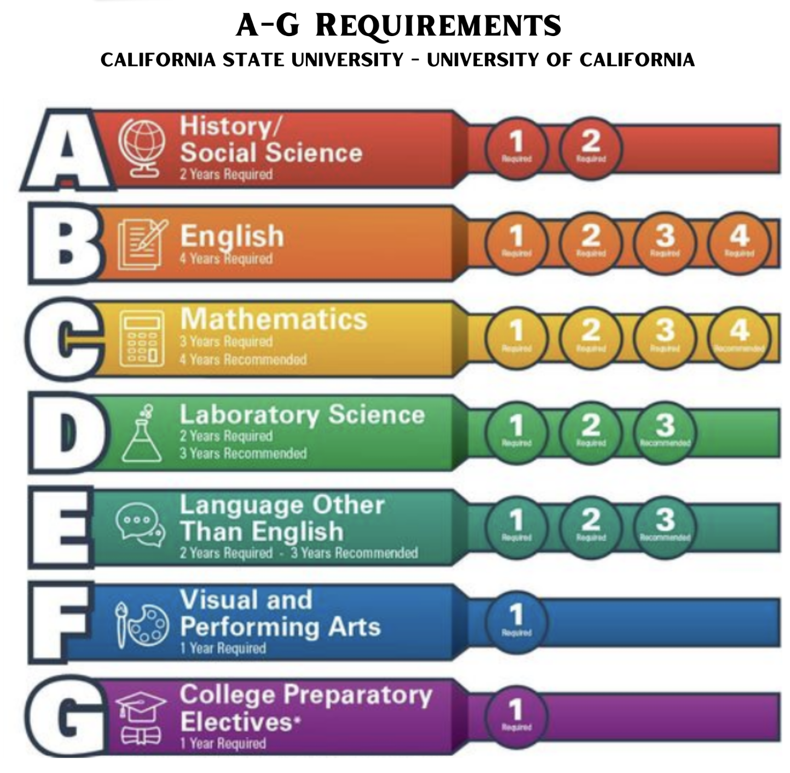
AVID: Advancement Via Individual Determination
AVID Mission:
Close the Achievement gap by preparing ALL students for college readiness and success in a global society
A Year-Long college prep elective class that focuses on academic skills and strategies for success in middle school, high school, and college.
Develop and practice skills that help you become a stronger student and lead to greater success in your classwork.
Notes:
Slide 7: Elective Offerings
Content: List electives (STEAM, Band, AVID, Leadership) and extended day opportunities (7 periods, Envisioneers after school).
Design: Create a “Choose Your Path” flowchart or carousel of elective spotlights.
Engagement: Include a live poll: “Which elective would you choose?”
Slide 8: STEAM Integration & CTE Pathways
Content: Discuss how STEAM is integrated into classes and how it connects to Career Technical Education pathways in high schools.
Design: Use a diagram showing progression from middle school to high school to careers.
Engagement: Include a stat about STEM underrepresentation (e.g., percentage of women/minorities in STEM fields).
Slide 9: Why These Opportunities Matter
Content: Emphasize the importance of providing opportunities in a high-need area.
Design: Use comparative charts (e.g., community wage stats vs. access to advanced programs) and impactful photos.
Engagement: Add a reflective question: “What future do you envision for your child?”
Slide 10: Aligned to GEAR UP Values
Content: Define GEAR UP values: Globally Aware, Empowered, Academically Courageous, Reflective, Upstanding, Problem Solver.
Design: Use icons and student quotes/stories exemplifying each value.
Engagement: Add an interactive slide where families can type what value resonates most with them.
Slide 11: Success in Action
Content: Showcase student projects, accomplishments, and testimonials.
Design: Create a digital scrapbook or slideshow with captions.
Engagement: Encourage parents/students to share their aspirations in a digital survey link.
Slide 12: Let’s Work Together!
Content: Explain how families can get involved and next steps (enrollment process, contacts).
Design: Use a simple, clear call-to-action slide with contact details and QR codes.
Engagement: Provide a fun photo booth for parents/students to take pictures with school props post-meeting.
Bonus Tips for Fun & Creative Slides
Animations: Use smooth transitions, animated icons, and text for visual appeal.
Live Polls/Interactive Elements: Use tools like Mentimeter, Slido, or Kahoot to engage attendees.
Themes: Choose a consistent and lively theme aligned with the school’s branding.
Background Music: Add soft, upbeat instrumental music to set a welcoming tone.
Let me know if you'd like help creating specific slides!

Slide 15
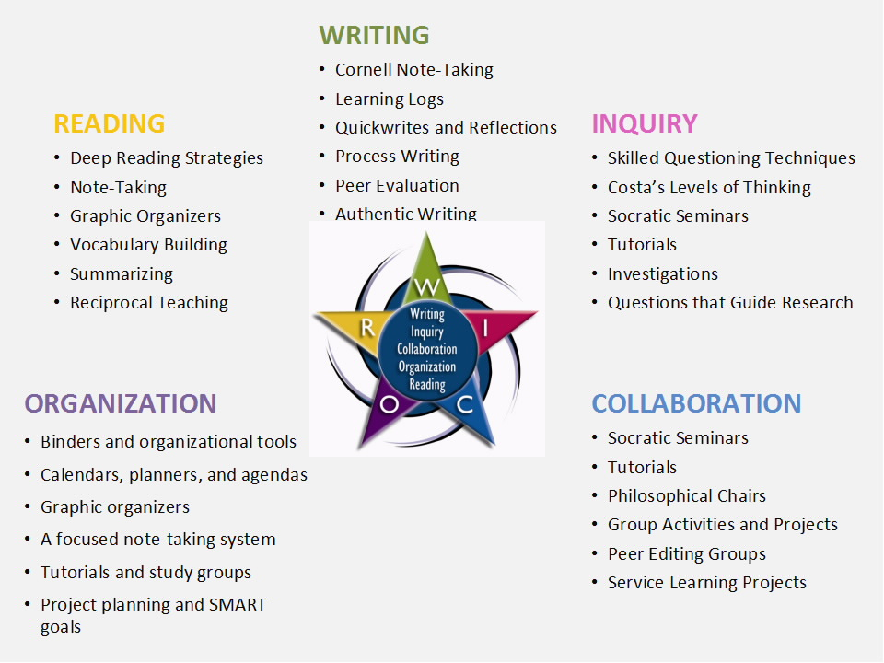
Learn and Practice Academic Skills essential to school and college success focusing on WICOR.
“Tutorial” Study Groups
Group Games, Team building, and Challenges
Group Discussions and Learning Challenges through Socratic Discussions and Debate
Explore Careers and College Degrees
College Field Trips!
Notes:
AVID A-G

Slide 16
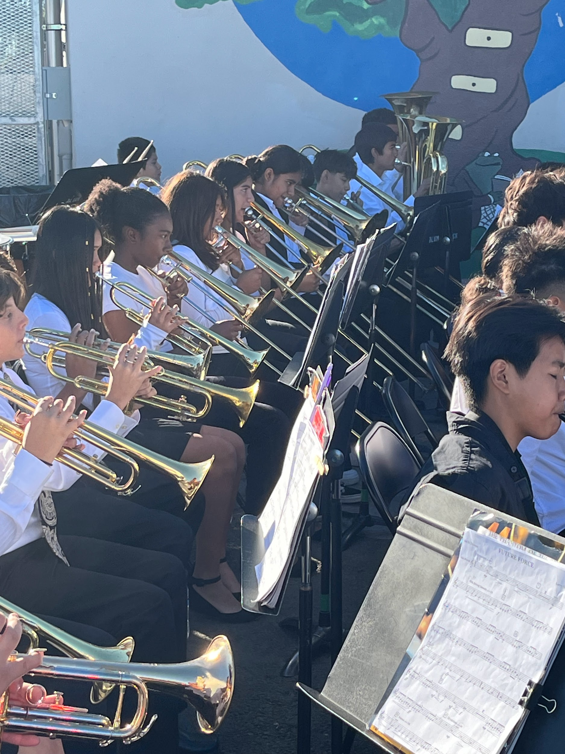
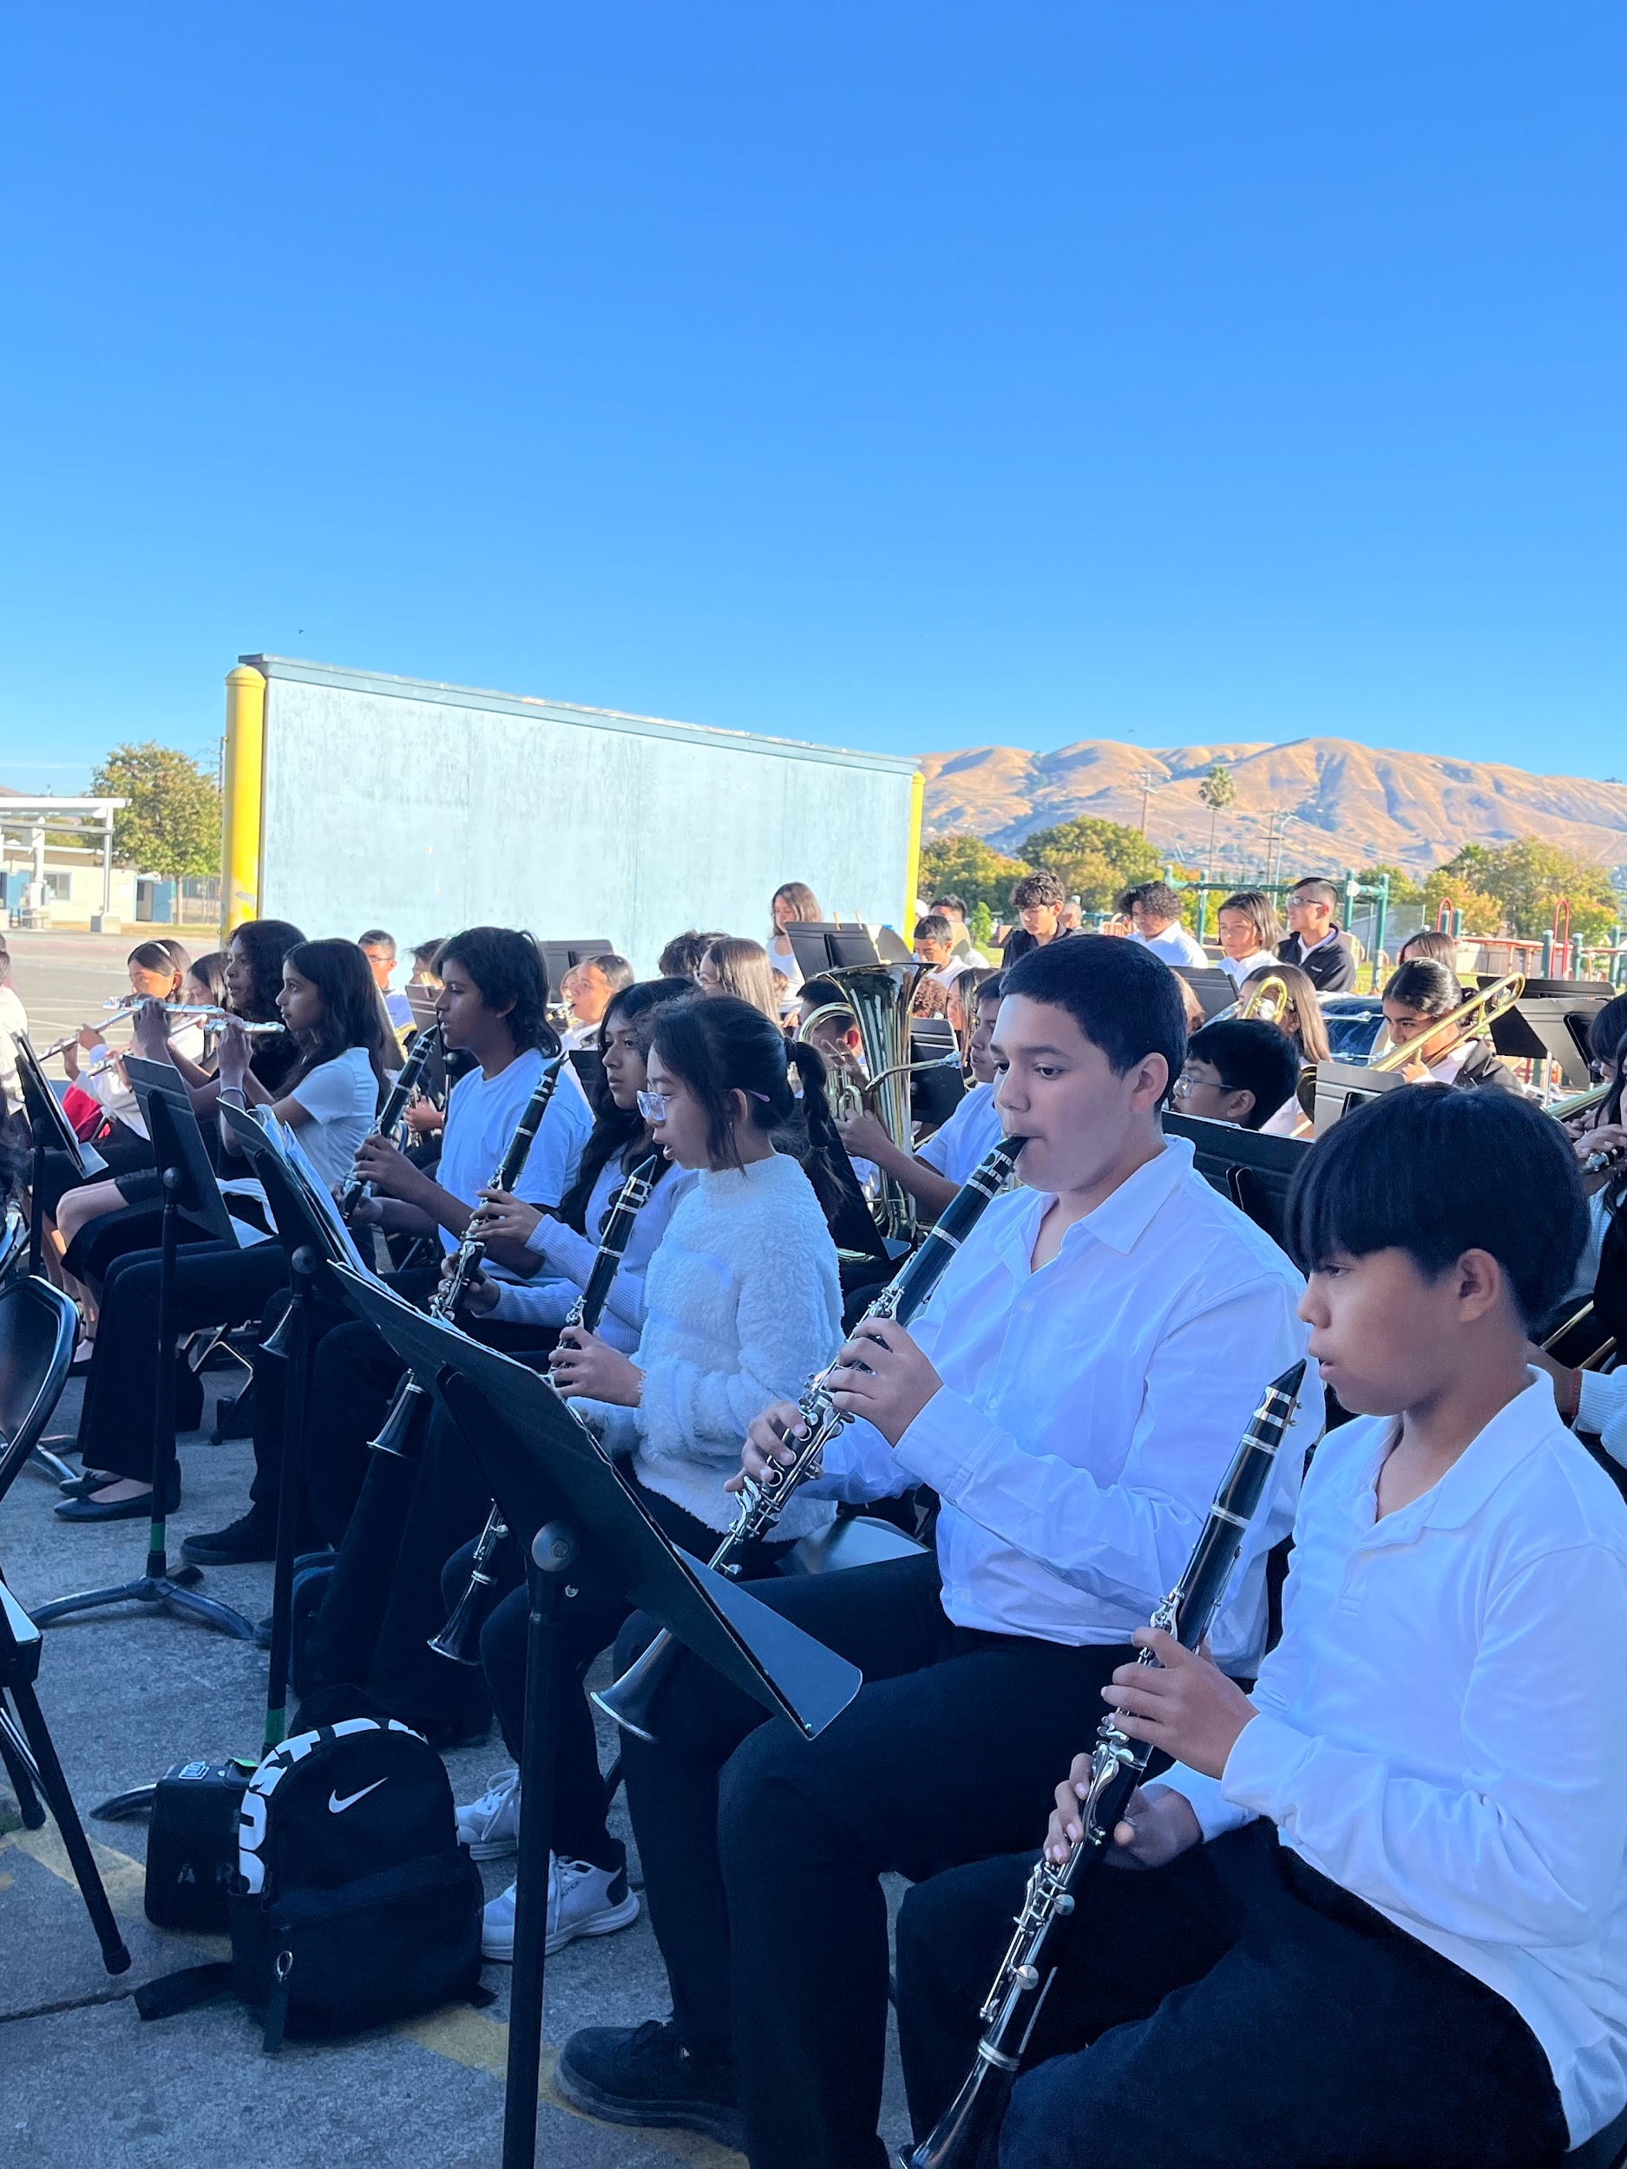
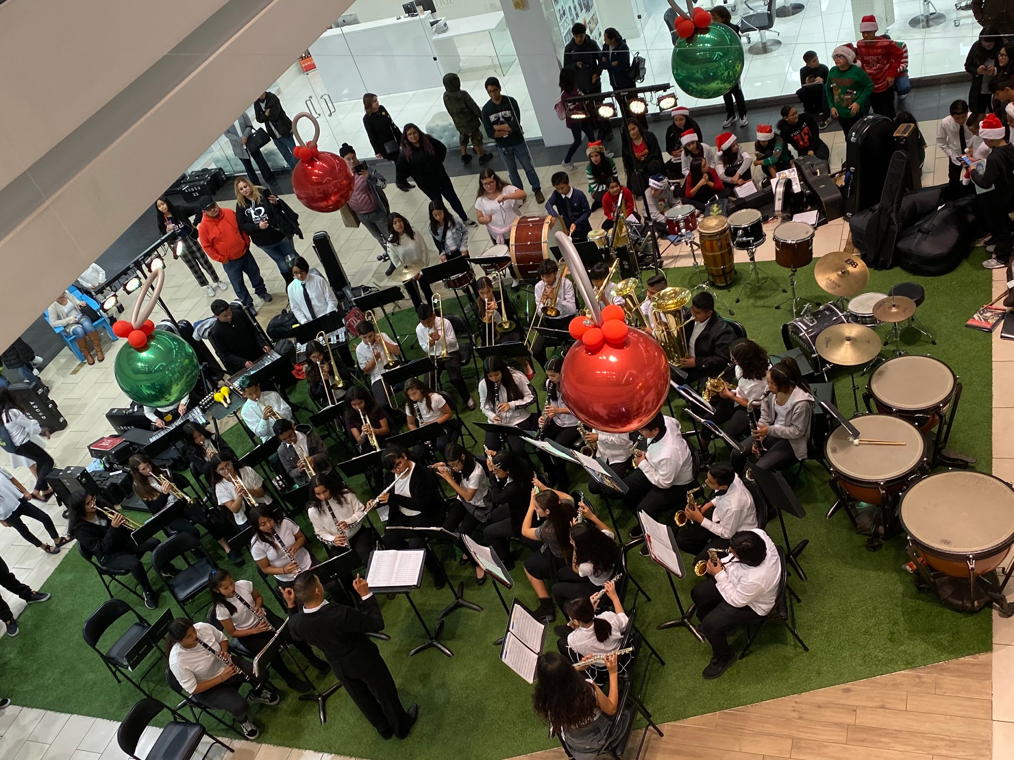
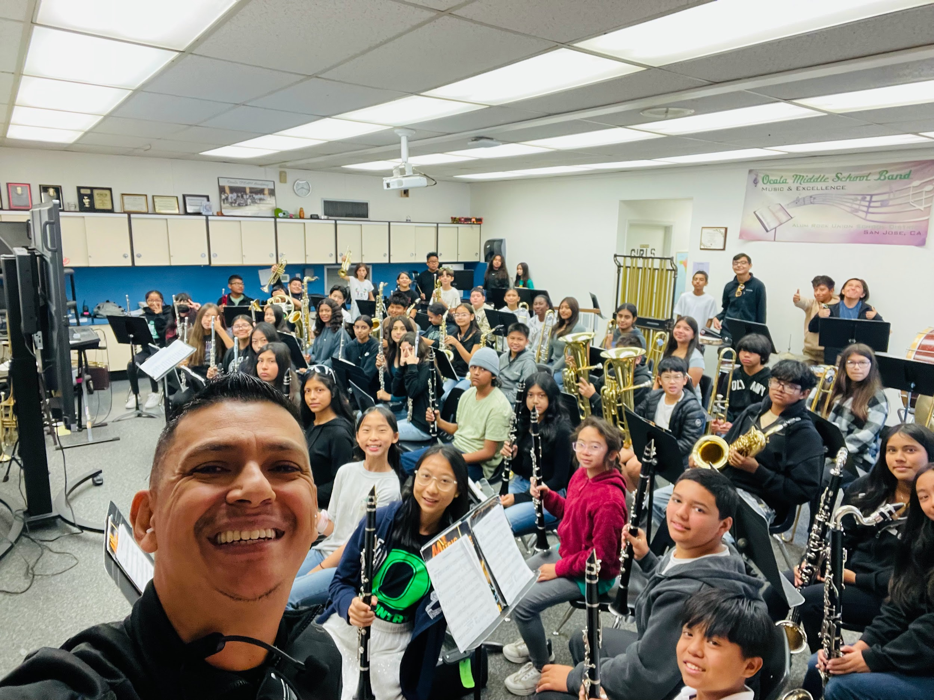
Ocala Band
The Ocala STEAM Academy (OSA) band program, consisting of woodwinds, brass, and percussion instruments.
Students have various opportunities to enhance their musicianship through performances, clinics, and festivals. A notable event is our very own Alum Rock School District Band Festival.
At Ocala, we are proud to have a dedicated band room on campus where students can practice and store their instruments. Many students also participate in after-school practice sessions and work together as a music ensemble.
Notes:
The Ocala STEAM Academy (OSA) band program, consisting of woodwinds, brass, and percussion instruments, currently includes 80 students and continues to grow each year. The program features two groups: the 6th-grade intermediate band and the 7th/8th-grade advanced band.
Students have various opportunities to enhance their musicianship through performances, clinics, and festivals. A notable event is our very own Alum Rock School District Band Festival.
At OSA, we are proud to have a dedicated band room on campus where students can practice and store their instruments. Many students also participate in after-school practice sessions and work together as a music ensemble.
Through our dedication, we aim not only to nurture skilled musicians but also to help develop professional, well-rounded individuals through music education.
For more information about the OSA band program, please contact Mr. Louie Flores Jr.
Slide 7: Elective Offerings
Content: List electives (STEAM, Band, AVID, Leadership) and extended day opportunities (7 periods, Envisioneers after school).
Design: Create a “Choose Your Path” flowchart or carousel of elective spotlights.
Engagement: Include a live poll: “Which elective would you choose?”
Slide 8: STEAM Integration & CTE Pathways
Content: Discuss how STEAM is integrated into classes and how it connects to Career Technical Education pathways in high schools.
Design: Use a diagram showing progression from middle school to high school to careers.
Engagement: Include a stat about STEM underrepresentation (e.g., percentage of women/minorities in STEM fields).
Slide 9: Why These Opportunities Matter
Content: Emphasize the importance of providing opportunities in a high-need area.
Design: Use comparative charts (e.g., community wage stats vs. access to advanced programs) and impactful photos.
Engagement: Add a reflective question: “What future do you envision for your child?”
Slide 10: Aligned to GEAR UP Values
Content: Define GEAR UP values: Globally Aware, Empowered, Academically Courageous, Reflective, Upstanding, Problem Solver.
Design: Use icons and student quotes/stories exemplifying each value.
Engagement: Add an interactive slide where families can type what value resonates most with them.
Slide 11: Success in Action
Content: Showcase student projects, accomplishments, and testimonials.
Design: Create a digital scrapbook or slideshow with captions.
Engagement: Encourage parents/students to share their aspirations in a digital survey link.
Slide 12: Let’s Work Together!
Content: Explain how families can get involved and next steps (enrollment process, contacts).
Design: Use a simple, clear call-to-action slide with contact details and QR codes.
Engagement: Provide a fun photo booth for parents/students to take pictures with school props post-meeting.
Bonus Tips for Fun & Creative Slides
Animations: Use smooth transitions, animated icons, and text for visual appeal.
Live Polls/Interactive Elements: Use tools like Mentimeter, Slido, or Kahoot to engage attendees.
Themes: Choose a consistent and lively theme aligned with the school’s branding.
Background Music: Add soft, upbeat instrumental music to set a welcoming tone.
Let me know if you'd like help creating specific slides!

Slide 17
STEAM Integration &
CTE Pathways
Students in STEAM maintain a higher GPA.
STEAM has been proven to prepare students for College.
STEAM increases student connectedness, student engagement and reduce behavioral problem. .
Students in STEAM programs eventually earn higher wages than other peers.
STEAM significantly increased high school graduation rate and students persisting through graduation.
High risk students or 8 to 10 times less likely to drop out if they are in STEAM programs
Students in STEAM stay in College.
Notes:
Slide 8: STEAM Integration & CTE Pathways
Content: Discuss how STEAM is integrated into classes and how it connects to Career Technical Education pathways in high schools.
Design: Use a diagram showing progression from middle school to high school to careers.
Engagement: Include a stat about STEM underrepresentation (e.g., percentage of women/minorities in STEM fields).
Slide 9: Why These Opportunities Matter
Content: Emphasize the importance of providing opportunities in a high-need area.
Design: Use comparative charts (e.g., community wage stats vs. access to advanced programs) and impactful photos.
Engagement: Add a reflective question: “What future do you envision for your child?”
Slide 10: Aligned to GEAR UP Values
Content: Define GEAR UP values: Globally Aware, Empowered, Academically Courageous, Reflective, Upstanding, Problem Solver.
Design: Use icons and student quotes/stories exemplifying each value.
Engagement: Add an interactive slide where families can type what value resonates most with them.
Slide 11: Success in Action
Content: Showcase student projects, accomplishments, and testimonials.
Design: Create a digital scrapbook or slideshow with captions.
Engagement: Encourage parents/students to share their aspirations in a digital survey link.
Slide 12: Let’s Work Together!
Content: Explain how families can get involved and next steps (enrollment process, contacts).
Design: Use a simple, clear call-to-action slide with contact details and QR codes.
Engagement: Provide a fun photo booth for parents/students to take pictures with school props post-meeting.
Bonus Tips for Fun & Creative Slides
Animations: Use smooth transitions, animated icons, and text for visual appeal.
Live Polls/Interactive Elements: Use tools like Mentimeter, Slido, or Kahoot to engage attendees.
Themes: Choose a consistent and lively theme aligned with the school’s branding.
Background Music: Add soft, upbeat instrumental music to set a welcoming tone.
Let me know if you'd like help creating specific slides!

Slide 18
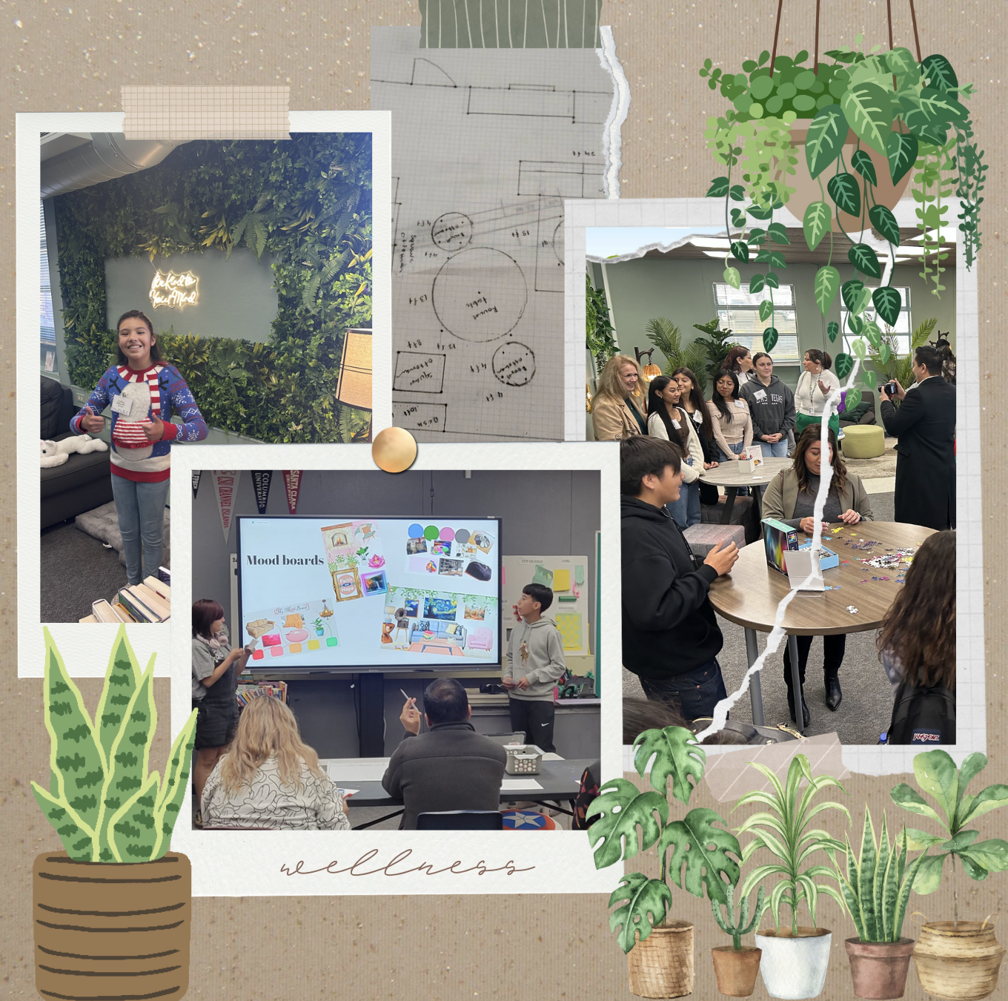
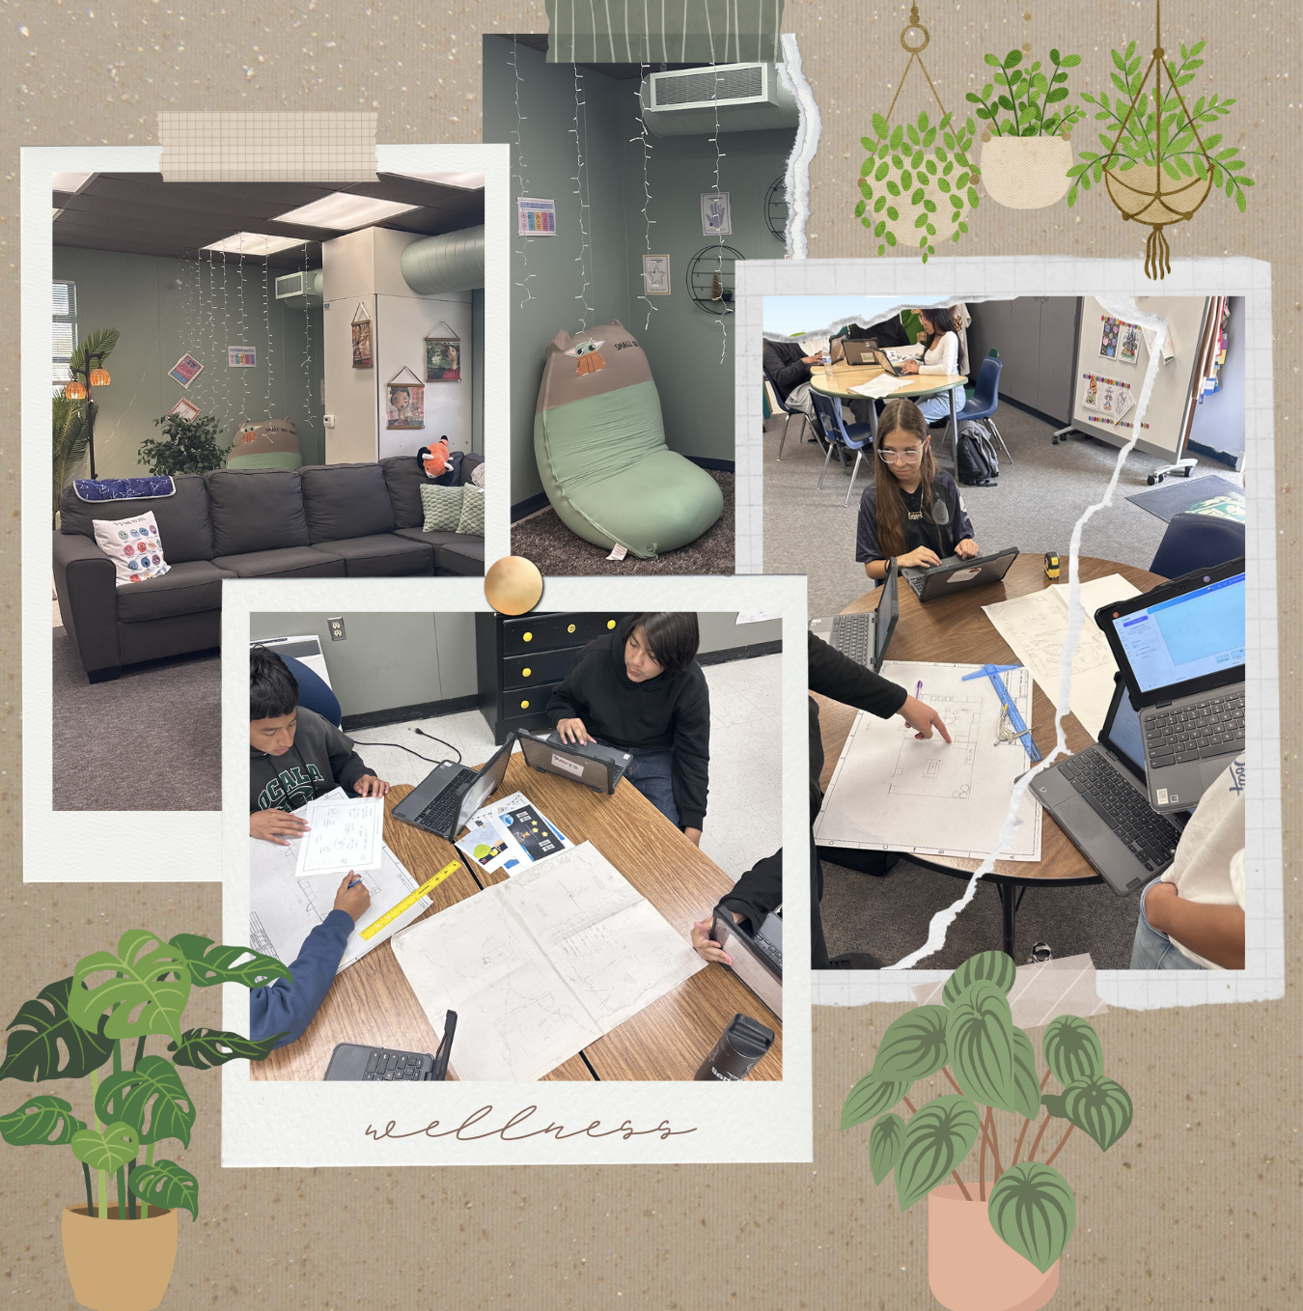
Wellness Room Design Project
STEAM Integration in Action

Slide 19
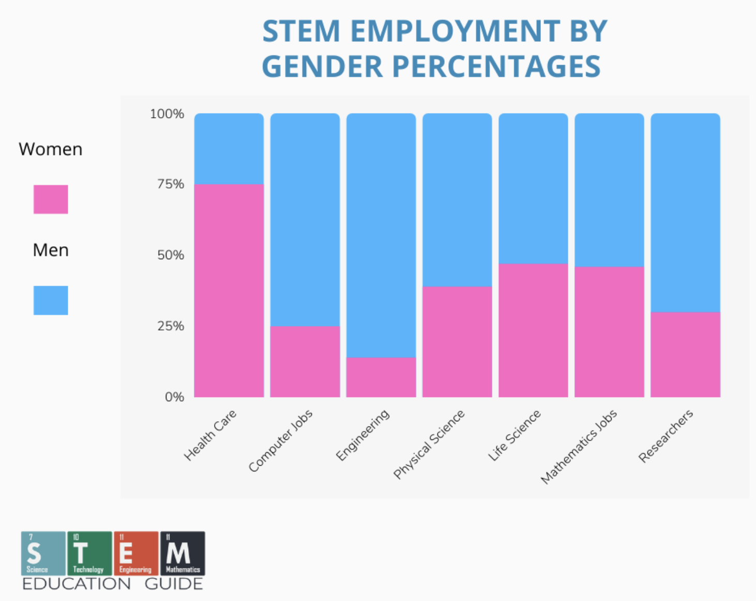
Why These Opportunities Matter
Notes:
https://stemeducationguide.com/stem-education-statistics/
Slide 9: Why These Opportunities Matter
Content: Emphasize the importance of providing opportunities in a high-need area.
Design: Use comparative charts (e.g., community wage stats vs. access to advanced programs) and impactful photos.
Engagement: Add a reflective question: “What future do you envision for your child?”
Slide 10: Aligned to GEAR UP Values
Content: Define GEAR UP values: Globally Aware, Empowered, Academically Courageous, Reflective, Upstanding, Problem Solver.
Design: Use icons and student quotes/stories exemplifying each value.
Engagement: Add an interactive slide where families can type what value resonates most with them.
Slide 11: Success in Action
Content: Showcase student projects, accomplishments, and testimonials.
Design: Create a digital scrapbook or slideshow with captions.
Engagement: Encourage parents/students to share their aspirations in a digital survey link.
Slide 12: Let’s Work Together!
Content: Explain how families can get involved and next steps (enrollment process, contacts).
Design: Use a simple, clear call-to-action slide with contact details and QR codes.
Engagement: Provide a fun photo booth for parents/students to take pictures with school props post-meeting.
Bonus Tips for Fun & Creative Slides
Animations: Use smooth transitions, animated icons, and text for visual appeal.
Live Polls/Interactive Elements: Use tools like Mentimeter, Slido, or Kahoot to engage attendees.
Themes: Choose a consistent and lively theme aligned with the school’s branding.
Background Music: Add soft, upbeat instrumental music to set a welcoming tone.
Let me know if you'd like help creating specific slides!

Slide 20
At Ocala STEAM our students are GEARed UP for success!
Globally Aware
Empowered
Academically Courageous
Reflective
Upstanding
Problem Solvers
Notes:
Slide 12: Let’s Work Together!
Content: Explain how families can get involved and next steps (enrollment process, contacts).
Design: Use a simple, clear call-to-action slide with contact details and QR codes.
Engagement: Provide a fun photo booth for parents/students to take pictures with school props post-meeting.
Bonus Tips for Fun & Creative Slides
Animations: Use smooth transitions, animated icons, and text for visual appeal.
Live Polls/Interactive Elements: Use tools like Mentimeter, Slido, or Kahoot to engage attendees.
Themes: Choose a consistent and lively theme aligned with the school’s branding.
Background Music: Add soft, upbeat instrumental music to set a welcoming tone.
Let me know if you'd like help creating specific slides!

Slide 21
Join Ocala, Where Students Are Empowered to Lead and Succeed

Slide 22
Want to know more, come visit for a shadow day!
408-928-8350
2800 Ocala Ave.
San Jose, CA
95148
Notes:
Shadow days

