Slide 1
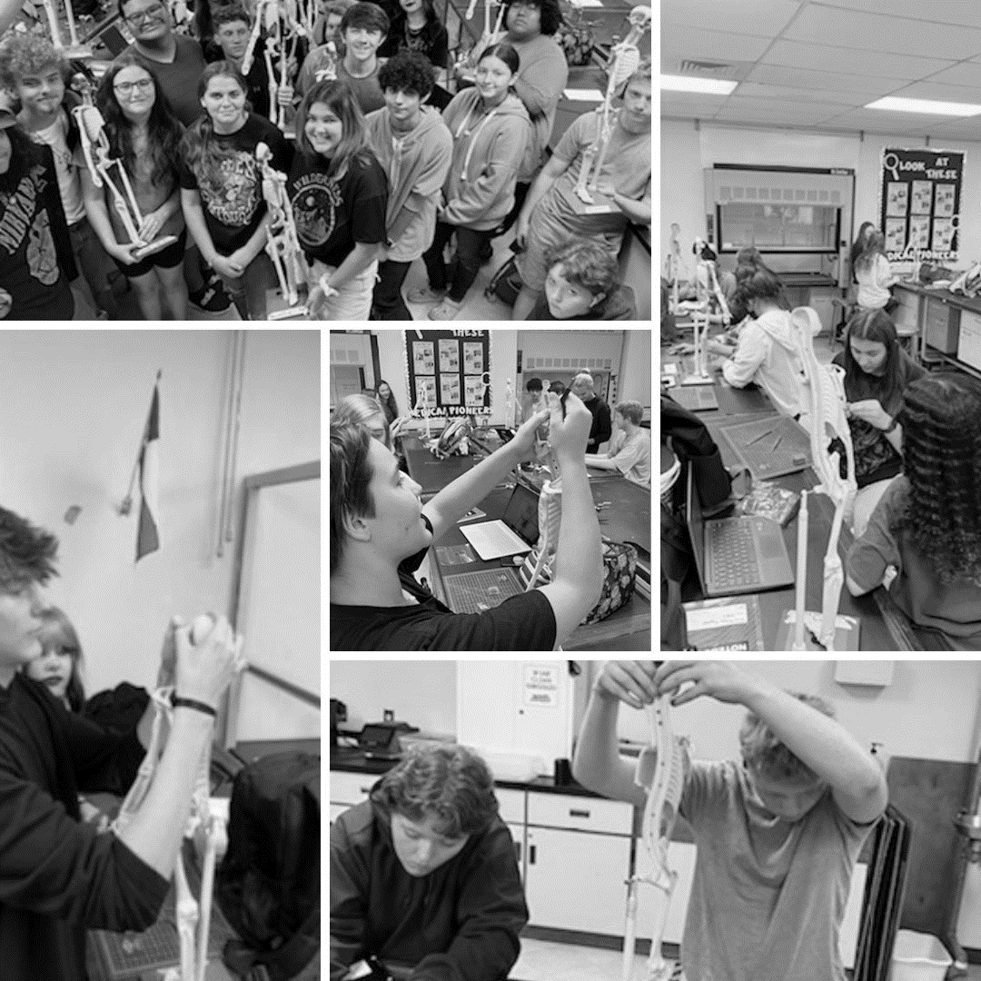

High School
Information Night

Slide 2

About Us - Video
AboutPBSTEM

Slide 3
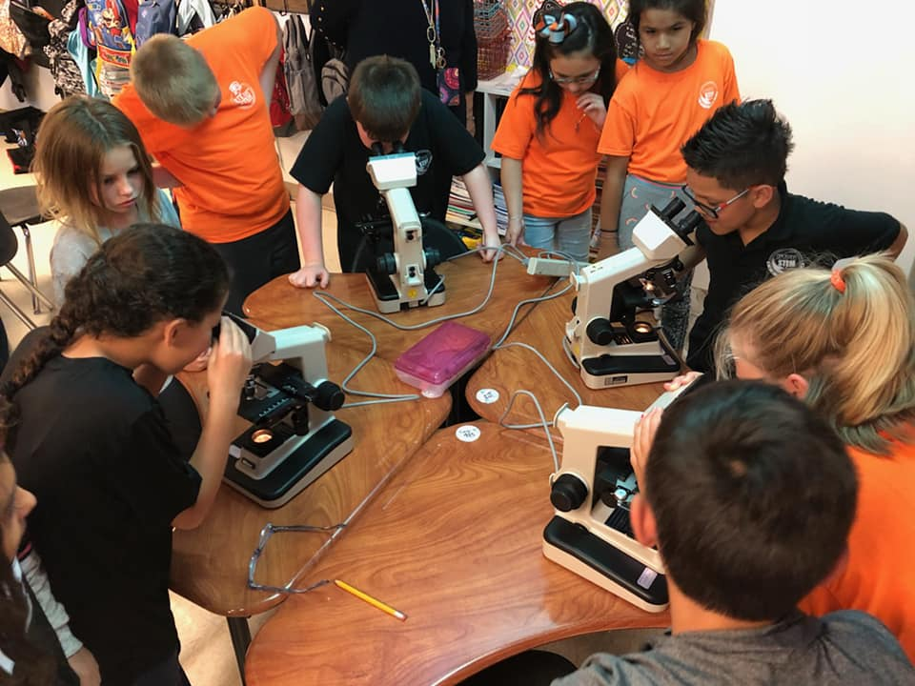
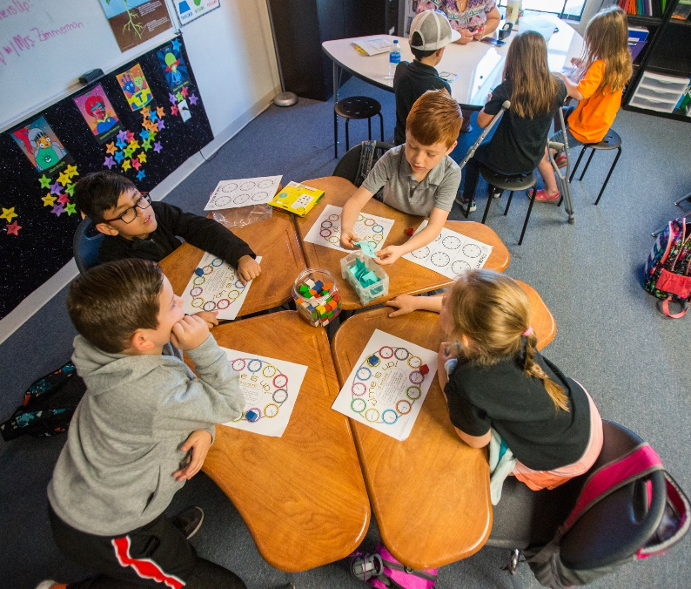
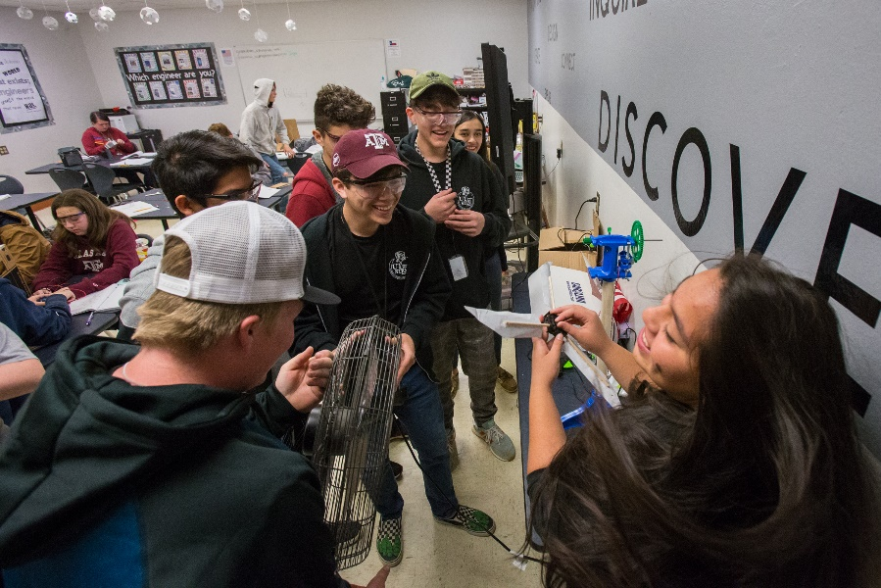
Mission Statement
The STEM Academy prepares students to be STEM college and career ready, with a shared focus on collaboration, creativity, communication, and critical thinking.

Slide 4

Student Enrollment History
2015-2016 K-7th 352 students 16 teachers
2017-2018 K-9th 654 students 30 teachers
2019-2020
K-11th 769 students 36 teachers
Current
K-12th 770 students 39 teachers
2014-2015 K-6th 308 students 14 teachers
2016-2017
*significant expansion K-8th 594 students 27 teachers
2018-2019
K-10th 721 students 33 teachers
2020-2021 K-12th 792 students 39 teachers

Slide 5
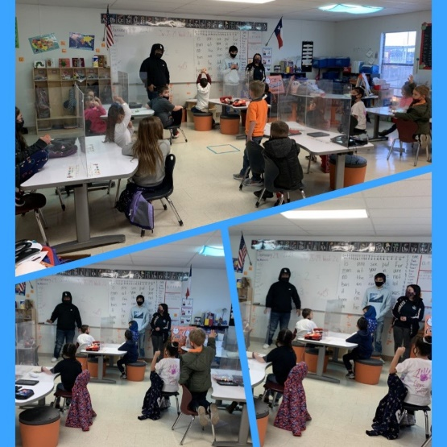
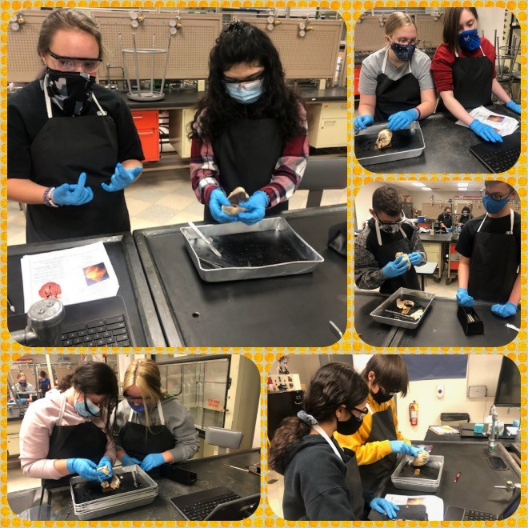
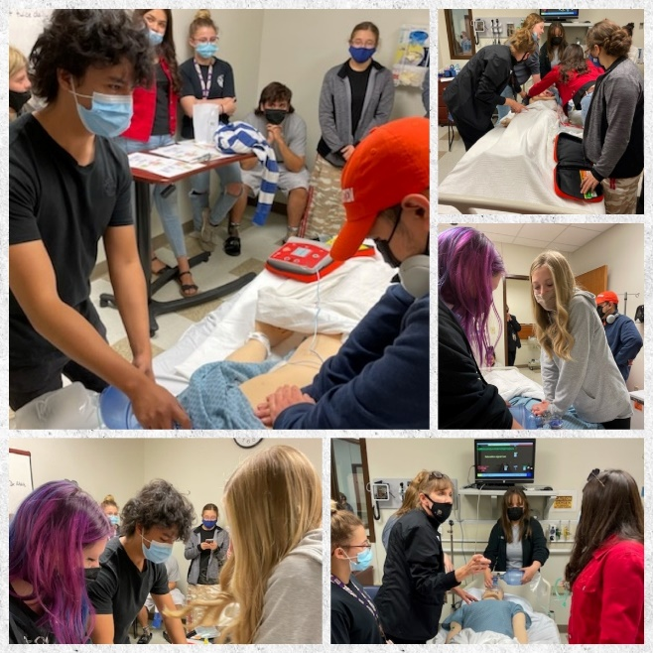
Student Demographics
Kinder- 12th Grade
Average class sizes - 22 students
3 Classes Per Grade Level
250 High School students
100% Graduation Rate
100% College Ready (CCMR)

Slide 6

Application Process
ECISD Schools of Choice for High School
Application Period
October 10- January 15
Parent Information Night (High School)
October 12, 6 pm
November 7, 6 pm
Lottery January 15, 2024
Parent Notification- January 23, 2024
Parents must accept or decline by January 25, 2024
Note- Parents and students will be scheduled to review expectations and have an orientation with the administration prior to start of school year.

Slide 7

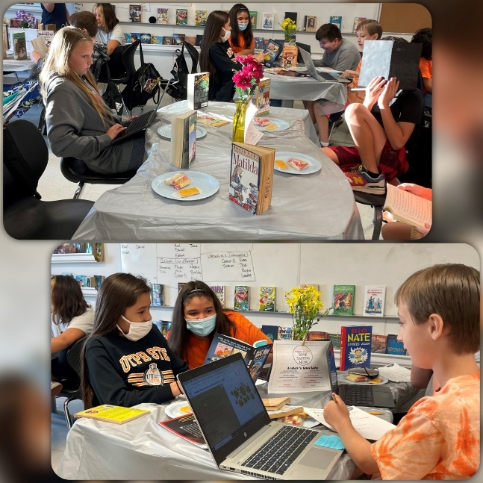

Schedule
Calendar = 180 days
Monday-Friday 7:50am – 3pm
8 Half Day Fridays throughout the year
10/11/12 Off Campus Lunch with
approval
7 Class Periods
LOTE is Computer Science 1 and 2
Pathway courses are considered electives
Junior and Senior year opportunity for Career Prep and
Internships within pathway field
Dual Credit courses online and assigned a monitor

Slide 8
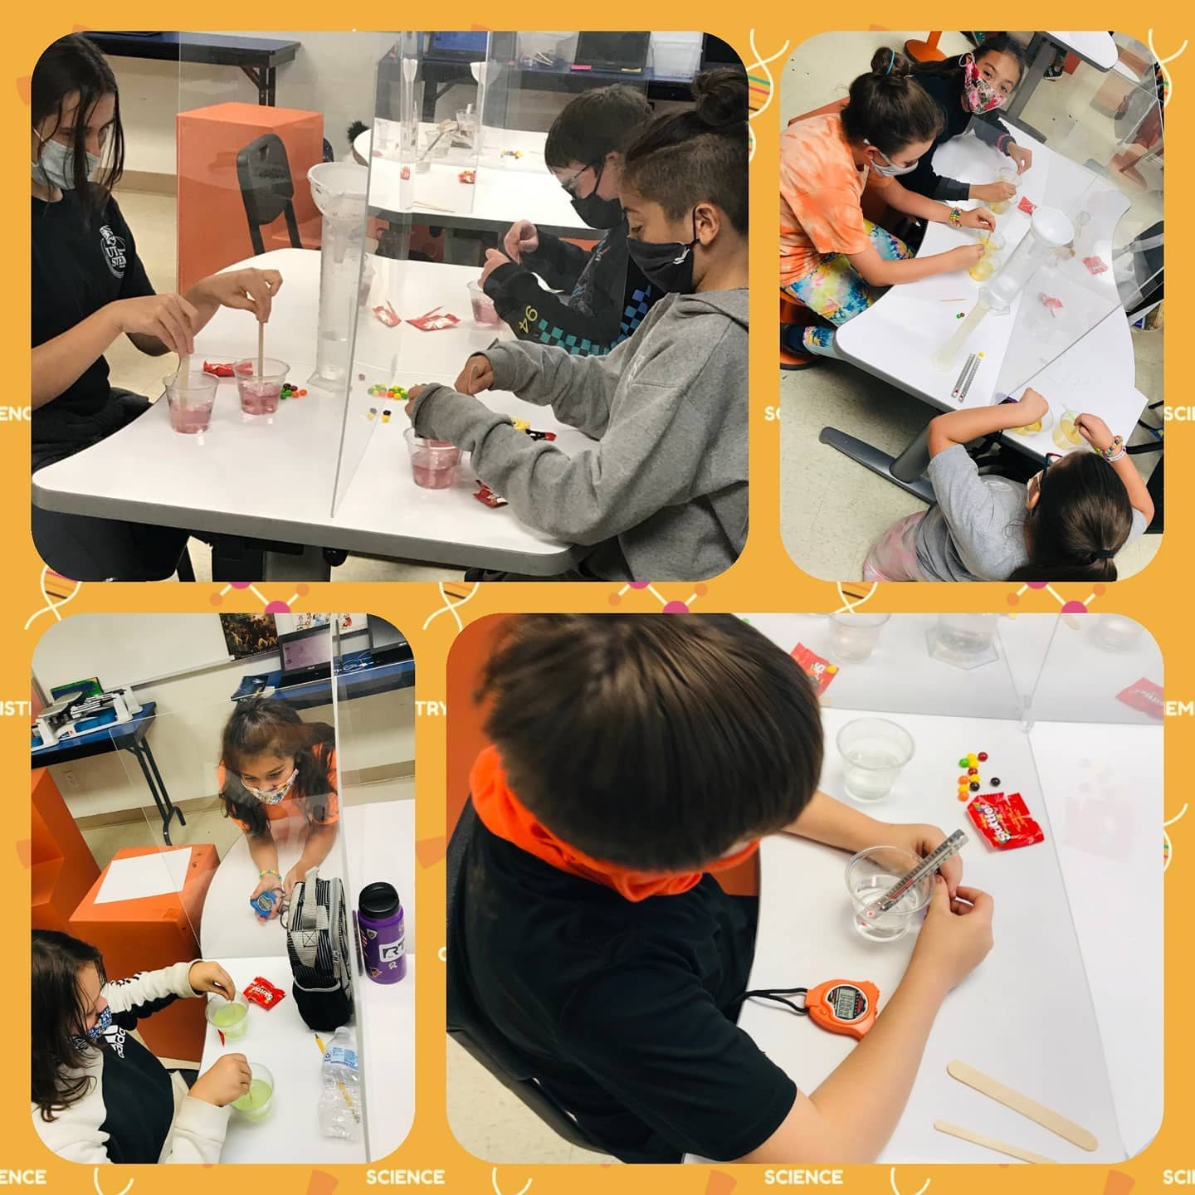
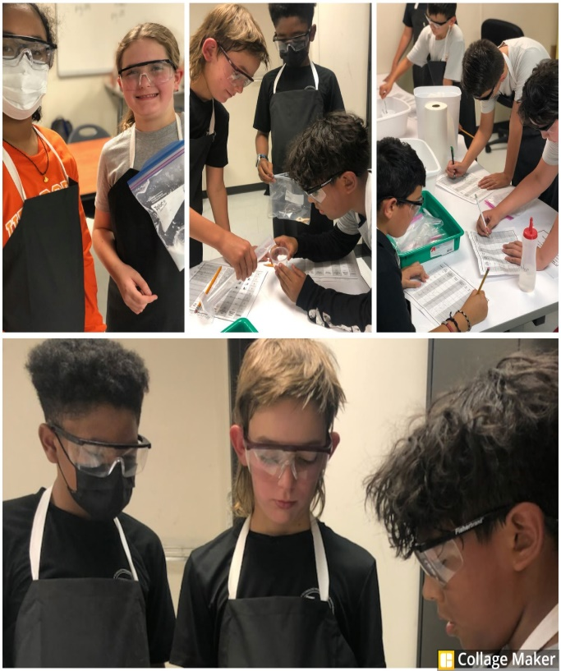
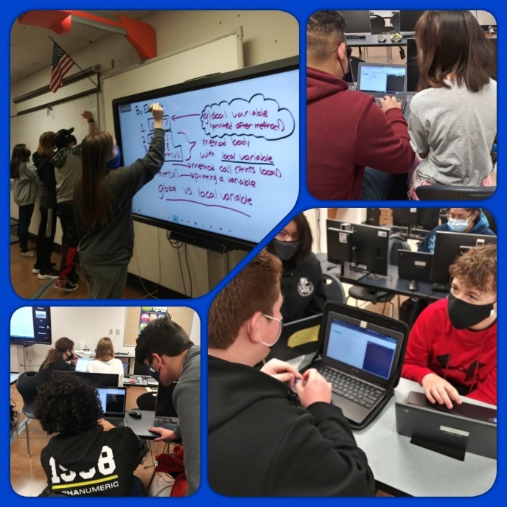
Academic Model
Texas Essential Knowledge and Skills
Project Based Learning
Early College High School
Advanced Coursework
Dual Credit
STEM Based Learning
Pathways
Biomedical
Engineering
Computer Programming

Slide 9
Extracurricular Activities
High School | Social Events | School Projects
eSports UIL Academics Destination Imagination Robotics TAME National Honor Society Student Council Botany Club Dance Club D&D Club Japanese Club Texas Scholars Book Club Yearbook Science Club First Priority | Back to School Bash Ice Cream Social Homecoming- Flag Football Spooky Sunset Car Show Pep Rally Family Picnics Friendsgiving #STEMGIVESBACK Winter Formal Prom Senior Banquet Senior Parade Senior Sunrise/Sunset Senior Tailgating Project Graduation | Monster Maker Challenge Boat Races Road to Graduation

Slide 10
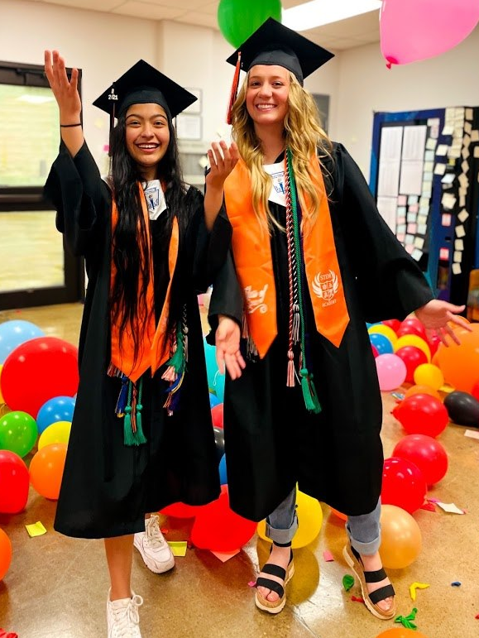
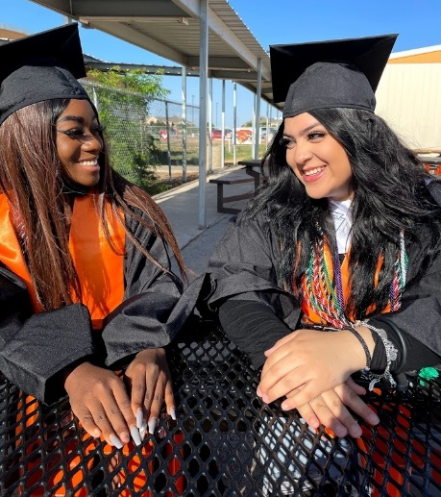
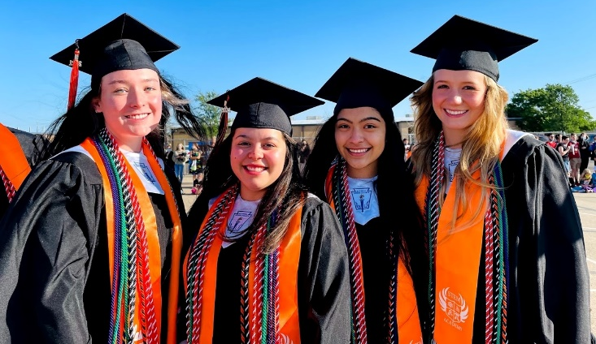
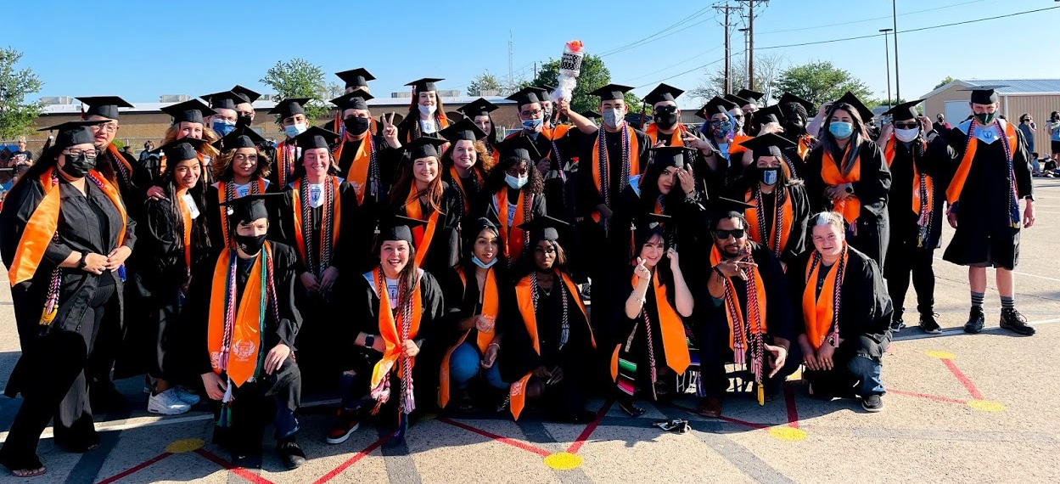
Post Secondary Focus
Early College High School
Attend Summer Bridge in Summer
Pass TSIA Test
Begin Dual Credit courses in 9th grade
Graduate with Associates Degree
Course fees paid by STEM Academy
Post Secondary Ready
Distinguished Level of Achievement
CCMR Ready

Slide 11
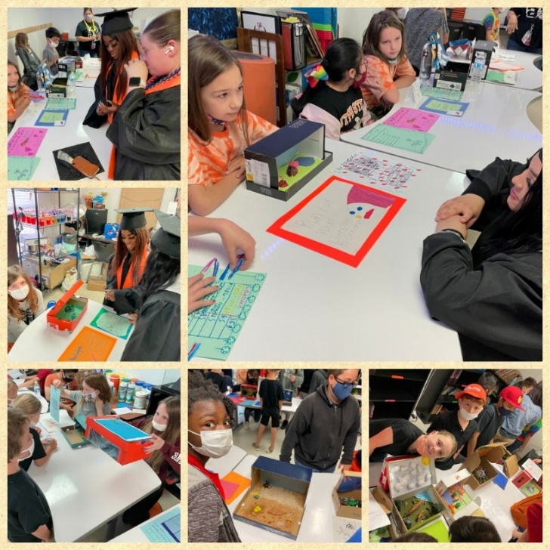
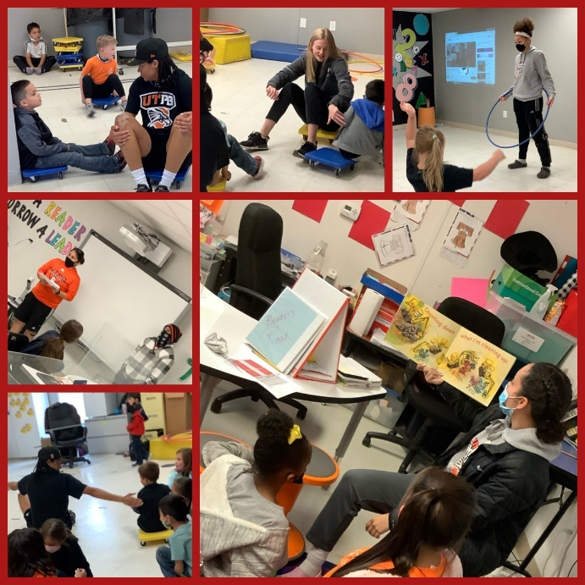
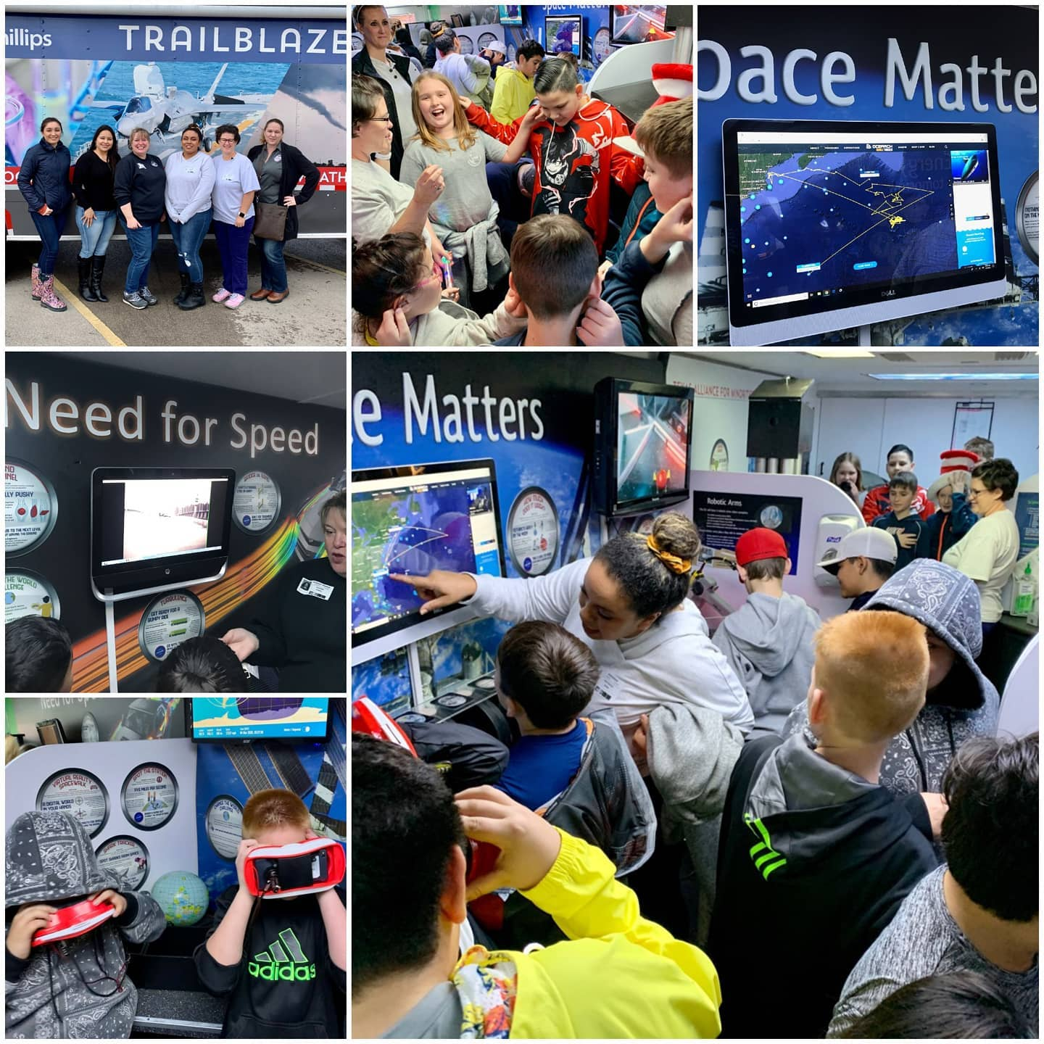
Parent Partnerships
Parent/School partnerships are the backbone of student success.
Family Engagement Activities
Social Events
Culminating Events of Projects

Slide 12
Choice Schools Parent Contract
The District may revoke an approved placement at a Choice School for the reasons listed below.
Use of false information submitted on the application.
Lack of parent support/cooperation with school staff
Persistent student misconduct.
Unsatisfactory academic progress. (Reagan & Hays only)
Excessive tardiness. (Exceeds 10 tardies, 10 early/late pickups)
Irregular attendance. (Exceeds 10 unexcused absences)
Failure by the parent to pick up the student at dismissal time. (10 early/late pick-ups)
Withdrawing student will automatically revoke placement at your Choice School.
Submitting an application to a Choice School other than the campus your student is currently attending, will result in loss of magnet seat at their current campus.
Any violation of ECISD Policy.

Slide 13
Student Expectations
I will come to school every day ready to learn.
I will complete all assignments on time and according to directions.
I will respect the rights of others at all times.
I will consistently monitor grades.
I will actively engage and participate in collaborative group work and projects.
I will choose one of the 3 STEM pathways and complete all 4 years in the pathway.
I will adhere to the expectations set in the Choice Schools Parent Contract.
I will adhere to the STEM Academy Dual Credit Agreement.
I understand that any severe or persistent misbehavior may result in immediate loss of placement.
I understand that I am required to pass the TSIA and expected to enroll in Dual Credit courses freshman year. All STEM Academy courses are considered advanced courses.

Slide 14
Parent Expectations
Ensure student is at school on time each day, students must be in their seats by 7:50 am.
Ensure student is prepared for each day and each learning project.
Consistently monitor students’ schoolwork and cordially communicate concerns with teachers. Parents and teachers are partners in the learning journey.
Support the school’s expectations of STEM and College Ready students.
Actively participate in STEM family events and student culminating events.

Slide 15


stemacad@utpb.edu

