Slide 1
Clyde Erwin Elementary School
Title I
2024-2025
This Photo by Unknown author is licensed under CC BY-NC.

Slide 2
What is Title I?
Title I is a federally funded program which helps children make progress in school.

Slide 3
Title I
This program provides additional help in reading for students who need the extra support.

Slide 4
Title I
This program also helps provide instructional materials for teachers and resources for families.

Slide 5
Title I Plan
Funding is based off number of students receiving free or reduced lunch.
Clyde Erwin has a full time Title I Reading Specialist and a part time tutor.
Our Instructional Coach
Teacher Assistant
Title I Plan

Slide 6
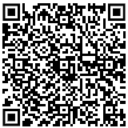
Family Engagement
The responsibility of a child's education is shared between both the family and the school. This partnership is essential to student's academic success. Please read through our Family Engagement Policy found here: https://cees.onslow.k12.nc.us/academics/title-one-information/parent-and-family-involvement-policy
Please use this form to provide any feedback on our Title I plan and Family Engagement Policy.

Slide 7
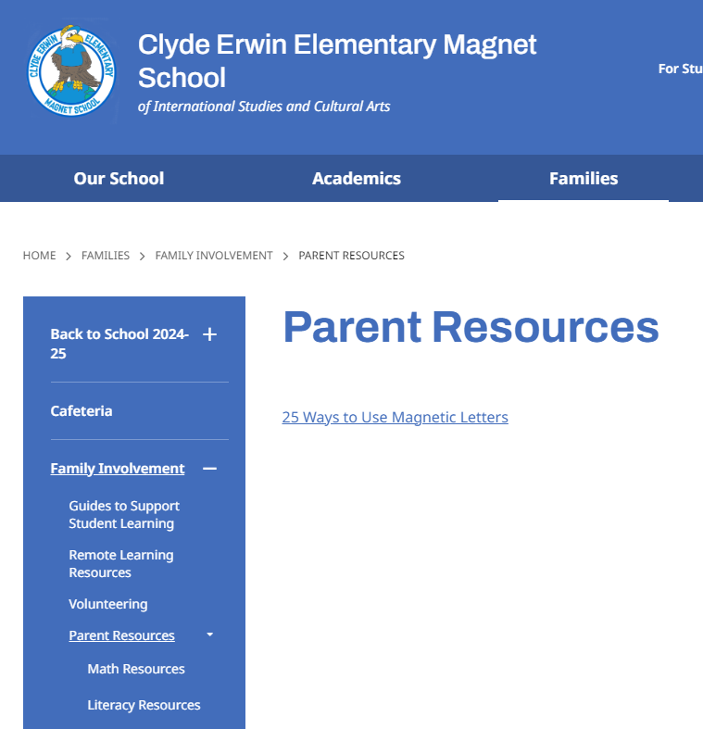
Ways to Help Your Child
If you would like some ideas on how to help your child in their academic growth, please visit our school website, Families, Family Involvement, and Parent Resources.

Slide 8
Thank you!
Please fill out this form using the QR code.

