Slide 1
JOHN M. CLAYTON OPEN HOUSE 2024-2025
Dr. Allisa Booth, Principal
Mr. Bennett Murray, Assistant Principal

Slide 2
It’s A Winning Year @ JMC

Slide 3
A School For Everyone!
Other Programs within JMC
HTE Satellite Classroom
Meeting the complex needs of our students with special needs
IRAP
Indian River Autism Program
High Roads
A classroom dedicated to providing more intensive services for special education students with behavioral needs.
They are learning the skills to be successful in a general education classroom.
Students will transition into other classes and back to their home school as they meet their goals.

Slide 4
What makes JMC Unique?
Art Show
Art Club
Book Club
Chess Club
Club Day (every quarter)
ExCel and TIDES
Field Day
Field Trips – fall and spring
Girls on the Run
Let Me Run
Math League
Meaningful Economics
National Honor Society
Paws for Reading
Read Aloud Delaware
Robotics Club
S.M.A.R.T.
Talent Show
Winter and Spring Concerts

Slide 5
School Counselors Mr. Redmiles and Mrs. Venezia La Consejera
Individual and Group Counseling
La consulta individual y de grupos
Focus on Character Education
La concentración en la educación de carácter
Please let us know about any issues that could affect school performance
Favor de avisar a la consejera si hay asuntos que le afectan el funcionamiento en las clases

Slide 6
Nurse’s Office – Mrs. Jones La Enfermera - Sra. Jones
Immunizations Las Vacunas
Dietary Concerns Asuntos dietéticos
Medication Medicina
Absences Ausencias
Pink Cards Tarjetas para emergencias
Screenings Evaluaciones
Dental Dentales
Insurance El Seguro

Slide 7
Health and Safety Salus y seguridad
Communication
The school and district will communicate any health concerns that may occur.
La escuela y el distrito comunicarán cualquier problema de salud que pueda ocurrir.
Contact the school nurse or the administration with any additional questions or concerns.
Comuníquese con la enfermera de la escuela o la administración si tiene preguntas o inquietudes adicionales.
Students must be fever free for 24 hours without medication before sending them to school.
Los estudiantes deben estar sin fiebre durante 24 horas sin medicamentos antes de enviarlos a la escuela.

Slide 8
Breakfast and Lunch El Desayuno y El Almuerzo
Breakfast and Lunch are offered each day for purchase by all students.
El desayuno y el almuerzo se ofrecen todos los días para que los compren todos los estudiantes.
Students must learn their student identification number as they use it in the cafeteria.
Los estudiantes deben aprender su número de identificación de estudiante a medida que lo usan en la cafetería.
Applications for Free and or Reduced Lunch must be made yearly. Benefits will run out unless a new application is filled out and returned.
Las aplicaciones por comidas gratis o reducidas debe llenar cada ano. Los beneficios paran si la aplicacion nueva no esta rellena y devuelta.

Slide 9
Important Reminders Recordatorios importantes
Students may be dropped off at the cafeteria entrance no earlier than 8:20 AM. No supervision is available prior to this time.
Los estudiantes no pueden llegar antes de las 8:20AM. No hay supervision antes de esta hora.
Parents cannot drop their children off in the main office before 8:45AM. Students MUST be dropped off at the cafeteria entrance between 8:20AM and 8:45AM.
Los padres no pueden dejar a sus hijos en la oficina principal antes de las 8:45am. Los estudiantes DEBEN estar en la entrada de la cafeteria entre las 8:20am y las 8:45am.
Parent pick up line may begin at 3:30PM.
La recogida de alumnos empezara a las 3:30PM.
Students will not sit with the opposite sex on the bus. If you want your children to sit together, you need to let the bus driver and front office staff know.
Los estudiantes no se sentarán con el sexo opuesto en el autobús. Si desea que sus hijos se sienten juntos, debe informar al conductor del autobús y al personal de la recepción.​.

Slide 10
Important Reminders Recordatorios importantes
Please send in a note if your child is going to be picked up. Phone calls will only be taken in an emergency and only before 3:00 PM.
Favor por mandar una nota si alguien va a recoger a su hijo(a). Si es una emergencia, puede llamar por teléfono, pero solamente antes de las 3:00 P.M.
Due to student safety, all parent pick-ups at the end of the school day will be required to follow the pick up lane that will enable you to retrieve your child at the cafeteria entrance. No parking in front of the school will be permitted at the dismissal time.
Por la seguridad de la estudiantes, toda los padres que recojan a sus hijos en la escuela al final del dīa deben seguir la linea de recoger para recoger a los estudiantes en la entrada de la cafeteria. No estará permitido aparcar delante de la escuela a la hora de la salida.

Slide 11
Important Reminders Recordatorios importantes
Please read over the attendance policy in the calendar. Parents only have two days to send in an excuse for an absence.
Favor de leer el programa de la asistencia. Los padres tienen solamente 2 días para mandar una nota despues de la ausencia del estudiante.
All food that is sent into the school must be commercially packaged and have food nutrition labels which include nutrient analysis and allergy information.
Toda la comida que se envie a la escuela debe estar empaquetada y debe tener etiqueta nutricional con los ingredients que contienen e información sobre las alergias.

Slide 12
Important Reminders Recordatorios importantes
Recess - Receso
A cart of equipment for students to utilize during recess will be provided.
Se proporcionará un carrito de equipo para que los estudiantes lo utilicen durante el recreo.
Students are not permitted to bring in recess equipment. (balls, jump ropes, etc.)
A los estudiantes no se les permite traer equipo de recreo. (pelotas, cuerdas para saltar, etc.)
The school will accept donations to the recess cart if any family would like to donate ítems that all students can use during recess time.
La escuela aceptara donaciones para el carrito del recreo si alguna familia desea donar artículos que todos los estudiantes puedan usar durante el recreo.
Personal items - Cosas personales
Toys, games, cards, stuffed animals, etc. from home are not permitted at school unless requested by the instructor.
Juguetes, juegos, cartas, animales de peluche, etc. de casa no están permitidos en la escuela a menos que lo solicite el instructor.

Slide 13
Class Dojo dojo de clase
Communication is key to a successful school year.
La comunicación es clave para un año escolar exitoso.
Class Dojo is a messaging App that is used by all JMC staff
Class Dojo es una aplicación de mensajería que utiliza todo el personal de JMC

Slide 14
Class Dojo dojo de clase
Reminders:
Some communication is best suited for discussion on the phone or in person.
Cierta comunicación es más adecuada para la discusión por teléfono o en persona.
The teachers will be sending and responding to Dojo during school hours.
Los maestros estarán enviando y respondiendo a Dojo durante el horario escolar.
If you have a question or issue that needs an immediate response, please call the front office.
Si tiene una pregunta o un problema que necesita una respuesta inmediata, llame a la oficina principal.

Slide 15
Title I: “What is Title I and how is it used in schools?”
Title 1 funds aim to bridge the gap between low-income students and other students.
The purpose of Title 1 funding, “is to ensure that all children have a fair, equal, and significant opportunity to obtain a high quality education and reach, at minimum, proficiency on challenging state academic achievement standards and state academic assessments.”

Slide 16
How can Title I funding
be used in a school?
Title 1 funds can be used to improve curriculum, instructional activities, counseling, parental involvement, increase staff and program improvement. The funding should assist schools in meeting the educational goals of low-income students.
Funds typically support supplemental instruction in reading and math.

Slide 17
School Bullying Acoso escolar
Delaware H.B. 243 requires school admin. to investigate and report alleged incidents of bullying (including cyber-bullying) and take corrective actions.
Characteristics of Bullying…
Aggressive, intentional behavior involving unwanted negative actions
Involves an imbalance of power or strength
A pattern of behavior repeated over time or which could be repeated over time
Características del Bullying…
Comportamients agresivo e intencional que involuucra acciones negativas no deseadas
Implica un desequilibrio de poder o fuerza
Un patron de comportamiento repetido en el tiemp o que podria repetirse en el tiempo
To report incidents of bullying…
Contact your child’s teacher or school’s administrator
Forms can be found – IRSD Website (www.irsd.net)
D.O.J. Ombudsperson 1-800-220-5414
Para reportar incidentes de intimidación...
Comuníquese con el maestro de su hijo o el administrador de la escuela
Los formularios se pueden encontrar en el sitio web del IRSD (www.irsd.net)
DOJ Defensor del pueblo 1-800-220-5414

Slide 18
IRSD Bullying Program
S.T.O.P. Bullying program - Introduced at all IRSD schools
S – Stand-up to the bully, and use your words to tell him/her/them to STOP hurting you. Say it loudly and clearly for others to hear.
T - Take appropriate Action to get away from the bully. Walk or run if need be, or go to an adult.
O – Open up to a trusted adult in your life, like your parents, a teacher, a counselor, or a coach.
P – Protect yourself from bullies by staying with a group of friends. If you are alone, self defense would include blocking the bully from hitting you and protecting your body.
Be aware of the resources on the IRSD website for families regarding bullying incidents (located under the “Students and Families” tab).

Slide 19
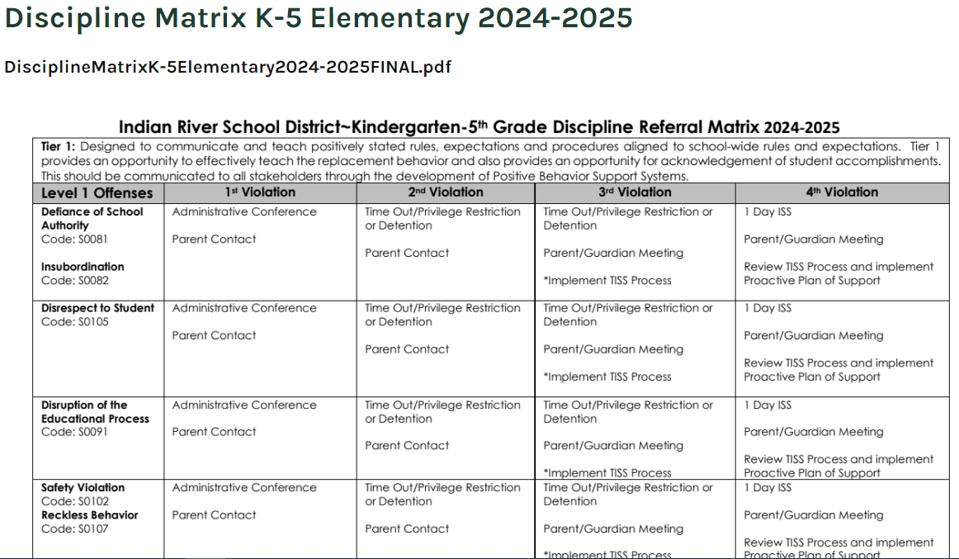
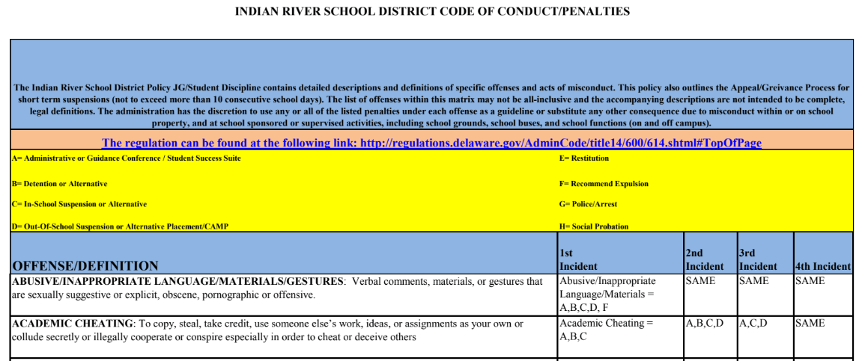
Discipline and Student Code of Conduct
The complete “IRSD Student Code Conduct” as well as the “K-5 Elementary Discipline Matrix” is located on the school’s website under the parent’s dropdown.

Slide 20
Security initiatives
School safety monitor - Monitora de seguridad escolar
Mr. John Justice
Doors are locked during the school day!
¡Las puertas están cerradas durante el día escolar!
Students will only be released to those authorized
Los estudiantes solo serán entregados a aquellos autorizados.
Swipe cards and readers - Tarjetas magnéticas y lectores
Visitors will have to buzzed into school.
Las visitantes tendrán que zumbar en la escuela.
Identification required for access.
Identificación requerida para el acceso.

Slide 21
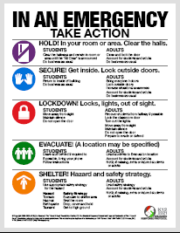
New Security initiative Nueva iniciativa de seguridad Standard Response Protocol (SRP)
What is it? Que es?
Students and staff will be training, practicing, and drilling these new protocols in case the need occurs to ensure everyone's safety.
Los estudiantes y el personal capacitaran practicaran estos nuevos protocolos en caso de que sea necesario para garantizar la seguridad de todos.
A handout for guardians is available on the school website. Also, ask your child what they do when they hear … ?
Un folleto para tutores esta dusponible en el sitio web de la escuela. Ademas, preguntele a su hijo que hace cuando escucha…

Slide 22
School Choice Elección de escuela
School choice is available within the Indian River School District for any guardian who wishes their child to attend a specific school other than their “home” school.
La elección de escuela está disponible dentro del Distrito Escolar de Indian River para cualquier tutor que desee que su hijo asista a una escuela específica que no sea la escuela de su “hogar”.
This can be due to special programs (STEM, immersion, AP, IB), day care, or good cause.
Esto puede deberse a programas especiales (STEM, inmersión, AP, IB), guardería o una buena causa.
Please tell your friends, neighbors, and family members.
Dígaselo a sus amigos, vecinos y familiares.
Any questions should be directed to Preston Lewis at 302-436-1000.
Cualquier pregunta debe dirigirse a Preston Lewis al 302-436-1000.

Slide 23
Parent Responsibilities Responsabilidades de los padres
Join/login to ClassDojo and Home Access Center
Únase/inicie sesión en ClassDojo y Home Access Center
Encourage your child - Anime a su hijo
About school, reading, homework, and more.
Acerca de la escuela, la lectura, la tarea y más.
Establish a school work location in the house that is quiet and can be monitored.
Establezca un lugar de trabajo escolar en la casa que sea silencioso y pueda ser monitoreado.
Limit screen time and recommend reading as well as other educational activities.
Limite el tiempo frente a la pantalla y recomiende la lectura, así como otras actividades educativas.
Communicate any concerns - Comunicar cualquier inquietud

Slide 24
Parent Responsibilities Responsabilidades de los padres
Get involved - Involucrarse
Attend scheduled parent conferences
Asistir a las conferencias de padres programadas
JMC PTO and their many events
JMC PTO y sus muchos eventos
Chaperone field trips
Excursiones de acompañantes
Join JMC on Facebook and Instagram
Únete a JMC en Facebook e Instagram
@jmcelementary

Slide 25
THANK YOU
VERY MUCH! Muchísimas gracias!
Have a great school year! Que tengas un gran año escolar!

Slide 26
Now to the classrooms …
Introduction of Kindergarten Teachers
Mrs. Granados
Mrs. Hill
Mrs. Truitt and Ms. Loaiza

