Slide 1
Maury High School - Unsolicited Proposal Pursuant to Public Private Education Facilities Infrastructure Act of 2002 (PPEA) December 6, 2023 Cheryl Spivey Chief Finance Officer

Slide 2
Maury High School - Timeline of Major Activities [2018-2022]
2018 - HBA Architecture (HBA) completed an educational specifications process to review the school’s condition and use of space for its academic programs.
2020 through 2022 - HBA conducted a feasibility study to create options for modernization or replacement.
This process included multiple meetings to gather input from staff, students, families, and the community.
(September 28, 2022 – Maury HS Cafeteria, October 12, 2022 – St. Helena ES Cafeteria, October 25, 2022 – Faith-Based Community Meeting)

Slide 3
Maury High School - Timeline of Major Activities [2018-2022 (continued)]
November 2, 2022 – School Board Meeting
HBA presented a modernization versus replacement feasibility study that included 2 options for renovating the existing building and 2 options for building a new one.
Recommendations included replacing Maury High School on its current site in a 3 to 4 story configuration (Option B2).
Before the next steps could be accomplished, Heartland filed its unsolicited proposal regarding the Maury site.

Slide 4
Maury High School - Timeline of Major Activities [2018-2022 (continued)]
November 22, 2022 – NPS received Heartland PPEA.
December 7, 2022 – School Board Meeting
HBA presented results of community engagement meetings & recommendations.
School Board held a public hearing regarding the future state of Maury High School.

Slide 5
General Information - Heartland PPEA Project
Conceptual Model: Construction of a new Maury High School and Adaptive Reuse and Rehabilitation of the Existing Historic Maury High School
Design-Builder: Heartland Construction
Architects: Work Program Architects (WPA) and
VMDO Architects
Adaptive Reuse: The Monument Companies

Slide 6
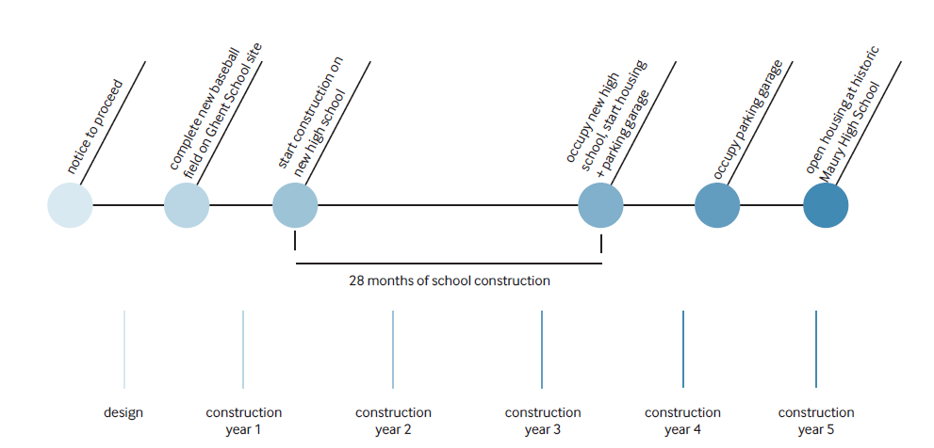
Heartland PPEA Project - Original Proposed Construction Schedule

Slide 7
Maury High School - Timeline of Major PPEA Activities (2023)
January 2023 – The NPS Administration hired MBP to review unsolicited offer and received report recommending revisions.
February 2023 - The NPS Administration requested revision to unsolicited offer to address parking and natatorium.
March 2023 - The NPS Administration received response from Heartland addressing parking and natatorium; and a working group was formed to review the proposal and make recommendations to the School Board to review or not review the unsolicited offer.
April 2023 - Working group reviewed/discussed the unsolicited offer and recommended proceeding in accordance with PPEA.

Slide 8
Maury High School - Timeline of Major PPEA Activities [2023 (continued)]
May 2023 - School Board approved recommendation to accept the unsolicited proposal for review along with other competing proposals that may emerge over a period of not less than 90 days.
June 2023 – The NPS Administration received notification of a $30M grant award for the construction or renovation of Maury High School and certified to VDOE the intent to obligate the awarded grant by no later than December 21, 2023.
June 2023 through September 2023 - The NPS Administration solicited competing proposals. No competing proposals were received.

Slide 9
Maury High School - Timeline of Major PPEA Activities [2023 (continued)]
September 27, 2023 - Work group met and expressed the following concerns and recommendations to the Superintendent of Schools.
Work Group Concerns:
No other competing proposals were received. Unable to determine if quoted pricing levels are of true market value.
Existing Maury High School structure to be sold to the developer once building is vacant, rather than the city maintaining control and security of the building.
Parking structure safety concerns.

Slide 10
Maury High School - Timeline of Major PPEA Activities [2023 (continued)]
Work Group Recommendations:
Reject the Heartland proposal and the PPEA.
Prepare and advertise two separate Requests for Proposals (RFP):
A design-build project for a new high school; and
A design-build for a major renovation of the existing Maury High School.
Superintendent of Schools supported the work group’s recommendation.
Heartland submitted an amendment in response to questions and comments regarding their unsolicited proposal.

Slide 11
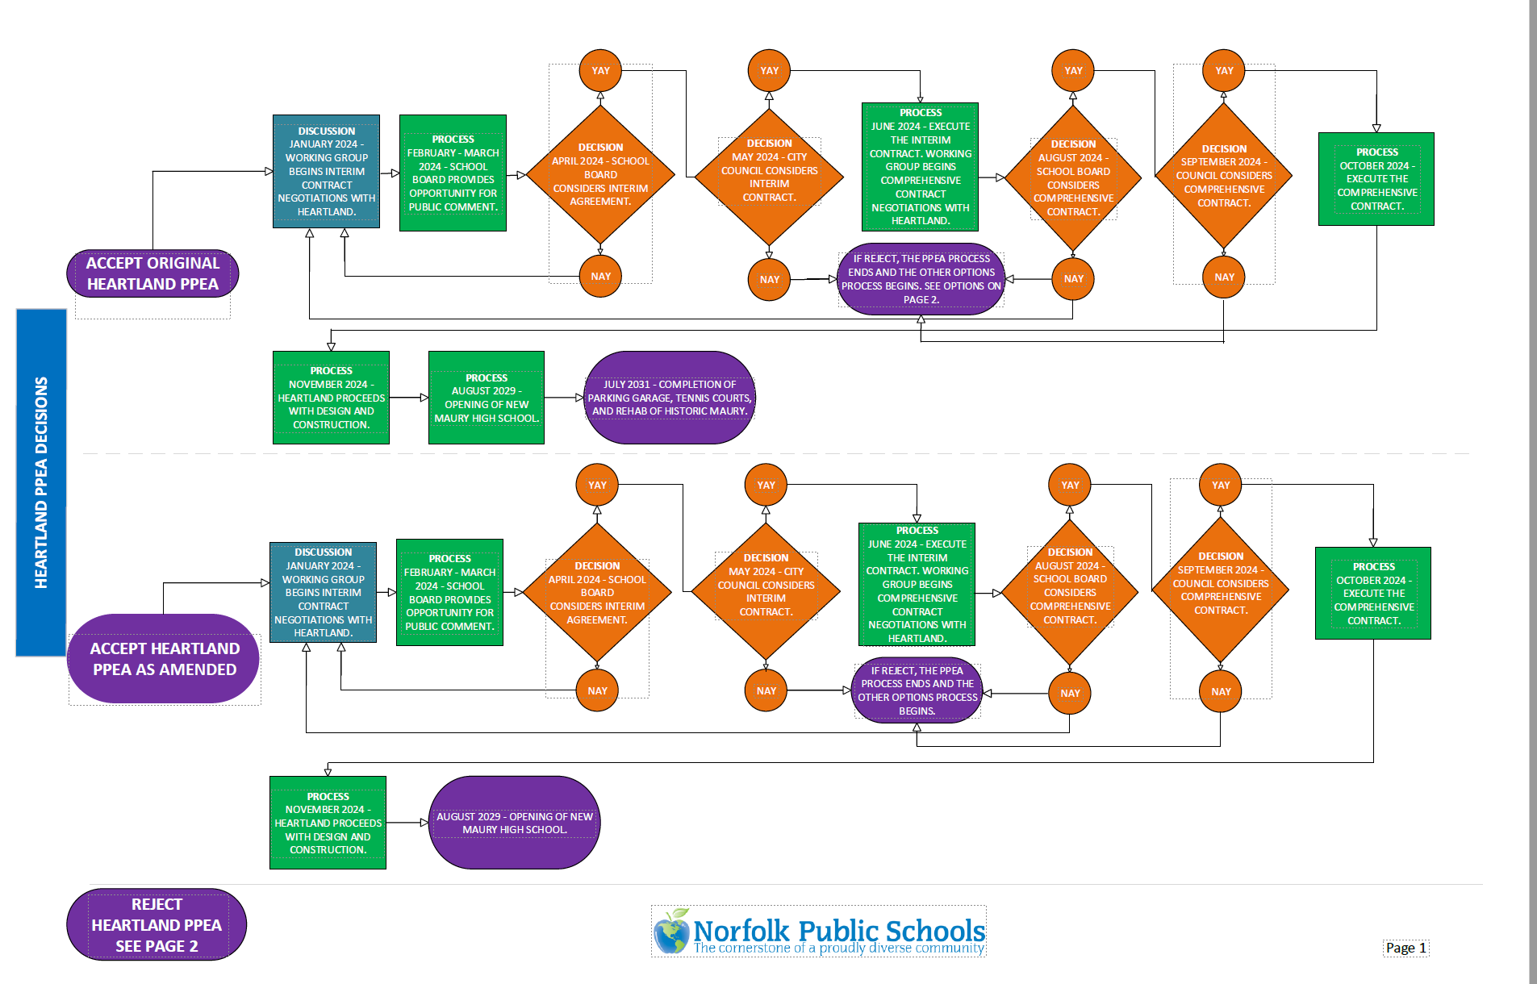
Potential Next Steps & Decisions

Slide 12
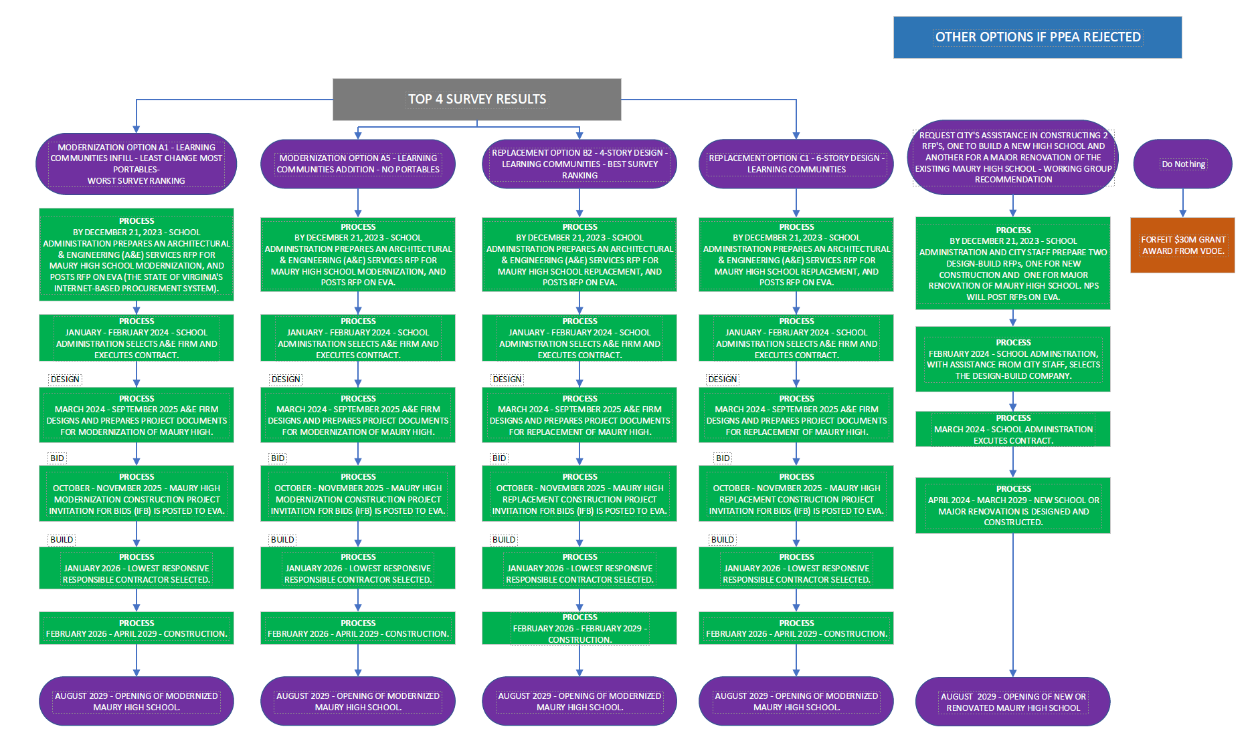
Potential Next Steps & Decisions (continued)

Slide 13

Maury High School PPEA
School Board Discussion and Decision

