Slide 1

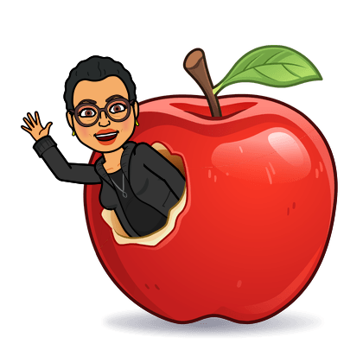

Welcome to
Ms. Fairweather’s Class!
G.E.A.R.S.
Gifted Education & Academic Rigor Services!
2022-2023

Slide 2



About the teacher
My name is Fonda Fairweather and I have the distinct honor of working with your gifted child this year. This is my 33rd year teaching. I hold a Bachelor’s Degree from San Diego State University, a Master’s Degree in Reading from Grand Canyon University, an endorsement in Library Media from Old Dominion University, lifetime certification from University of California San Diego for Gifted and eight years’ experience as a Gifted/Seminar teacher with San Diego Unified School District. I have worked for NPS 23 years as a 5th grade teacher, Library Media Specialist and GRT.

Slide 3

What is my child’s identification and what does it mean?
Your child was identified using 5 criteria: CogAT test scores, teacher rating form, parent rating form, portfolio and interview.
Students who are identified gifted are identified in one of several ways: Reading, Math, Reading and Math, General Intellectual Aptitude (GIA).
If your child has any of those identifications, he/she will receive gifted services. Your child’s ID can not be taken away; it will stay with them as long as they are in Norfolk Public Schools.
Norfolk’s Local Plan for gifted education states that your child will be part of a cluster class and/or will receive services from the gifted teacher.
Pull out or push in model; cluster grouping; collaboration

Slide 4
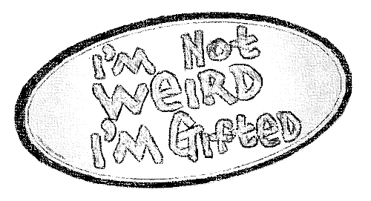
How will my child receive gifted services?
Currently I am pushing into grades 2-5 classes for instruction.
5 days at Norview ES-Room 6
We will be using Canvas & Google Classroom https://classroom.google.com/c/MzQ1NDg4Mzg1OTY5 for asynchronous assignments. A notice on ClassDojo for joining my Google Classroom will go out tomorrow! ☺
Additional information is posted on the school website under the Our Families tab
Norview: Norview Elementary School / Homepage (npsk12.com)

Slide 5

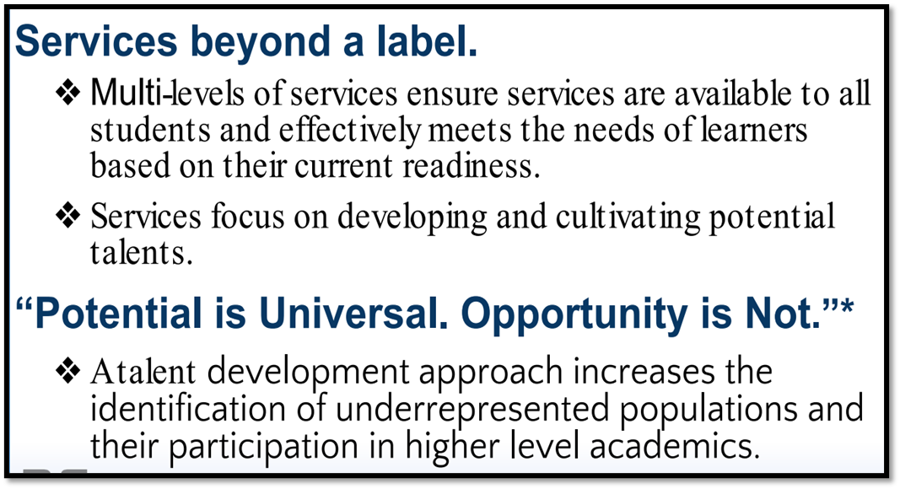

Slide 6
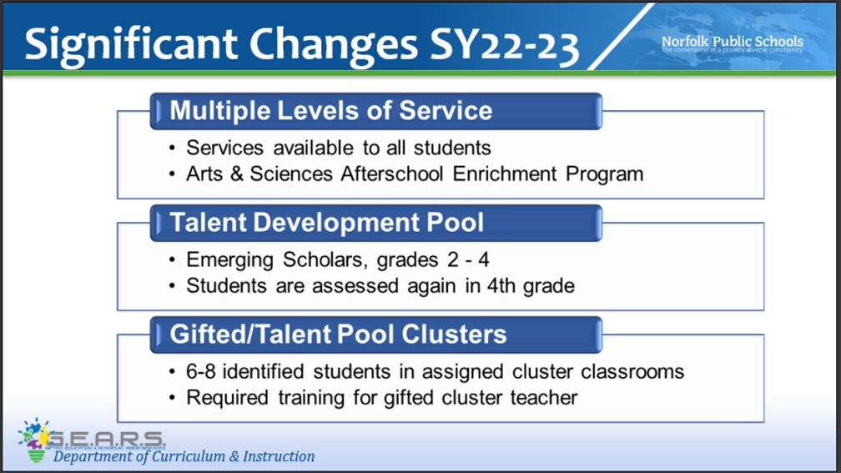



Slide 7
What are emerging scholars?
Emerging Scholars are determined by a First Grade Universal Screening(CogAT) under the new local plan including revised benchmarks. Emerging scholars' services available to top 15% scorers in every school, and increased focus on enrichment and exposure for all students.

Slide 8
How will I know how
my child is doing in gifted?
I do not give grades; however, I do give a progress report or quarterly evaluation.
I collaborate with the classroom teacher about behavior and academics. Classroom grades are PRIORITY!
Communication with parents: Class Dojo for progress reports, notes and/or phone calls, as needed.

Slide 9
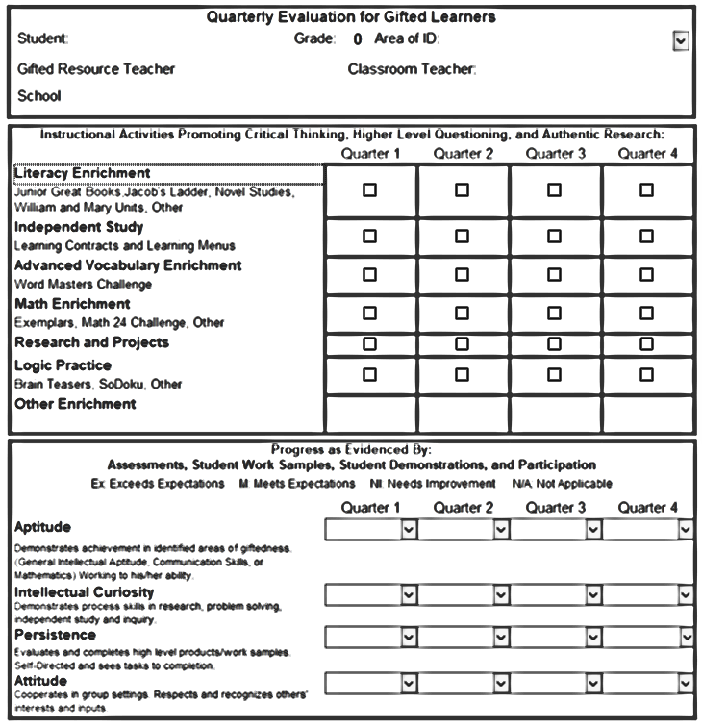
Quarterly Evaluations will be sent out with report cards.

Slide 10
Testing
When testing is going on, we will not have groups. I will notify you on google classroom or Class Dojo. However, I will collaborate with teachers about assignments and there may be some asynchronous work on google classroom/canvas.
November: Gifted testing for referred students in grades 2-5
February: Gifted testing for all first-grade students
May/June: SOLs
Classroom testing (STAR, benchmarks, etc.)

Slide 11
2nd and 3rd | 4th and 5th
Learning Style Inventory Junior Great Books Questioning strategies Exemplars (logic problems) Hands on Math | Learning Style Inventory Junior Great Books/Shared Inquiry Jacob’s Ladder Exemplars (logic problems) Hands on Math
Curriculum

Slide 12
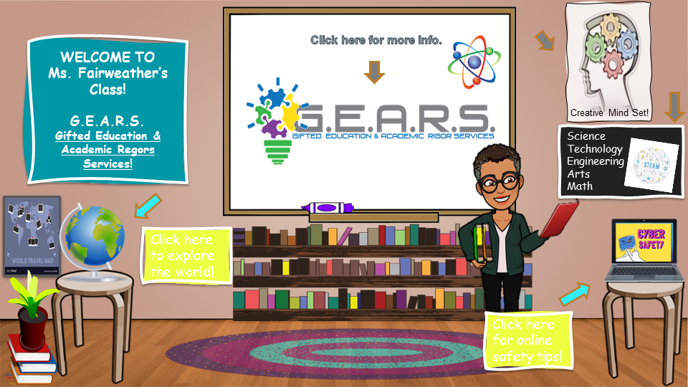

Slide 13
Links to Learn More About our Curriculum
Junior Great Books: https://www.greatbooks.org/junior-great-books-k-5/
Jacob’s Ladder: https://education.wm.edu/centers/cfge/curriculum/languagearts/materials/jacobsladders/index.php
One Hour Mysteries: https://www.rainbowresource.com/category/3481/One-Hour-Mysteries.html
Logic Safari: https://www.routledge.com/Logic-Safari-Book-1-Grades-2-3/Risby/p/book/9781593630898
Exemplars: https://exemplars.com/
Noetic Math: https://www.noetic-learning.com/

Slide 14

E-mail is the easiest way to reach me:
ffairwe@nps.k12.va.us
By Cell
434-658-7688

Slide 15
Questions?????

Slide 16

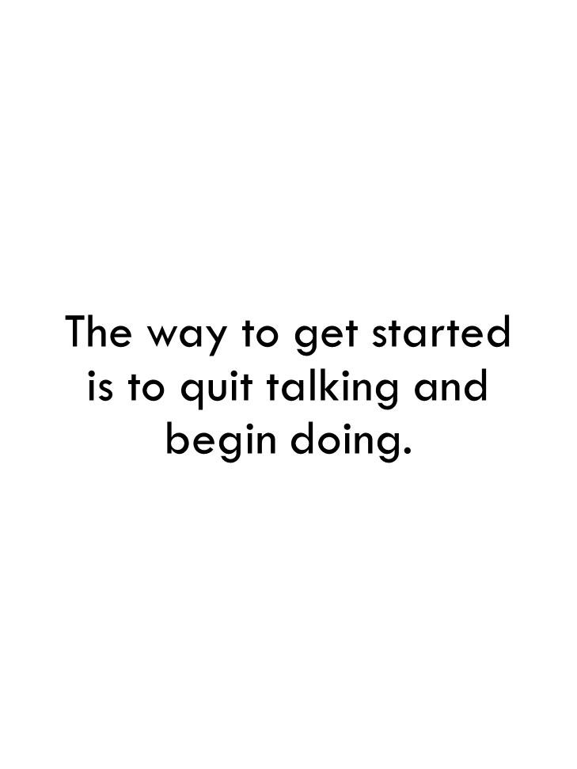
Walt Disney

