Slide 1
Parent Guide to Academic Success Guía para Padres sobre Éxito Académico Part 3
By:
NPS ESL Teachers
Profesores de Inglés como Segundo Idioma de Norfolk

Slide 2
Introductions
Welcome!
¡Bienvenidos!
اهلا وسهلا
Maligayang pagdating
Accueillir

Slide 3
Objectives
We will discuss:
High School Graduation Requirements
Virginia SOL Tests
LEP Plans
LEP Meeting Demonstration

Slide 4
Session 1 Review/Repaso de sesión 1
Officer Valdez
Enrollment / Matrícula
Translation Support / Traducción
First Week / Primera semana
Tracking grades & attendance / Cómo revisar calificaciones & asistencia
Health Department / Departamento de Salud
Adult Education Classes

Slide 5
Session 2 Review/Repaso de sesión 2
Importance of attending Parents’ Night
FERPA Law
After school tutoring/support
Parent/Teacher Conferences
Specialty Programs (Middle and High School)

Slide 6
Virginia High School Graduation Requirements
https://docs.google.com/viewerng/viewer?url=https://www.npsk12.com//cms/lib/VA02208074/Centricity/Domain/4194/2019-2020+SSC.pdf
Page 10

Slide 7
VA SOL Tests
Standards of Learning/SOLs :
Es un programa de pruebas estandarizadas en el estado de Virginia.
Expectativas de logros y aprendizaje para materias básicas.

Slide 8
VA SOL Tests
¿Cuándo son administradas?
¿Qué miden las pruebas SOL?
¿Cuáles son los SOLs que mi hijo/hija tiene que tomar?

Slide 9
VA SOL Tests
Grado | Lectura | Matemáticas | Ciencias | Estudios Sociales | Escritura
3 | X | X
4 | X | X
5 | X | X | X | VA Studies
6 | X | X
7 | X | X
8 | X | X | X | Civics and Economics | X

Slide 10
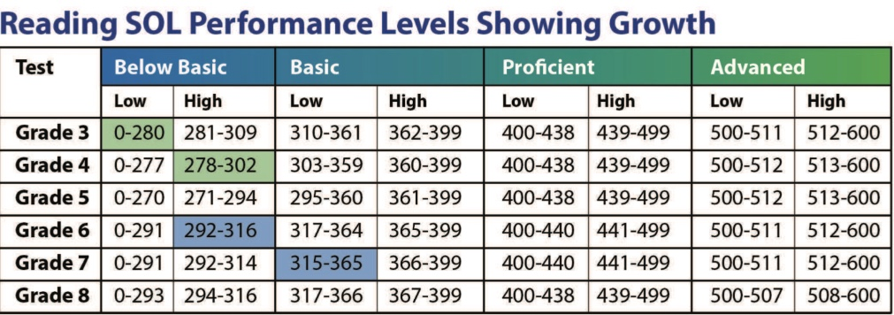
VA SOL Tests

Slide 11
LEP Plan and Meeting
What is it? / ¿Qué es?
How do I find out when it is? /¿Cómo sé cuándo es?
What are the accommodations? /¿Cuáles son los acomodos?
Who is going to be there? / ¿Quién va estar allí?
Why should I go? /¿Por qué debo asistir?

Slide 12
LEP Plan and Meeting
Direct linguistic testing accommodations involve adjustments to the language of the test. The following direct linguistic testing accommodations are available to ELs on the SOL assessments:
• Test Directions Delivery
• Read-Aloud Test
• Audio Test
• Bilingual Dictionary
• Dictation to a Scribe (Writing, short-paper component only)
• English Dictionary
• Plain English Mathematics Test (Available for Mathematics tests assessing the 2009 Mathematics Standards of Learning only.)
Indirect linguistic testing accommodations involve adjustments to the conditions under which ELs take SOL tests. The following indirect linguistic testing accommodations are available to ELs on the SOL assessments:
• Multiple Test Sessions (Paper Only)
• Visual Aids
• Examiner Records Response
• Flexible schedule

Slide 13
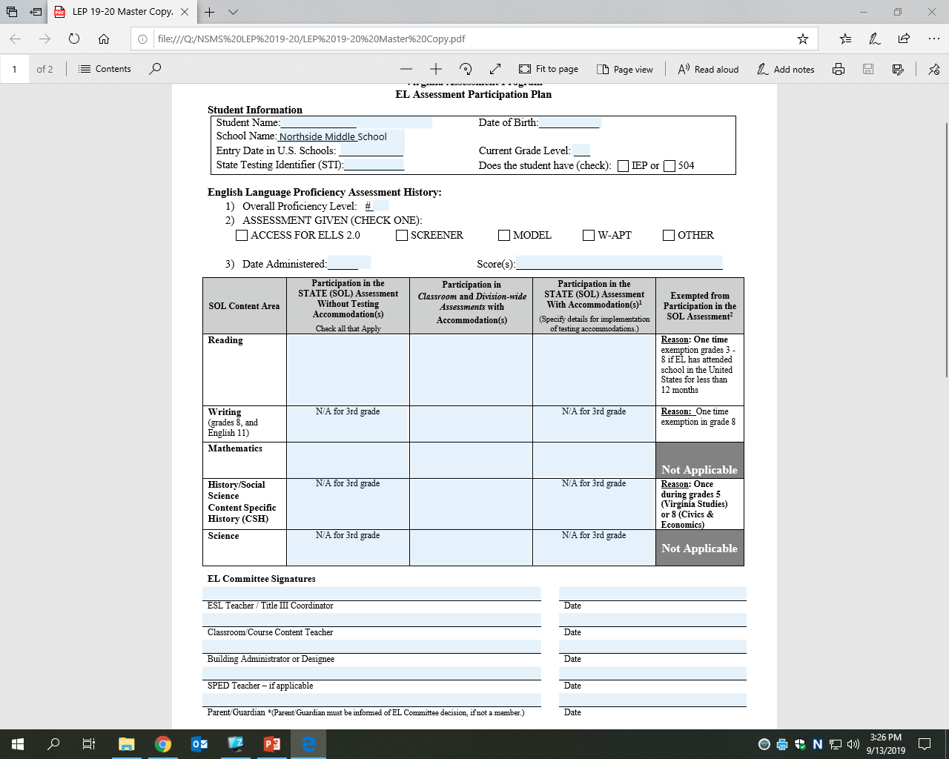
LEP Plan and Meeting

Slide 14
LEP Plan and Meeting
LEP Meeting Demonstration
Language Line

Slide 15
Important Websites
Norfolk Public Schools
https://www.npsk12.com
Foreign Language & ESL
https://www.npsk12.com/fl
Student Handbook
https://www.npsk12.com/Page/10208 (Spanish)
https://www.npsk12.com/Page/1349 (English)

Slide 16

Questions / Preguntas

