Slide 1
Parent Guide to Academic Success
Guía para Padres de Éxito Académico
Part 1
By:
NPS ESL Teachers
Profesores de Inglés como Segundo Idioma de Norfolk

Slide 2
Introductions
Welcome!
¡Bienvenidos!
اهلا وسهلا
Maligayang pagdating
Accueillir

Slide 3

Hopes and Dreams / Sueños y metas

Slide 4
Objectives
We will discuss:
  Enrollment / Matrícula
  Translation Support / Traducción
  First Week / Primera semana
  Tracking grades & attendance / Cómo revisar calificaciones & asistencia

Slide 5
Enrollment
Enrollment
  Where do I go?
    How to get School and Bus Information (Handout)
  Who do I talk to?
  List of required/accepted documents
  Brief Lunch Info
  Etc.

Slide 6
Translation
Parents’ Rights
  Calling or talking to the school’s front office.
  Communicating with:
    Teachers
    Guidance
    Nurse
  Meetings
    LEP
    IEP (Special Education)
    504
    School Incidents (Suspensions, Bullying, etc.)

Slide 7
First Week
First Day of School: September 3, 2019
  School Calendar
School Supplies List (Varies by School)
Bus Information (Handout)
Students’ Class Schedules
Importance of updated address and phone number

Slide 8

Tracking academic information
ParentVue
  Login in
  Attendance (NPS Policy)
  Grades (Scale, “L”, Quarters)

Slide 9
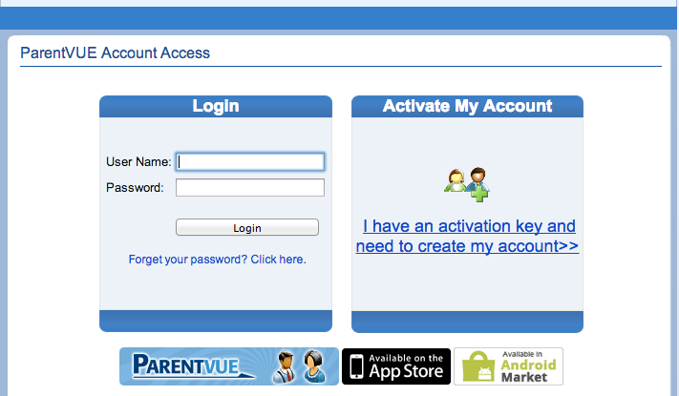
Login In

Slide 10
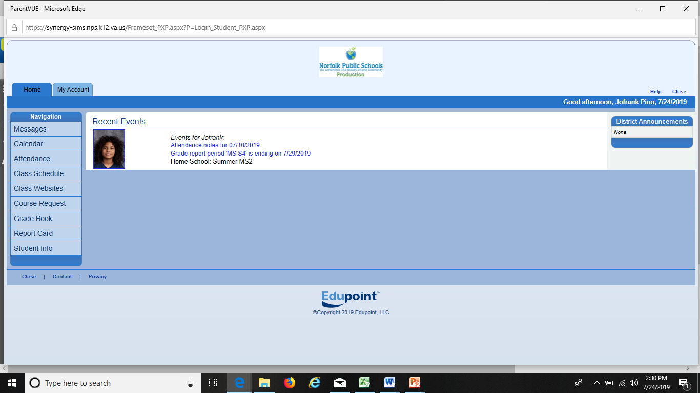
Main Page

Slide 11
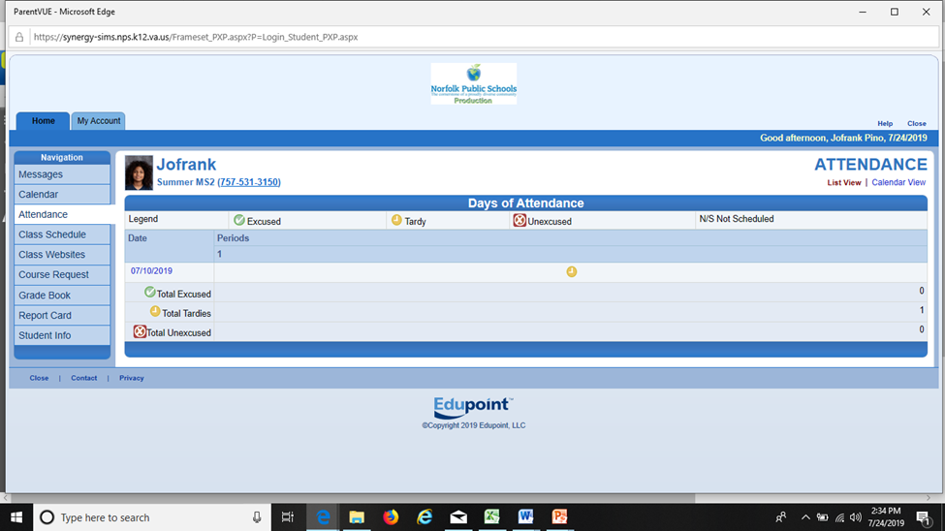
Attendance

Slide 12
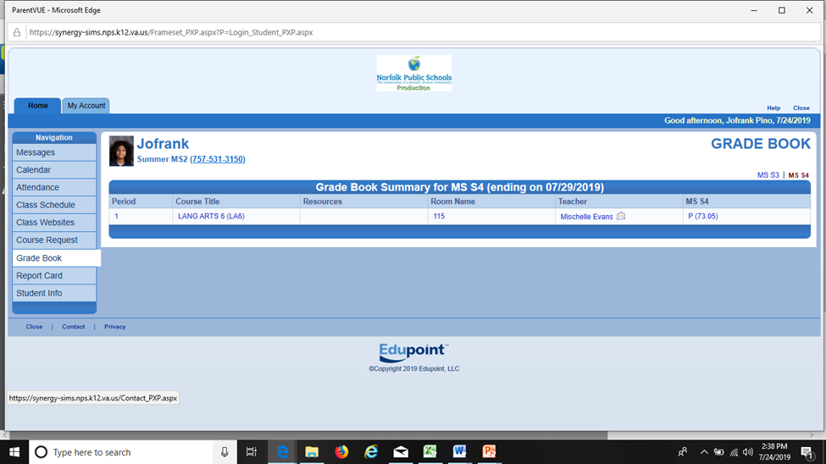
Grades

Slide 13
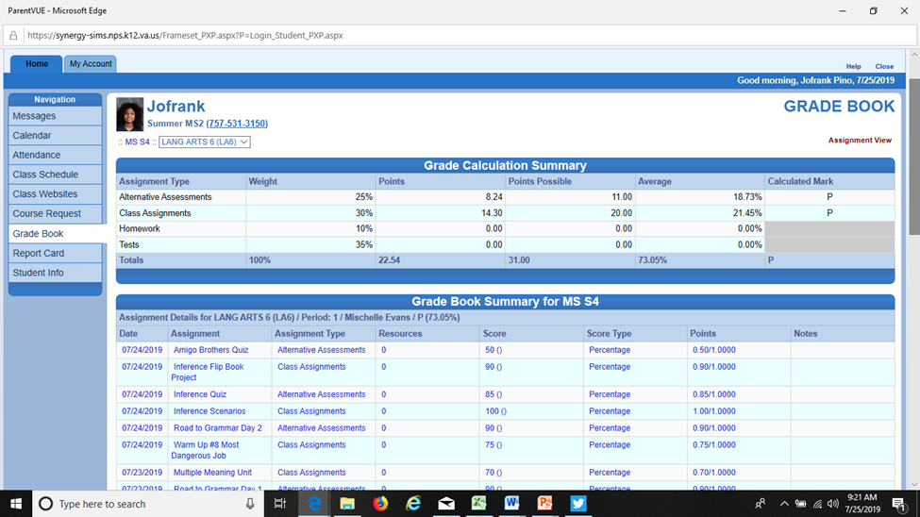
Grades

Slide 14
Important Websites
Norfolk Public Schools
  https://www.npsk12.com
Foreign Language & ESL
  https://www.npsk12.com/fl
Student Handbook
  https://www.npsk12.com/Page/10208 (Spanish)
  https://www.npsk12.com/Page/1349 (English)

Slide 15

Questions / Preguntas

