Slide 1

Information Technology
Welcome to Norfolk Public Schools
Technology Safety Overview

Slide 2
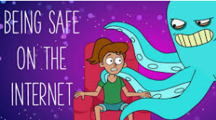
Internet Safety Guidelines
Monitor and limit internet usage – Ask questions. Know what your child is doing online.
Set rules and talk about them - Keep an open line of communication with your child regarding their online activities. If your child feels comfortable talking with you, they will be more likely to open up if they encounter an online bully, or inappropriate content or someone behaving inappropriately towards them.
Limit internet usage – Set a time for homework and a set amount of time for games, etc.
Keep kids in sight while they use the internet devices.
Do your homework - Check the browser history to know
where your kids are going online.

Slide 3

Communicating and social networking:
Online communication consists primarily of email, instant messaging (IMs), chat rooms, and journals or web logs (blogs). On networking sites such as Facebook, kids (often, they must be 13 or older) can create web profiles, and then invite others to view and become online buddies. Your child may use these media to share gossip, exchange photos, make weekend plans, find out about missed assignments, connect over common interests, and express opinions.
.

Slide 4

What to know: One out of every five kids gets sexual solicitations online. Strangers, predators, and cyber-bullies all target children, and their work is simplified when screen names reveal age, gender, or hometown. If posts aren't marked as private, personal information can be displayed to an unrestricted audience of readers.
What to do:
Know who your child talks to online. Review their buddy list: do they really know everyone, or are some buddies "friends of friends"? Have them remove anyone they haven’t met in person.
Tell them not to exchange personal information like a phone number, address, best friend's name, or picture. No party invitations, revealing details, or meeting in person — ever.
Know your child’s password: They are not yet adults, social media is a privilege not a right.
Security Settings: Set them to PRIVATE not Public, friends/relatives ONLY!!!

Slide 5
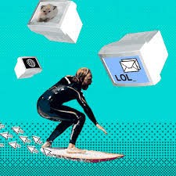
Web surfing: Kids can explore new interests, check to see if a library book is available, or find a recipe for the class party in valuable resources, such as online encyclopedias, newspapers, and periodicals.
What to know: Surfing the Web without restrictions can mean encountering pop-up ads, viruses, erroneous information, and inappropriate content. The ease of cutting and pasting means that plagiarism is a real concern. And time flies online! Kids can click from one site to another until bedtime (or beyond), if you let them.

Slide 6

What to do:
Set a code of conduct and time limits. Keeping kids safe means setting guidelines about suitable language, content, and behavior. While it's important to direct your child to suitable websites, it's even more valuable to help them recognize the redeeming qualities of those sites, so they can surf safely on their own.
Critique content. Help your child think critically about the content they read and see. Encourage them to check facts with multiple sources before including them in a school report. Try to distinguish between user-generated content and reputable institutions.

Slide 7

Don’t let computers/devices be the only activity for your child. Find an activity such as sports, theater, scouts, environmentalism to help occupy their free time. Being “online” should not be the only extracurricular activity they have. Talk to your child and know their interests and try to get them involved with other activities.

Slide 8

Online Bullying
Things to know

Slide 9

NEVER:
Tease or harass people online
Spread gossip or lies
Threaten anyone
Disrespect anyone

Slide 10

ALWAYS:
Commit to stand up against bullying
Treat others with respect & kindness
Be responsible to help others being bullied and report bullying to school guidance counselor or trusted teacher or adult

Slide 11
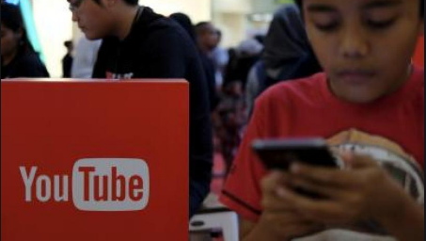
Again, keeping an open line of communication with your child can assist with knowing what is going on in their life and if they are having any problems with bullies. Norfolk Public Schools has a ZERO tolerance for bullies!

Slide 12
Norfolk Public Schools
Useful links:
https://www.npsk12.com

Slide 13
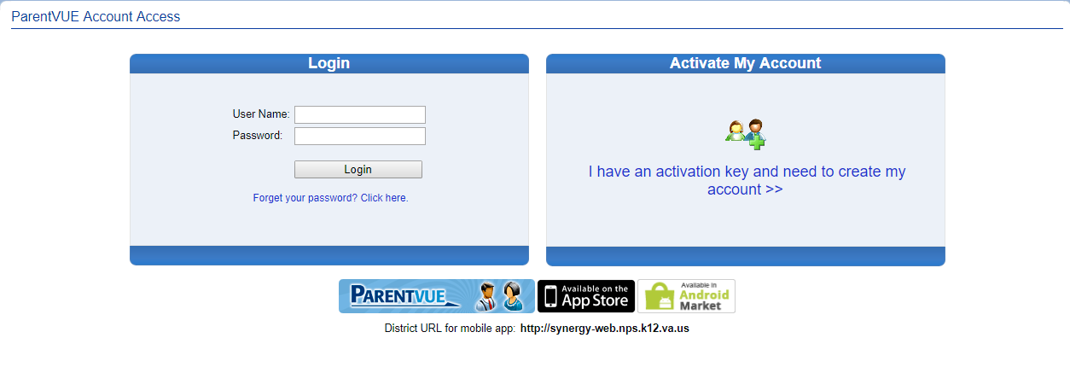
ParentVUE
https://synergy-web.nps.k12.va.us/Login_Parent_PXP.aspx?regenerateSessionId=True

Slide 14

Microsoft Office
Available at no additional cost for Students
Please visit the below link for download and installation instructions
https://www.npsk12.com/site/Default.aspx?PageID=10530

Slide 15

Thank you!
Have a great school year!

