Slide 1

Charity
April - PreK - 2nd

Slide 2
Charity
Define
We will define charity.
Identify
We will identify ways to show charity.
Apply
We will determine ways to be charitable in different scenarios.

Slide 3
Charity Definition
Aid, assistance or support given to those in need.

Slide 4
Insert CFISD Charity Video

Slide 5
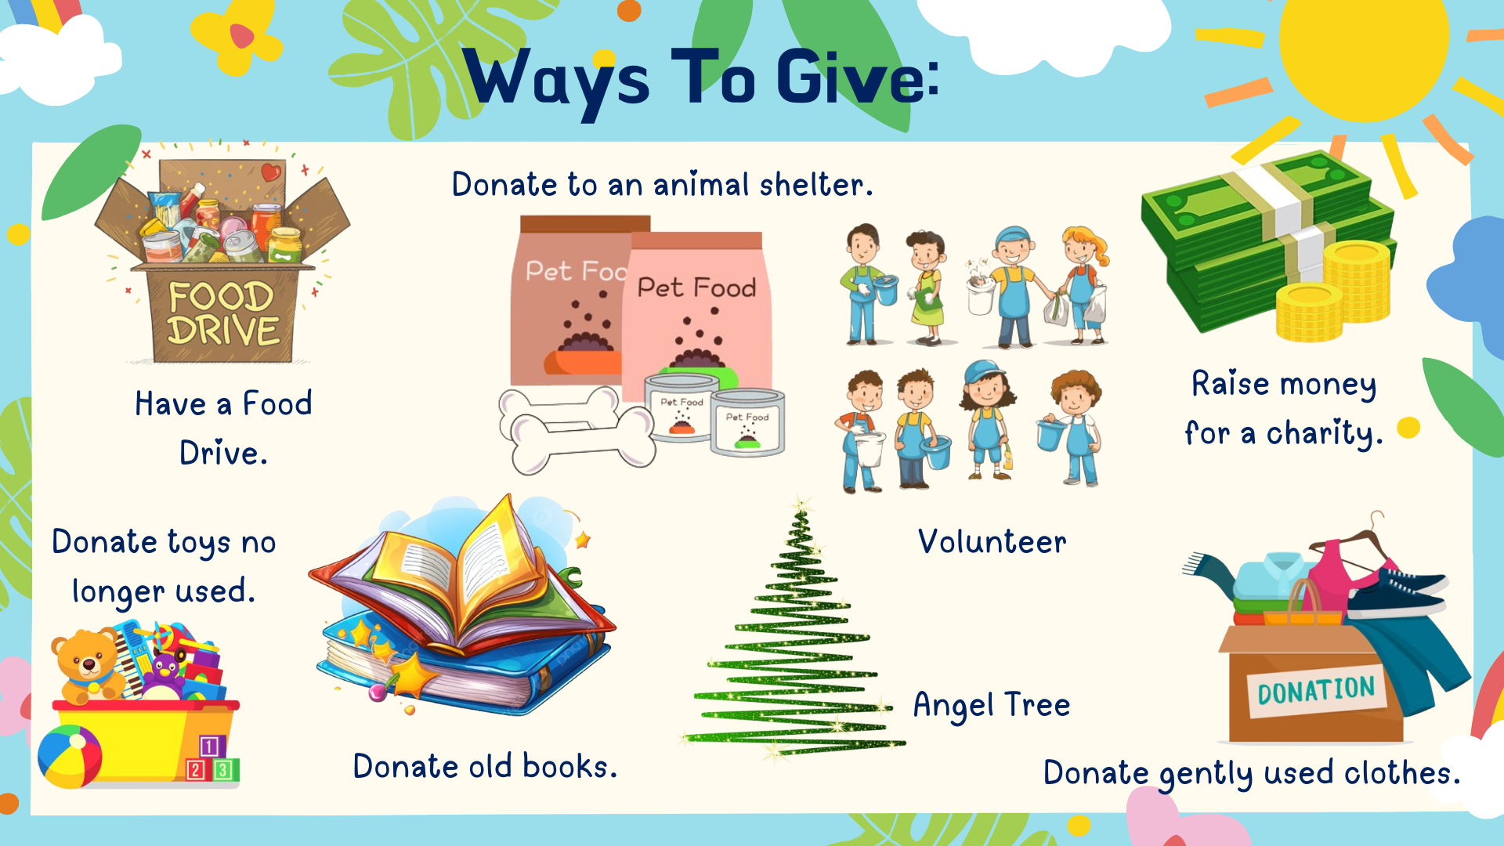

Slide 6
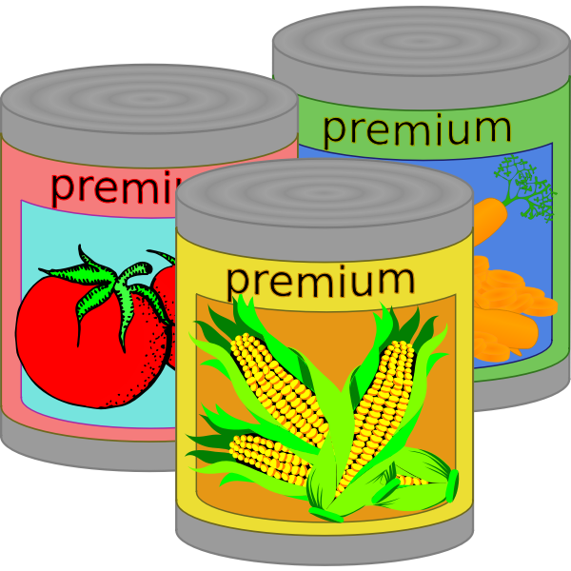


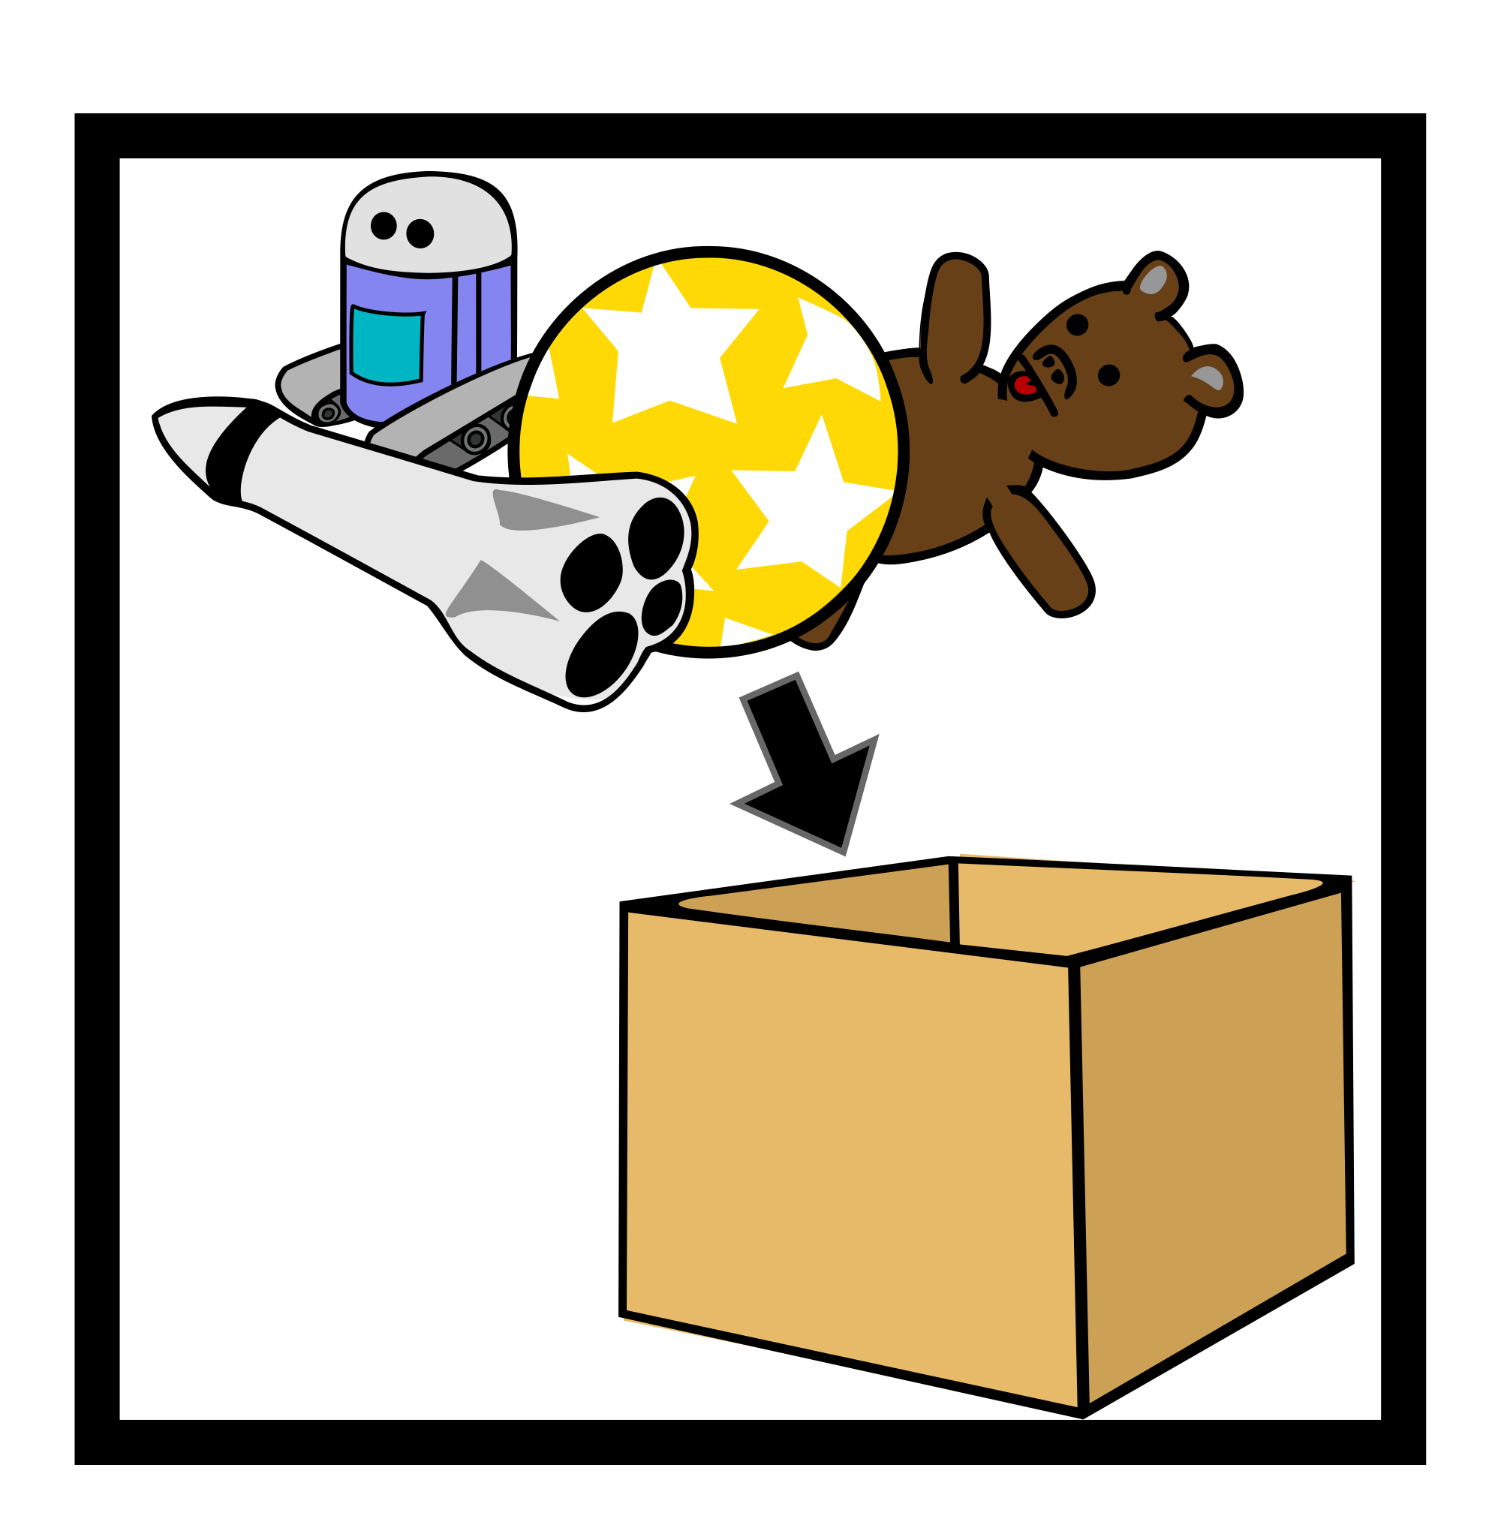
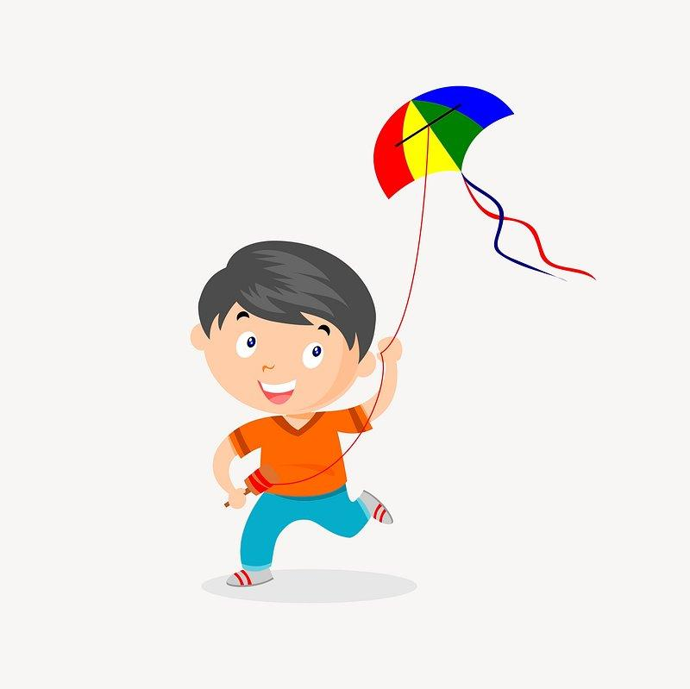
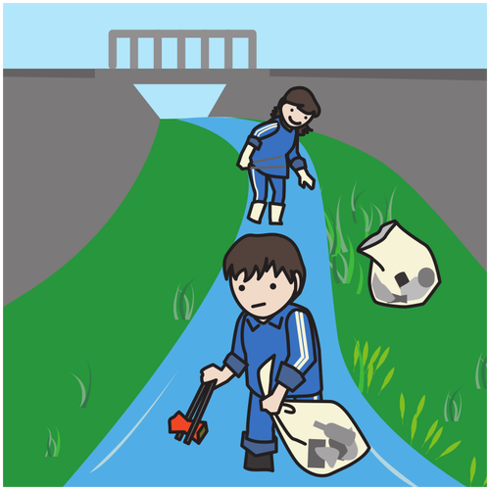
What pictures show charity?
Donating to a canned food drive
Going to your friends birthday party
Shopping at the mall
Donating old toys
Playing outside with your toys
Cleaning up trash in the park

Slide 7
What are some other ways to give?
Home
I can give at home by ____________.
I can give at home by ____________.
School
I can give at school by ____________.
I can give at school by ____________.
Community
I can give in my community by ____________.
I can give in my community by ____________.

Slide 8


How is Charity helpful?
•Increases self esteem
•Empowers us to make a difference
•Grows responsibility
•We learn to recognize the needs of those around us
•Makes the world healthier and happier
•Gives the feeling of hope and kindness to others.

Slide 9
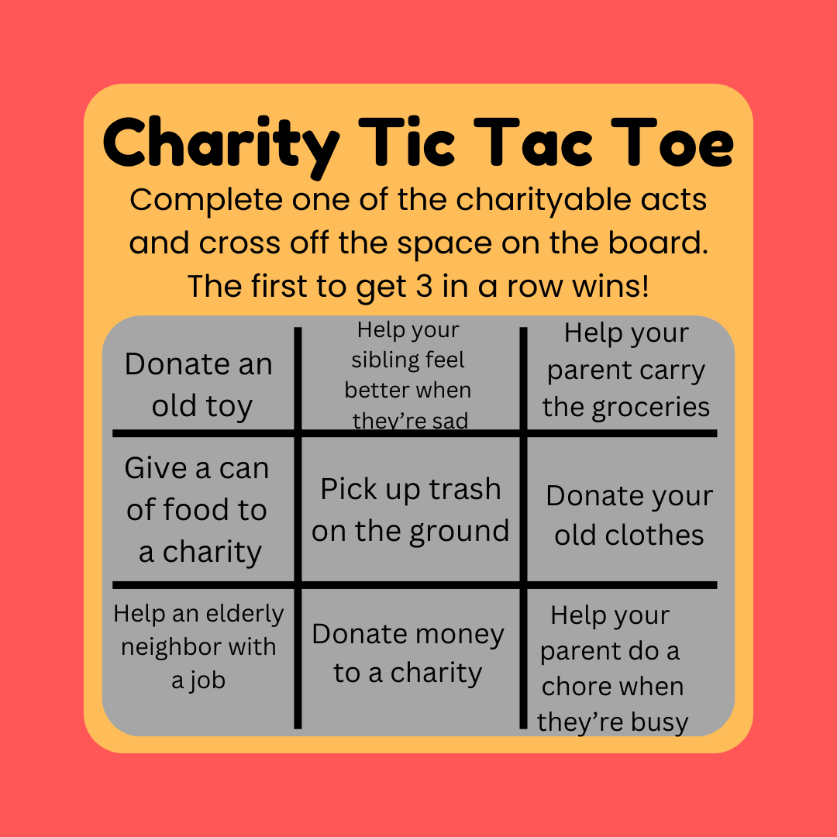
Home Activity
Play Charity Tic Tac Toe at home with your family!

